Slide 1
S-band RF gun based on new type accelerating structure
A.M. Barnyakov, D.A. Nikiforov, A.E. Levichev
Accelerator seminar
KEK-BINP
26.10.2017
nikdanila@bk.ru

Slide 2
Outline
Motivation and requirements
Typical RF gun parameters
Parallel coupling accelerating structure (PCAS)
Beam dynamics for SUPER c-tau
Beam dynamics for FCC
Prototype of parallel coupled accelerating structure
Ir5Ce Cathode
Conlusion

Slide 3

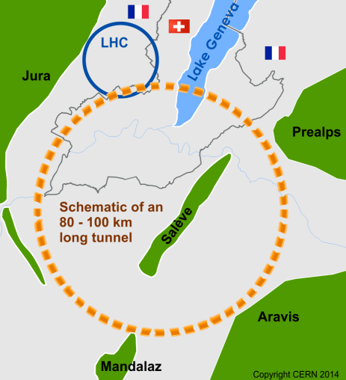
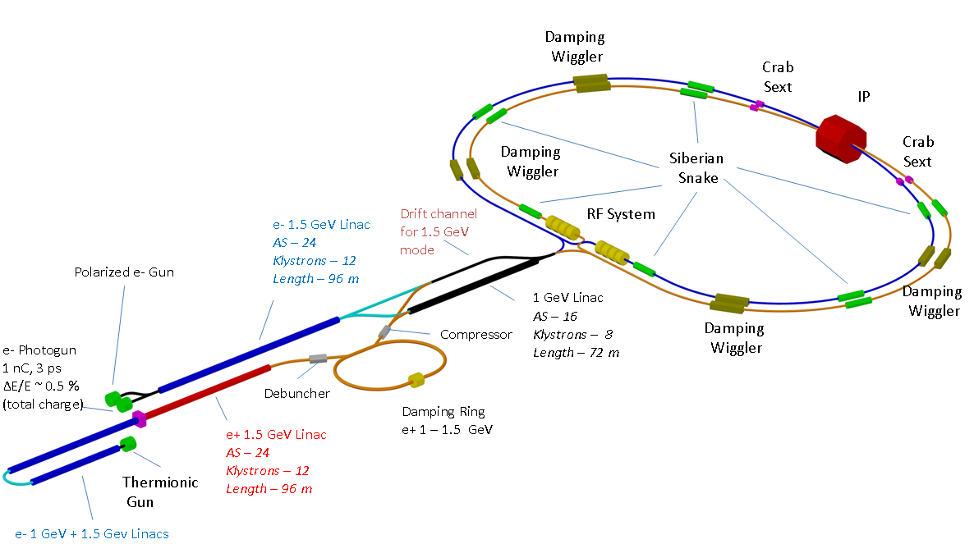
Motivation
Photocathode rf guns are considering today as the most advanced type of electron injectors for modern electron-positron colliders.
Super KEKB (Japan)
FCC (CERN)
Super-с-τ-factory (BINP)
High charge and low emittance are needed!

Slide 4
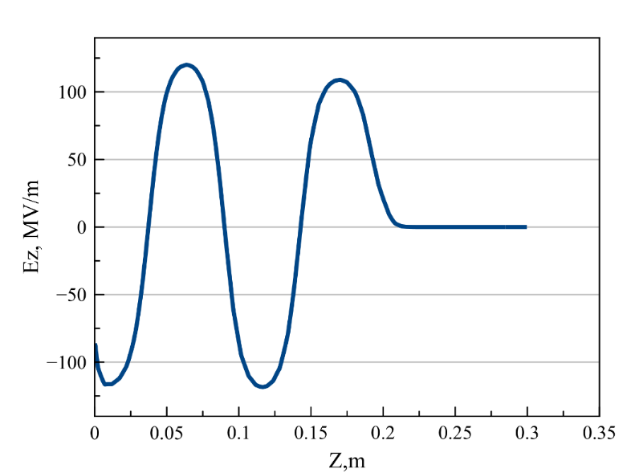
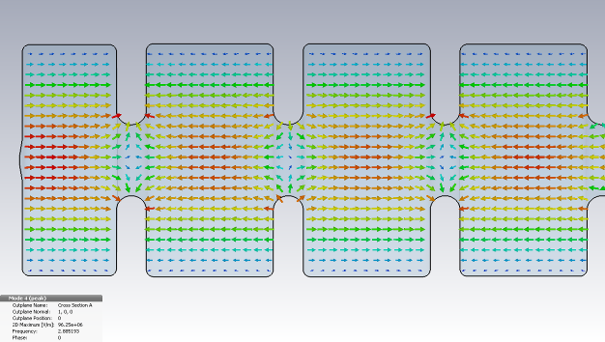
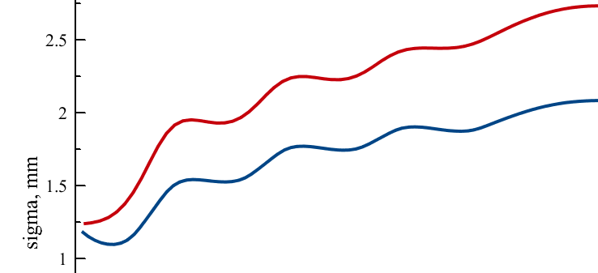
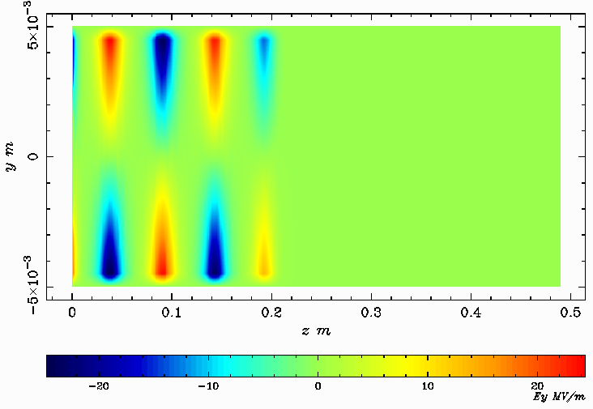
Motivation and requirements
Electric field on axis
Beam envelope along the gun
Distribution of the vertical electrical field component near the beam axis
In the last cell beam can occupy a half of aperture

Slide 5

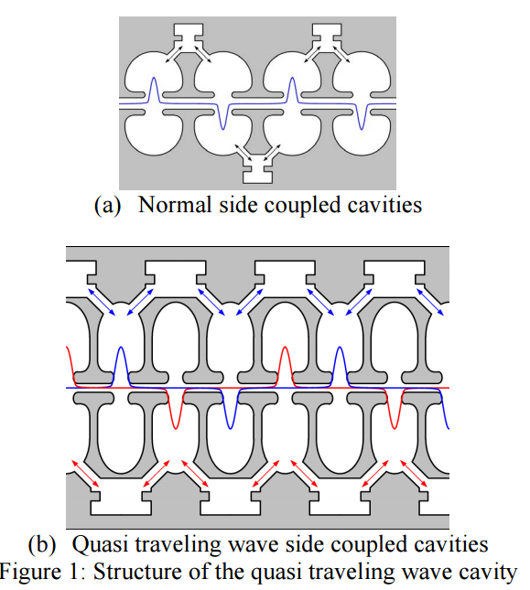
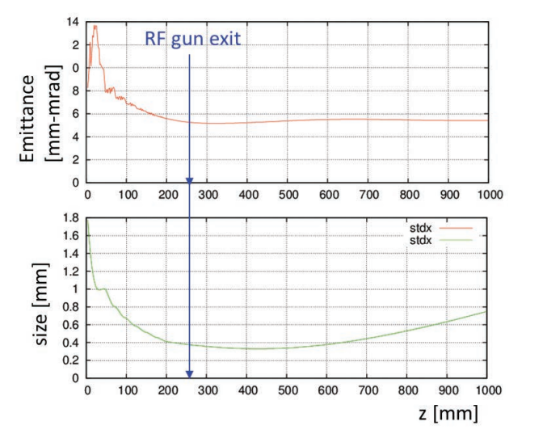
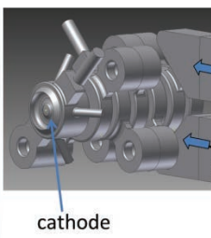
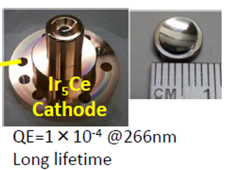
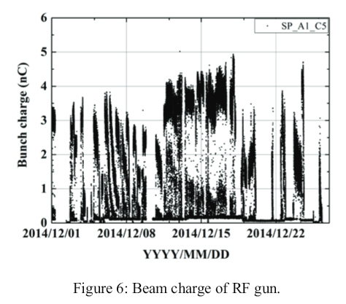
Motivation and requirements

Slide 6
Motivation and requirements
Main parameters of Super C-tau Injector Linac
Beam energy (GeV) | 1.5-2.5
Bunch charge e-/e+ (nC) | 1.5/3.5
Norm. emittance (pi mm mrad) | <10 pi mm mrad
Energy spread | <1%

Slide 7
Typical RF gun parameters
Parameters | Value
Energy (MeV) | 9-11
Charge (nC) | 6.5 (FCC*), 1.5 (Super c-tau)
Horizontal emittance (mm mrad) | <6 (FCC), <10(Super c-tau)
Vertical emittance (mm mrad) | <10(FCC),<10 (Super c-tau)
Longitudinal sigma (mm) | ~1.3
Transverse sigma (mm) | 1-2
RMS Energy spread | <1%
To extract such a big charge, beam size will be too large , due to space charge limit ( several mm)
Focusing magnetic field along the cavities or/ strong RF focusing are needed to preserve or decrease transverse beam dimensions.
* - PRELIMINARY

Slide 8
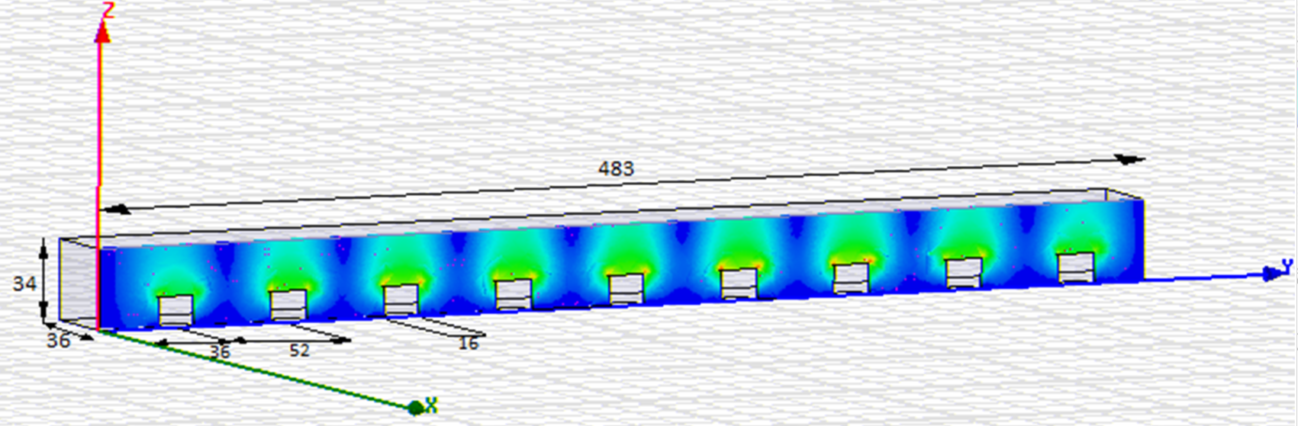
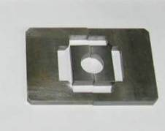
Parallel coupling accelerating structure (PCAS)
Tuning rods
Exciting cavity
Р
е⁻
е⁻
Permanent focusing magnets
Coupling slots
Accelerating cells
Features:
Parallel RF power feeding.
Cavities are not connected with each other by RF power: process in one cavity doesn’t influence on every cavities
Organization of the free electric field distribution along the structure can be obtained by changing the individual coupling slot
In order to develop accelerating structure only one accelerating cells have to be calculated due to absence of the cavities connection by electromagnetic field
Aperture of the structure is defined by only beam motion and can be considerably reduced
Design of the structure allows using internal permanent focusing magnets.
For more details of PCAS excitation you can see:
Chernousov Yu D., Ivannikov V. I., Shebolaev I. V., Levichev A. E., Pavlov V. M.. Bandpass characteristics of coupled resonators. JOURNAL OF COMMUNICATIONS TECHNOLOGY AND ELECTRONICS, Volume 55, Issue 8, pp. 863-869. DOI: 10.1134/S1064226910080036. Published: AUG 2010
A. M. Barnyakov, A. E. Levichev, D. A. Nikiforov.. Intercavity Coupling Constant of the Cavities. Journal of Communications Technology and Electronics, 2016, Vol. 61, No. 7, pp. 783–788

Slide 9
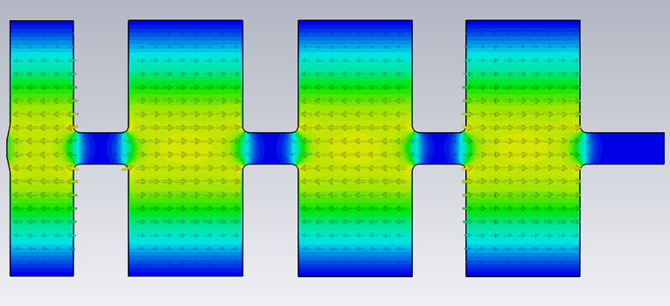
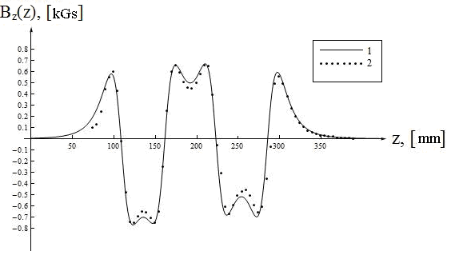
RF gun based on (PCAS)

Slide 10
Beam dynamics for SUPER c-tau
ASTRA simulation parameters
Initial emittance | 0.6 mm mrad
Initial kinetic energy | 0.6 eV
Total charge | 1.5 nC
Cathode spot size | 3 mm
Initial distribution | Rad. Uniform
Laser pulse duration | 10 ps
Laser injection phase | variable
Magnetic field on the cathode | 0 T
Peak accelerating field | 70 MV/m
Focusing solenoid field | 0.35 T

Slide 11
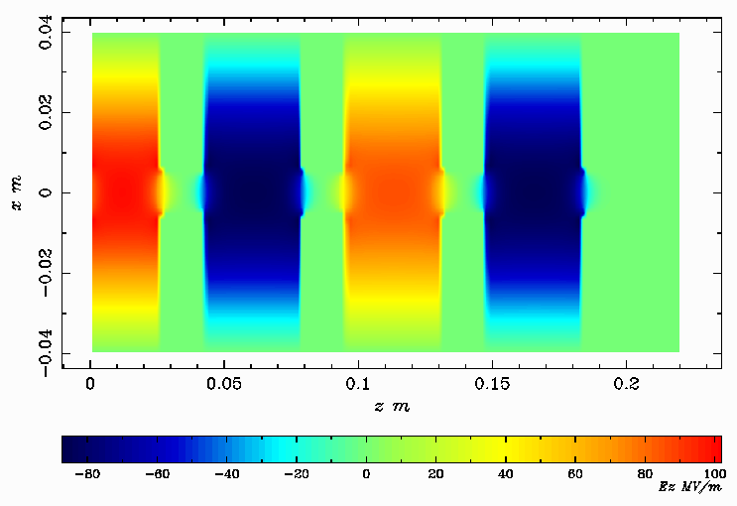
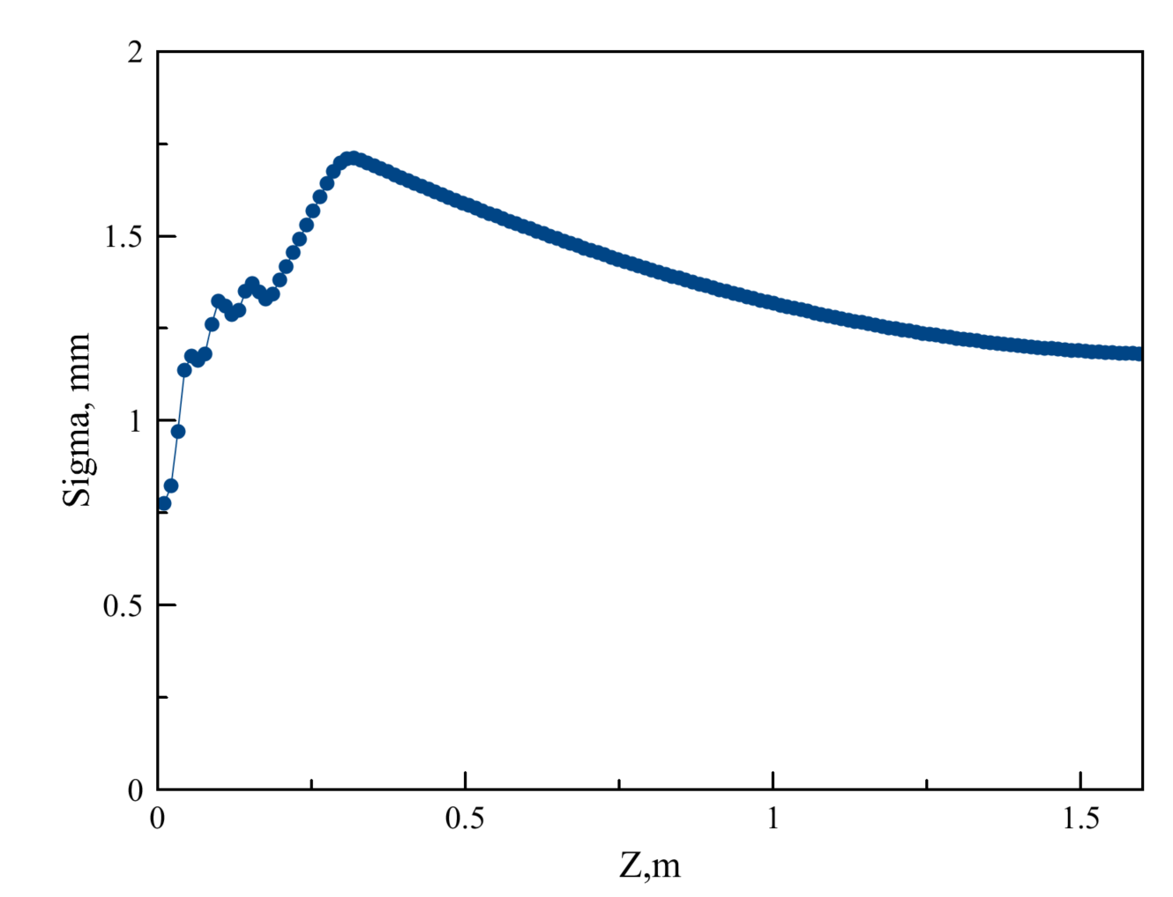
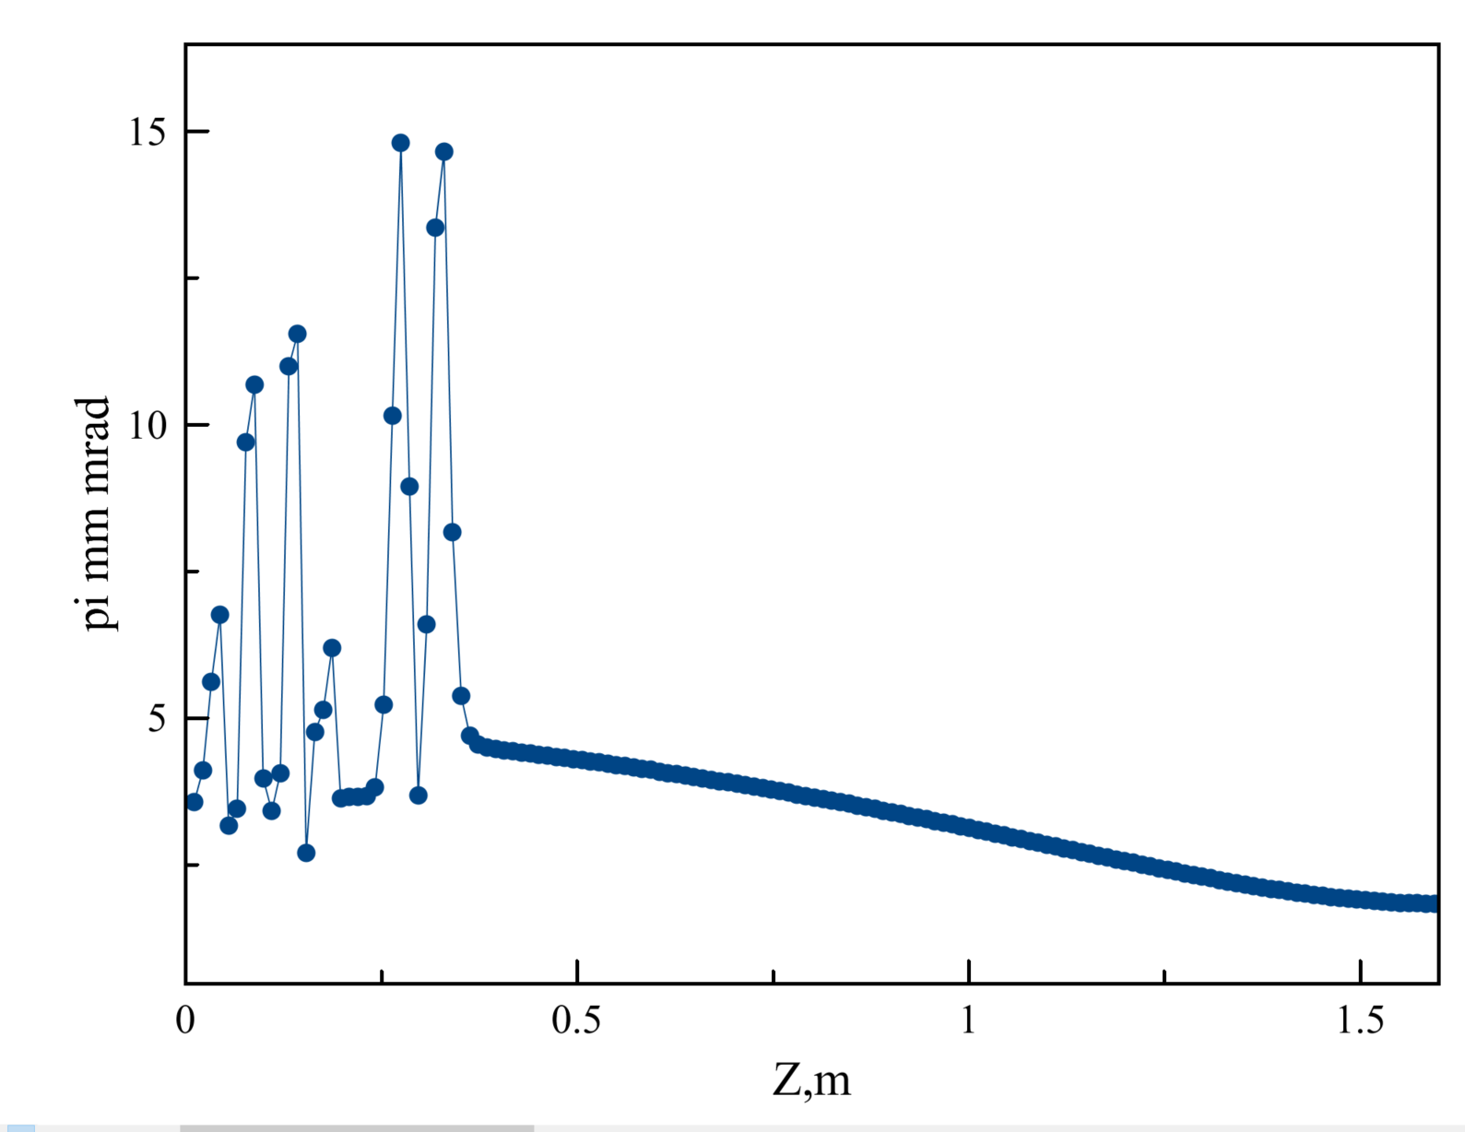
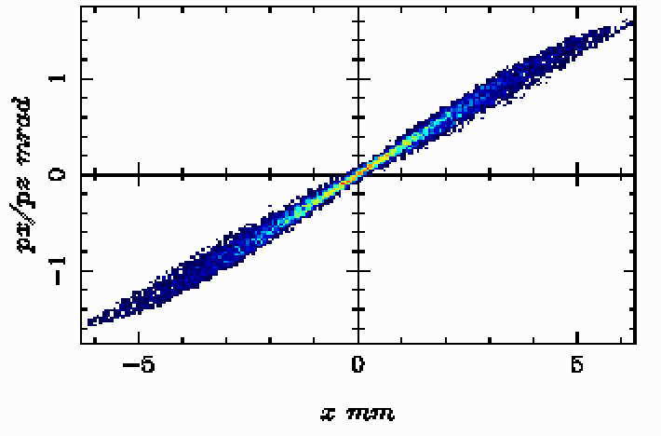
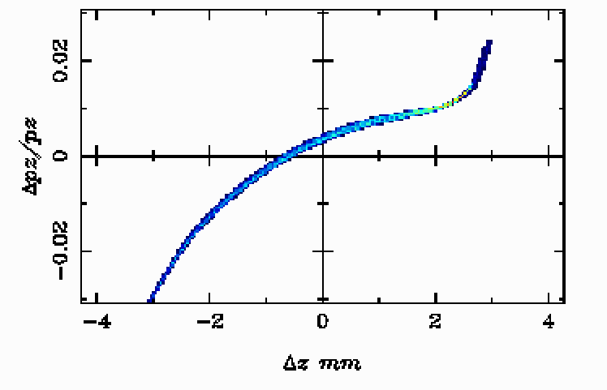
Beam dynamics for SUPER c-tau factory
Parameter | Value
Beam length (sigma, mm) | 1.5
Norm tr. Emittance (mm mrad) | 2.3
Energy (MeV) | 6.5
Energy spread (%) | ~1%
Injection phase (deg) | 200
Em_n=2.3 mm mrad

Slide 12
Beam dynamics for FCC
ASTRA simulation parameters
Initial emittance | 0.6 mm mrad
Initial kinetic energy | 0.6 eV
Total charge | 6.5 nC
Cathode spot size | 5 mm
Initial distribution | Rad. Uniform
Laser pulse duration | 14 ps
Laser injection phase | variable
Magnetic field on the cathode | 0 T
Peak accelerating field | 100 MV/m
Focusing solenoid field | 0.5 T

Slide 13
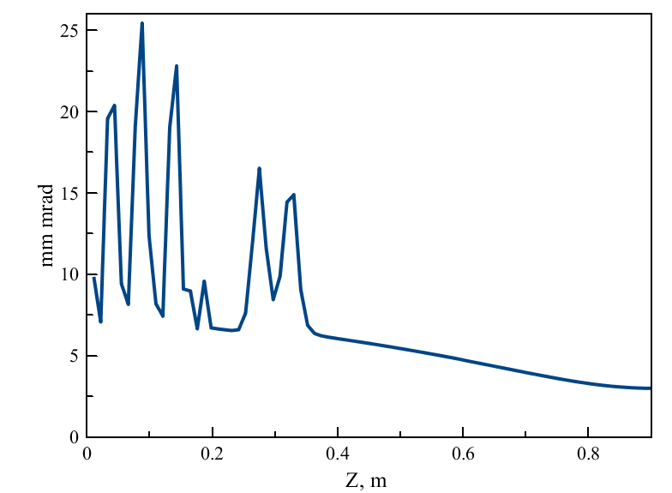
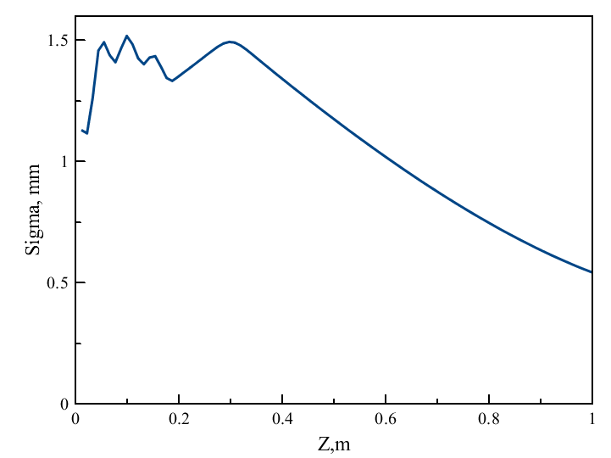
Beam dynamics for FCC
Parameter | Value
Beam length (sigma, mm) | 1.5
Norm tr. Emittance (mm mrad) | 3
Energy (MeV) | 9.8
Energy spread (%) | ~1%
Injection phase (deg) | 200
Em_n=3.1 mm mrad
Em_n=2.2 mm mrad (95%)

Slide 14
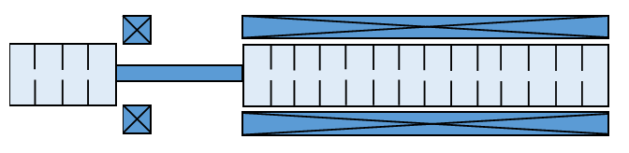
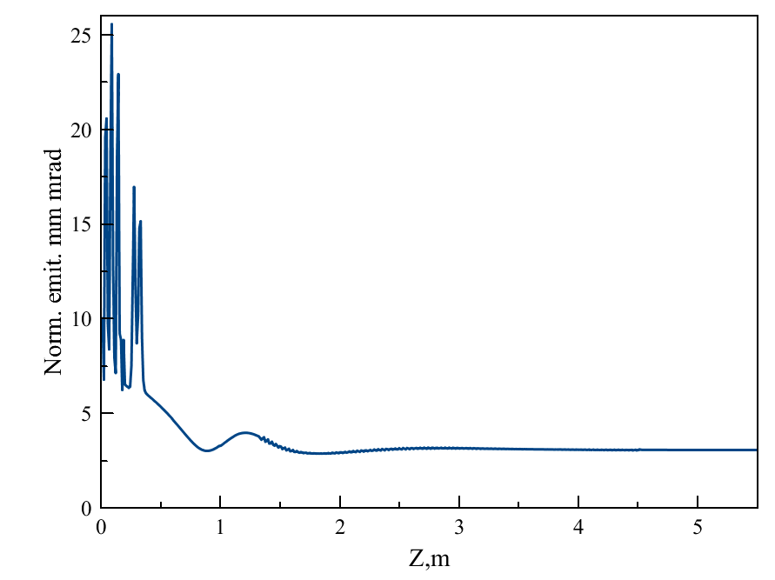
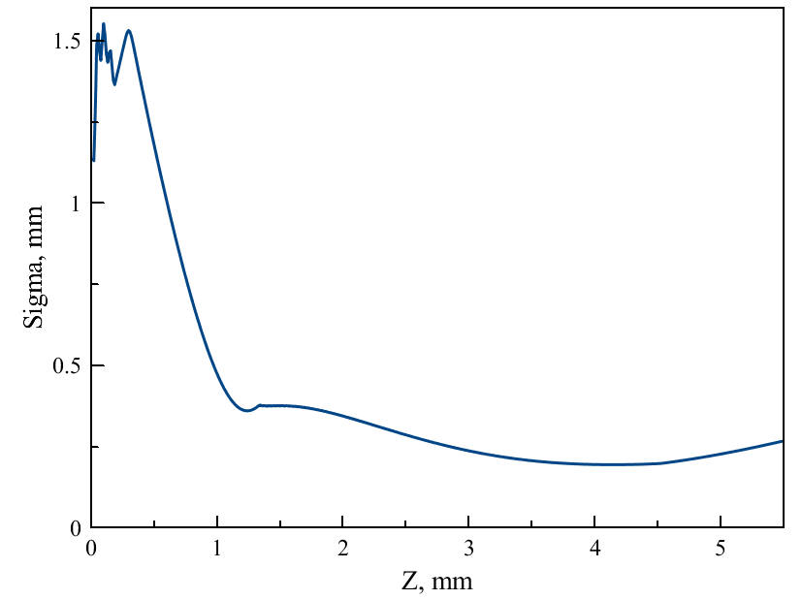
Beam dynamics for FCC
Em_n=3 mm mrad
Em_n=2.2 mm mrad (95%)
Parameter | Value
Beam length (sigma, mm) | 1.5
Norm tr. Emittance (mm mrad) | 3
Energy (MeV) | 9.8
Energy spread (%) | 0.7%
Injection phase (deg) | 293
3 m. long SLAC type acc. structure

Slide 15
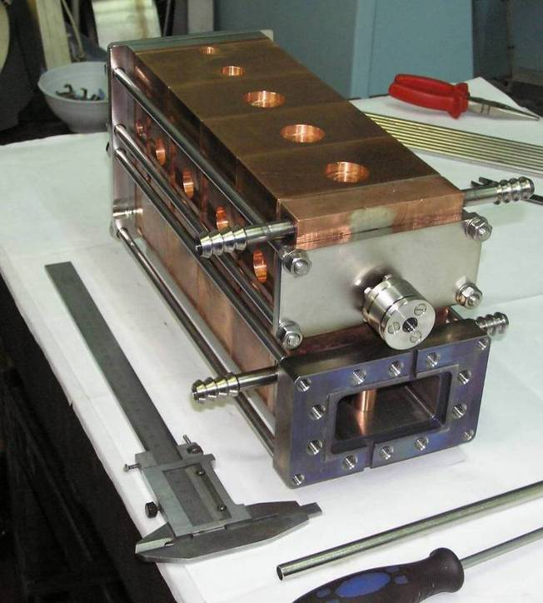
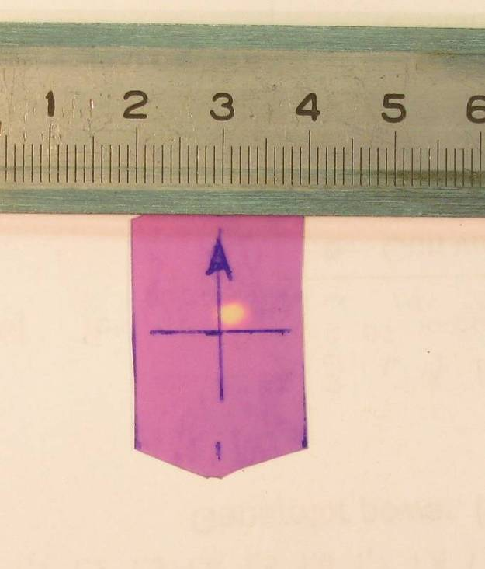
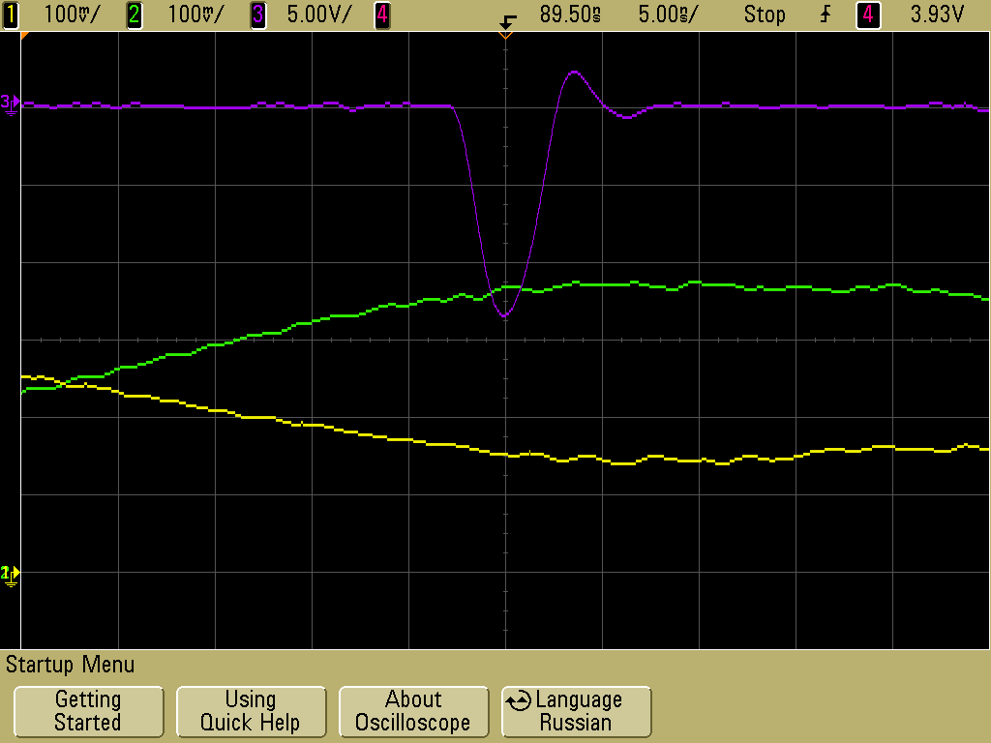
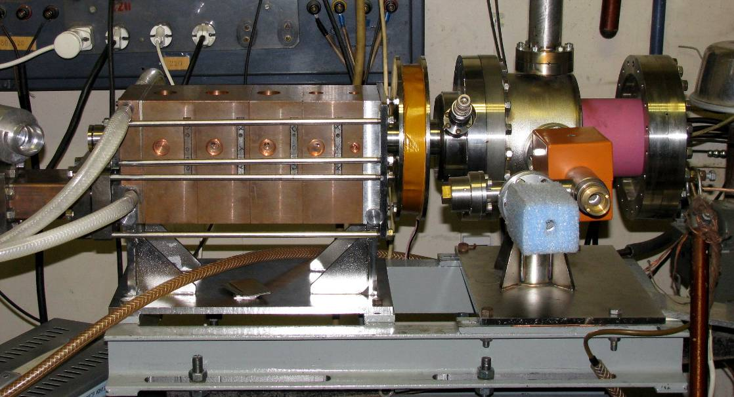
Prototype of parallel coupled accelerating structure with 2450 MHz
Beam current of 300 mA in the end of accelerating structure, duration is 2.5 ns (half of pulse), energy is about 4 MeV
Measured and calculated magnetic field from the permanent nagnets

Slide 16
Prototype of parallel coupled accelerating structure with 2450 MHz: breakdowns
Breakdown in the 5-th accelerating cavity. yellow – RF power from klystron, 1.6 MW, pulse duration 5 μs; blue – reflected signal; green –
stored RF energy in 5-th accelerating cavity
Regime with breakdowns in several accelerating cavities. F1 – RF power from klystron, 1.6 MW, pulse duration 5 μs; F3 – reflected signal; F4 –
stored RF energy in 5-th accelerating cavity
The peak on the reflected signal (blue) corresponds to the breakdown in one of the accelerating cavities. One can see that only cavity with breakdown is “switched off”. On the left figure the first breakdown is in the fifth cavity and the its storage energy is terminated. On the right figure the first breakdown doesn’t influence on the fifth accelerating cavity.

Slide 17
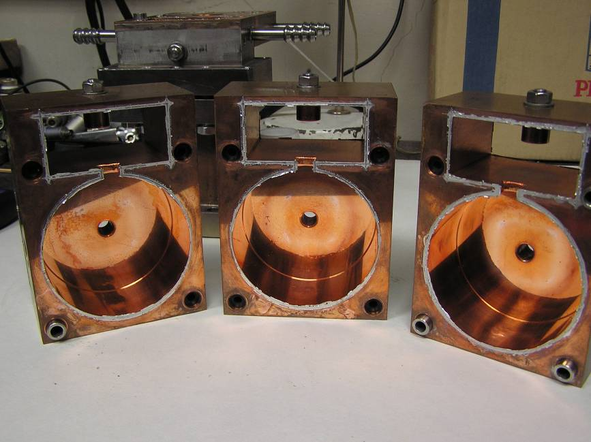
Prototype of parallel coupled accelerating structure with 2450 MHz: after a few years of operating
After a few years of operating the structure were disassembled. Further, the cavities were tuned, assembled. The structure is working now.

Slide 18
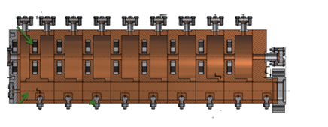
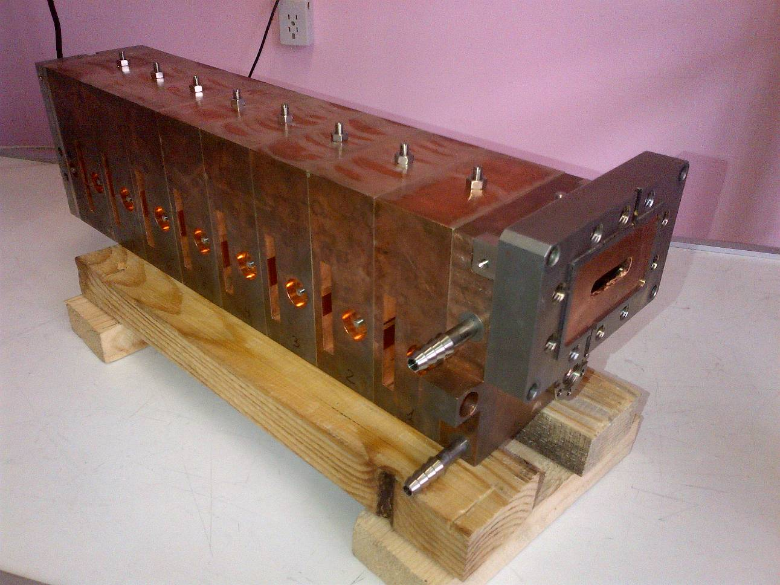
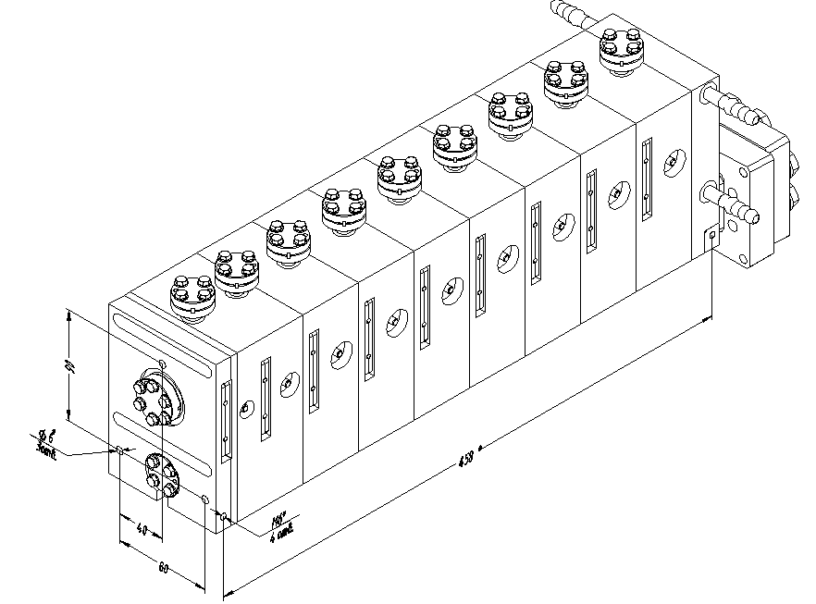
Prototype of parallel coupled accelerating structure with 2856 MHz

Slide 19
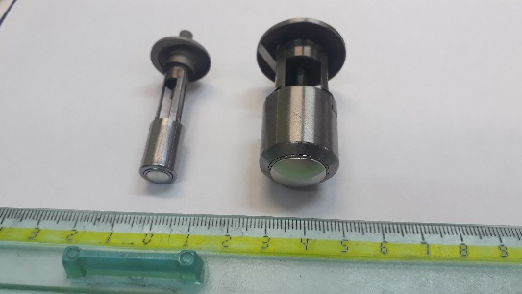
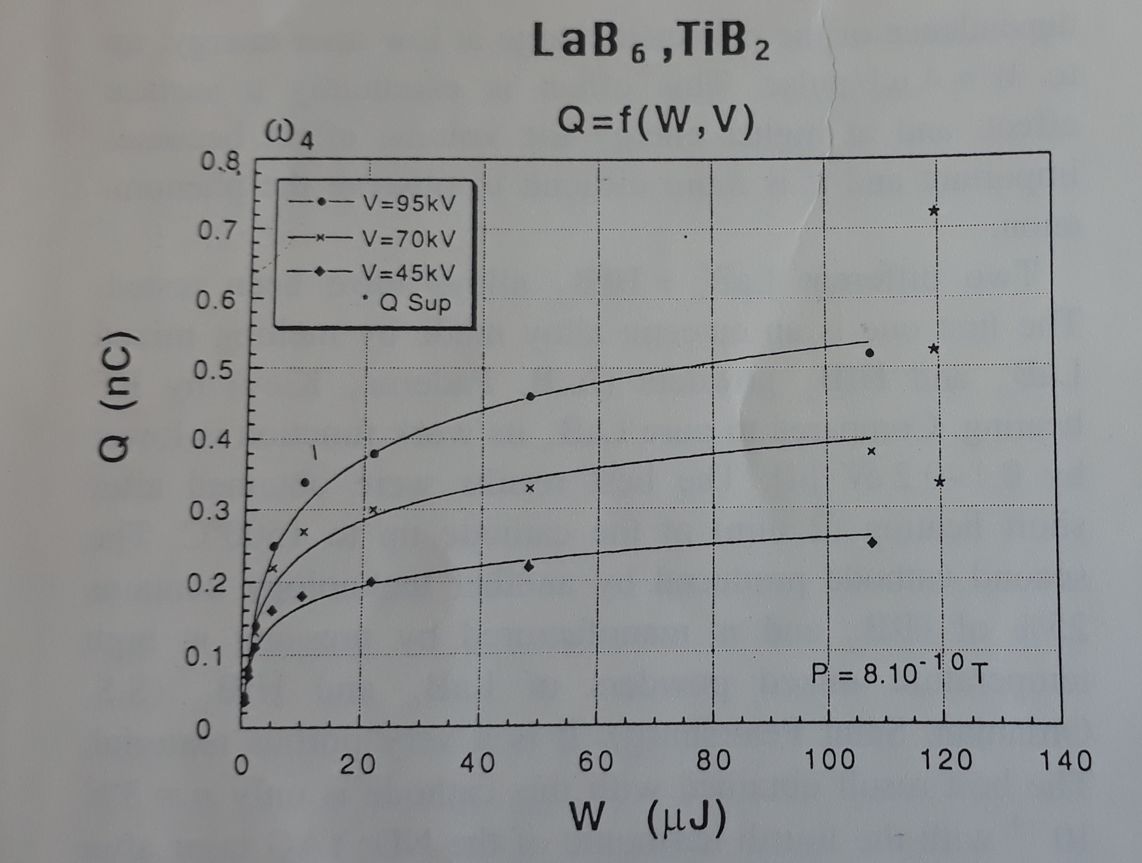
Ir5Ce and LaB6 as a Photocathode
Ir5Ce cathodes for Korean EBIS (left) and for BNL EBIS (right) was produced and tested at BINP (G. Kuznetsov)
In cooperation with institute of Laser physics SB RAS we are going to make a stress test and investigate the life time of such a cathodes

Slide 20
Conclusion
The design of parallel coupled accelerating structure allows using the permanent focusing magnets and create the strong magnetic field along the cavities and save the beam size.
The travelling tube aperture can be decreased as significantly as it allows the beam dynamics.
This design of the RF gun allows us to consider the cavities as independent. The length and field amplitude can be tuned separately for every cavity.
Preliminarily results of beam dynamic simulations gave reason to hope that this construction is acceptable solution for high charge generation.
The prototype of the accelerating structure based on new design with parallel coupling between the cavities have been produced in BINP with operating frequency of 2450 MHz and successfully tested.
It is currently planned to perform tests the new parallel coupled accelerating structure with 2856 MHz .
But:
More investigations for high power operation mode are needed

Slide 21
Possible cooperation
The procedure of manufacturing, tuning and measurement of PCAS is well established at BINP.
There is good experience of operation of such structure (especially with indium variant).
At BINP we have a good experience of production and exploiting of high quality IrCe cathode with high current density and long lifetime.
But…
For further testing of such a structure with high power and intense beam extraction, the klystron and laser system are needed.
And…
KEK has a great experience of modern electron-positron injector development. BINP is very interesting in the possibility to adopt experience of KEK in this field.

Slide 22
References
1) H. A. Bethe, "Theory of Diffraction by Small Holes", Phys. Rev., Vol. 66, PP. 163-182, 1944.
2) ChernousovYuD., IvannikovV. I., ShebolaevI.V., LevichevA. E., PavlovV. M.. Bandpass characteristics of coupled resonators. JOURNAL OF COMMUNICATIONS TECHNOLOGY AND ELECTRONICS, Volume 55, Issue 8, pp. 863-869. DOI: 10.1134/S1064226910080036. Published: AUG 2010
3) Characteristics of the model of accelerator based on parallel coupled accelerating structure with beam loading. A.E. Levichev, V.M. Pavlov, V.I. Ivannikov, I.V. Shebolaev, Yu.D. Chernousov. Proceedings of RuPac 2012, JACoW publication, pp. 164-166
4) Localization of the RF breakdown in the parallel coupled accelerating structure. A.M. Barnyakov, A.E. Levichev, V.M. Pavlov, V.I. Ivannikov, I.V. Shebolaev, Yu.D. Chernousov. Proceedings of RuPac 2012, JACoW publication, pp. 281-283
5) Linear accelerator based on parallel coupled accelerating structure. A.E. Levichev, V.M. Pavlov, V.I. Ivannikov, I.V. Shebolaev, Yu.D. Chernousov. Proceedings of LINAC 2012, JACoW publication, pp. 282-284
6) A. Levichev, D. Nikiforov, A. Barnyakov, Yu. Chernousov, I. Shebolaev. Transient Process in a Parallel Coupled Accelerating System with Regard to Beam Current Loading. TechnicalPhysics, 2015, Vol. 60, No. 1, pp. 137–140.
7) A. M. Barnyakov, A. E. Levichev, D. A. Nikiforov.. Intercavity Coupling Constant of the Cavities. Journal of Communications Technology and Electronics, 2016, Vol. 61, No. 7, pp. 783–788

Slide 23
Thank you for attention

Slide 24
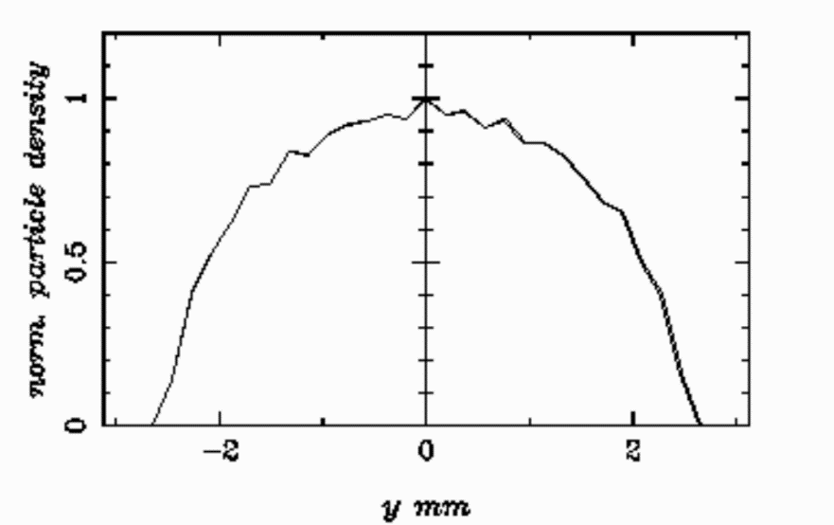
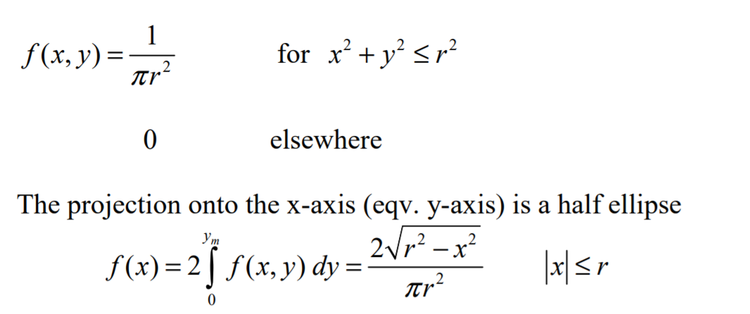
Initial distribution

Slide 25
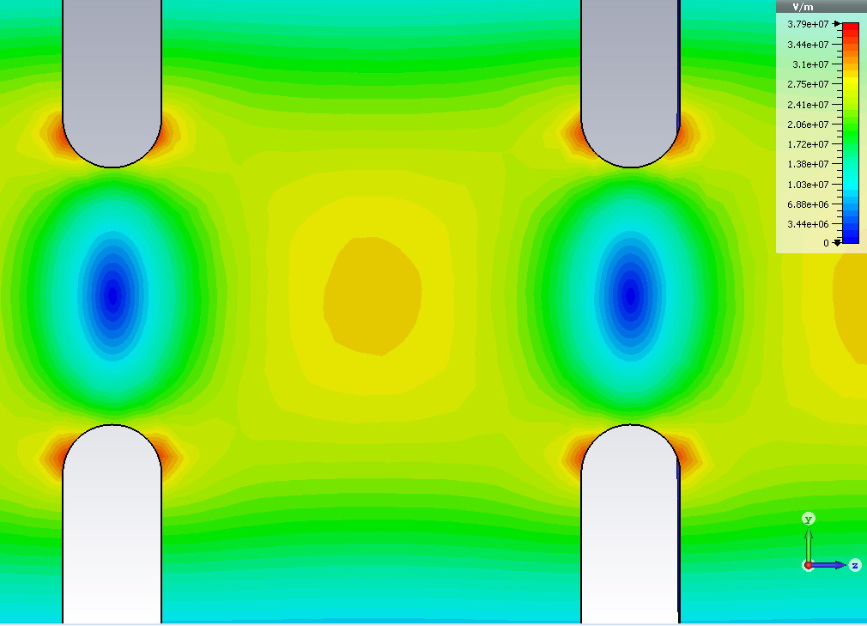
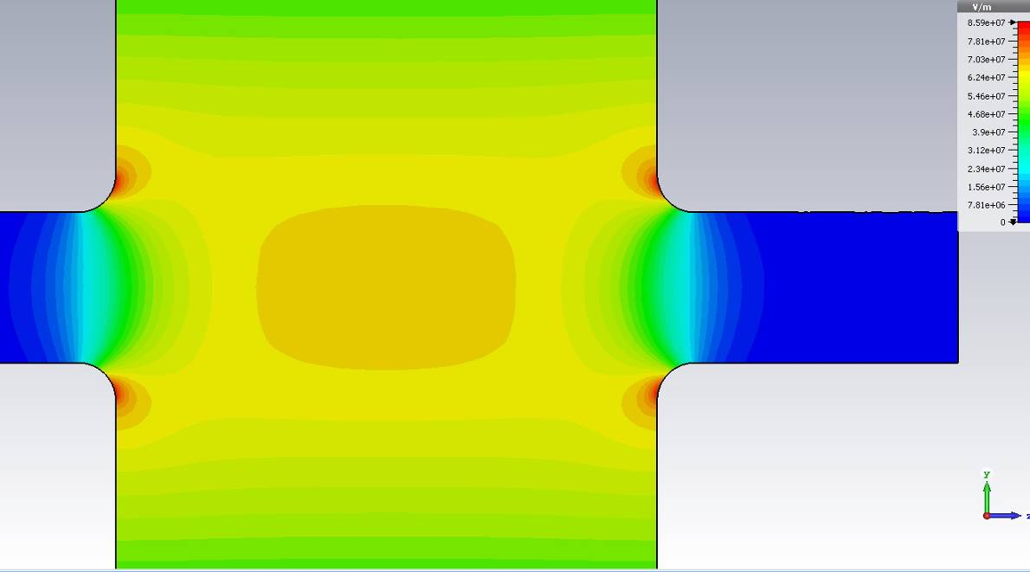
Overvoltage factor
K_{u}≈1.2
K_{u}≈1.3
Overvoltage factor of PCAS is higher than for the ordinary structure. Shape of the cavities can be optimized.

Slide 26
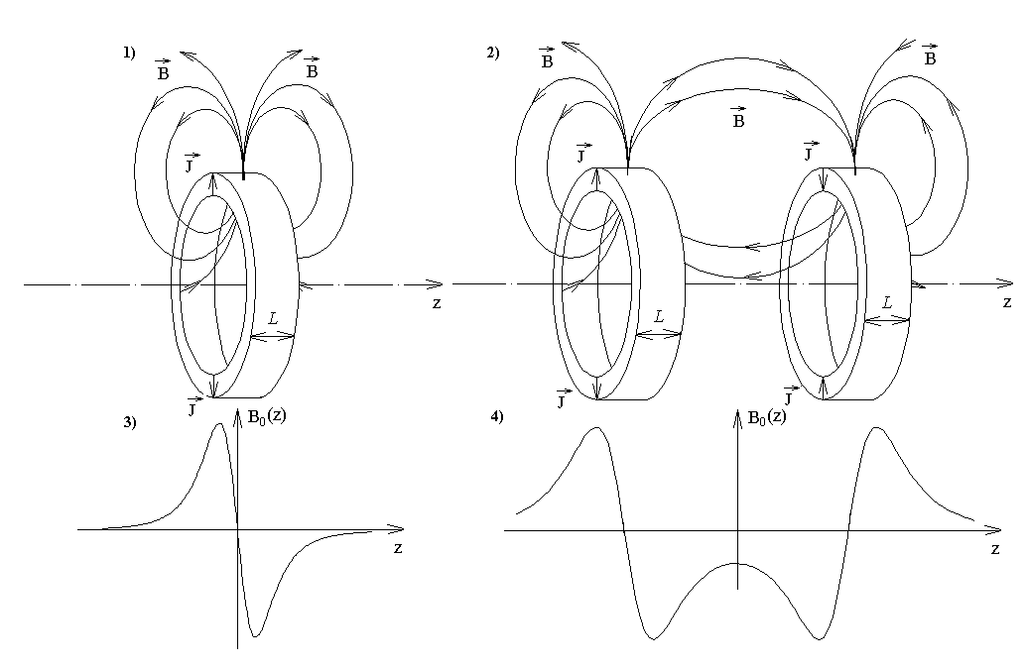

Slide 27
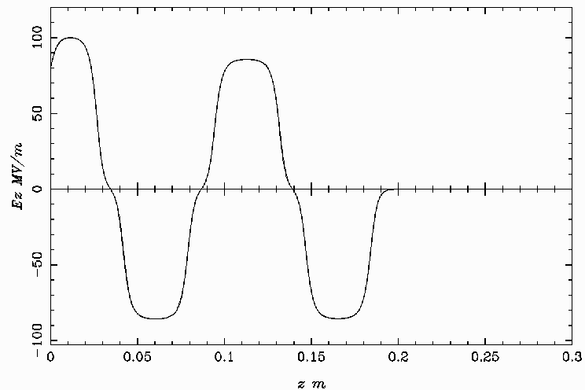
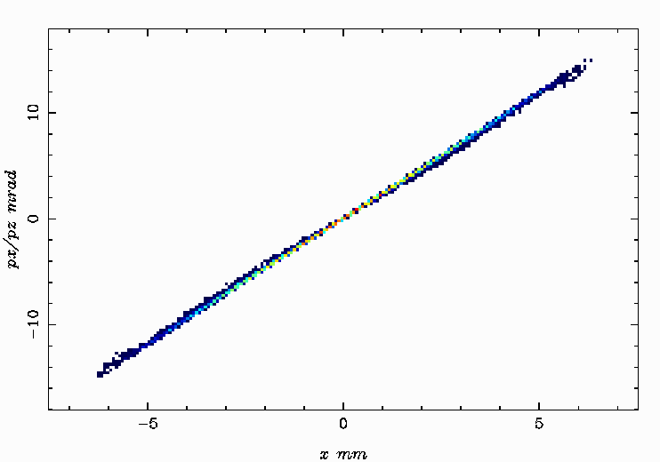
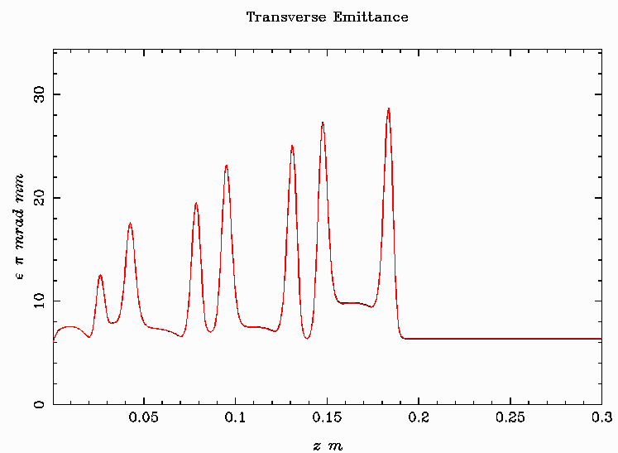
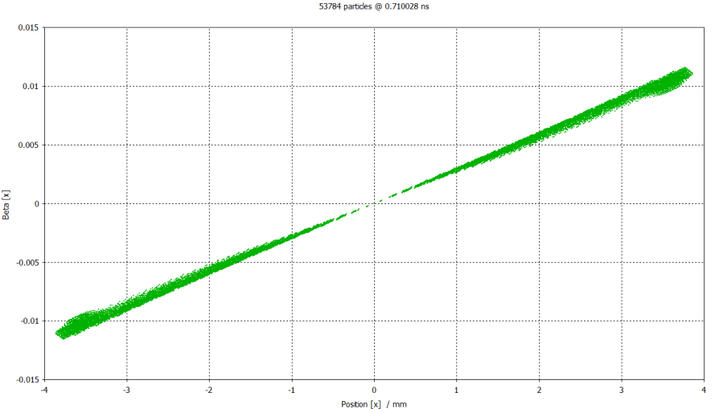
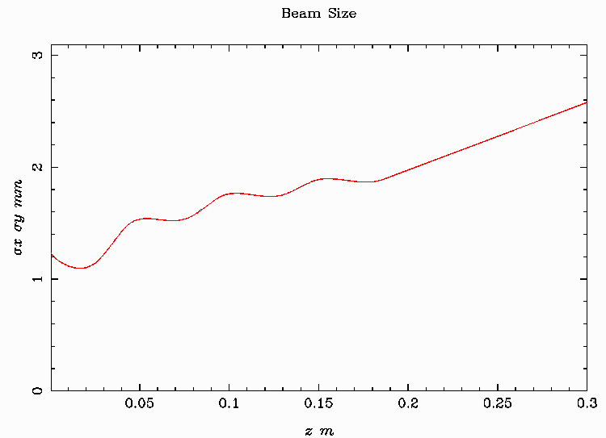
Beam dynamics in the gun without any magnetic fields
ASTRA
Em_n=6 mm mrad
Em = 0.3 mm mrad
CST
Em_n=6 mm mrad
Em = 0.3 mm mrad

Slide 28

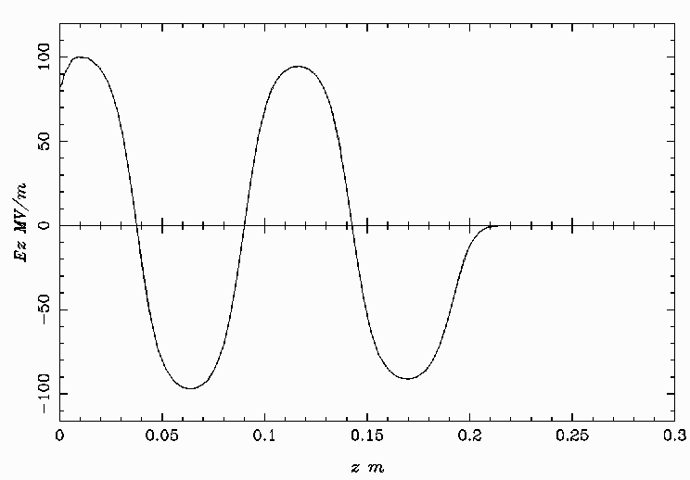
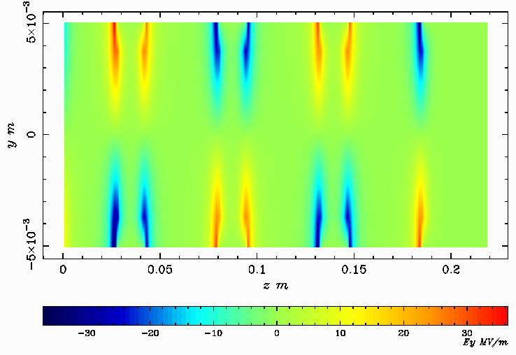
Two guns comparison
Parallel coupled accelerating structure
Ordinary accelerating structure

Slide 29
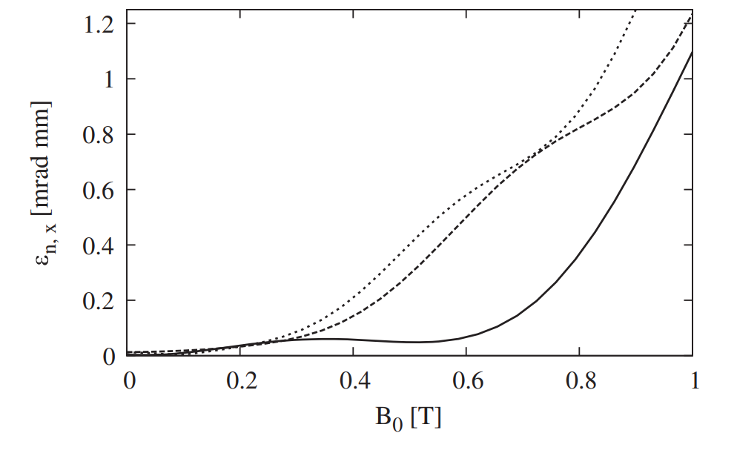
Emittance growth in combined solenoid-cavity section

Slide 30
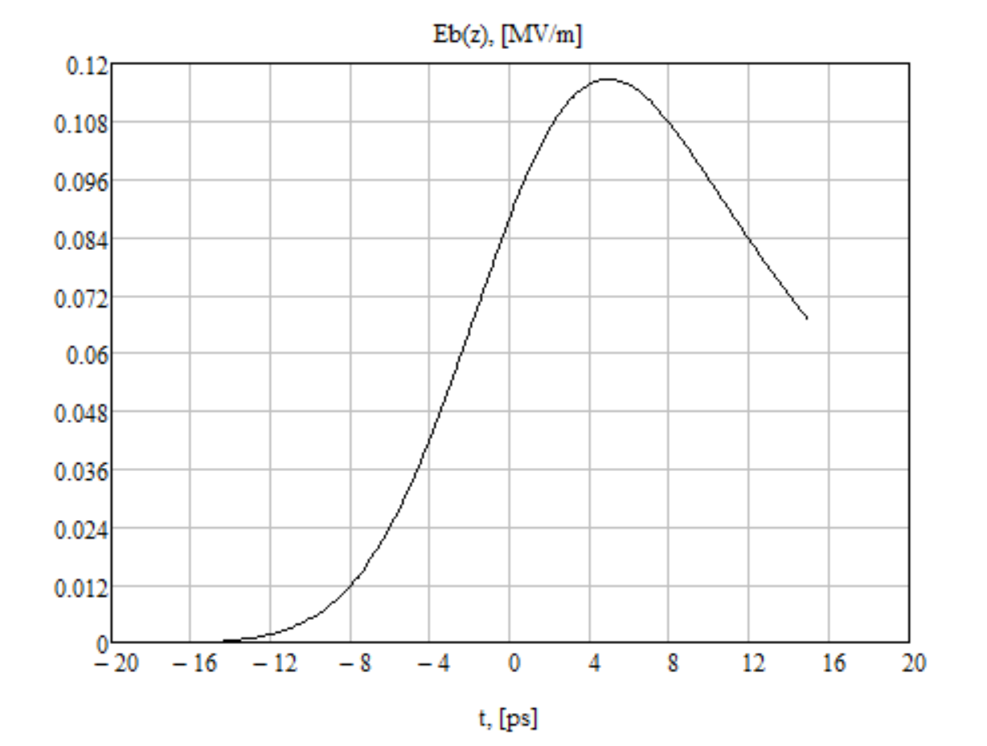
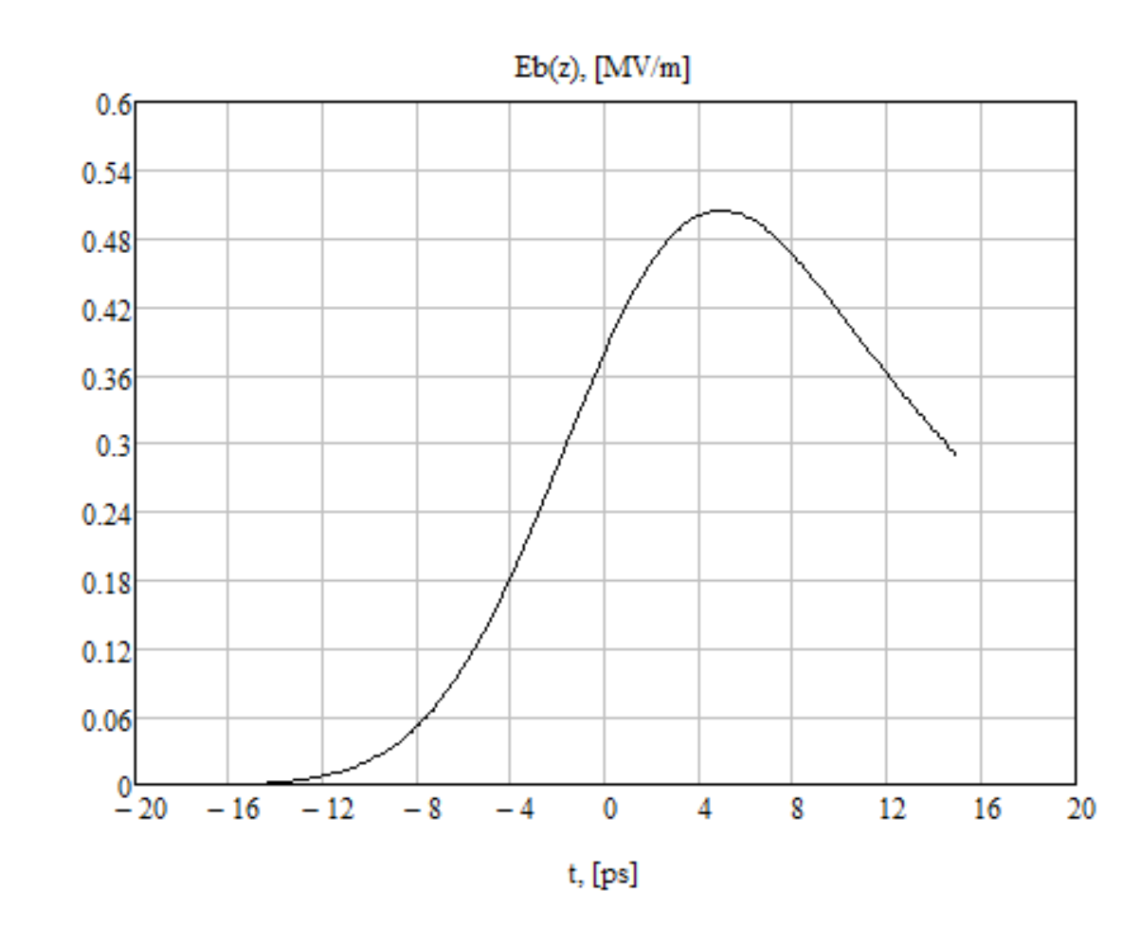




SLAC Estimation of the electric field distribution for Gaussian beam
Q=1.5 nC
Sigma=1.5 mm
Q=6.5 nC
Sigma=1.5 mm

