Slide 1
Injector linac status
BPAC November 2020
Kazuro Furukawa
for Injector Linac Groups
<http://www-linac.kek.jp/linac-paper/general/>
< kazuro.furukawa @ kek.jp >

Slide 2
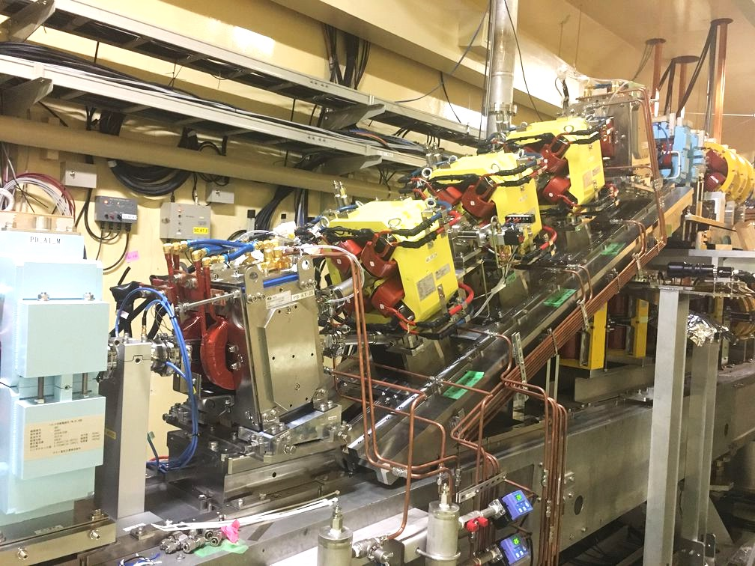
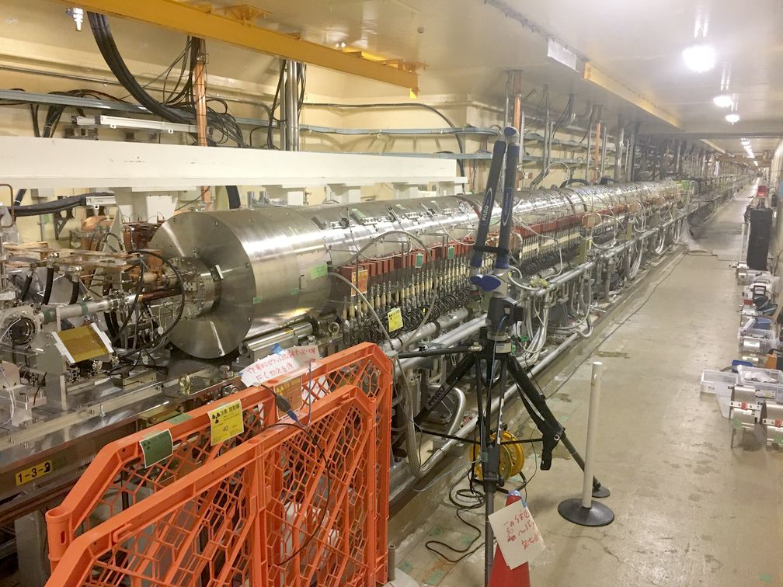
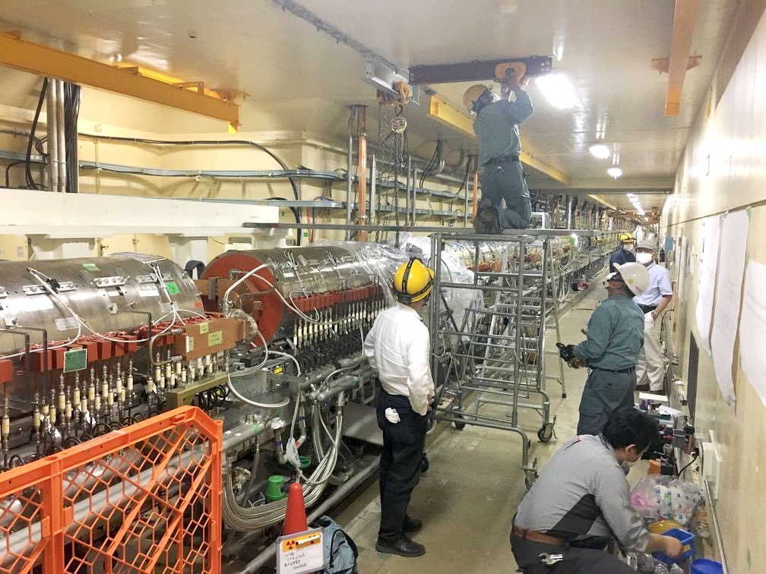
Improvements during summer shutdown
Installation of diffractive optical element (DOE, laser profile shaping), laser position stabilization feedback, cathode, etc. for true 50 Hz, cleaning and stabilization
Improvement to master oscillator with more detectors and phase shifters
Upgrade the merger beamline of two guns with 2 pulsed bends, 3 quads, 2 bpms and a chamber for true 50 Hz
Installation of 4 steering magnets and 4 bpms inside of positron capturing section
Replacement of flux-concentrator and nominal operational field (12 kA)
And many other improvements

Slide 3
Positron yield
Y. Enomoto
Flux concentrator replacement
After summer
Before summer

Slide 4
Improvements during summer shutdown
Replacement of thermionic gun cathode
Replacement of RF gun cathode (Ir7Ce2), removing heating system
Installation of diffractive optical element (DOE, laser profile shaping), Laser position stabilization feedback
Upgrade of event timing controls for continuous laser cleaning
Preparation for secondary RF gun
Replacement of high power klystron (KL_B4)
Replacement of klystron solenoid power supply (2)
Replacement of thyratron (KL_A1_B, A2, 15, 16, 17, DS, DN)
Installation of noise elimination measure (all 60 units)
Replacement of inverter power supply (KL_17, DS)
Improvement to master oscillator with more detectors and phase shifters
Replacement of driver klystron with solid-state amplifier (SB_B)
Installation of independent amplifier (KL_C8)
Pulse-to-pulse amplitude controls at SHB
Replacement of flux-concentrator and nominal operational field (12 kA)
Installation of 4 pulsed steering magnets and 4 bpms inside of positron capturing section
Replacement of charging circuit for all pulsed magnet power supplies
Replacement of old cables for high power magnet power supplies
Upgrade merger beamline after two guns with 2 pulsed bends, 3 quads, 2 bpms and a new chamber

Slide 5
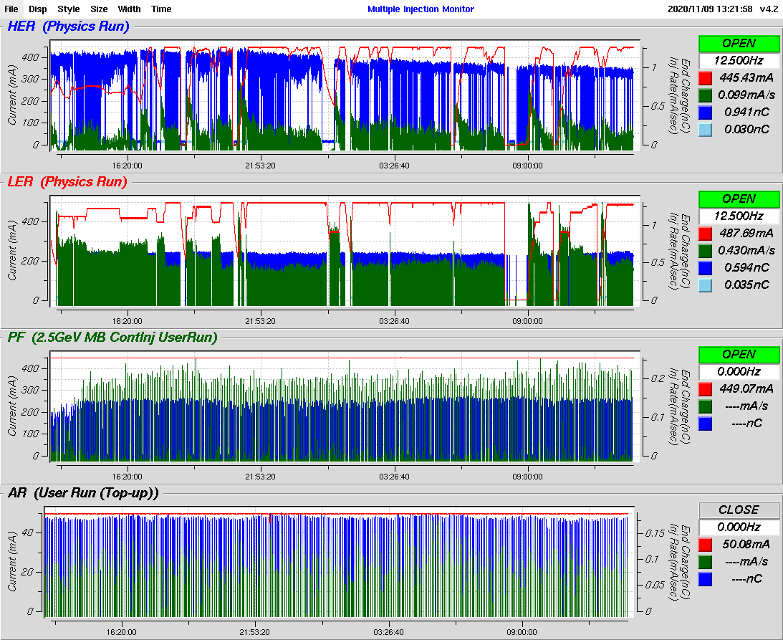
Injector linac operation
HER
LER
PF ring
PF-AR
Injector linac could not allocate machine study time this season up to last week, that was devoted to bt beam study and radiation safety.
Injector linac had limited chance to tune injector beams as we shared startup time for light sources, who cancelled most of beam time before summer.
This week, several study items are being performed.

Slide 6
Investigations and improvements in this week
Discrete vertical orbit
Discrete orbits observed with light-source injections, that didn’t affect the injection much (?)
Caused by the combination of magnetic aftereffect and hysteresis of the new pulsed bending magnet to merge two guns, and by the beam pattern (found on Nov.18)
Would tune the beam pattern in this season
Further tuning measures during winter shutdown
7-minute orbit variation
Orbit and charge variation even with laser stabilization, that annoyed the injection tuning.
Caused by one of the chillers for a optical table (found on Nov.19)
Would stop it for the moment, while laser position stabilization should cover this
Further investigation in this week
Emittance break-up at the latter part of the beam transport
Emittance blow-up several times while the beam goes through BT
Precise tuning of the beam with new beam monitors like OTR beam profile, etc
Trying to understand step by step from beam experiments and simulations
Many other items like dispersion corrections, device calibrations, backup device preparation, operation software improvements, etc.

Slide 7
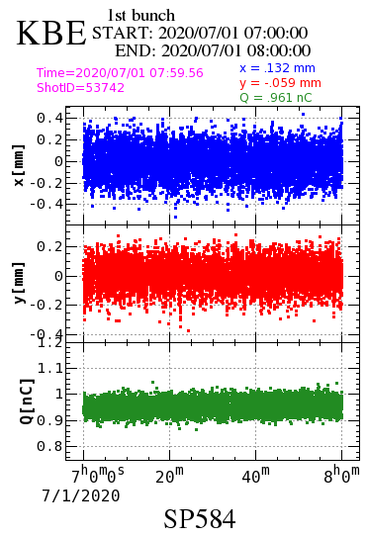
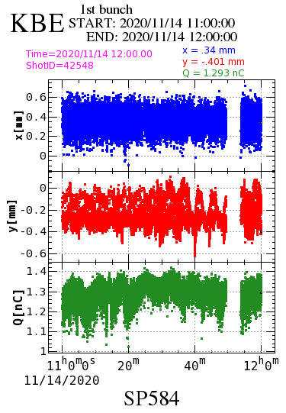
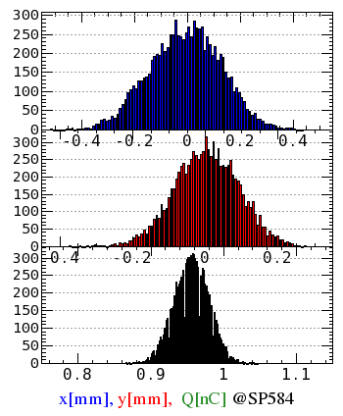
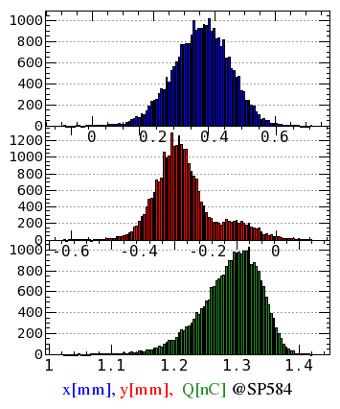
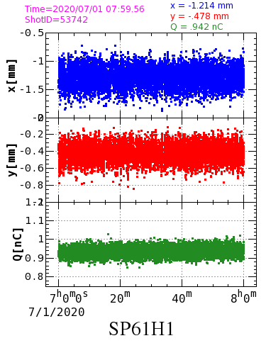
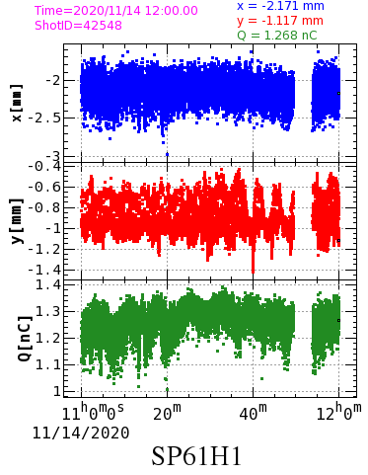
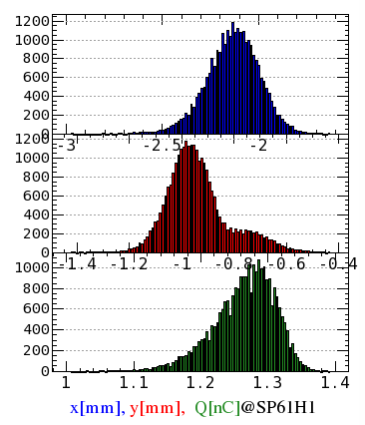
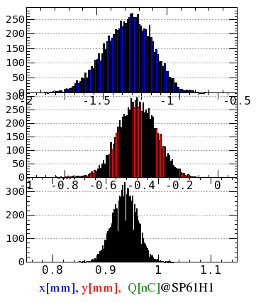
Examples at the end of linac
Y. Seimiya
After summer
* 7-minute instability
==>
Chiller for a table
* Discrete vertical orbit
==>
New pulsed bend
Before Summer
After Summer
Hor.
Ver.
Charge

Slide 8
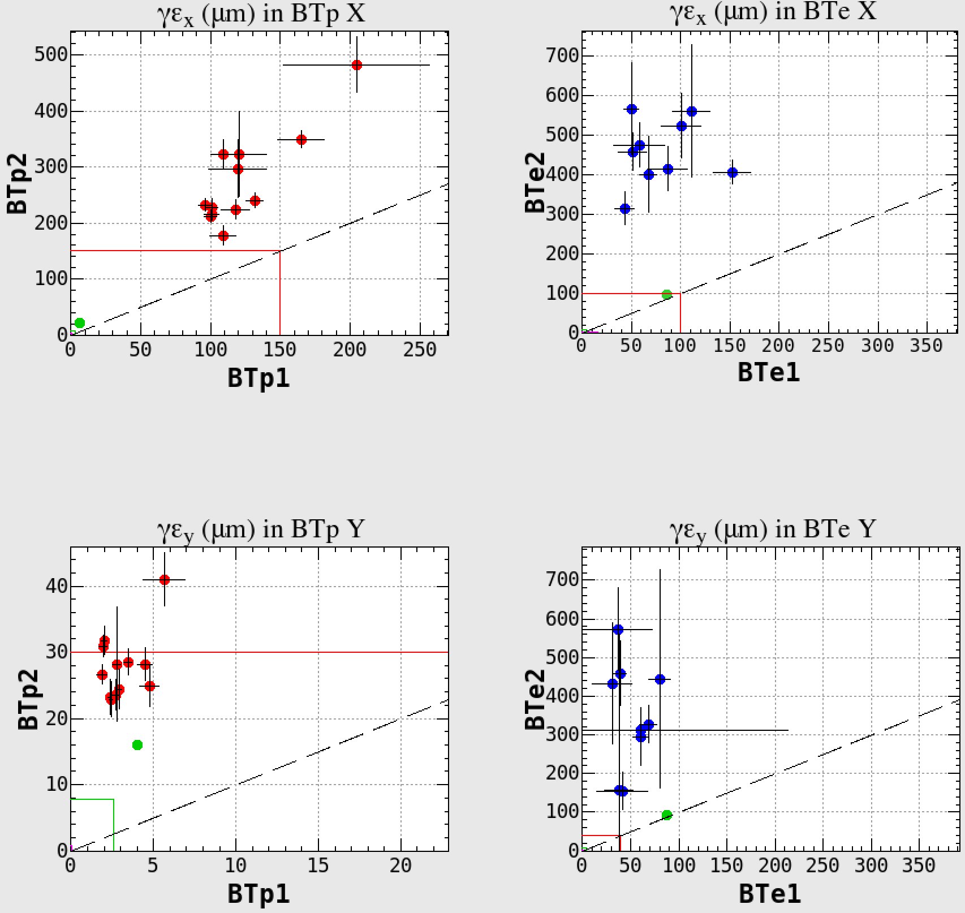
Emittance break-up in BT
e+X
e- X
● Measured by WS
● Emittance due to Jitter
ー Emittance due to BPM res.
ー Emittance due to σ_{δ}
(invisibly small)
21/Oct
22/Oct
Same emittance line
of BT2 as BT1
Required emittance
from LER/HER
e+Y
e- Y
The horizontal orbit jitter in the e+ is negligibly small.
The other jitter emittances at BT1 is comparable as measured emittance.
But in BT2, all measured emittances are larger than the jitter emittances.
21/Oct
22/Oct
Notes:
The emittances due to the measured jitter are plotted by green points.
The green lines show the emittance due to BPM resolution.
They are calculated assumed the design beta.
The pink lines show the emittance due to energy spread by leaked dispersions, which are invisibly small.

Slide 9
 | 早朝 | 日中 LINAC mode | 準夜 BT dump mode
11/18（水） |  | ２値化問題(パターンを変える。)(夏井) | ~18:00 OTR, BT2 QuadScreen
11/19（木） | QuadBPM(BTp) OctoPos(SY3)e- data taking | 7分変動の調査(吉田) KBP DS Study(三浦) | ~できるまで BT Study
11/20（金） | KBP DC4 response 8:00~9:00e-放射線測定 25Hz Jarc dispersion(吉田) | Jarc dispersion(清宮) 3-5 sector 軌道FB(清宮) | ~できるまで BT Study
11/21（土） | TBD | KBE beam Cleaning | ~18:00 Conditioning KBP DS Study(三浦) 1H MOFB Offの影響を見る
11/22（日） | KBE beam Conditioning | KBE beam Conditioning | KBE beam Conditioning
11/23（月） | KBE beam 1st laser | KBE beam 1st +2nd laser | KBE beam
11/24（火） | KBE beam | HER injection LER injection

Slide 10
Many improvements during summer shutdown and additional items in this week
Injection stabilization is still one of the major challenges for now
Further stabilization expected with existent hardware to help investigation at the beam transport line
Then, pursue several more steps to final designed beams
Thank you

Slide 11
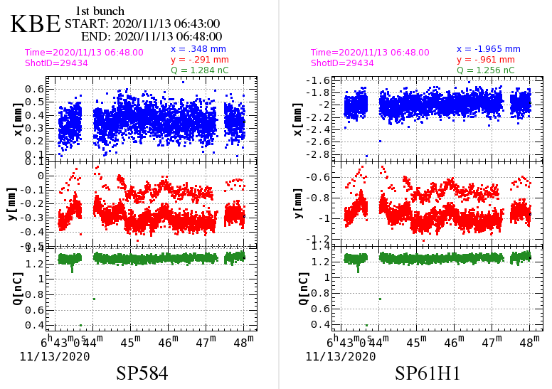
e- beam V-orbit binarization at LINAC end

Slide 12
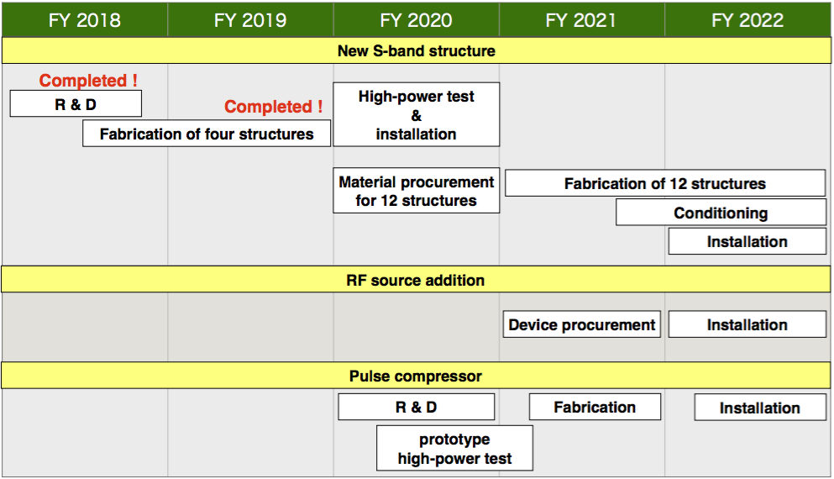
Higher energy injection and collision
Mitigation of accelerator structure failures
Originally designed for 8 MeV/m, but used at 20 MeV/m
Degradation that lead to high field emission rate and discharges
Water leaks
Not only Y(6S) but even Y(4S) could be suffered
4-year plan to fabricate and install new accelerator structures

Slide 13
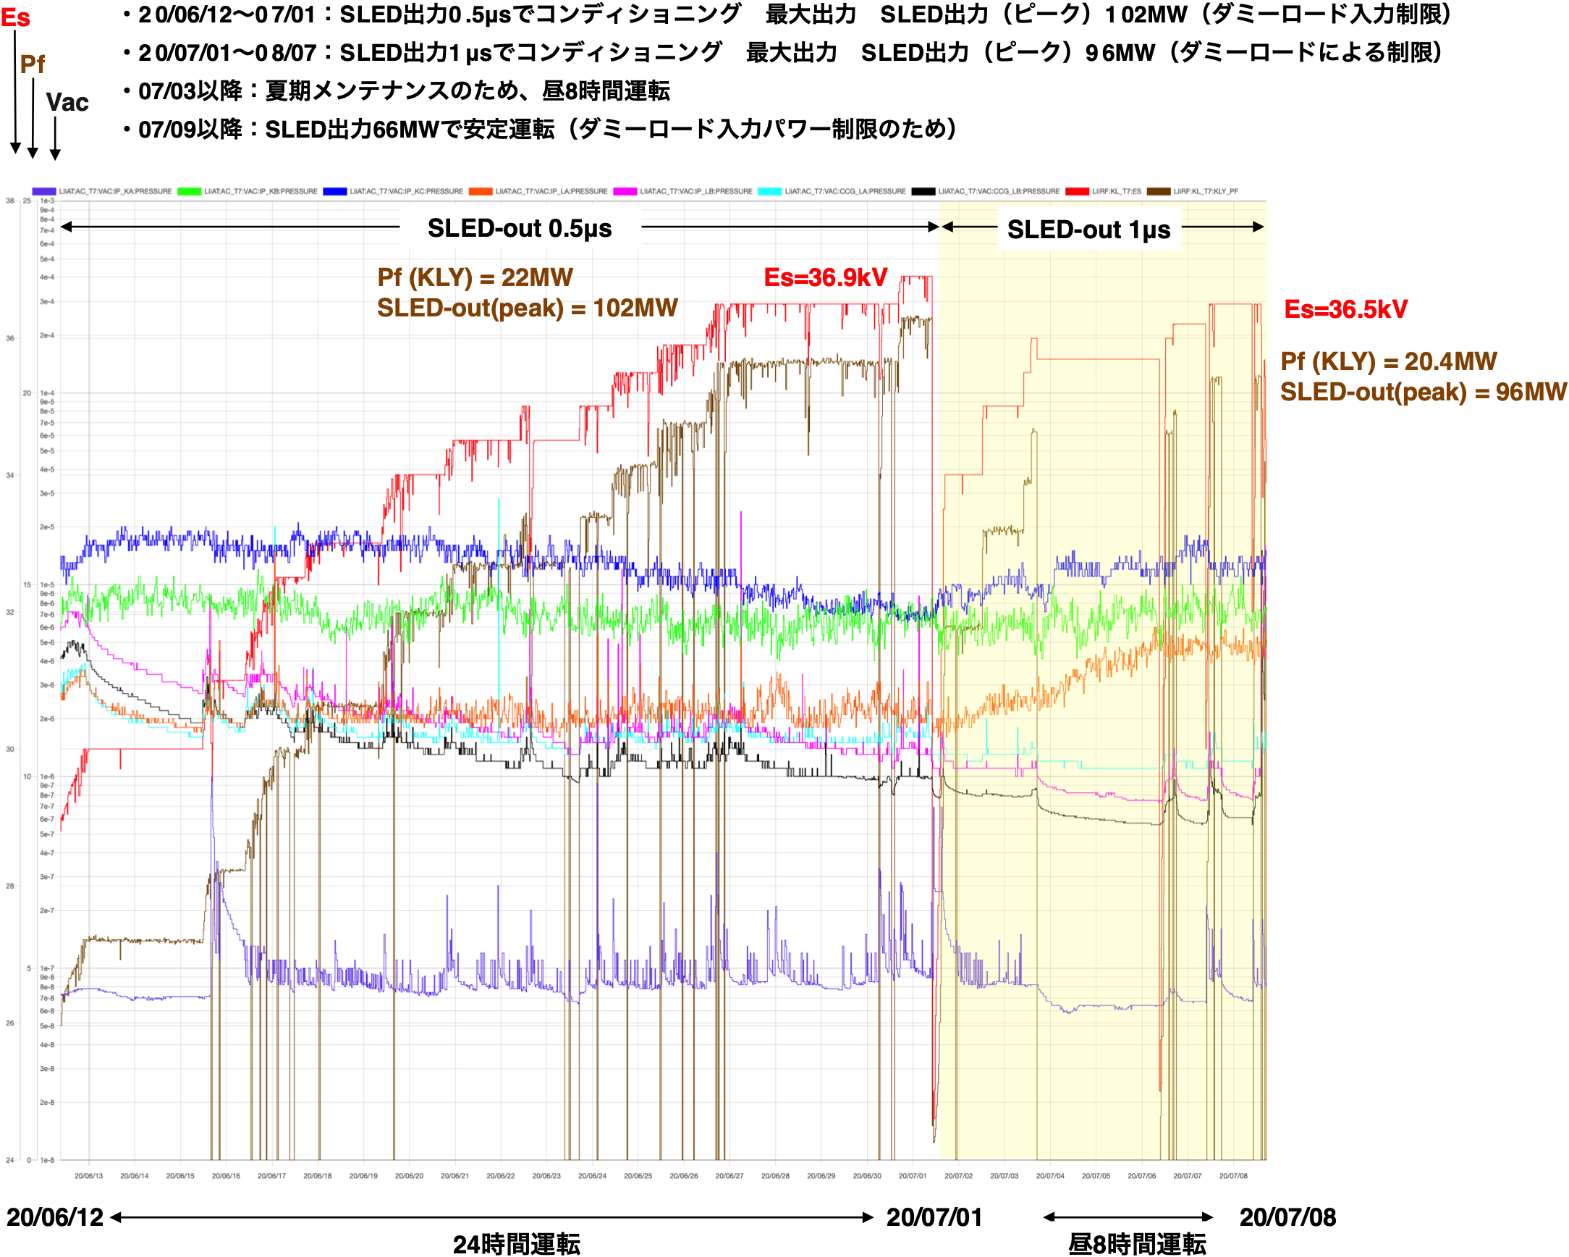
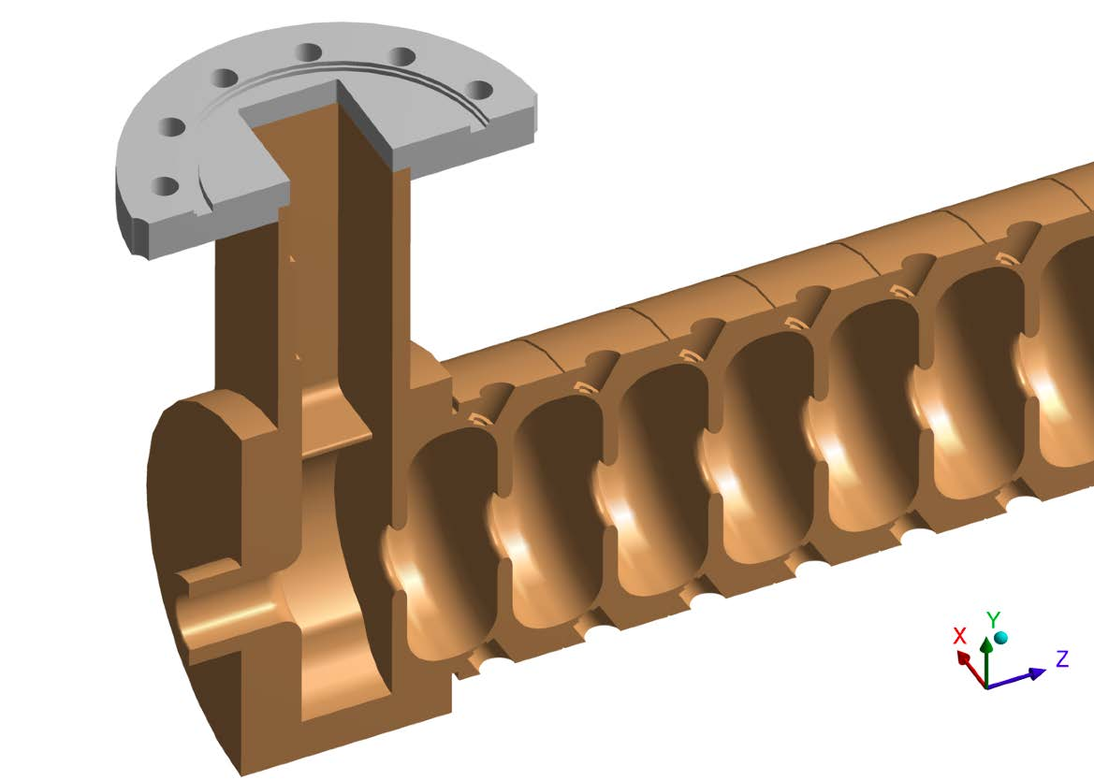
New accelerator structures
First batch acceptance of structures (4)
Now being high-power- conditioned
It exceeded our expectations

Slide 14
Energy
Recent effort to optimize parameters
10.753 + 0.023/2 GeV could be possible with backups
e+ : 4.071 GeV, e- : 7.124 GeV
with 2 nC/bunch
After structure upgrade in 2023 winter
6S : 11.020 GeV could be reached with backups
e+ : 4.165 GeV, e- : 7.289 GeV
with 2-3 nC/bunch
BT limit
e+ : 4.290 GeV, e- : 8.465 GeV (both coil heating limit)
MR
No discussion yet, while included in the design
Easier with Belle II solenoid scaled
Otherwise, …

Slide 15
Linac Beam Parameters for KEKB/SuperKEKB
Linac Beam Property Requirements
Stage | KEKB (final) |  | Phase-I (achieved) |  | Phase-II (achieved) |  | Phase-III (interim) |  | Phase-III (final)
Beam | e+ | e– | e+ | e– | e+ | e– | e+ | e– | e+ | e–
Energy | 3.5 GeV | 8.0 GeV | 4.0 GeV | 7.0 GeV | 4.0 GeV | 7.0 GeV | 4.0 GeV | 7.0 GeV | 4.0 GeV | 7.0 GeV
Stored current | 1.6 A | 1.1 A | 1.0 A | 1.0 A | – | – | 1.8 A | 1.3 A | 3.6 A | 2.6 A
Life time (min.) | 150 | 200 | 100 | 100 | – | – | – | – | 6 | 6
 | primary e- 10 |  | primary e- 8 | 1 | 0.5 | 1 | 2 | 2 | primary e- 10 | 4
Bunch charge (nC) | → 1 | 1 | → 0.4 |  |  |  |  |  | → 4
Norm. Emittance | 1400 | 310 | 1000 | 130 | 200/40 | 150 | 150/30 | 100/40 | 100/15 | 40/20
(γβε) (mrad) |  |  |  |  | (Hor./Ver.) |  | (Hor./Ver.) | (Hor./Ver.) | (Hor./Ver.) | (Hor./Ver.)
Energy spread | 0.13% | 0.13% | 0.50% | 0.50% | 0.16% | 0.10% | 0.16% | 0.10% | 0.16% | 0.07%
Bunch / Pulse | 2 | 2 | 2 | 2 | 2 | 2 | 2 | 2 | 2 | 2
Repetition rate | 50 Hz |  | 25 Hz |  | 25 Hz |  | 50 Hz |  | 50 Hz
Simultaneous top-up injection (PPM) | 3 rings (LER, HER, PF) |  | No top-up |  | Partially |  | 4+1 rings (LER, HER, DR, PF, PF-AR) |  | 4+1 rings (LER, HER, DR, PF, PF-AR)
Final parameters will be updated

Slide 16
24th KEKB accelerator review
Remotely on July 15th and 20th
General recommendations on injector
Pursue aggressive linac/injector improvements …
Injector recommendations
Improvements in
Positron capturing section, positron yield
Photocathode for RF gun, electron bunch charge
BT2 for obstacles, beam instrumentations, beam optics
Mostly in line with planned improvements during summer

Slide 17
MEXT roadmap and injector
MEXT Roadmap 2020
HER 2.6 A x LER 3.6 A (original plan before 2020)
4 nC/bunch, 2 bunch/pulse, 50 Hz, 50% efficiency could have supported 6 minute lifetime in HER/LER
➡ HER 2.0 A x LER 2.8 A
The same condition supports lifetime down to 240 seconds
although beam quality has to be maintained

