Slide 1
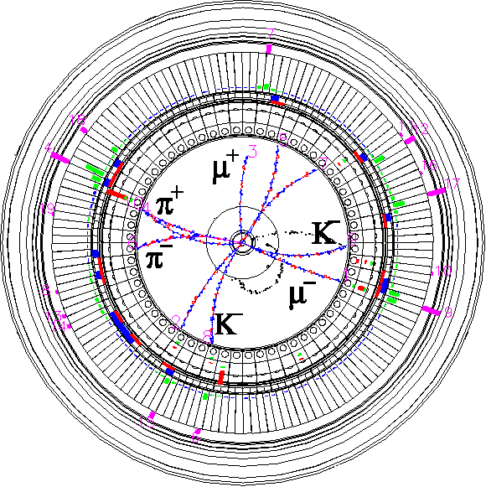


Beam-beam related issues at SuperKEKB
Y. Funakoshi, K. Ohmi, Y. Ohnishi, H. Sugimoto, Y. Yamamoto, D. Zhou
2024.10.07
B2GM
Inter-University Research Institute Corporation High Energy Accelerator Research Organization (KEK)
大学共同利用機関法人 高エネルギー加速器研究機構 (KEK)

Slide 2
Contents
Beam-Beam force
Crab waist
Specific luminosity and beam-beam parameters
Beam injection
Effect of bunch-by-bunch feedback system
Tune survey
Beam-beam simulations

Slide 3
Beam-beam force

Slide 4
Terminology
Bunch current
  Total beam current / number of bunches
Specific luminosity
  Peak luminosity / number of bunches/ LER bunch current / HER bunch current
Beam-beam parameter (beam-beam tune shift)
  To be explained in the following slides

Slide 5
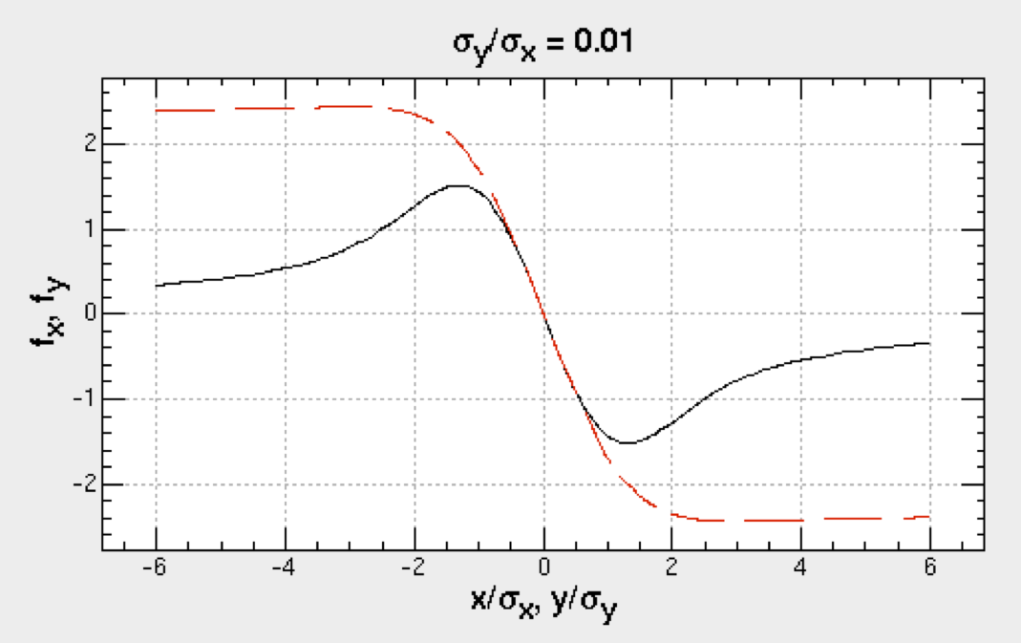


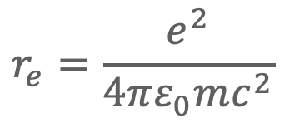
Beam-beam force (2 dimensions)
Bassetti-Erskine formula
When the beam is Gaussian:
y
x
(w: complex error function)
Q-force (focusing force) near zero-offset
$$r_{e}=\frac{e^{2}}{4πε_{0}mc^{2}}$$
Q-force is represented by K-value.
Q-force makes tune shift: Δν_{x,y} = K_{x,y}β_{x,y}/(4π)
Beam-beam tune shift (or beam-beam parameter): ξ_{x,y}

Slide 6
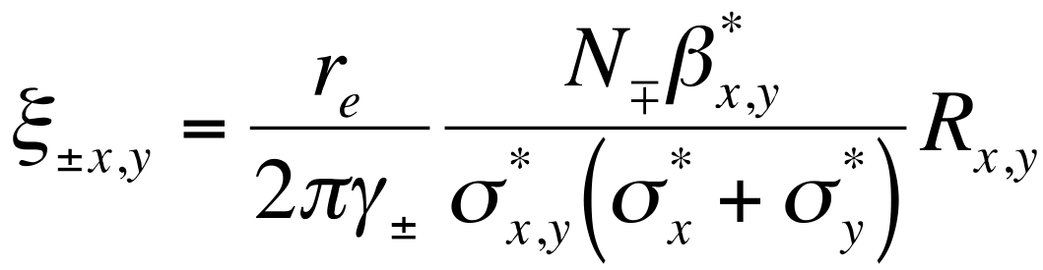
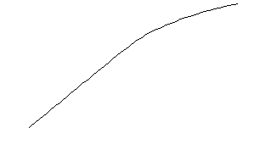
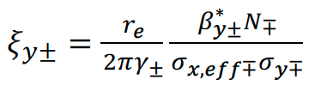

Beam-beam parameters
x_{y}
Beam-beam parameter (tune shift)
Effective σ_{x,eff} in nano-beam scheme
Beam-beam parameters may saturate at some value due to vertical beam size blowup (beam-beam limit).
Beam-beam parameters are global parameters across different colliders.
Its maximum value is an indicator of the beam-beam performance of each collider.
Maximum beam-beam parameters can be increased by beam tuning.
beam-beam limit
beam size: increasing
Nano-beam scheme
*
*
I_{beam}
*
beam size :constant
*

Slide 7
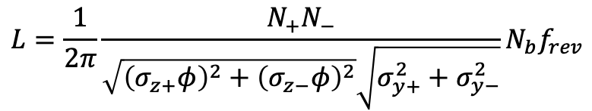
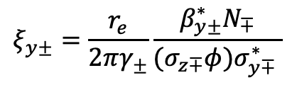
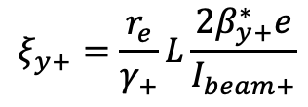

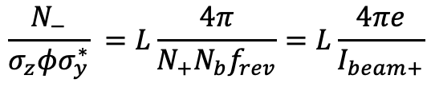
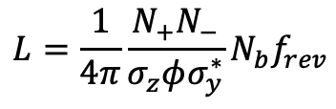
Calculation of beam-beam parameters
Definition
Incoherent beam-beam parameters ($ξ_{yi}\left(LER\right), ξ_{yi}\left(HER\right)$)
Beam-beam parameters from luminosity($ξ_{y}\left(LER\right), ξ_{y}\left(HER\right)$)
  Assume beam sizes at IP are equal for both beams
  Another way for calculation
$$ξ_{y±}=\frac{r_{e}}{2πγ_{±}}\frac{β_{y±}^{∗}N_{∓}}{(σ_{z∓}φ)σ_{y∓}^{∗} }$$
$σ_{y∓}^{∗}$: from X-ray monitor, $σ_{z∓}$: nominal bunch length (LER: 4.6 mm, HER: 5.1 mm)
$$L=\frac{1}{4π}\frac{N_{+}N_{−}}{σ_{z}φσ_{y}^{∗}}N_{b}f_{rev}$$
$$\frac{N_{−}}{σ_{z}φσ_{y}^{∗}} =L\frac{4π}{N_{+}N_{b}f_{rev}}=L\frac{4πe}{I_{beam+}}$$
$$ξ_{y+}=\frac{r_{e}}{γ_{+}}L\frac{{2β}_{y+}^{∗}e}{I_{beam+}}$$
If the difference in σ_{y}* of the two beams are large, ξ_{y} from this calculation becomes much different from ξ_{yi}.
$$L=\frac{1}{2π}\frac{N_{+}N_{−}}{\sqrt{{\left(σ_{z+}φ\right)}^{2}+{\left(σ_{z−}φ\right)}^{2}}\sqrt{σ_{y+}^{2}+σ_{y−}^{2}}}N_{b}f_{rev}$$
By using r=(σ_{y+}*/σ_{y-}*) from X-ray monitor, σ_{y+}* and σ_{y-}*
can be calculated from luminosity.
-> beam-beam parameters

Slide 8
Crab waist

Slide 9
What is Crab Waist?
positron
electron
Shifted wait point
using Crab Waist
Original waist of electrons
As a result of large crossing angle、a particle with horizontal offset collides with the center of the other beam
where the β_{y} is larger than its minimum point (waist). -> another kind of hourglass effect
``Crab Waist” is to compensate this effect.

Slide 10
Crab waist scheme
Introduction of crab waist at SuperKEKB
  Motivations
    The beam-beam performance was poor in spite of all of knob tunings for improving it.
  Method
    FCC-ee type scheme: use of imbalance sextupoles in the vertical local chromaticity correction section.
  Time table
    2020 March 16th : LER crab waist (40%)
    2020 March 24th : LER crab waist (60%)
    2020 April 24th : HER crab waist (40%)
    2030 June 1st : LER crab waist (80%)

Slide 11
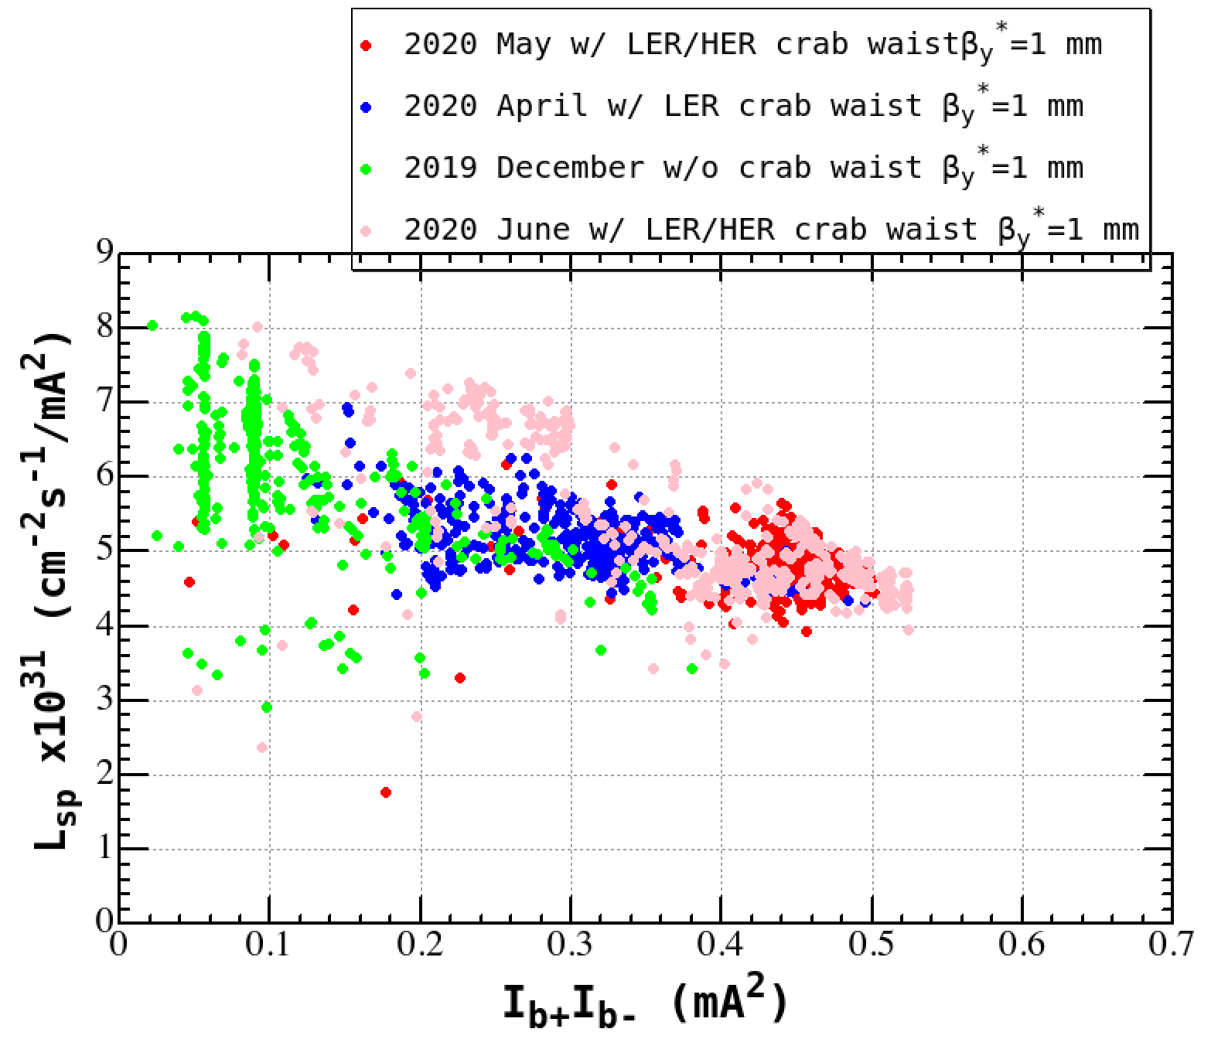
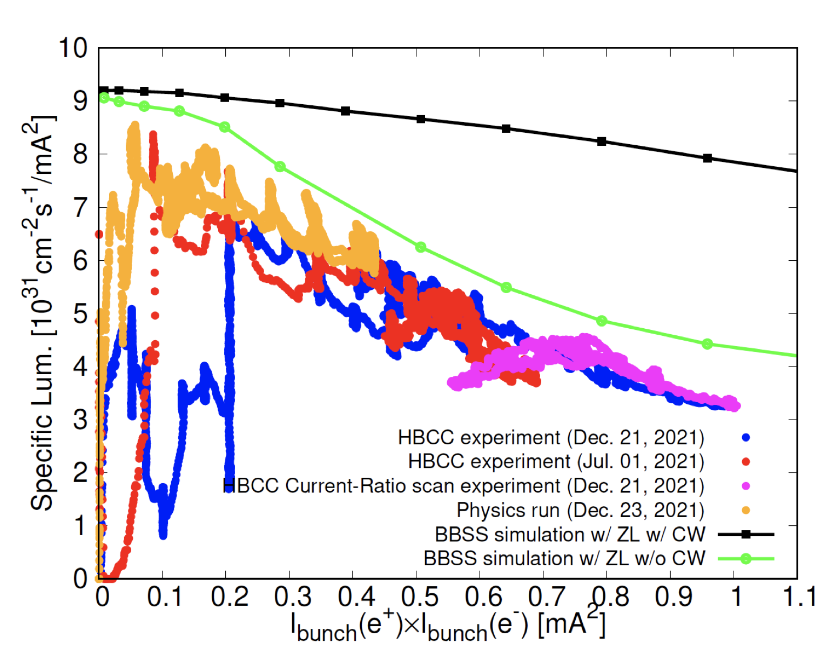
Specific luminosity w/ and w/o crab waist
Strong-Strong Beam-Beam simulation (D. Zhou)
I_{b+}I_{b-} was limited at around here
w/o CW

Slide 12
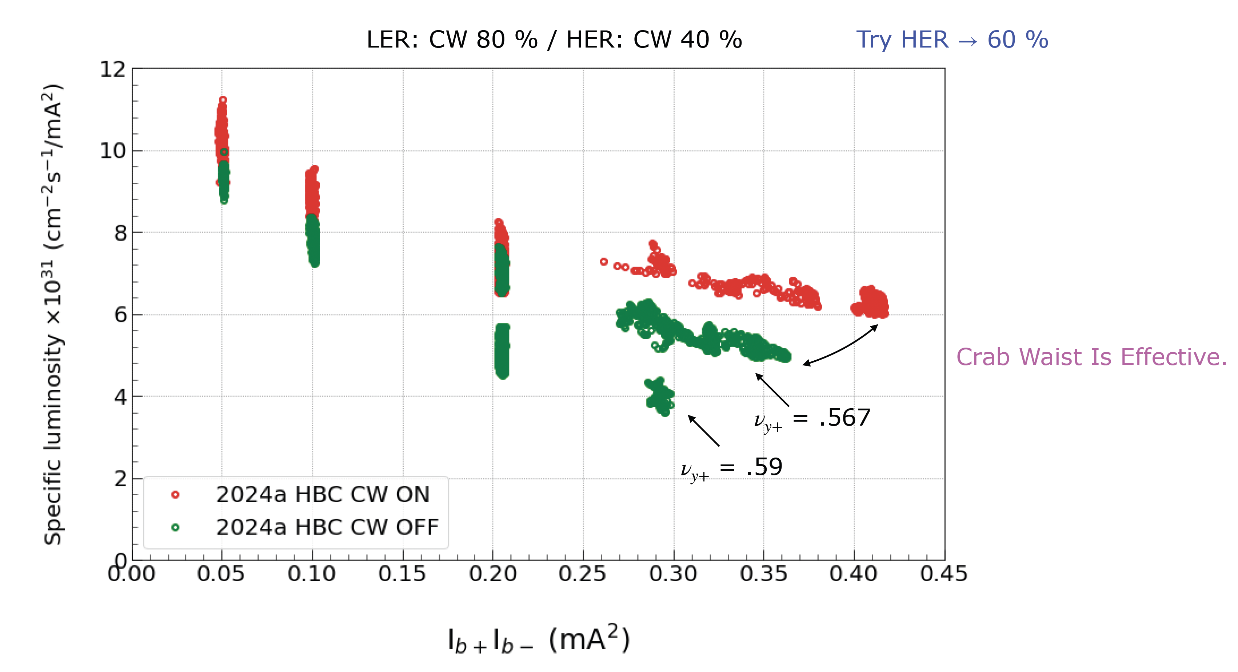
Crab waist ON and OFF (2024)

Slide 13
Specific luminosity w/ and w/o crab waist
Strong-Strong Beam-Beam simulation (D. Zhou)
w/o crab waist
(0.37,5),(0.27,6.5)
I_{b+}I_{b-} was limited at around here
w/o CW

Slide 14
Summary of crab waist scheme
Benefits of use of crab waist scheme
  Suppression of beam-beam blowup
    Specific luminosity was improved. The gain of the luminosity with CW is about 30 % at 0.35mA².
  Increase of the bunch currents of both beams
    W/o crab waist, beam injections was limited due to bad injection efficiency.
Beam lifetime issue
  Dynamic aperture shrinks w/ crab waist and the lifetime decrease w/ crab waist was expected.
    But in βy*= 1mm case, no lifetime decrease was observed in LER and HER, maybe since the collimator physical aperture is already very narrow.
    In case of lower βy*, the lifetime w/ crab waist will be an issue.

Slide 15
Specific luminosity and beam-beam parameters

Slide 16
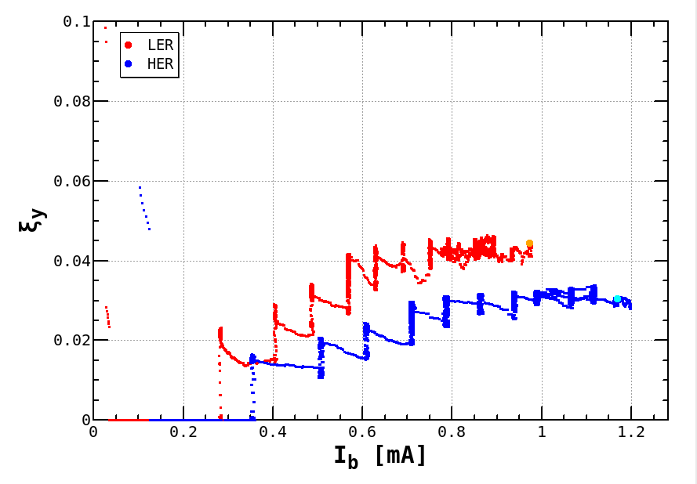
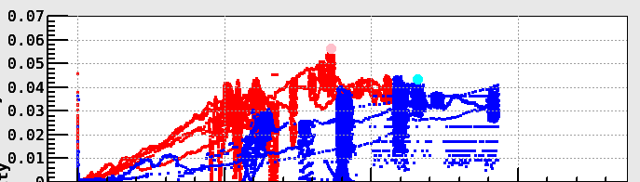
Beam-beam parameters
0.06
N_{bunch} = 31
2022 March 28th
Bunch-by-bunch FB:off
N_{bunch} = 393
2022 April 5th
ξ_{y}
Bunch-by-bunch FB:on
0.04
0.02
0
0
0.5
1
1.5
I_{bunch} [mA]
With smaller number of bunches (31 bunches), which
allowed us to switch FB off, ξ_{y} of HER reached
~0.043. This is the highest value achieved ever at
SuperKEKB.
Vertical beam-beam parameter (ξ_{y}) of HER
is saturated around 0.03.

Slide 17
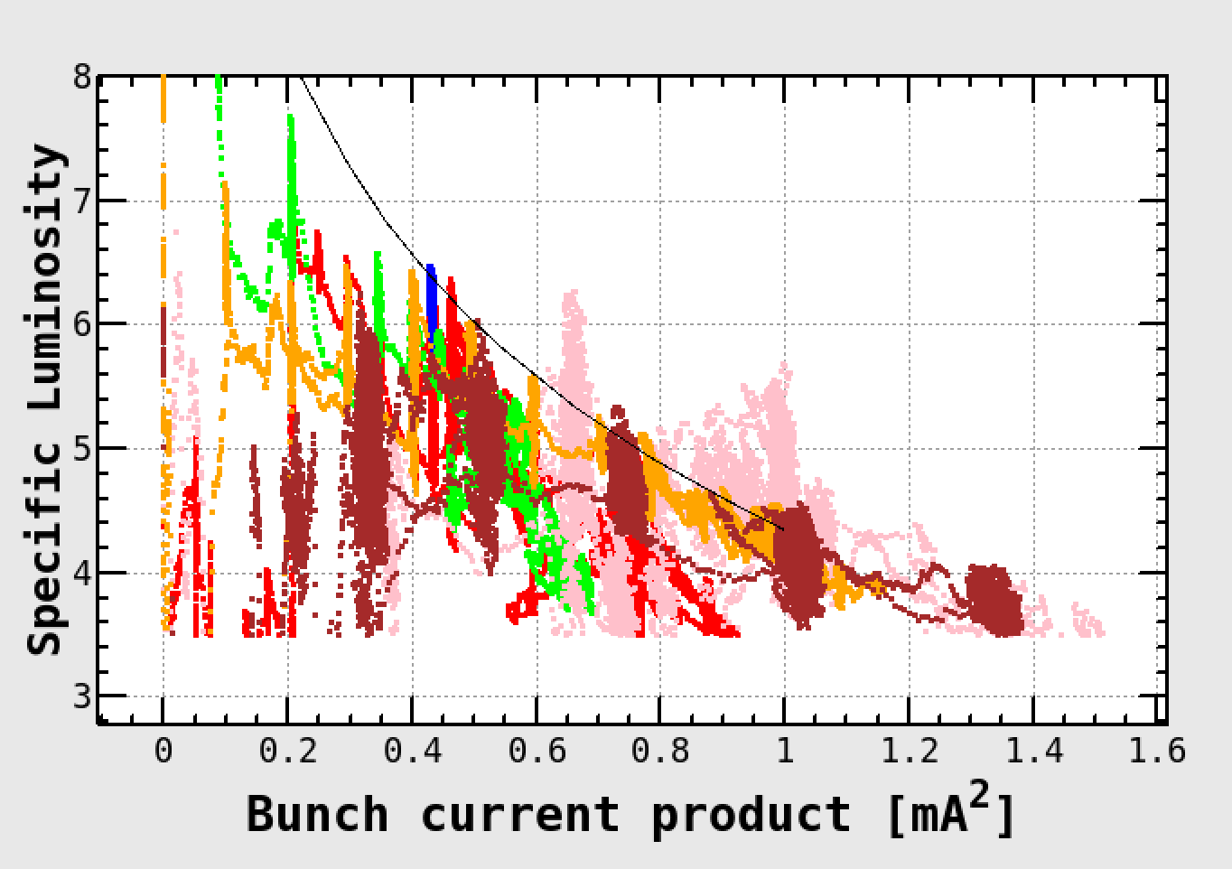
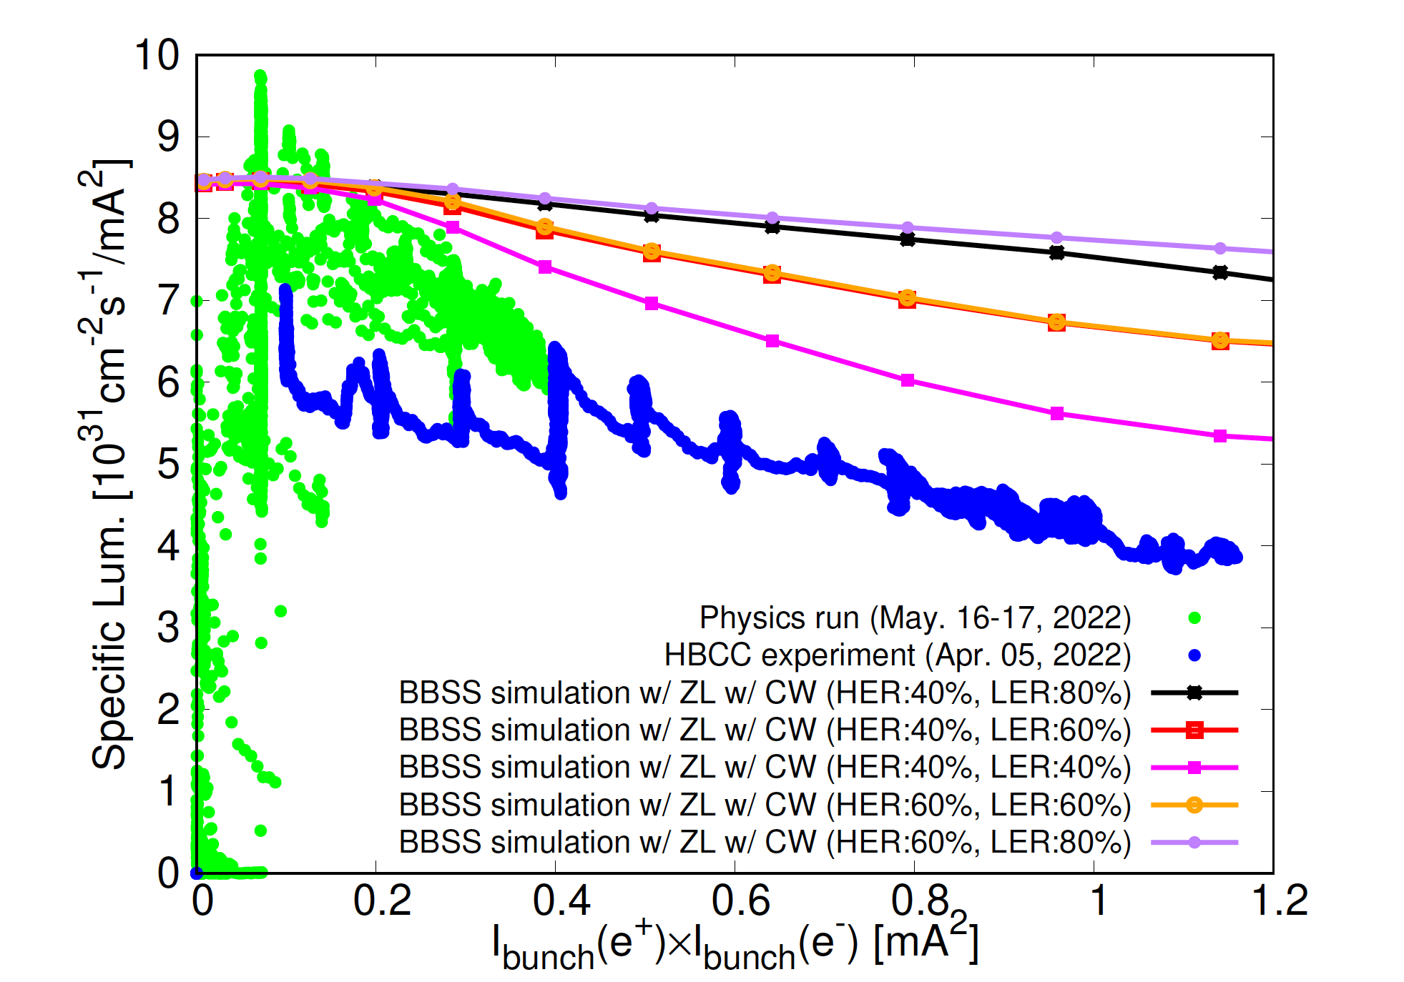
Specific luminosity
Crab waist: LER:80%, HER:40%
Machine tuning was not enough for April 5th study.
Pink: Nb=31, March 28th 2022
Blown: Nb = 61, April 5th 2022
Orange: Nb = 393, April 5th 2022
Nb = 1662, May 16-17th 2022 (physics run)
Nb = 393, April 5th 2022
There is a big discrepancy between simulation
and experiment. This issue is very serious.

Slide 18
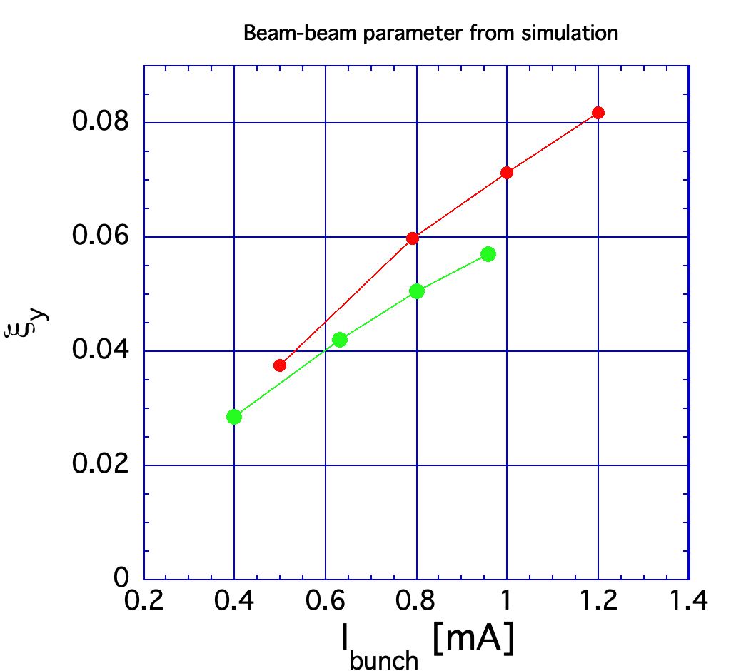
Beam-Beam Parameter calculation from simulation
Crab waist:
LER:80%, HER:40%

Slide 19
Summary of Specific luminosity and beam-beam parameters
The achieved specific luminosity at a higher bunch current product (~> 1 mA2) is about a half of the strong-strong simulation (w/ longitudinal wake).
  To identify the cause for this is very important for SuperKEKB.
In high bunch current collision (HBCC) experiment ,vertical beam-beam parameters (ξ_{y}) of HER and LER seems to be saturated at around 0.03 and 0.045, respectively.
With FB off, the specific luminosity was improved and the Vertical beam-beam parameters (ξ_{y}) of HER and LER obtained were 0.0434 and 0.0565, respectively.

Slide 20
Simulations on beam-beam effects

Slide 21
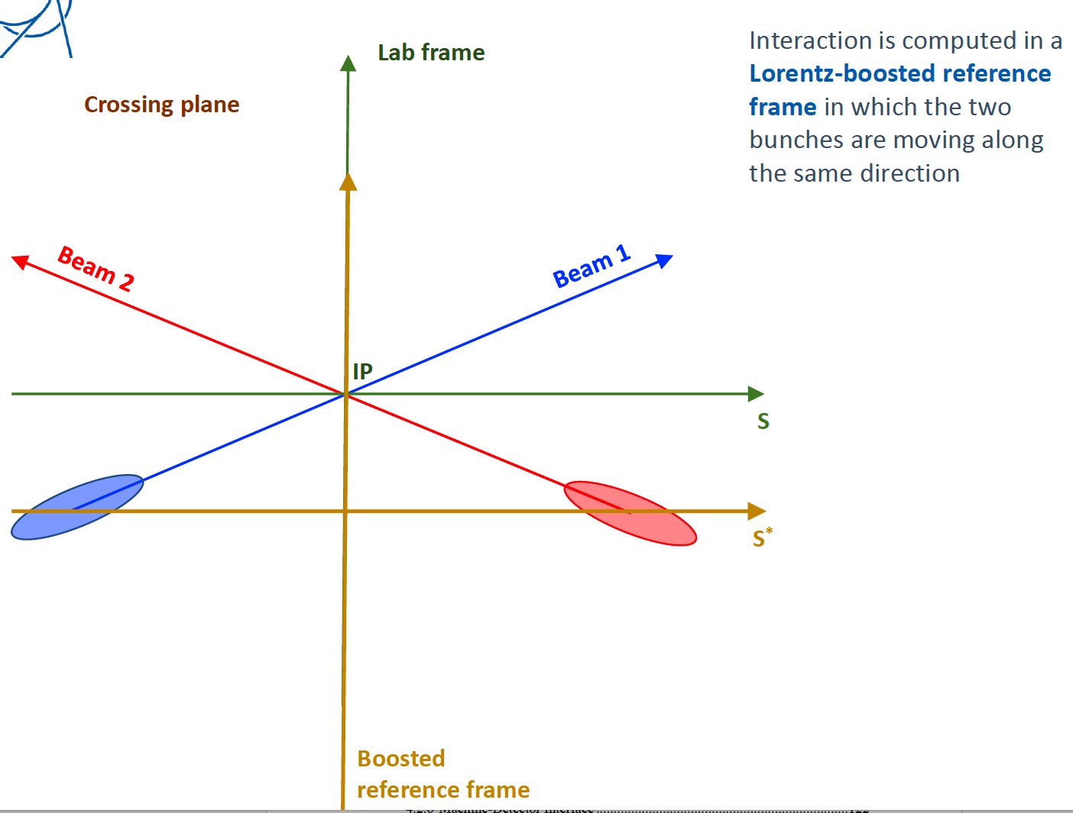
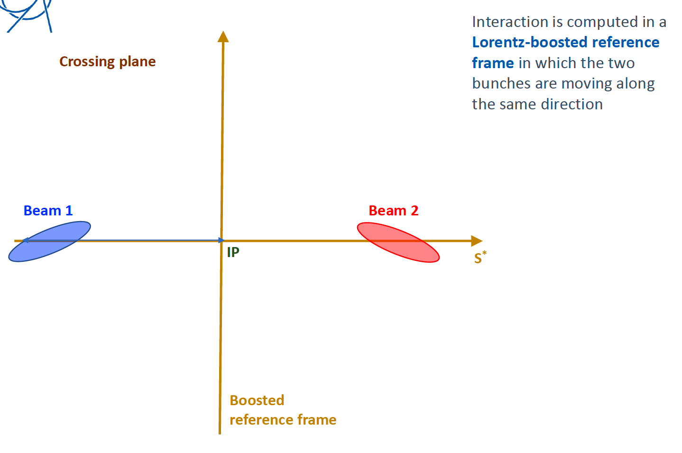
Boosted frame
G. Iadarola

Slide 22
Strong-weak and strong-strong simulations
Strong-weak simulation
Strong-strong simulation
typical # of slices: ~ 200
IP
Slice vs a macro-particle collision
Strong beam (divided into slices)
Each slice has rigid gaussian shape
-> beam-beam force is given by Bassetti formula using σx and σy
Weak beam
represented by macro particles
(typical # of macro particles: 100 ~ 10⁶)
IP
Slice vs Slice collision
Strong beam (divided into slices)
Each slice represented by macro particles
Beam-beam force is given by Bassetti formula by doing gaussian fit after each slice-slice collision (soft gaussian method)
or by solving 2D Poisson equation using particle density distribution deposited on the grid cells (X-Y plane) (PIC method)

Slide 23
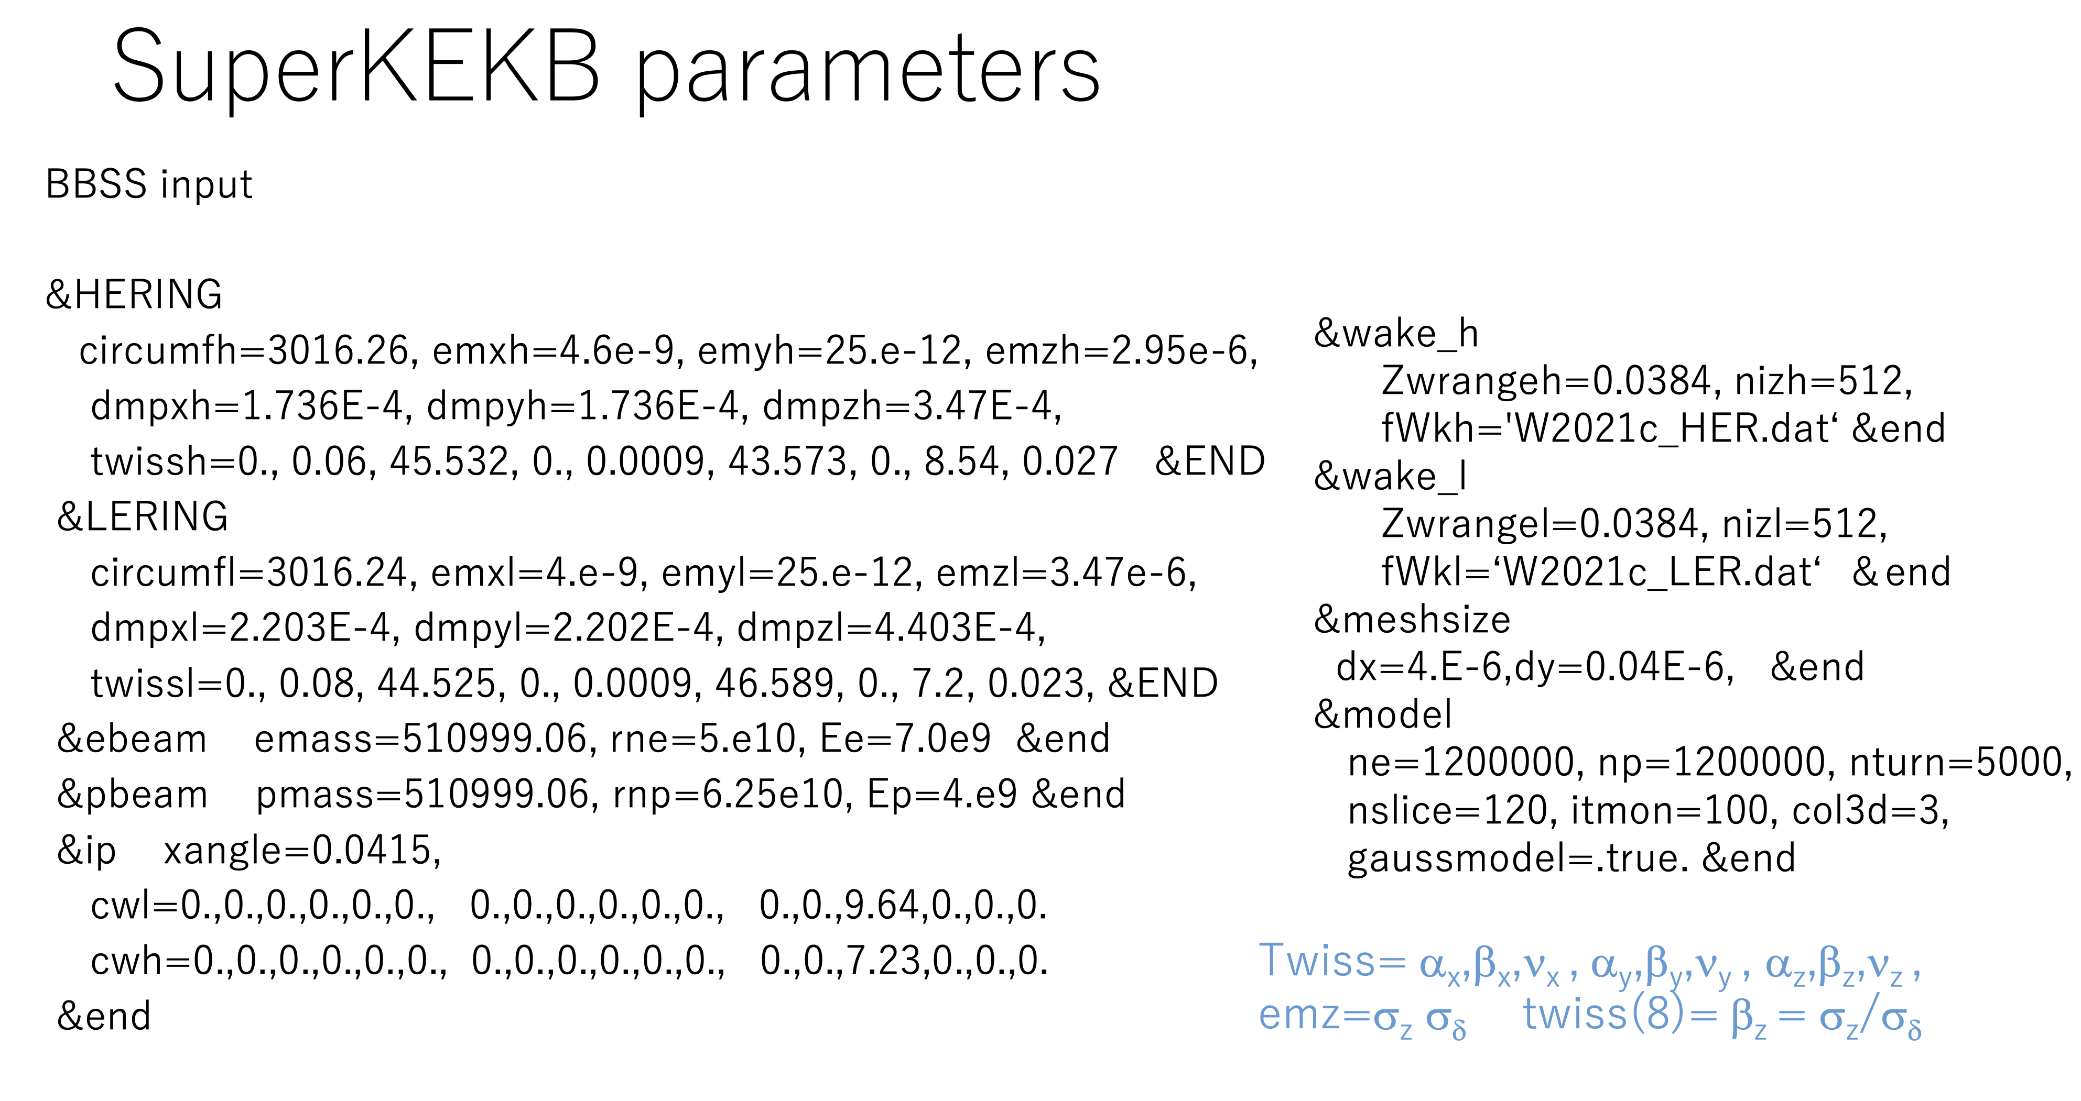
Parameters of recent strong-strong simulation (K. Ohmi) using BBSS
# of macro particles = 1.2 x 10⁶
# of slice = 120, soft gaussian method

Slide 24
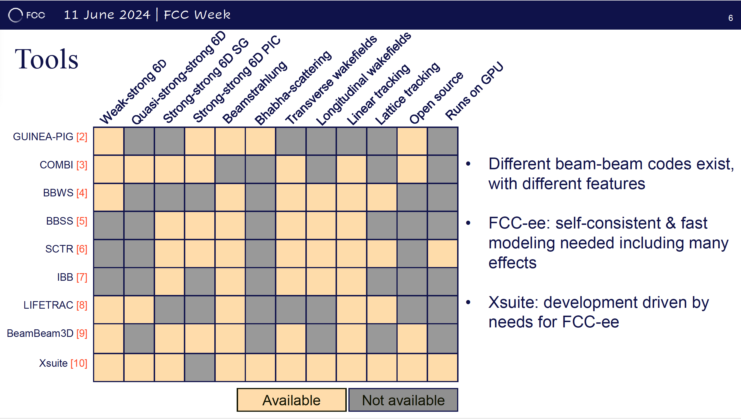
Peter Kicsiny
Linear colliders
CERN LHC
KEK Ohmi
KEK Ohmi
KEK Ohmi
IHEP
BINP
LBL
CERN

Slide 25
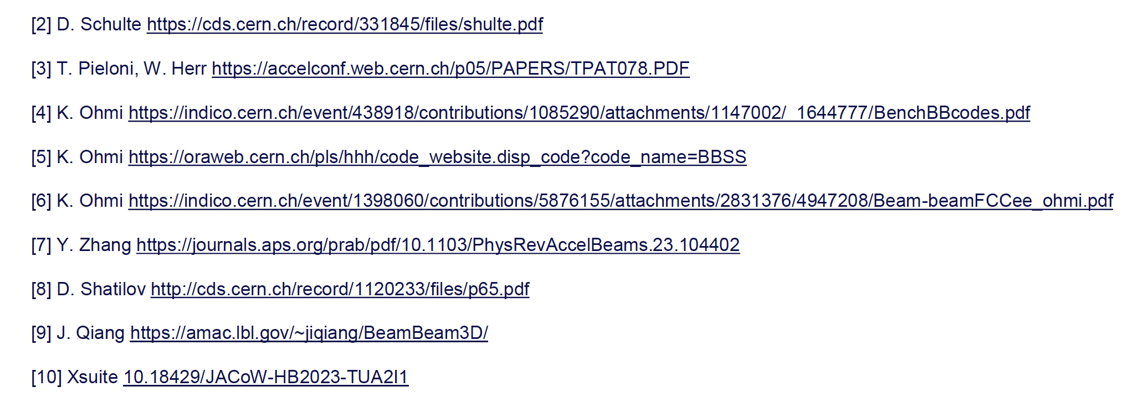

Slide 26
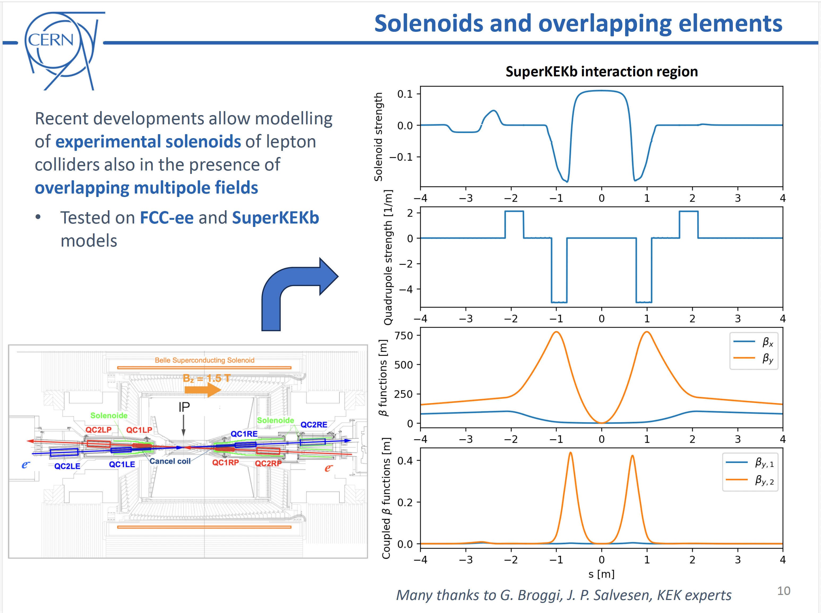
Plan:
SAD Lattice -> Xsuite
Beam-beam simulation of SuperKEKB
using Xsuite (J. P. Salvesen).

Slide 27
International Collaboration in SuperKEKB
International Working Group (new organization introduced at the last ARC)
  Beam Tuning and Operation
  Sudden Beam Loss (SBL)
  Beam-Beam Interaction and Collective Effects
  Beam Instrumentation
  Future Upgrade
One possible avenue for cooperation with US national labs/universities is Beam-Beam Interactions.
  Strong-strong beam-beam simulations with the full lattice, using the BMAD package.
  US DOE HPC (high-performance computing) machines are available for HEP for these simulations.
  The proposal could involve junior acc. physicists, supervised by senior scientists,
  Yunhai Cai (SLAC), David Sagan (Cornell), Mark Palmer (BNL)
US accelerator leaders, Tor Raubenheimer, Sergei Nagaitsev, and Mark Palmer, are highly supportive
The DOE has requested a clear plan for a possible US contribution to SuperKEKB
Keisuke Yoshihara
(for US Belle II)

Slide 28
On validity of beam-beam codes used in SuperKEKB
D. Zhou
Beam-beam codes used in SuperKEKB
  In-house codes at KEK: BBWS/BBSS/STCR (developed by K. Ohmi) and SAD (maintained by K. Oide et al.)
    BBWS: weak-strong model + perturbation maps
    BBSS: strong-strong model (soft-Gaussian and PIC options) + perturbation maps
    STCR: strong-strong model + full lattices + space charge
    SAD: weak-strong model (BBWS integrated into SAD) + full lattices + space charge
  External third-party codes
    IBB (Y. Zhang, IHEP): strong-strong model (soft-Gaussian and PIC options) + perturbation maps
    APES-T (Z. Li and Y. Zhang, IHEP): strong-strong model + full lattices
    Xsuite (P. Kicsiny, CERN): weak-strong and strong-strong models
  Findings/Achievements
    Overall, all codes consistently capture the key beam-beam physics in SuperKEKB, including coherent X-Z instability, combined effects of beam-beam and impedances, synchrobetatron resonances, and the effects of machine aberrations.
    External codes have been improved through benchmarking and collaborative studies with KEK researchers, as well as through their applications to SuperKEKB. These activities have also provided valuable training for young accelerator physicists, particularly from China and Europe.
Other successful benchmarks/collaborations
  BBSS benchmarked with BeamBeam3D (J. Qiang)
  BBSS benchmarked with Lifetrac (D. Shatilov)
  BBSS benchmarked with Y. Cai’s code for KEKB (PRST-AB 12, 061002) and high-current SuperKEKB (SLAC-PUB-11188)

Slide 29
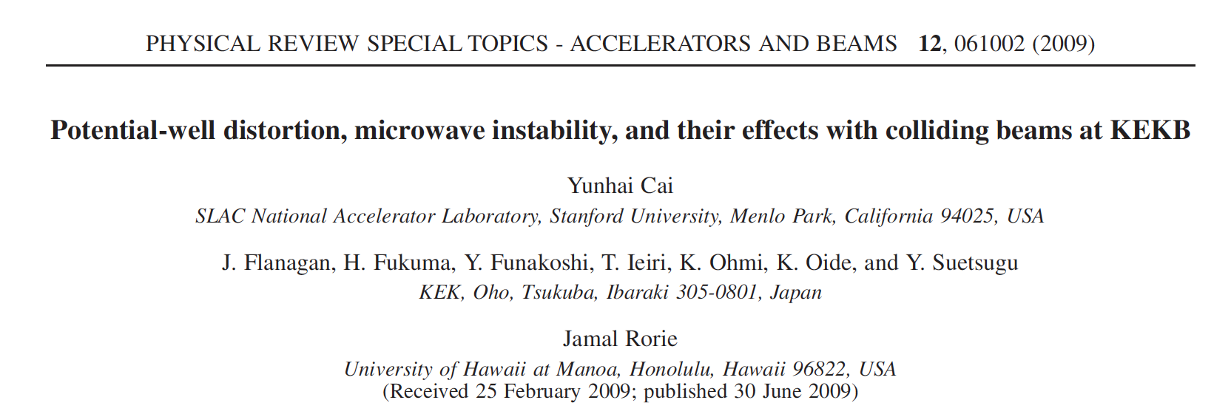
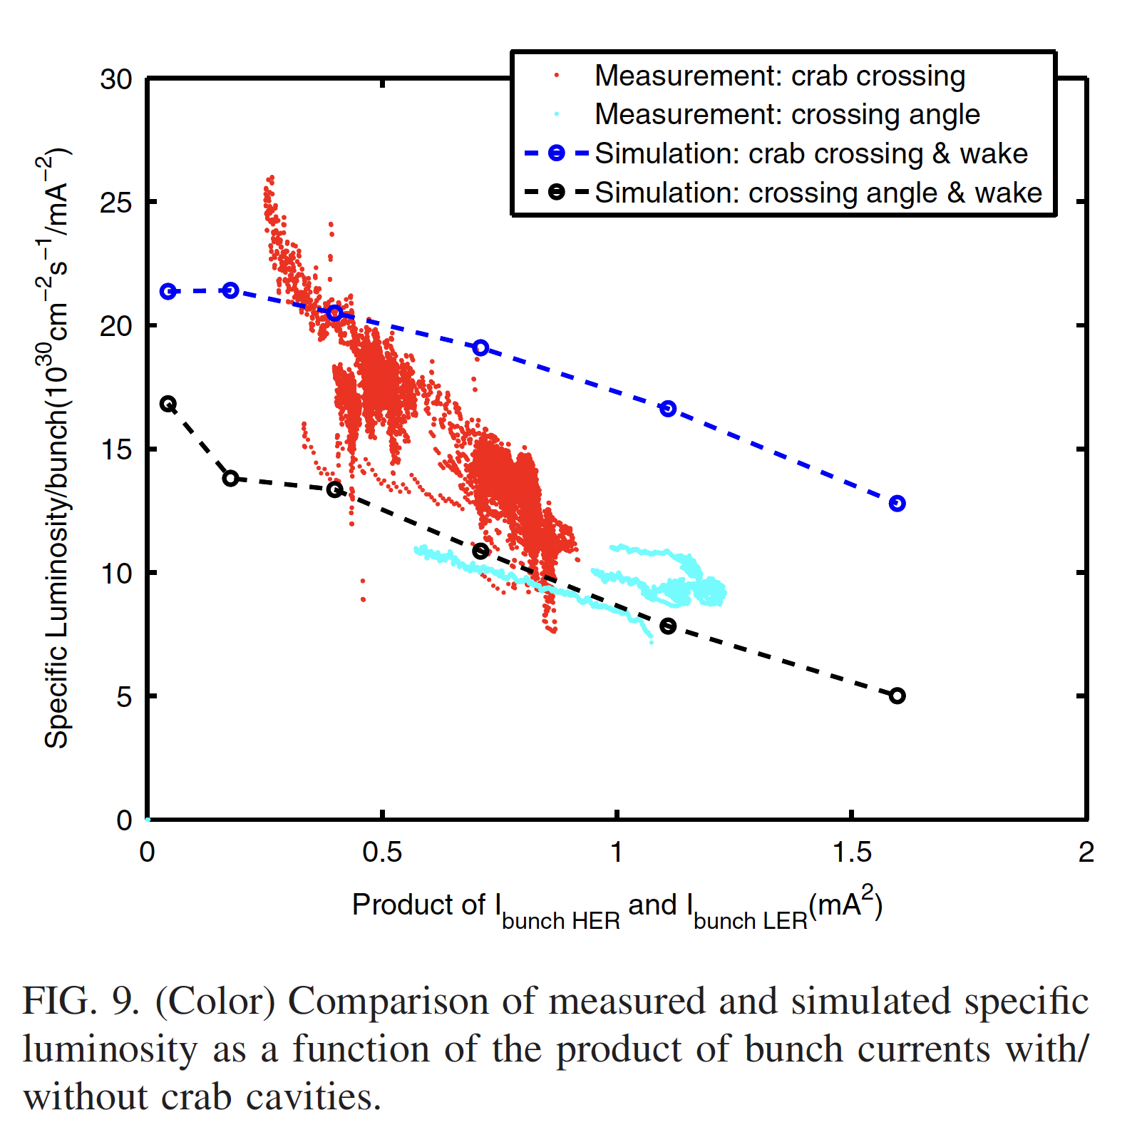
Comparison between Ohmi and Y. Cai’s code (1)
2009 KEKB case
w/ crab cavities
In the Yunhai Cai’s simulation, it was confirmed that the luminosity would be doubled by using the crab cavities which was predicted by Ohmi’s simulation.
No explicit statement is given in this paper. But the simulated specific luminosity by Cai’s simulation was consistent with Ohmi’s simulation.
Before installing the crab cavities, the simulated luminosity was consistent with the experiments.
w/o crab cavities

Slide 30
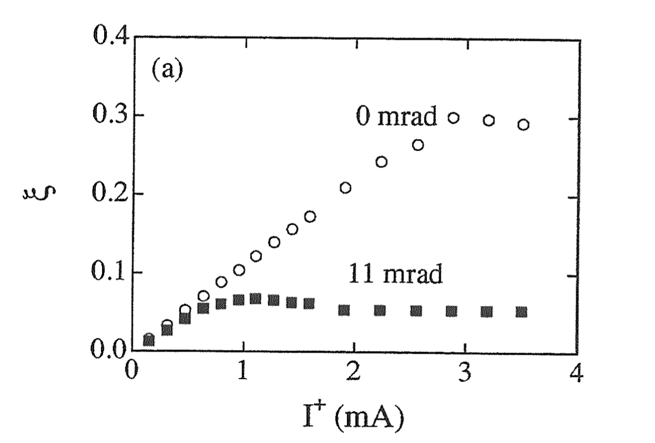
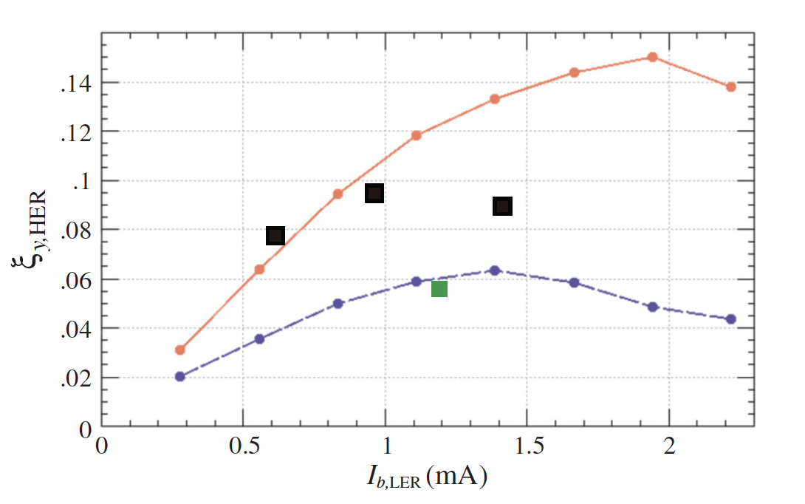
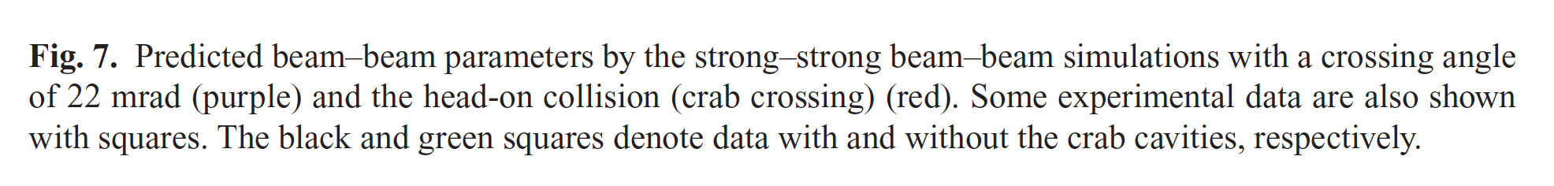
Beam-beam parameters in KEKB
Strong-weak simulation (BBWS) (Ohmi)
Strong-weak simulation (BBSS) (Ohmi)
w/ crab cavities
w/o crab cavities
Before introducing crab cavities, the predicted beam-beam parameter by simulation was actually
achieved in experiment.

Slide 31
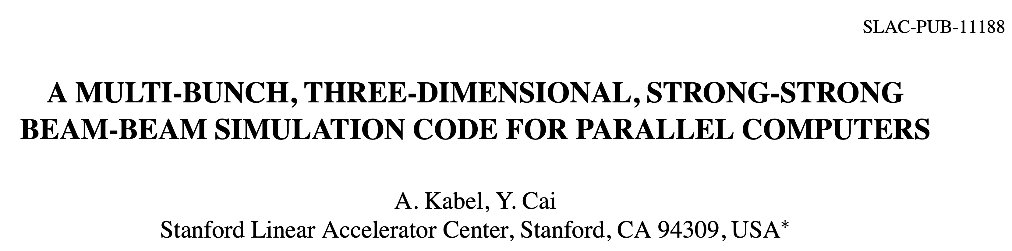
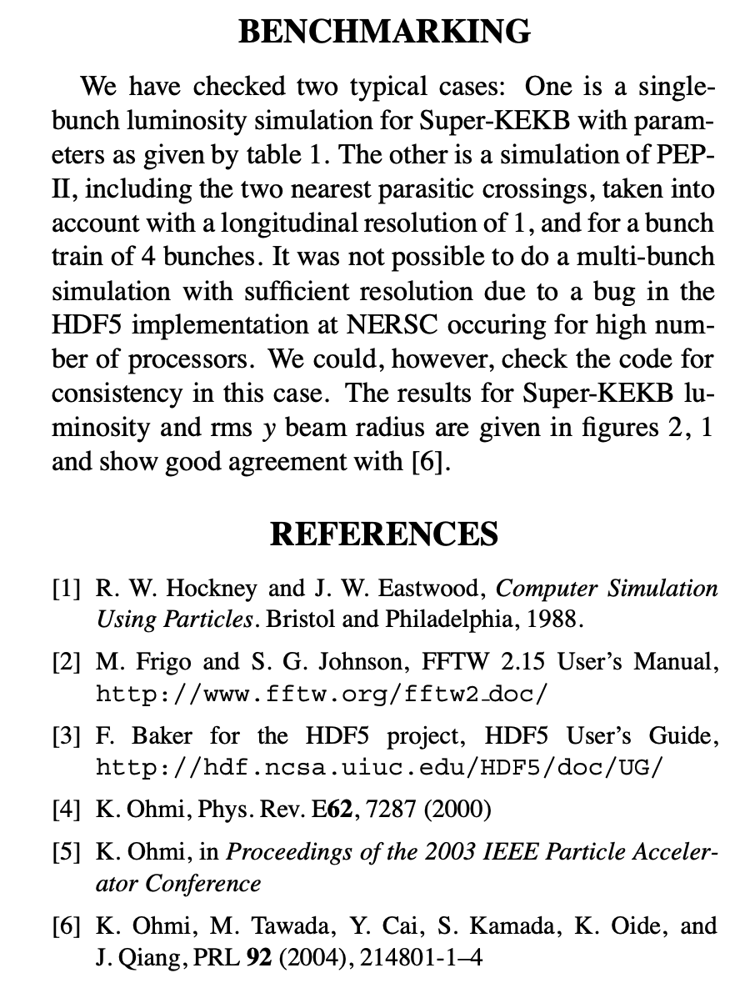
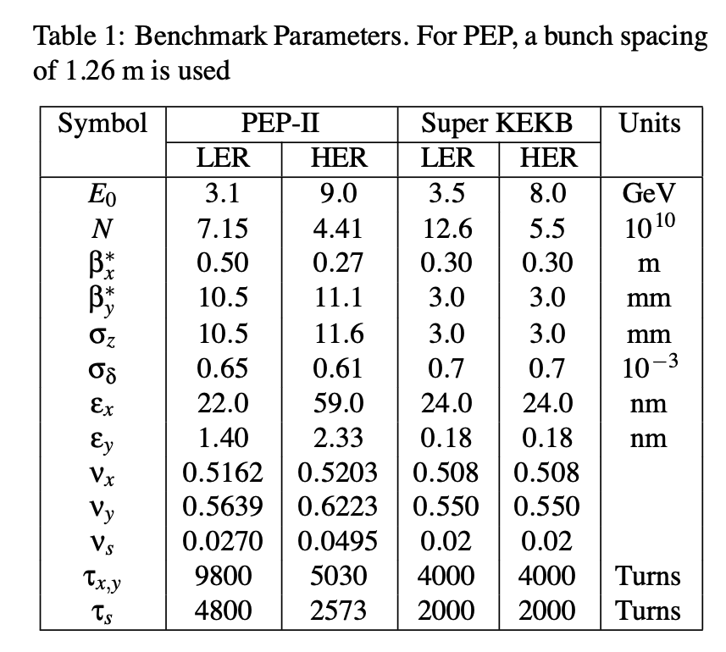
Comparison between Ohmi and Y. Cai’s code (2)
Jul, 2004
Parameters for high beam current
option of SuperKEKB

Slide 32
Message from Ohmi’san
Yunhai Cai has only worked on KEKB and PEPII, so I think he will have a hard time with the large Piwinski angle.
J. Qiang (LBNL) seems to have done some work with the EIC collider. He often compares it with IBB by Y. Zhang (IHEP).
CERN is starting to work on it little by little.
In any case, we cannot use a code that does not reproduce the theoretically clear coherent instability.
The series of work being done with IHEP is theoretically established, so we cannot use the code until we have confirmed that it produces the same phenomenon.
If you want to do a simulation that takes lattices into account, the only option is the GPU code I created, BBSCL (SCTR-bb). Running various things with this takes too much time for the IR, so I would like to simplify it first.

Slide 33
Ohmi-san’s references
K. Ohmi, N. Kuroo, K. Oide, D. Zhou, F. Zimmermann, Phys. Rev. Lett. 119, 134801 (2017).
N. Kuroo, K. Ohmi, K. Oide, D. Zhou, F. Zimmermann, Phys. Rev. Accel. Beams 21, 031002 (2018).
Y. Zhang, N. Wang, C Lin, D. Wang, C. Yu, K. Ohmi, M. Zobov, Phys. Rev. Accel. Beams 23, 104402 (2020).
Y. Zhang, N. Wang, K. Ohmi, D. Zhou, T. Ishibashi, C. Lin, Phys. Rev. Accel. Beams 26, 064401 (2023).
K. Ohmi, Y. Zhang, C. Lin, Phys. Rev. Accel. Beams 26, 111001 (2023).
C. Lin, K. Ohmi, and Y. Zhang, Phys. Rev. Accel. Beams 25, 011001 (2022).
D. Zhou, K. Ohmi, Y. Funakoshi, Y. Ohnishi, Y. Zhang, Phys. Rev. Accel. Beams 26, 071001 (2023).

Slide 34
My opinions
The KEKB beam-beam study team (K. Ohmi and D. Zhou) is one of the front runners in the world accelerator community on the beam-beam issues.
  The beam-beam simulation codes developed at KEK (BBSS, BBWS, SCTR) are considered to be well-established standards that have helped improve other codes (e.g. IBB, APES-T, Xsuite, BeamBeam3D) through benchmarking and collaborative research.
  Pioneering feature
    Strong-strong simulation with full lattice (SCTR and APES-T) and with space charge effects
    Speeding up simulation time by running on GPU
  Discovery of coherent instability
    X-Z instability in a large Piwinski angle collision (FCC-ee, CEPC, SuperKEKB)
    TMCI-like instability
The KEKB beam-beam code (BBSS) has been well benchmarked by other codes.
  Y. Cai’s code, IBB, BeamBeam3D, LIFETRAC…
I think that the beam-beam code at KEK is reliable. But there is large discrepancy between simulations and experiments. In my opinion, the discrepancy is due to some unknown (possibly multiple) physical effects which are not included in the present simulations and it is important to identify such effects.
Collaboration with US and CERN researchers
  We will welcome collaborators from other laboratories.
  I don’t think that mere benchmarking study is fruitful.
  Researchers who will study SuperKEKB problems through persistent, long-term efforts visiting at KEK are particularly helpful.

Slide 35
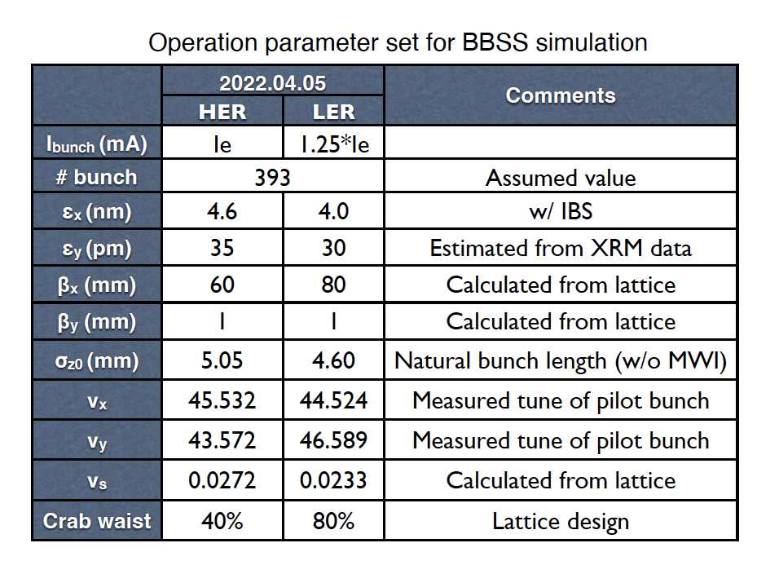
What is the cause of discrepancy btw simulation and experiment?
Observed luminosity performance is much lower than simulations with BBSS (Beam-Beam Strong-Strong). This has been and will be challenges for us.
Candidates of causes
  Machine imperfections: Non-zero coupling and dispersions at IP, beam-current dependent optics distortion due to orbit change at QCS* and SLY*. Unexpectedly large nonlinearity, Imperfect crab waist scheme
  Other effects: Beam-beam + lattice nonlinearity, Beam-beam + impedance, Beam-beam + space charge
  Effects of FB system (noise)
  BBSS simulation with PIC gives ~5% lower values than simulation with Gaussian fitting model at _{Ib+}I_{b-} = 0.8mA² (D, Zhou).
  Belle II – accelerator mis-alignment? (K. Oide)
Strong-strong simulation
(CW: LER:80%, HER:40%)
Nb = 393, April 5th 2022

Slide 36
Luminosity tuning (compensation of machine errors)
Machine tuning routinely done even during physics run on machine parameters. In spite of those efforts, the achieved specific luminosity
is very low compared with simulation so far.
Tuning parameters | Observables | Typical frequency
Beam offset at IP (orbit feedback) | beam-beam kick (BPMs) | FB 32kHz
Target of orbit feedback at IP (offset) | vertical size at SRM, luminosity | ∼1/2 day
Global closed orbit | BPMs | ∼ 20 s
Betatron tunes | tunes of non-colliding bunches | FB ∼ 20 s
Relative RF phase | center of gravity of the vertex | ∼ 10 min
Global coupling, dispersion, beta-beat | orbit response to kicks, RF freq. | ∼ 14 days
Vertical waist position | vertical size at SRM, luminosity | ∼ 14 days
x-y coupling and dispersion at IP | vertical size at SRM, luminosity | ∼ 1/2 day
Chromaticity of x-y coupling at IP | vertical size at SRM, luminosity | ∼ 14 days
Very important for luminosity

Slide 37
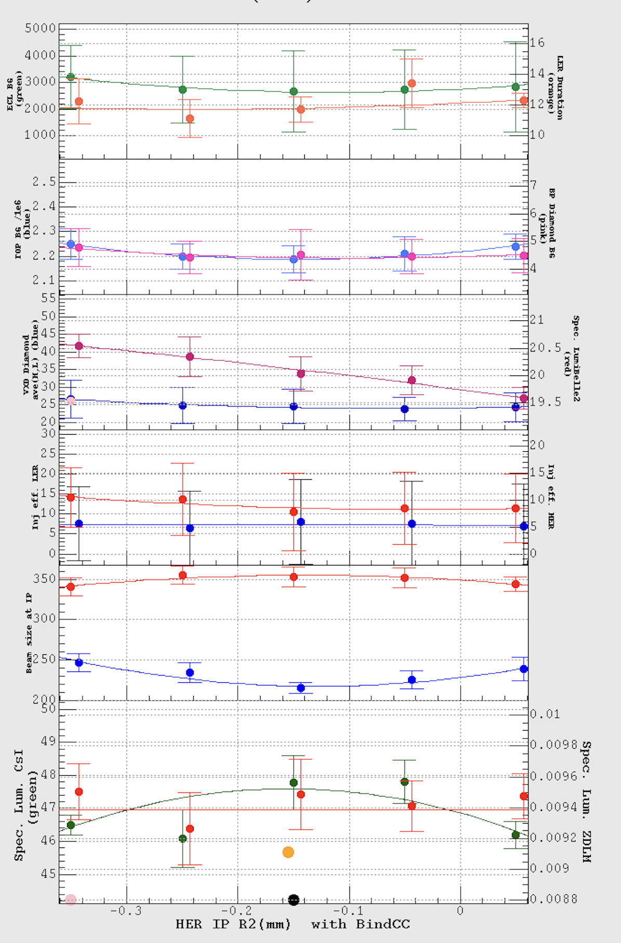
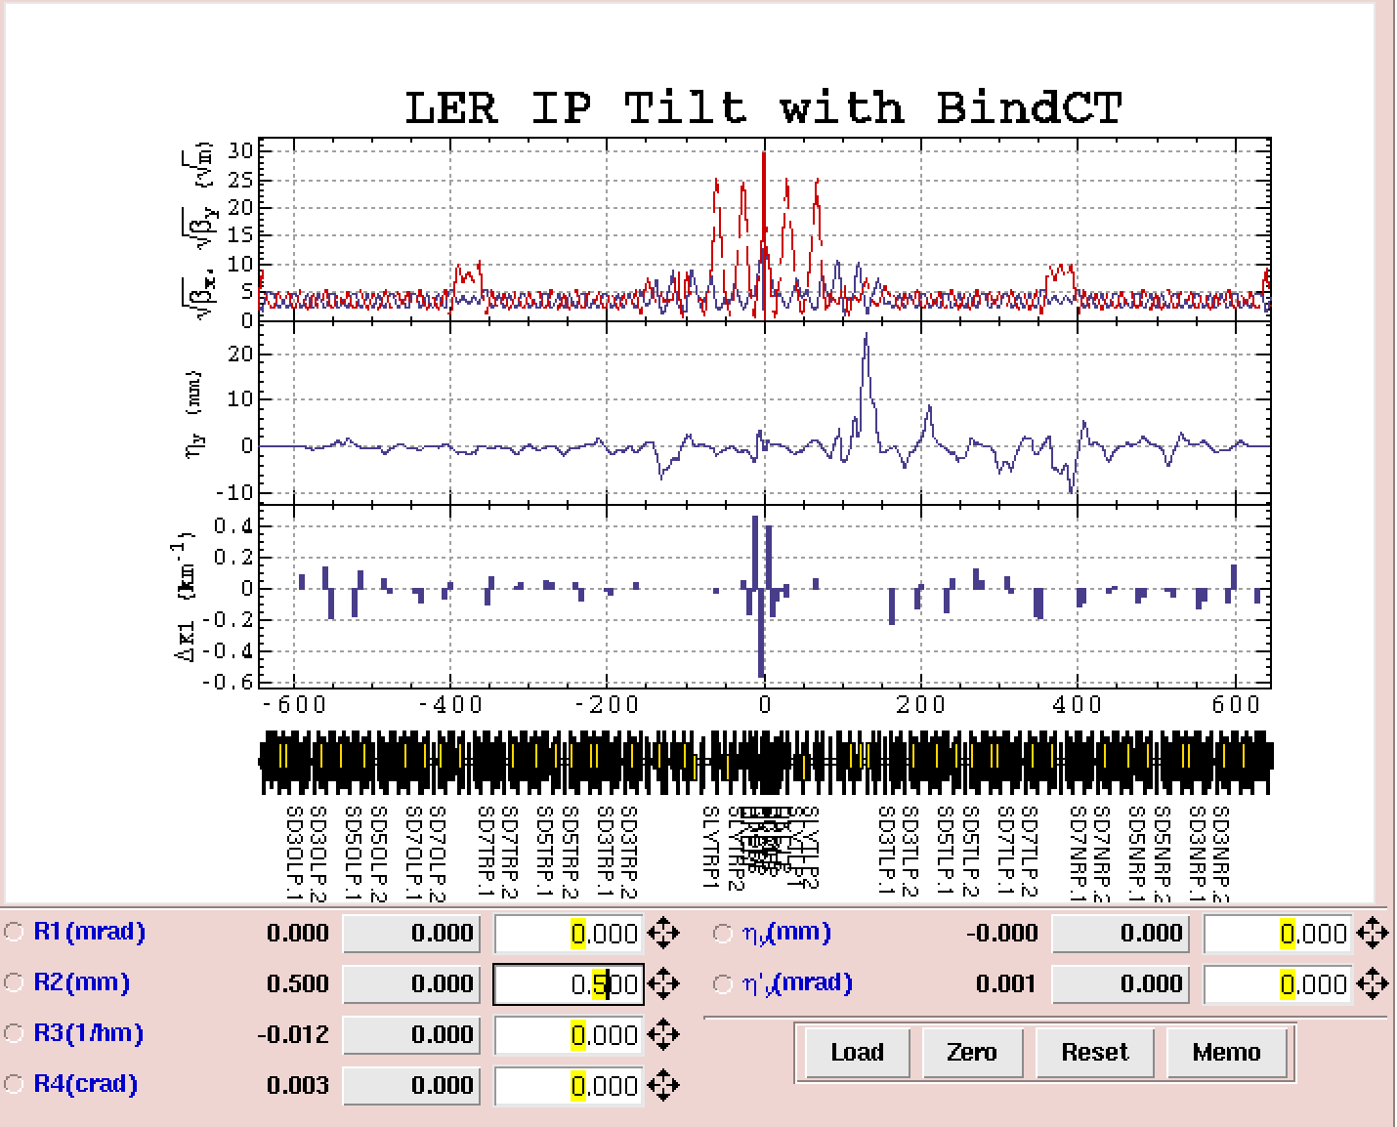
Tuning knob on X-Y coupling at IP

Slide 38
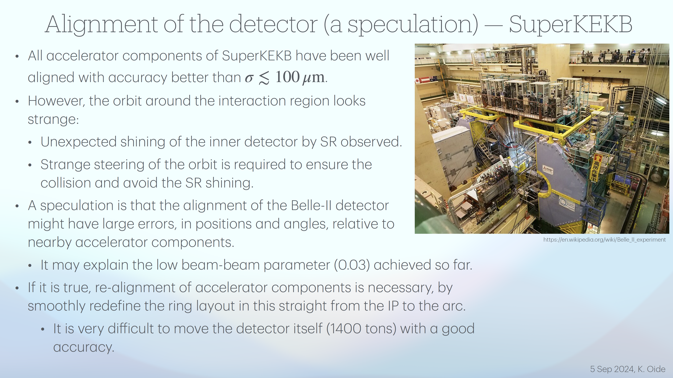
K. Oide @ BB24 workshop
Some simulations by Koiso-san are underway.

Slide 39
Beam-Beam study group
Beam-beam study group was established in July 2024 in SuperKEKB accelerator group.
Motivations
  D. Zhou (beam-beam expert) has left from SuperKEKB and Ohmi-san (beam-beam expert) is now in China. And so we had to create a group to study beam-beam related issues.
Member
  K. Ohmi, Y. Yamamoto (new comer), Y. Ohnishi, H. Sugimoto, S. Uno, Y. Funakoshi
Task list
  Simulations
    Tune survey on injection efficiency (Strong-Weak: BBWS+SAD): ongoing (urgent)
    Bunch current dependence of specific luminosity with βy* = 0.9mm (Strong-Strong: BBSS) just started
    Tune survey with BBSS code with Wx,y,z wake (impedance). Just started.
    Strong-Strong simulations with machine errors
    (Study on machine errors)
    Strong-strong simulations with full SAD lattice (SCTR)
  Beam study
    Effect of bunch-by-bunch FB
    Study on machine errors
      Amplitude dependent tune shift
      Skew-sextupole at QC1

Slide 40
Fin.
Thank you for your attention.
Inter-University Research Institute Corporation High Energy Accelerator Research Organization (KEK)
大学共同利用機関法人 高エネルギー加速器研究機構 (KEK)

Slide 41
Spare slides

Slide 42
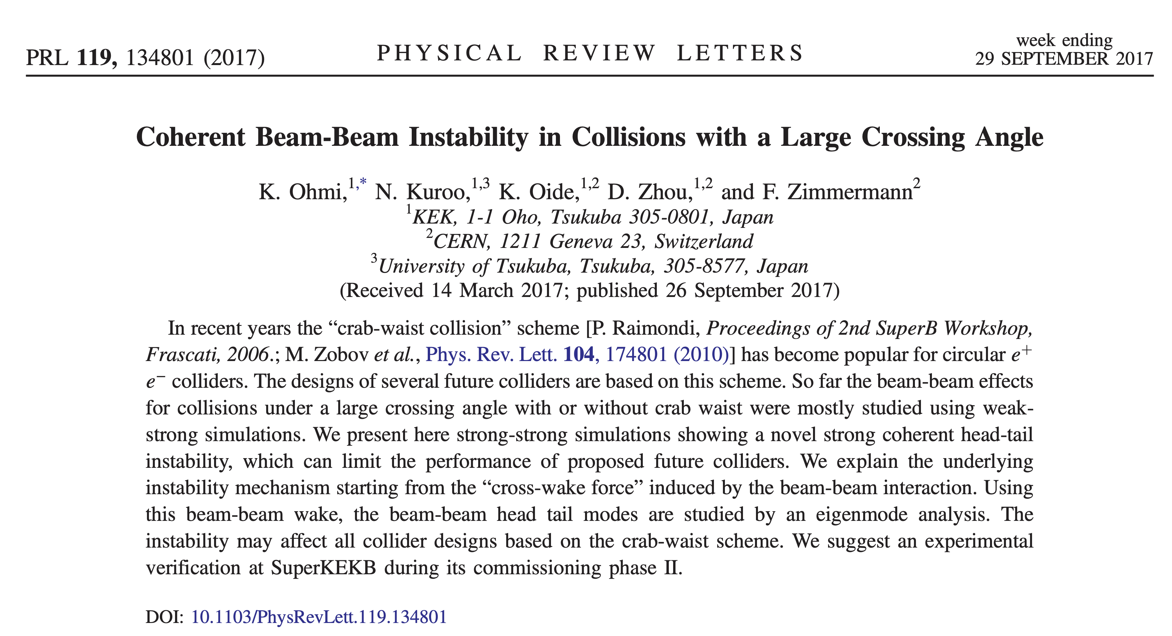

Slide 43
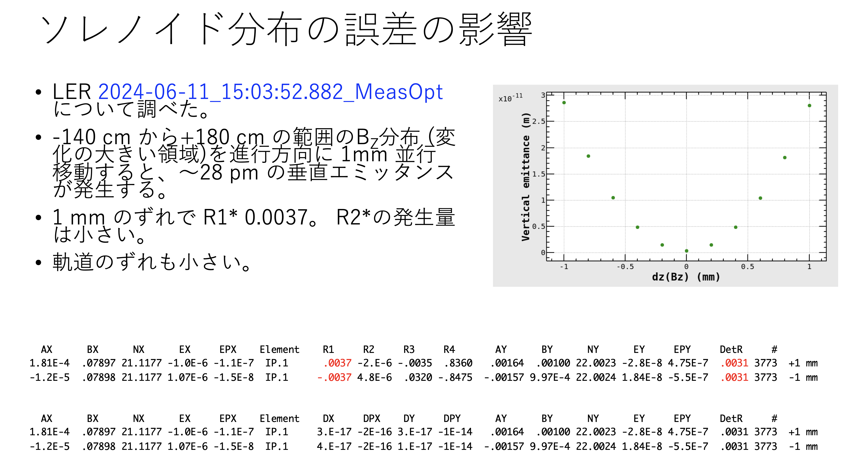
H. Koiso

Slide 44
Beam injection

Slide 45
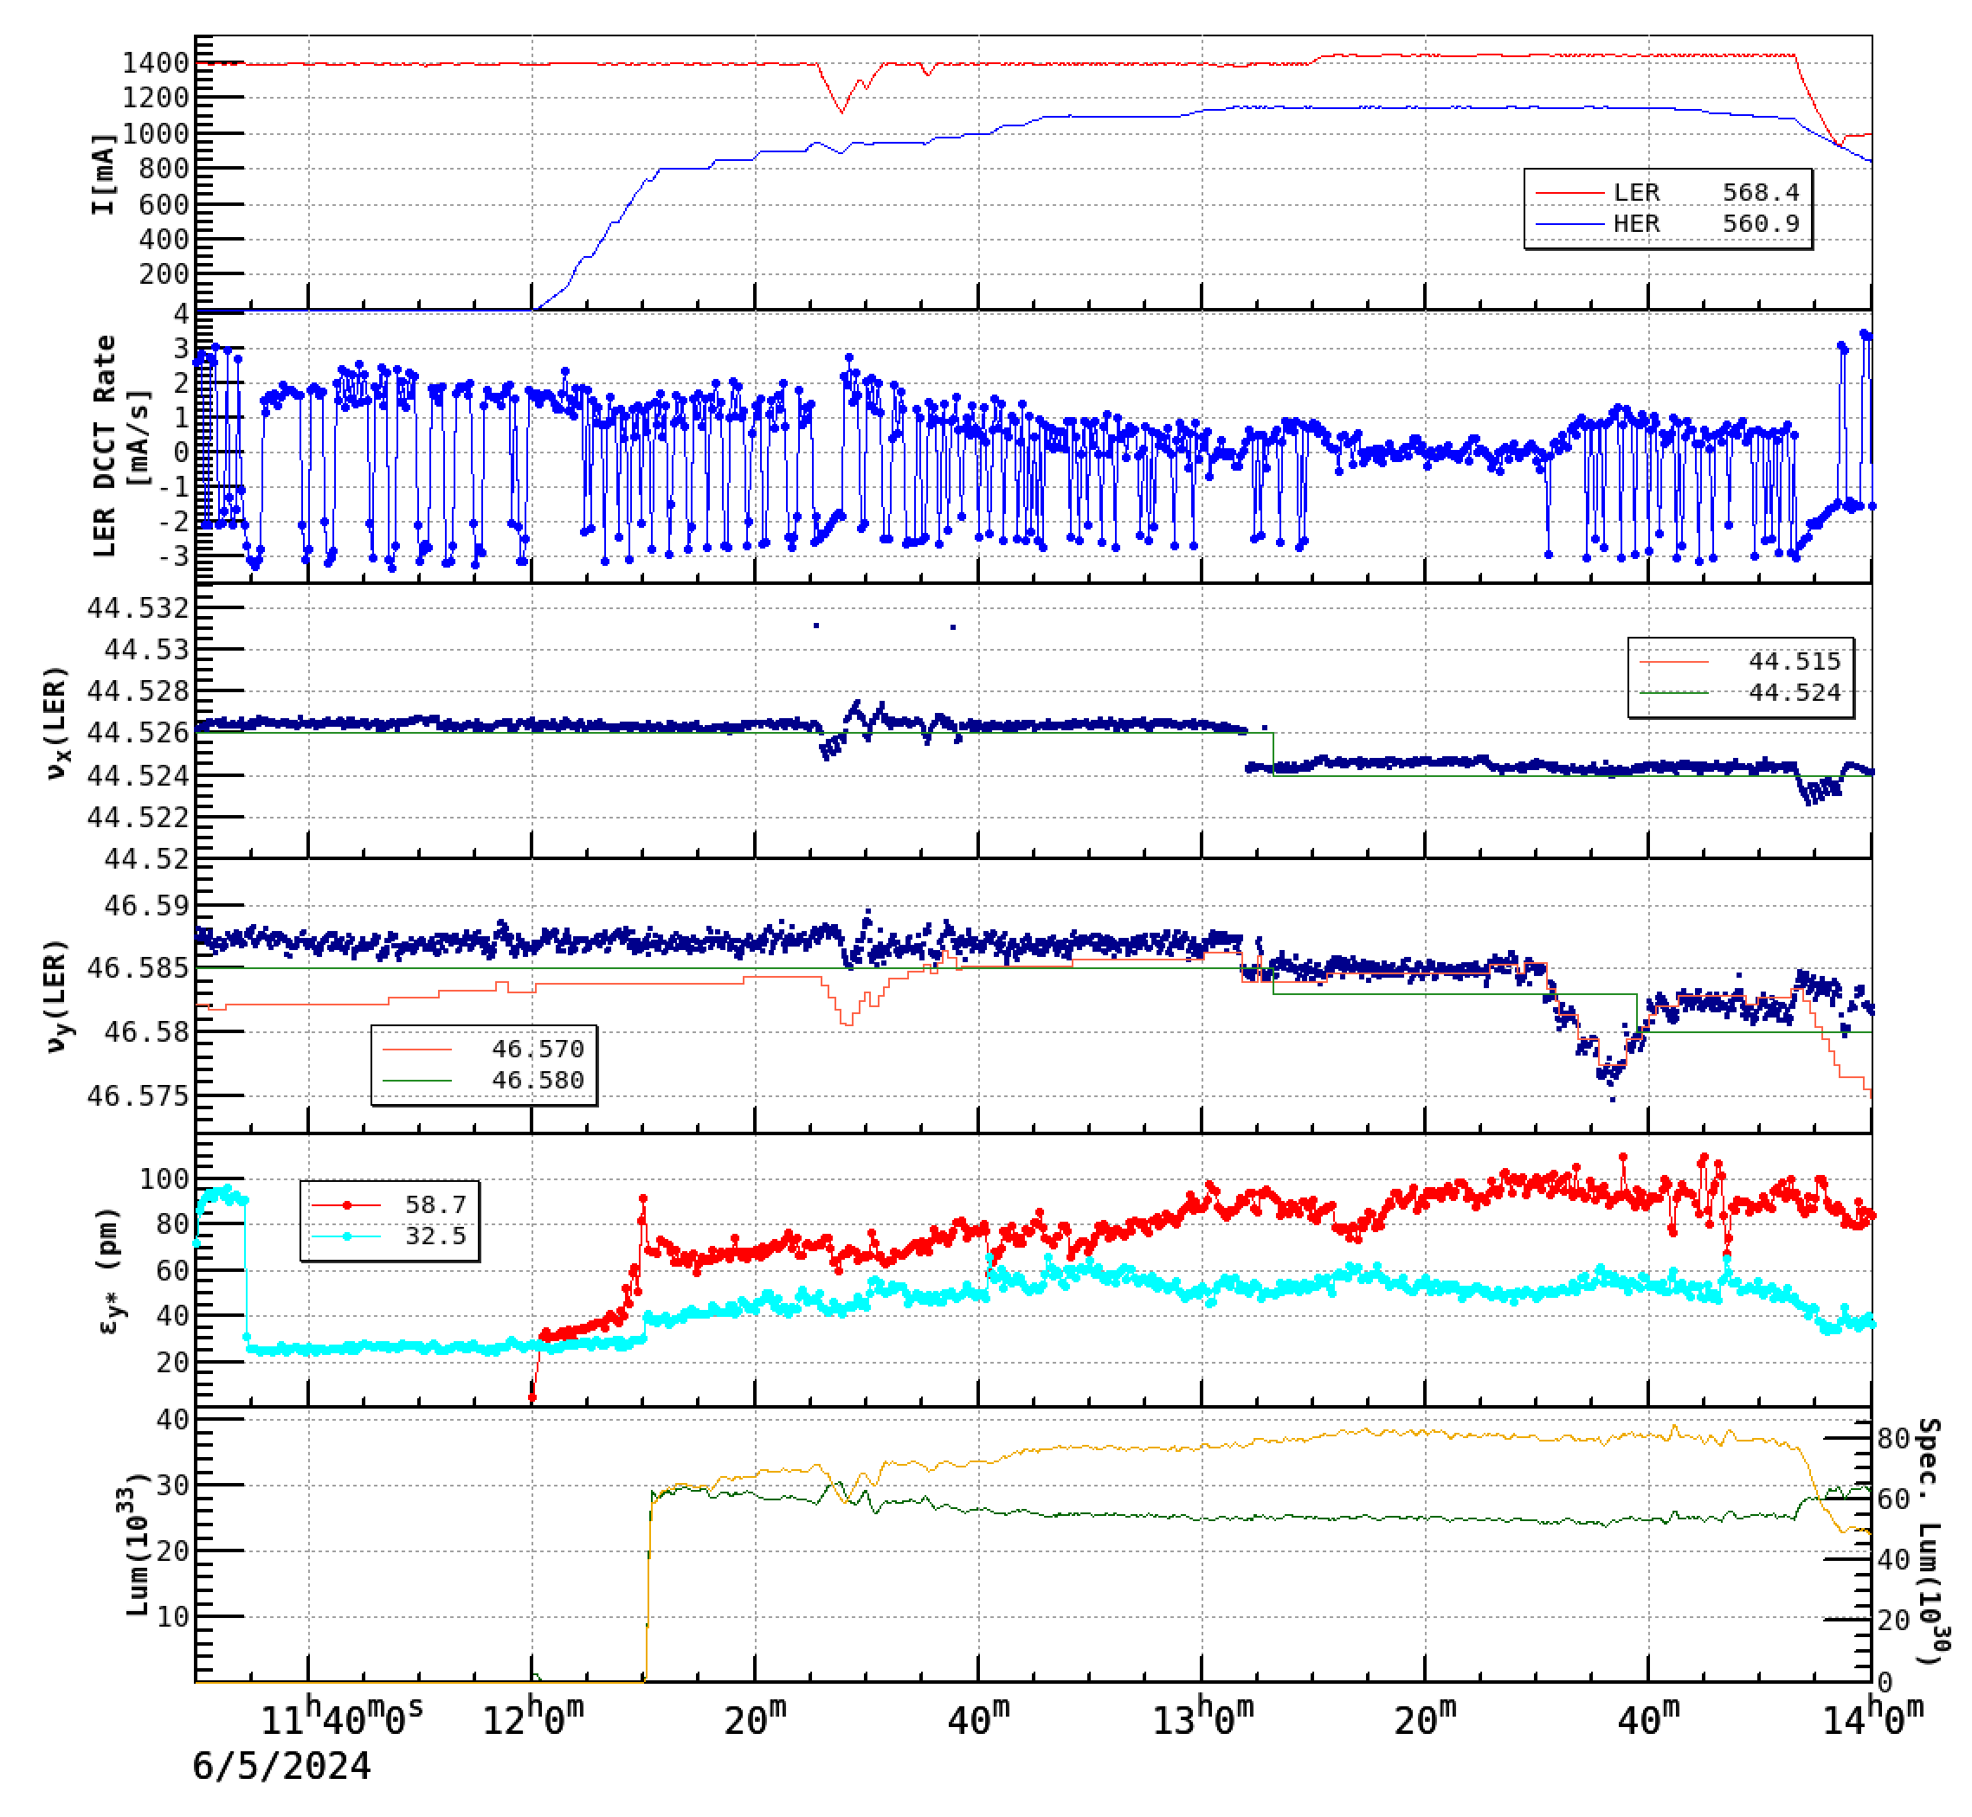
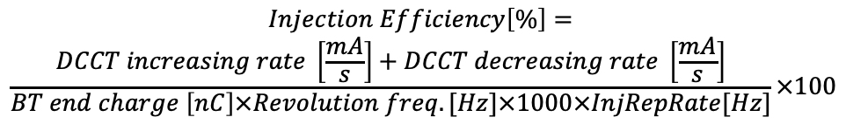
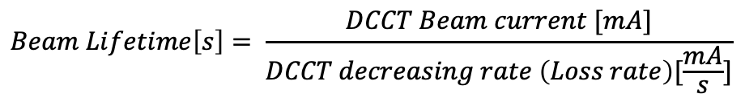
Experiment on beam injection of LER
(June 5th 2024)
w/ beam-beam
Beam lifetime increases w/ beam-beam blowup.
Injection efficiency get worse seriously
→ By optimizing working points, the injection
efficiency is improved.
Nb =2346
(1)
(2)
(3)
 | Ibeam (LER) | Ibeam (HER) | IncRate (L) | Life (L) | InjEff (L)
(1) | 1395 mA | 0 mA | 1.68mA/s | 7.3 min. | 77.4%
(2) | 1395mA | 1100mA | 0.42mA/s | 8.9 min. | 48.0%
(3) | 1444mA | 1100mA | 1.02mA/s | 8.0 min. | 64.8%
$$Beam Lifetime\left[s\right]= \frac{DCCT Beam current [mA]}{DCCT decreasing rate \left(Loss rate\right)[\frac{mA}{s}]}$$
$$Injection Efficiency\left[\%\right]=$$
$$\frac{DCCT increasing rate \left[\frac{mA}{s}\right]+DCCT decreasing rate \left[\frac{mA}{s}\right]}{BT end charge \left[nC\right]×Revolution freq. [Hz]×1000×InjRepRate[Hz]}×100$$

Slide 46
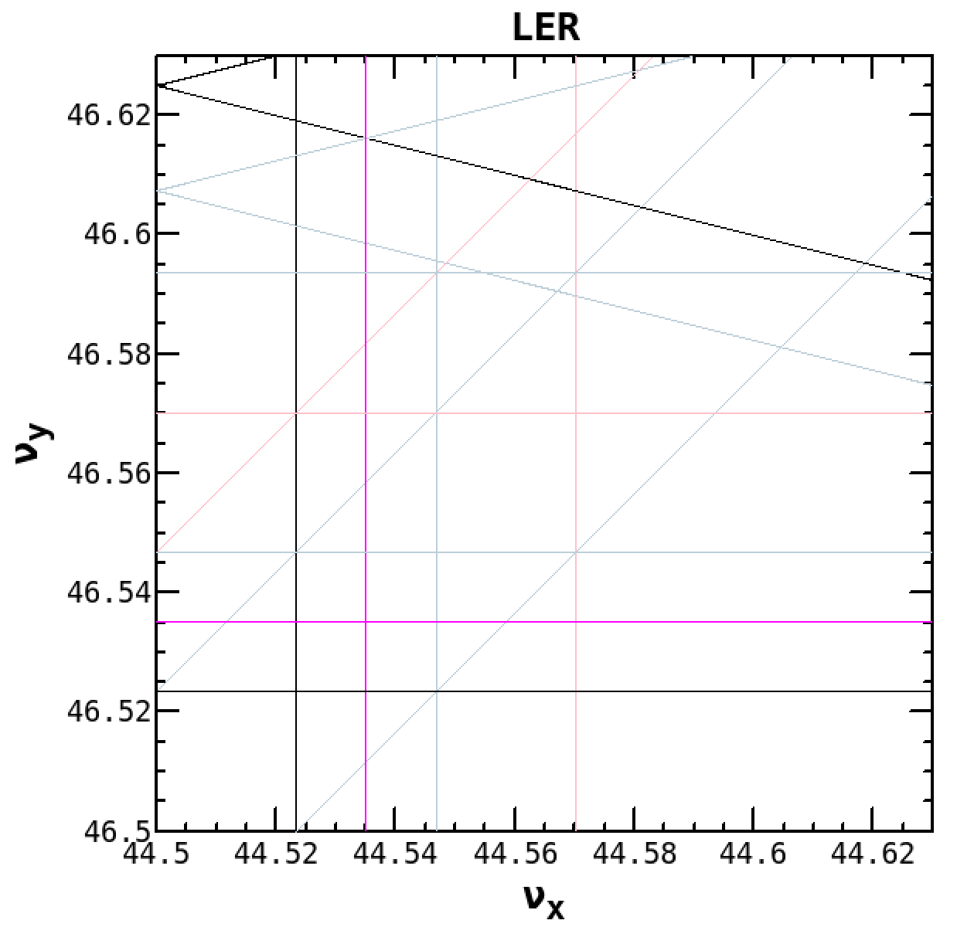
Summary of beam injection
Injection scheme of SuperKEKB
  Usual betatron (horizontal) injection with stacking mode
  With crab waist, the beam injection was improved.
Even with crab waist LER injection efficiency was decreased by ~30%
with beam-beam effects.
  At the present SuperKEKB, the beam injection limits the storable beam
  currents and then luminosity.
  The maximum LER beam current (and luminosity) is limited by the beam injection.
By changing working point, the injection efficiency was
recovered by ~ 15%.
With this change in tunes, the beam sizes and luminosity did not
change so much. The beam lifetime did not change
so much either.
A simulation on the injection w/ beam-beam is going on.
  Strong-weak with SAD lattice
    tune survey, w/ impedance
In the next run, several measures for better
injection will be taken.
  Reduce horizontal injection oscillation amplitude by increasing
  βx at injection point (~100m -> 160m)
  Reduce βx* at the IP (80mm -> 60mm: LER)
  Try synchrotron injection in HER
(.5265,.587)
(.524,.580)

Slide 47
Effect of bunch-by-bunch feedback system

Slide 48
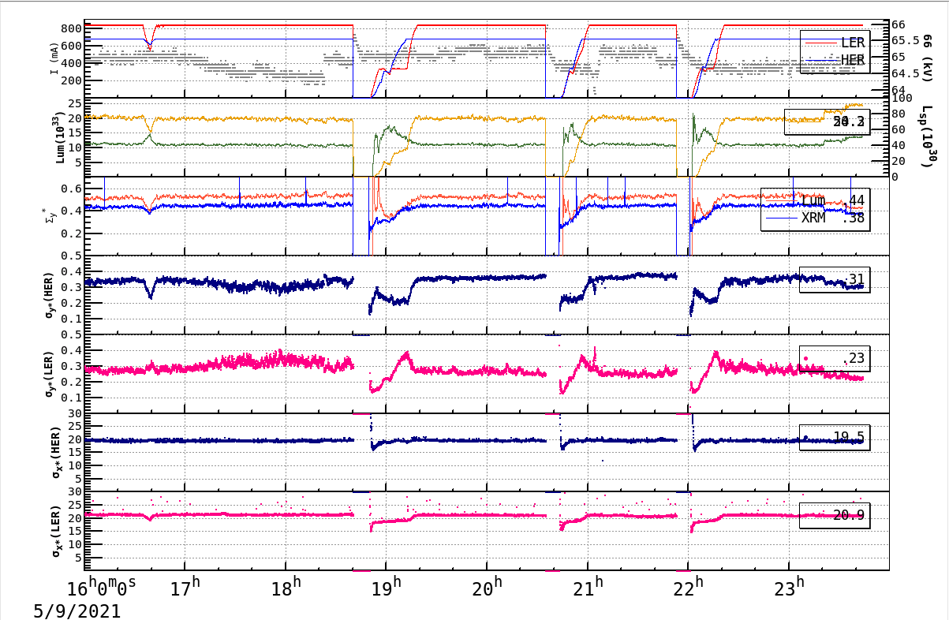
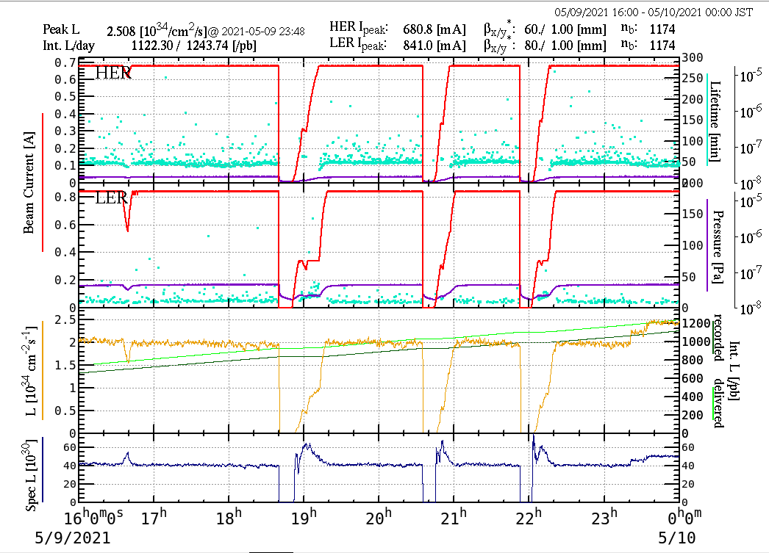
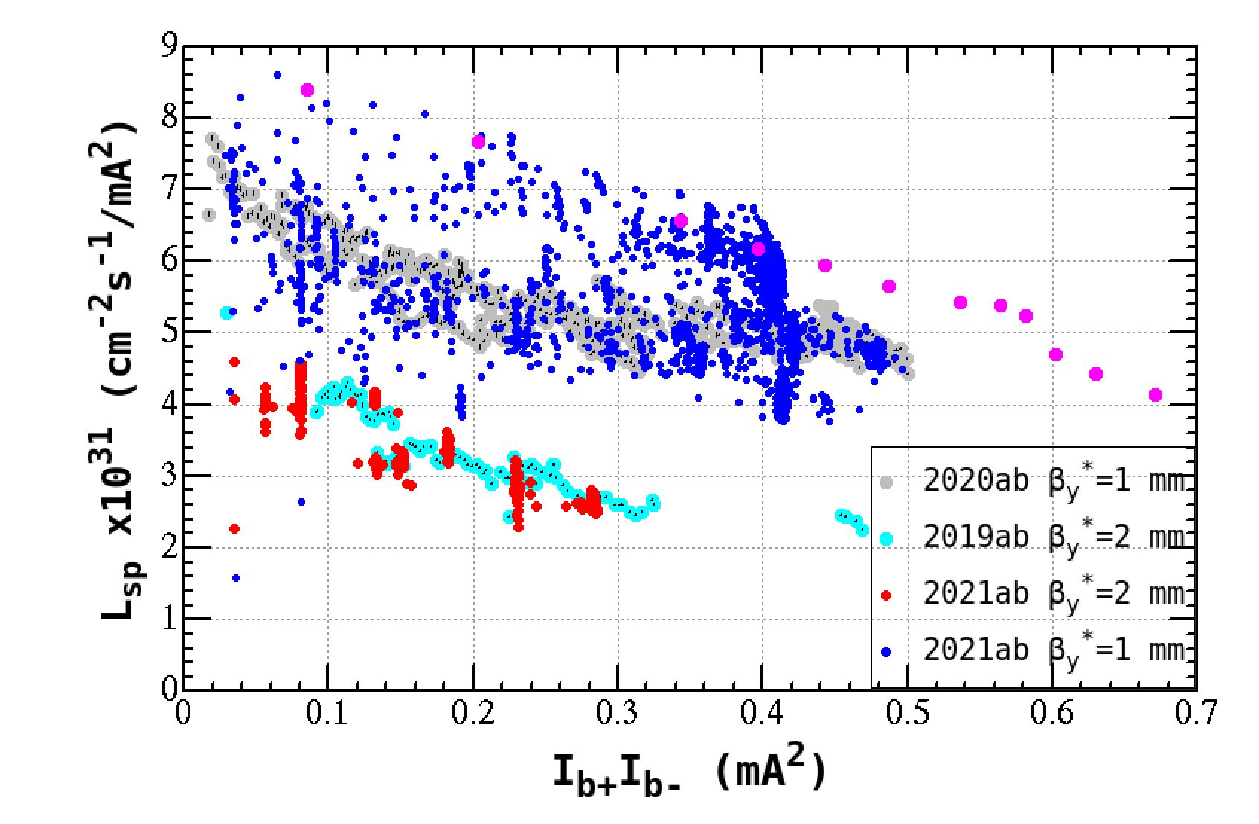
Bunch-by-bunch feedback gain
In May 2021, the luminosity increased by lowering gain of the bunch-by-bunch feedback system in HER.
Noise mixed in FB system seemed to affect the luminosity.
  The noise was caused by a troubled module. Since the noise frequency was near the betatron tune, its effect was large.
HER beam current
σy* HER
Beam sizes
σy* LER
LER beam current
Luminosity
Specific luminosity
The luminosity increased by lowering HER vertical FB gain by 4dB + 4dB.
The increase in the luminosity was ~25%.

Slide 49
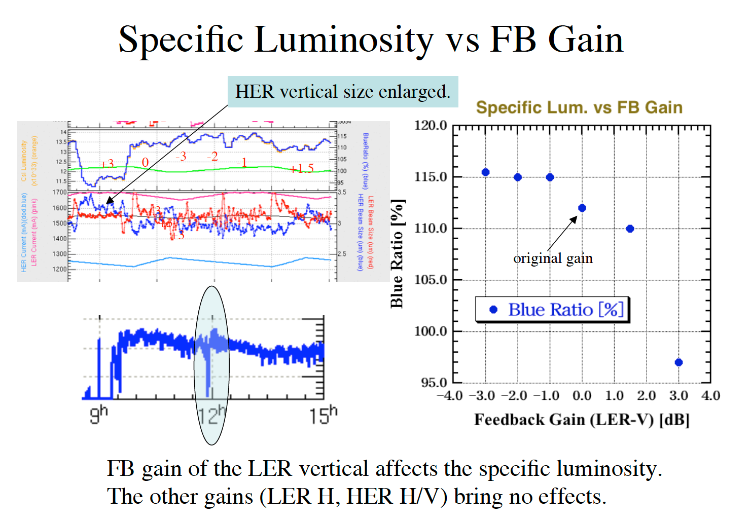
KEKB case

Slide 50
Summary of effects of FB system
In some situation, the luminosity is increased by reducing the gain of the bunch-by-bunch feedback (FB).
With FB off, the specific luminosity was increased by ~20 % at the bunch current product of ~ 1 mA² once.
  In the next run, we will try to confirm this effect.

Slide 51
Tune survey

Slide 52
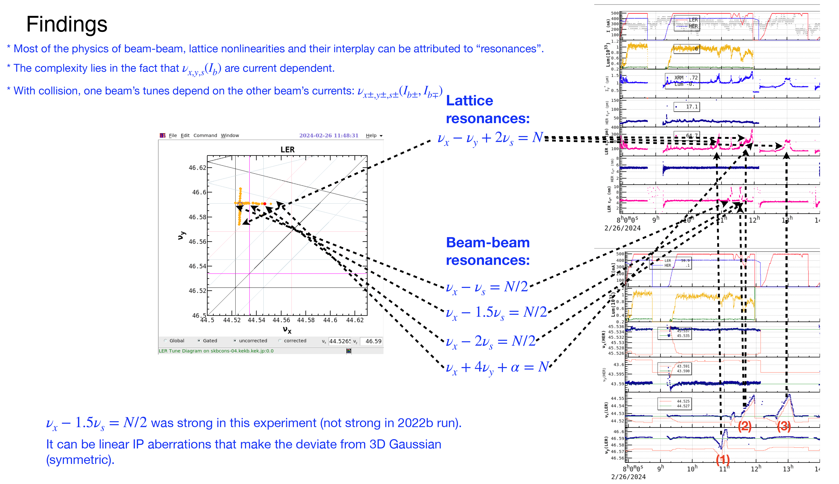
Resonance lines
D. Zhou

Slide 53
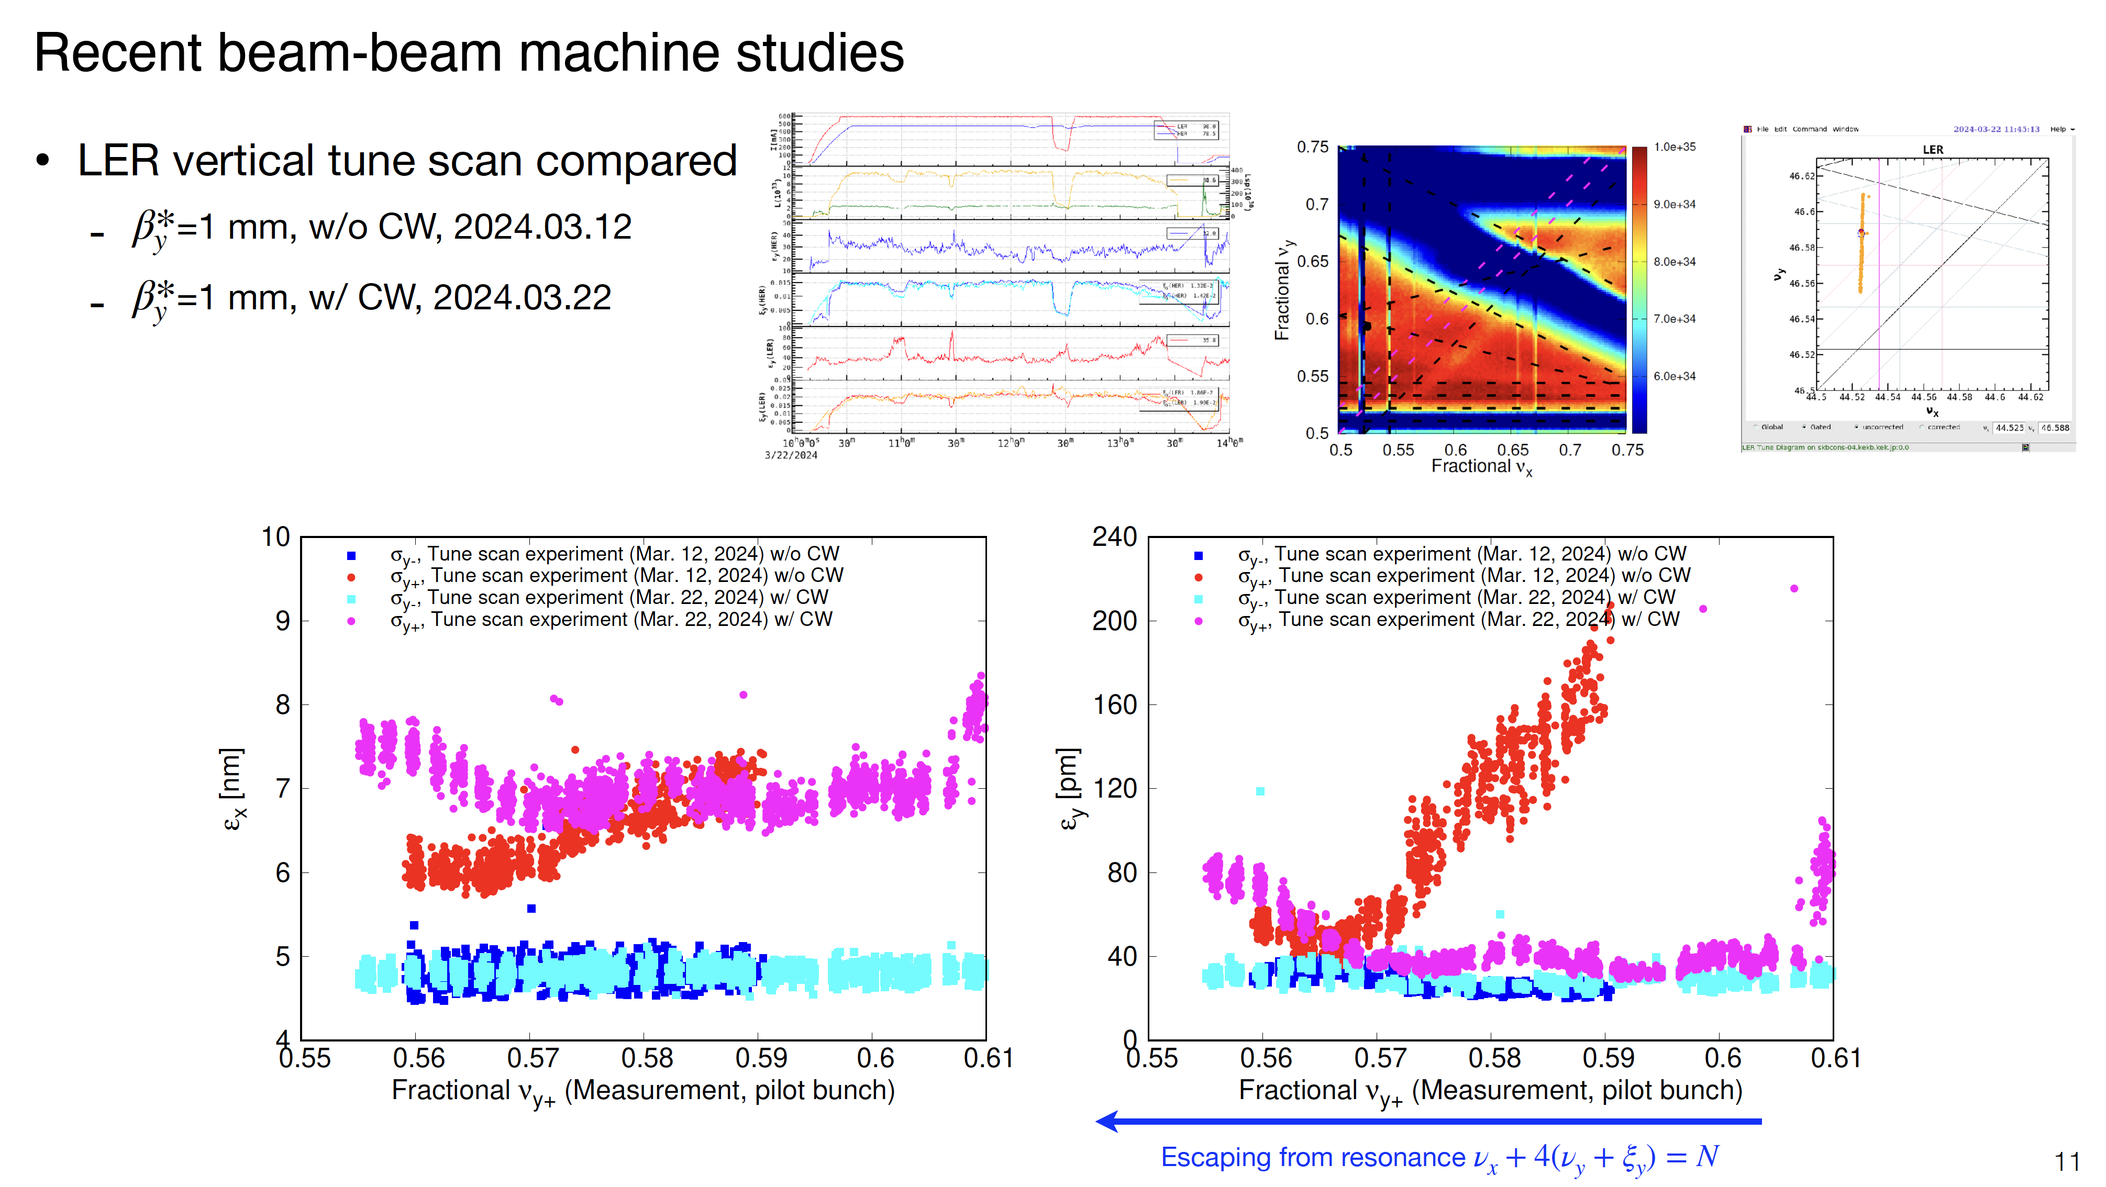
LER vertical tune survey
Date | by* | single/collision | CW | nx/ny | Ibeam (LER) | Ibeam (HER) | Nb | Ibunch(LER) | Ibunch(HER) | xiy(LER)
2024.02.26 | 8 mm | single | off | nx | 500 |  | 1535 | 0.319
 |  | collision | off | nx | 500 | 410 | 1565 | 0.319 | 0.256 | 0.018
2024.03.12 | 1mm | single | off | nx | 400 |  | 1565 | 0.256
 |  | collision | off | ny | 200 | 160 | 393 | 0.509 | 0.407 | 0.023
2024.03.22 | 1mm | collision | on | nx/ny | 600 | 480 | 2346 | 0.256 | 0.205 | 0.023
Horizontal emittance growth is observed
in LER.
Crab waist (CW) seems to kill the (νx + 4νy+ α=N) resonance.
εx
εy
CW off by*=1mm,
I_{bunch}LER = 0.51mA
CW on by*=1mm,
I_{bunch}LER = 0.26mA
HER
D. Zhou

Slide 54


Vertical tune scan in LER on May 22nd 2024

Slide 55

LER Horizontal tune survey
The working point νx+-44.548 seems worse than νx+=44.525 due to vertical blowup.
w/o CW, βy*=8mm,Ib(LER)=0.32mA
w/ CW, βy*=1mm,Ib(LER)=0.26mA
εy+
εx+
single, βy*=8mm,
Ib(LER)=0.32mA
single, βy*=1mm,
Ib(LER)=0.51mA
D. Zhou

Slide 56
Summary of tune survey
Crab waist (CW) seems to kill the (νx + 4νy+ α=N) resonance as is expected.
The working point νx+-44.548 seems worse than νx+=44.525 due to vertical blowup, although simulation showed νx+-44.548 is good to suppress the horizontal blowup,
  We need to try again after chromatic coupling correction.
The present working points of (ν_{x},ν_{y}) = (.523, .580) (LER) and (.531, .575)(HER) at the end of 2024b run are near to the design value of (ν_{x},ν_{y}) = (.530, .570) .
To search for better working points for LER, which give a higher luminosity, a relatively wide-range (horizontal and vertical) tune survey was done. However, a better working point was not found so far.
At the present SuperKEKB, one of the most serious problem is that the total beam current of LER (and HER) (and the luminosity) is limited by the balance between beam injection and beam lifetime. Beam-beam effects affect beam injection efficiency and their effects depend on betatron tune. We need more tune survey in both simulations and experiment.

Slide 57

Crab waist sextupoles
LER: Crab waist ratio = 80%

Slide 58


Slide 59


Slide 60


Slide 61


Slide 62


Slide 63


Slide 64

Inverse of beam lifetime as function averaged vacuum pressure
Loss due to
Touschek lifetime
13.9 min.

Slide 65


Beam lifetime as function of total beam current with keeping the bunch current
Beam lifetime decreased with larger vertical emittance.
Emittance was changed by using YaECK.

Slide 66


Beam sizes (single beam) on June 27th 2024
2024 June 27th βy* = 0.9mm
The single beam blowup must be suppressed for a higher luminosity.

Slide 67

Comparison of LER single beam emittance (before and after LS1)
2024 June 27th βy* = 0.9mm

Slide 68



Beam-Beam Study

Slide 69

Collision with 393 bunches May 22nd 2024

Slide 70

Specific luminosity at KEKB

Slide 71
Machine performance of SuperKEKB
IPAC2020
IPAC2022
 | KEKB achieved |  | SuperKEKB 2020 May 1st |  | SuperKEKB 2022 June 8th |  | SuperKEKB design
 | LER | HER | LER | HER | LER | HER | LER | HER
I_{beam} [A] | 1.637 | 1.188 | 0.438 | 0.517 | 1.321 | 1.099 | 3.6 | 2.6
# of bunches | 1585 |  | 783 |  | 2249 |  | 2500
I_{bunch} [mA] | 1.033 | 0.7495 | 0.5593 | 0.6603 | 0.5873 | 0.4887 | 1.440 | 1.040
βy* [mm] | 5.9 | 5.9 | 1.0 | 1.0 | 1.0 | 1.0 | 0.27 | 0.30
ξy | 0.129 | 0.090 | 0.0236 | 0.0219 | 0.0407 (0.0565)ª | 0.0279 (0.0434)ª | 0.0881 | 0.0807
Luminosity [10³⁴cm⁻²s⁻¹] | 2.11 |  | 1.57 |  | 4.65 |  | 80
Integrated Luminosity [ab⁻¹] | 1.04 |  | 0.03 |  | 0.40 |  | 50
doubled
a) High bunch current collision study
Beam operation after Long Shutdown 1 (LS1) (2024 Feb. ~ June), we couldn’t make a new luminosity record.

Slide 72

Beam-beam parameter with βy*=3 mm
ξy(L) = 0.027
ξy(H) = 0.021
Vertical beam-beam parameter (ξ_{y}) of HER
is saturated around 0.03.
I_{bunch}L = 0.222mA
I_{bunch}H = 0.162mA

Slide 73
List for future investigation
Experiment
  Confirmation of beam-beam performance w/ FB off.
  Tune scan with chromatic coupling correction and with higher bunch current product
  Tune survey from view points of be injection efficiency
  Nonlinear optics corrections
Simulations
  Simulation on beam injection with beam-beam interaction (tune survey).
  Beam-beam simulation with full lattices
  More beam-beam simulation with impedance
  Beam-beam simulation with space charge
Parameter optimization
  Squeeze βx* of LER (80 mm -> 60 mm) is to be done in the next run for better injection and for suppression of horizontal beam blowup (this will also reduce ΔK₂ for SLY (CW SX).

