Slide 1
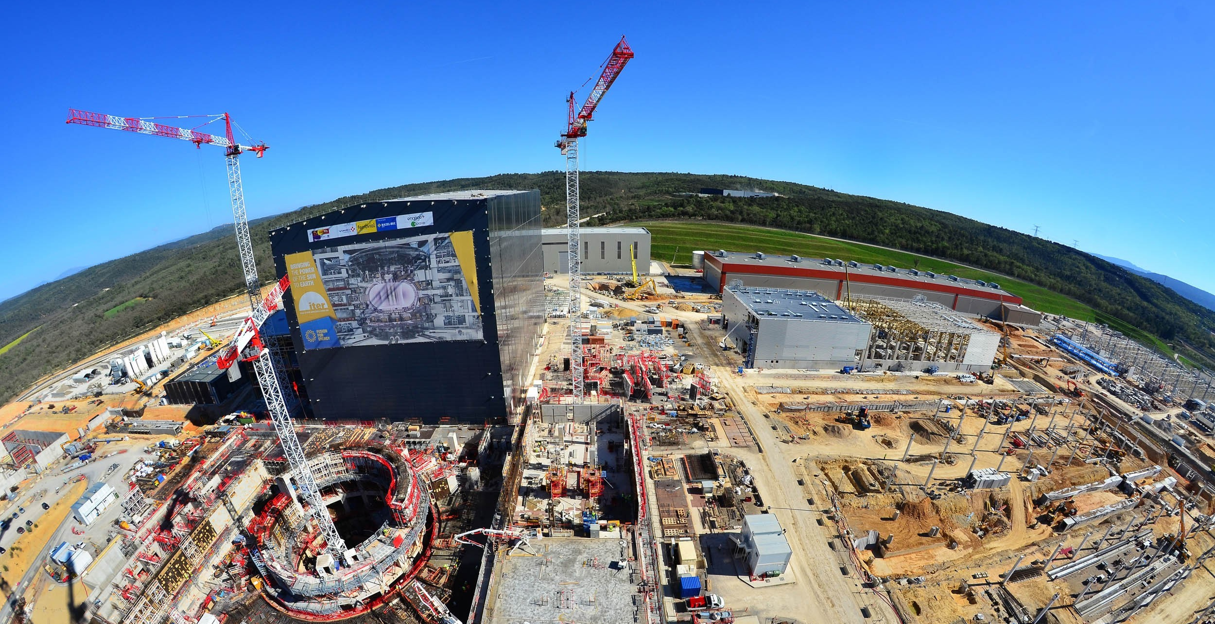
ITER and its Control System –
Status and Perspectives
Ralph Lange
Control System Division
ITER Organization
Disclaimer: The views and opinions expressed herein do not necessarily reflect those of the ITER Organization.

Slide 2
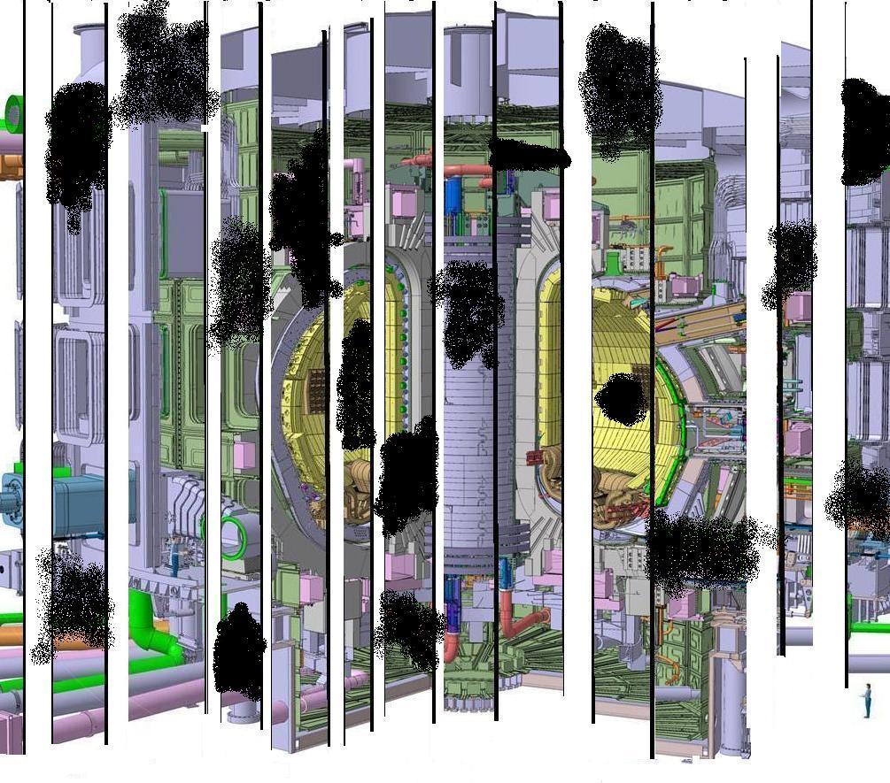
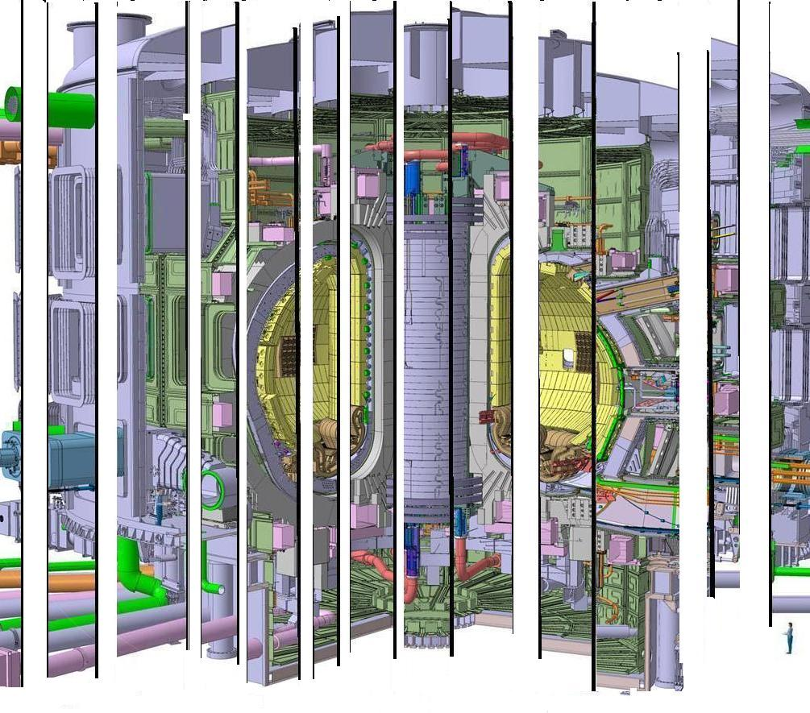
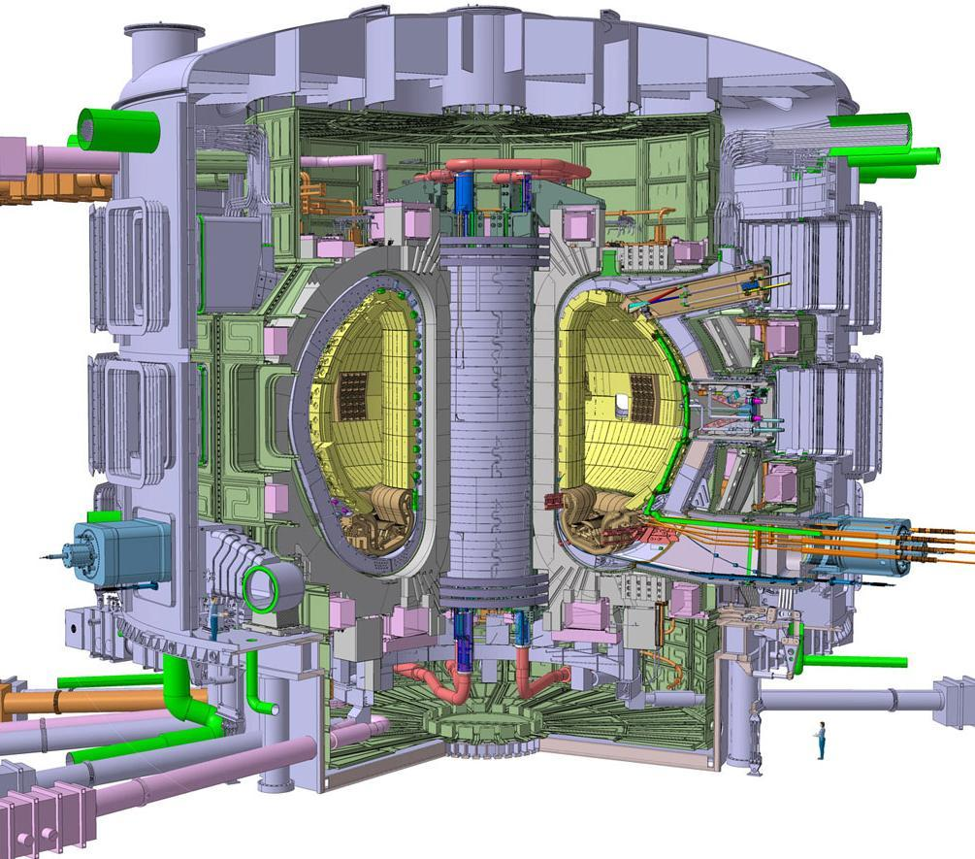
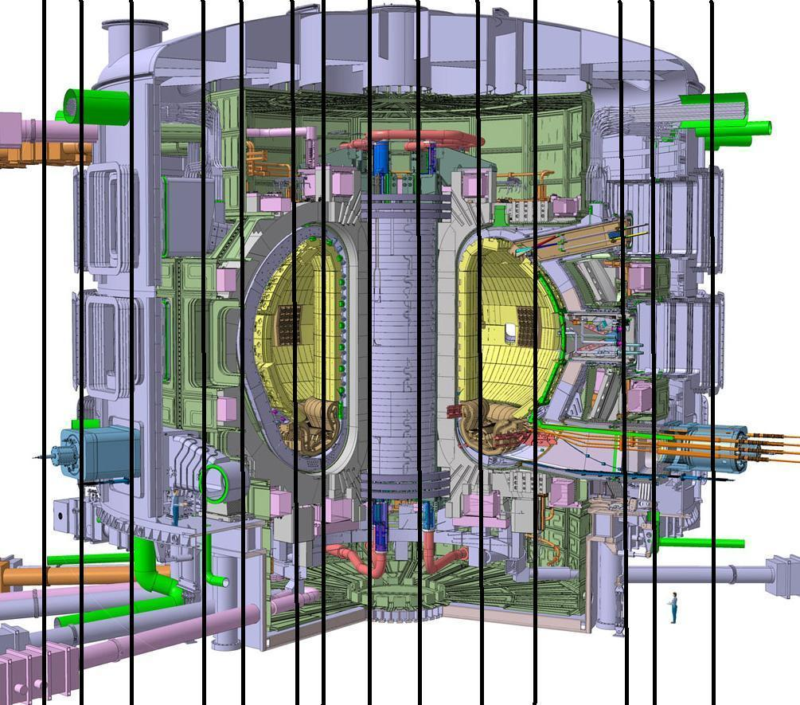
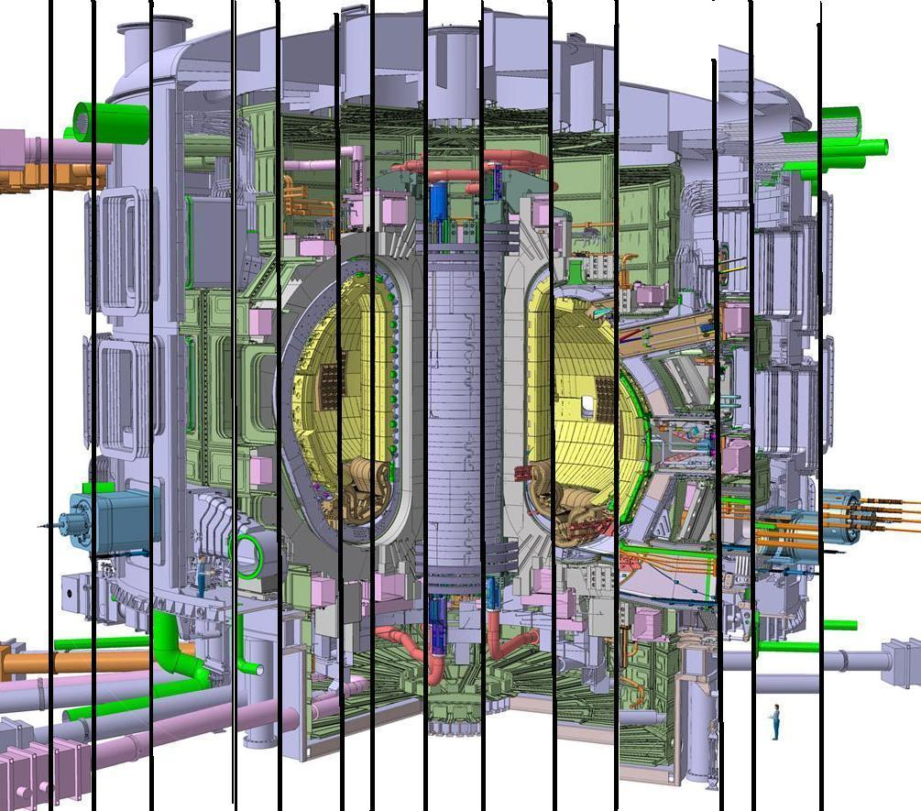
We forgot there is an interface between A and B
ITER Agreement splits the project in procurement arrangements distributed among the seven members
A bit of interface problems
We changed the design so the interface does not exist anymore
Island mentality
Misinterpreted scope
I forgot that I need that in my system
That should be implemented in your system, not mine
I did not know the others are doing the same thing in a different way
I do not care what the others do. I build my system.

Slide 3
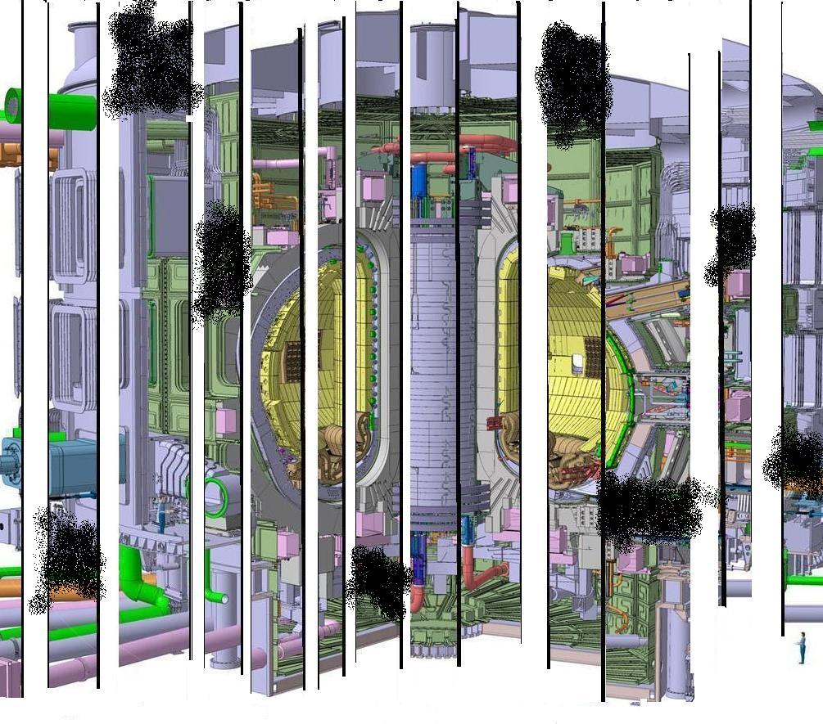
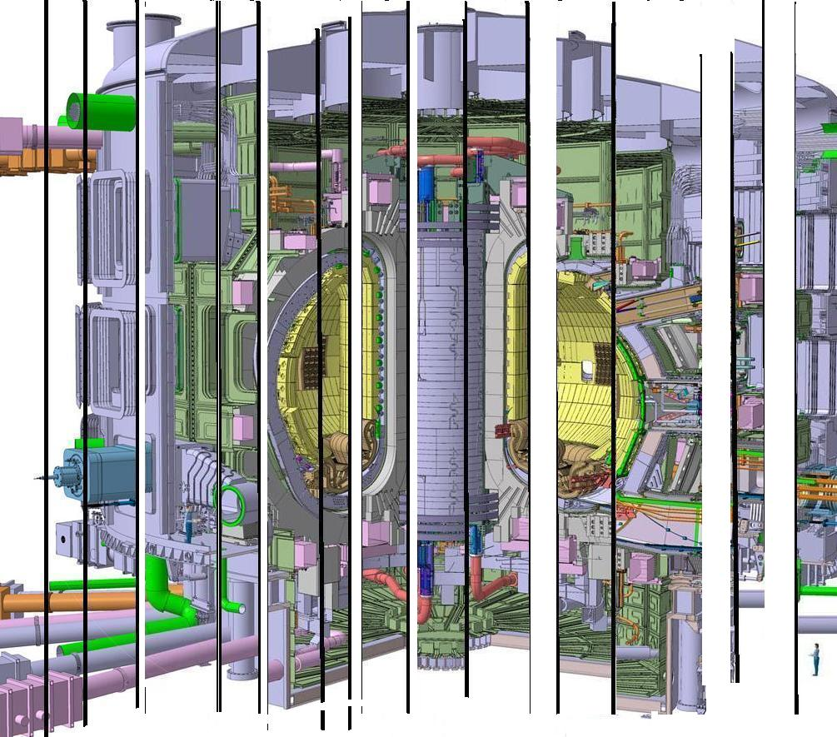
The ITER control system
performs the
functional integration of the ITER plant
and
enables integrated and automated operation

Slide 4
Outline
Introduction and Architecture
  System Breakdown, Networks, Structure
  Key Parameters
CODAC Core System
  Standardization: Specification, Hardware, Software, Support
CODAC Operation Applications
Infrastructure and Protection Systems
Schedule
Early Integration Approach

Slide 5
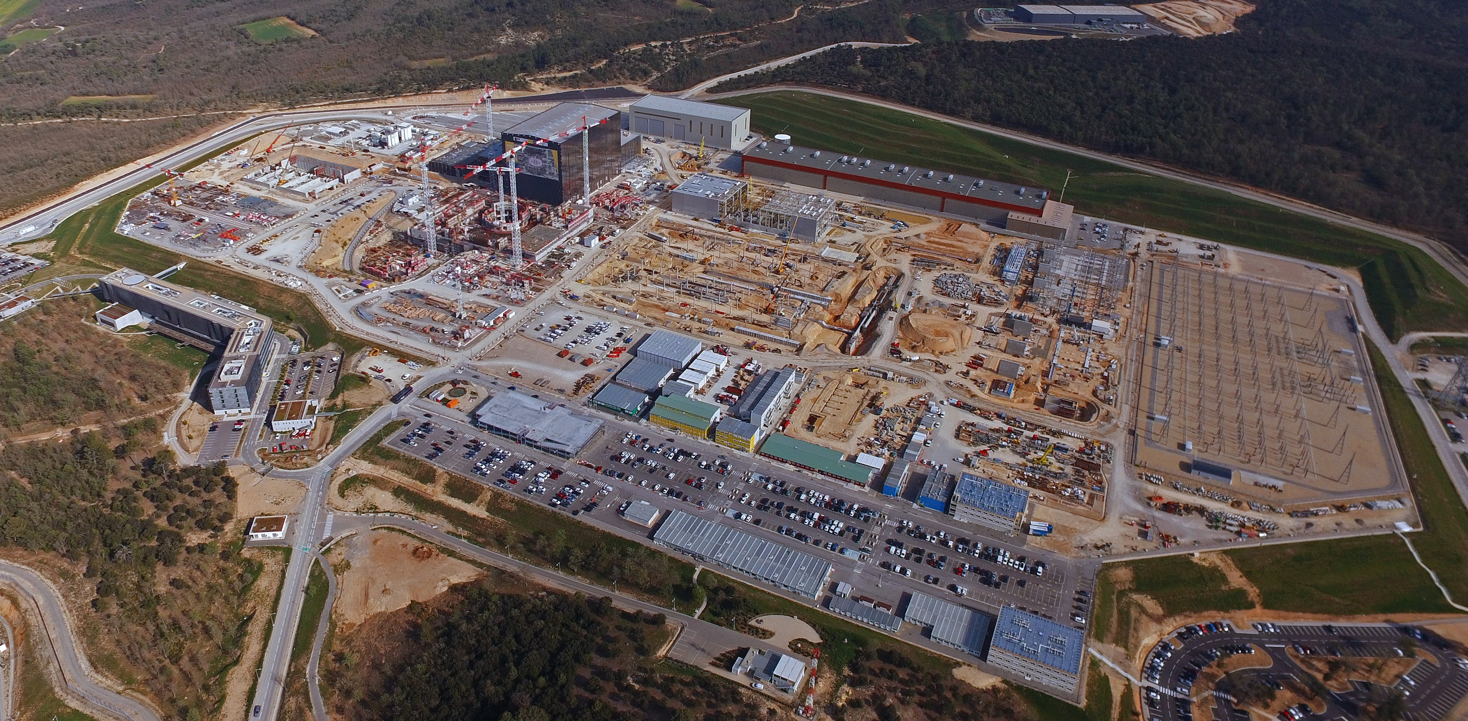

Slide 6
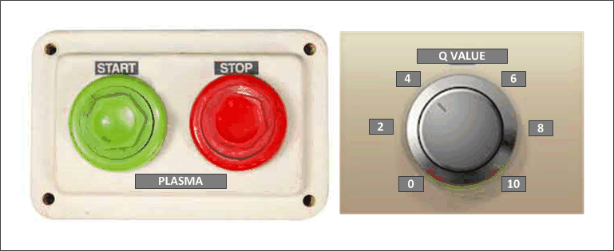
High Level Requirements
The ITER control system
performs the
functional integration of the ITER plant
and
enables integrated and automated operation

Slide 7
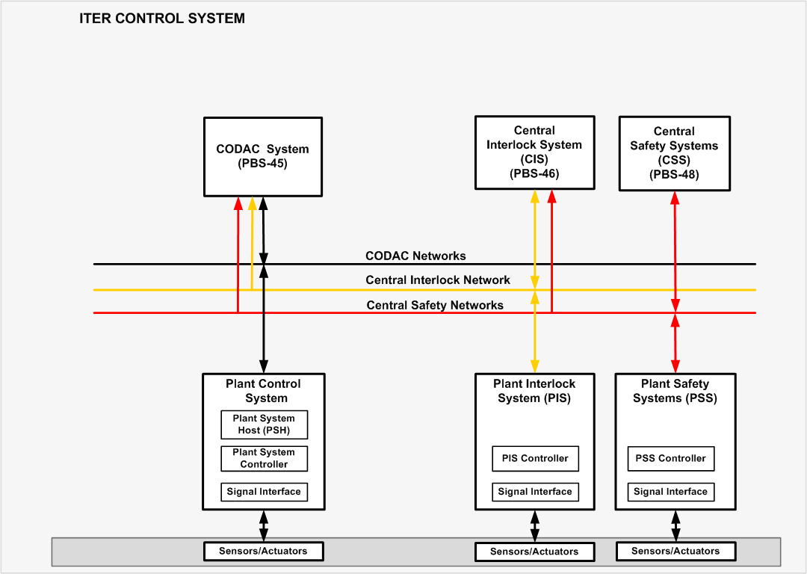
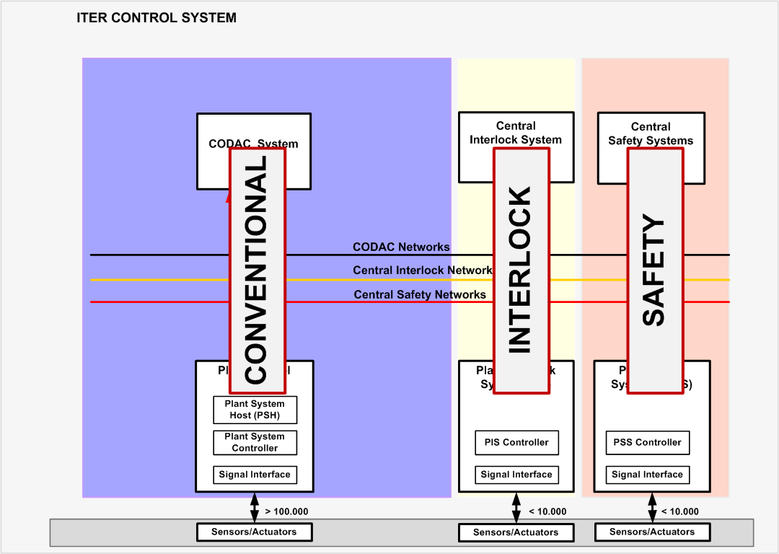
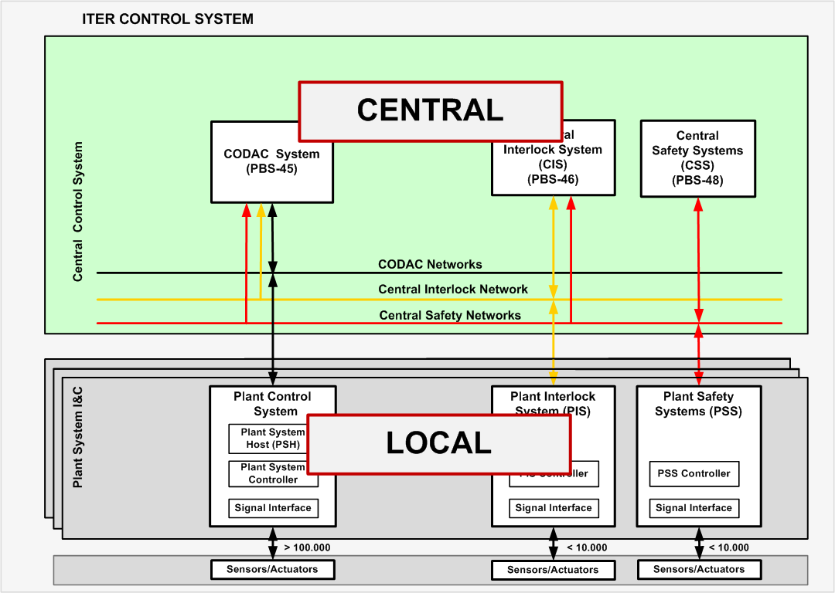
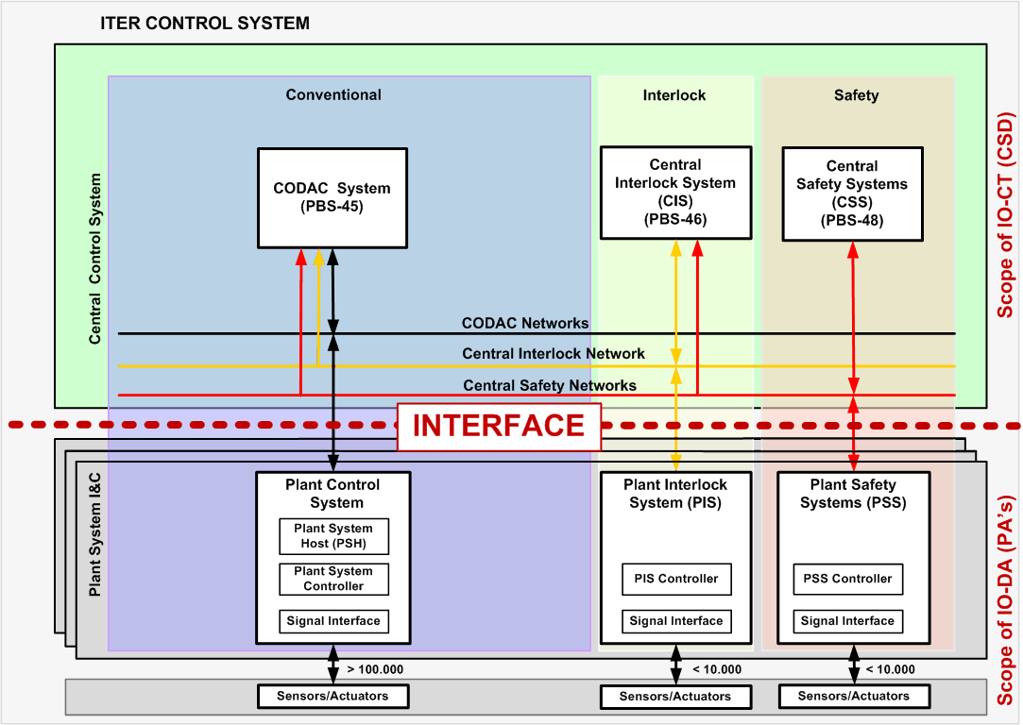
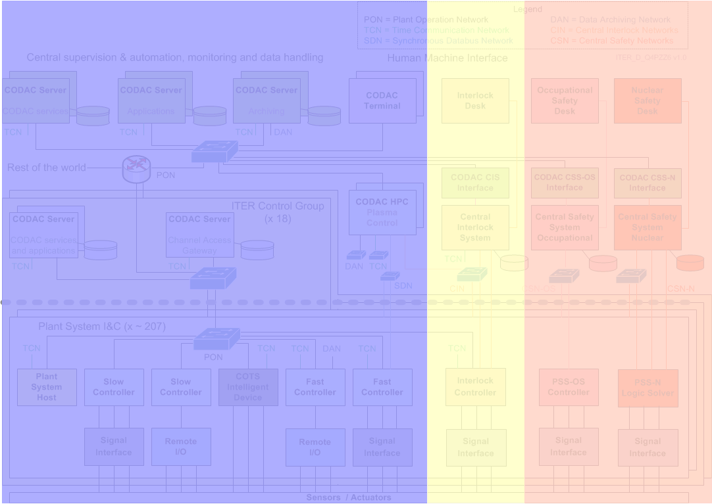
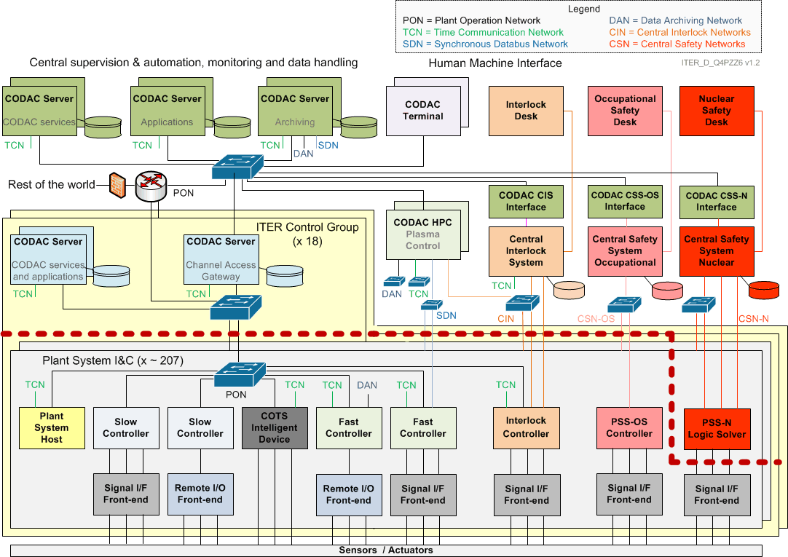
Architecture

Slide 8
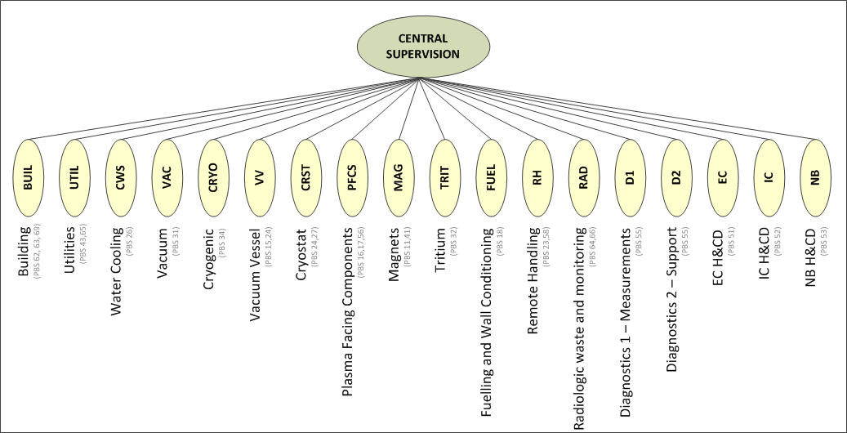
Architecture

Slide 9
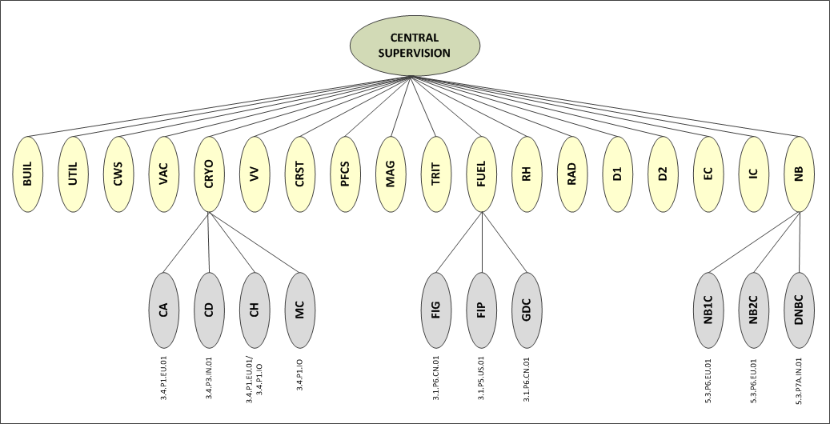
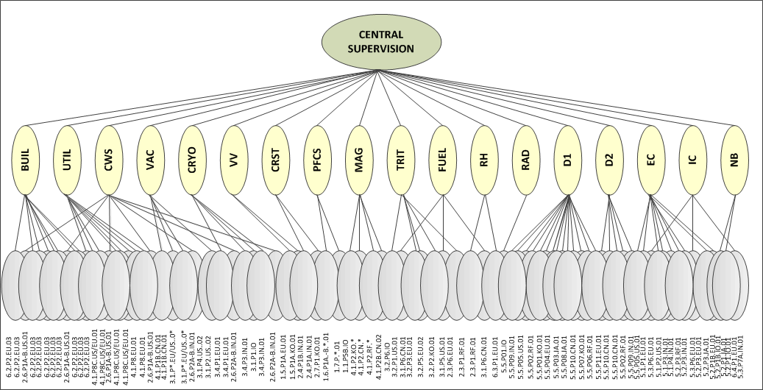
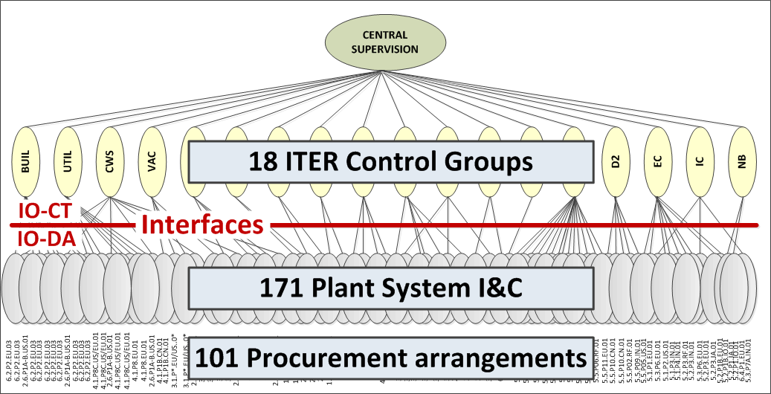
Architecture
CBS 1
CBS = Control Breakdown Structure
CBS 2
Breakdown in 18 ITER control groups (CBS level 1) covering 28 PBS
An ITER control group contains many Plant System I&C, total no. 171 (CBS level 2)
A Plant System I&C is a deliverable from a procurement arrangement (IN-KIND)
A procurement arrangement delivers a part, one or many Plant System I&C

Slide 10
Some Key Parameters (Quantities)
Parameter | Value
Total number of I&C cubicles/racks | >5.000
Total number of plant I&C signals (wires) | >100.000
Total number of process variables (PV) | >1.000.000
Total number of active operator stations | 100
Physical size of ITER site | 900*600 m
Number of buildings and plant areas with I&C equipment | 90
Number of central-plant I&C interfaces | 330
I&C cables (sensors/actuators to controllers) | 6000 km
Multi-core single mode fiber optic network cables | 300 km
Multi-pair copper network cables | 170 km
Number of identified machine protection I&C functions | 150
Number of identified nuclear safety I&C functions | 252

Slide 11
Some Key Parameters (Performance)
Parameter | Value
Update rate per operator station (200 PVs) | 5 Hz
Maximum sustained data flow on Plant Operation Network (PON) | 50 MB/s
Total PON archive rate | 25 MB/s
Total Data Archive Network (DAN) archive rate (initial) | 2 GB/s
Total DAN archive rate (final) | 50 GB/s
Total archive capacity | 90-2200 TB/day
Accuracy of time synchronization | <50 ns RMS
Number of nodes on Synchronous Data Network (SDN) | 100
Maximum latency asynchronous events | 1 ms
Maximum latency sensor to actuator (SDN) | 500 µs
Maximum jitter sensor to actuator (SDN) | 50 µs RMS
Maximum sustained data flow on SDN | 25 MB/s
Maximum latency sensor to actuator for “slow” interlock | 1 sec
Maximum latency sensor to actuator for “fast” interlock | 1 ms

Slide 12
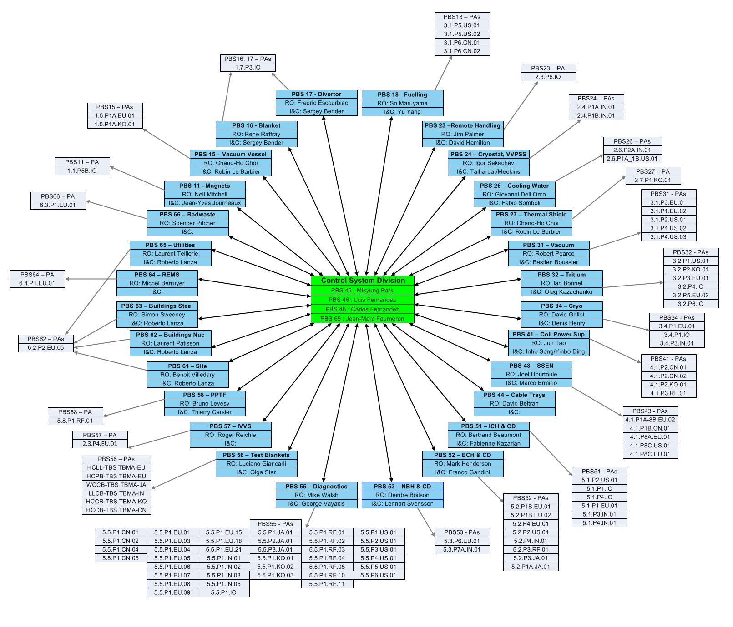
Interfaces
Interface and integrate 28 plants supplied by 101 procurement arrangements
Page 12

Slide 13
Standardization – Specifications
Core document with specification
Catalogues.
Mainstream industry COTS technologies.
Special prices for ITER project
Guidelines to help plant system I&C suppliers
Full documentation set available on public web

Slide 14
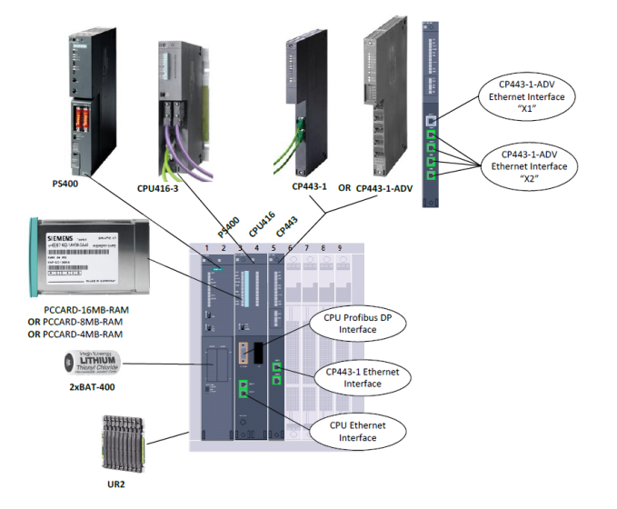

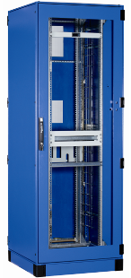

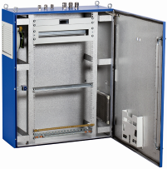
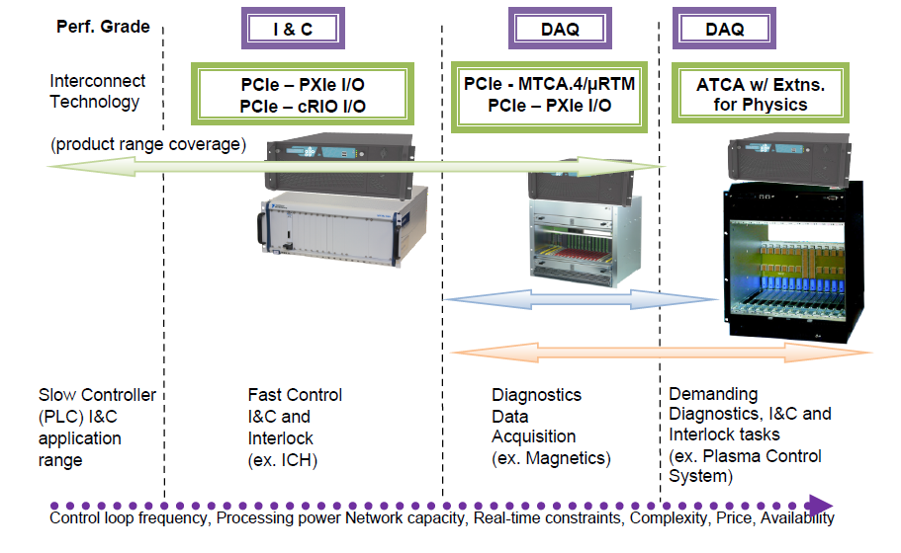

Standardization – Hardware
Slow control
Siemens S7-300/400 products (1500 series soon)
ET200M and ET200S for remote I/O
Covering standard industrial systems
Cubicles
Schneider Electric products
Address floor standing and wall mounted cubicles
Address Standard and EMC protected.
Fast control
PCI Express. CPU and I/O segregated
Mainly National Instruments products
Covering acquisition and control > 50 Hz

Slide 15




Standardization – Software
  OS: Red Hat Enterprise Linux (RHEL x86_64)
  with MRG-R real-time extensions on fast controllers
  Infrastructure: EPICS, control system tool set used in hundreds of projects world-wide: light sources, high energy physics, fusion (KSTAR, NSTX)
  CODAC services layer: Control System Studio used at many EPICS and other sites and including HMI, alarming, archiving etc.
  ITER specific software such as configuration (system description), state handling, drivers, networking, etc.
  Fixed 1 year release cycle (maintenance releases when needed), extensive testing procedures
Version | Release date | Changes
4.0.0 | 2013-02-15 | 434
4.1.0 | 2013-07-04 | 416
4.2.0 | 2014-02-14 | 455
4.3.0 | 2014-07-07 | 274
5.0.0 | 2015-02-20 | 616
5.1.0 | 2015-07-17 | 353
5.2.0 | 2016-02-17 | 524
5.3.0 | 2016-01-01 | 280
5.4.0 | 2017-02-21 | 357
Infra | 2013 |  | 2014 |  | 2015 |  | 2016 |  | 2017 |  | 2018 | 2019 | 2020 | 2021
RHEL 6.3 MRG-R 2.1 EPICS 3.14 | 4.0 | 4.1 | 4.2 | 4.3 | Support
RHEL 6.5 MRG-R 2.5 EPICS 3.15 |  |  |  |  | 5.0 | 5.1 | 5.2 | 5.3 | 5.4 |  | Support
RHEL 7.x MRG-R x.x EPICS 7.x |  |  |  |  |  |  |  |  |  |  | 6.0 | 6.1 | 6.2 | 6.3

Slide 16
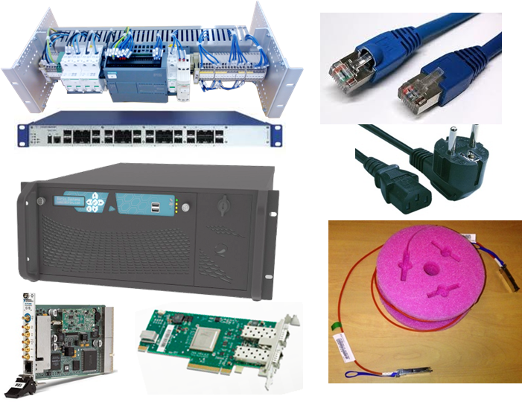
Standardization – I&C Integration Kits
Distributed for free to all
plant system I&C (171)
Contains:
An industrial computer hosting:
  Plant System Host
  mini-CODAC
as virtual systems
An industrial network switch to set-up
the local network
A cubicle monitoring system
The interfaces boards to connect the fast controllers to High Performance Networks (TCN/SDN/DAN)

Slide 17
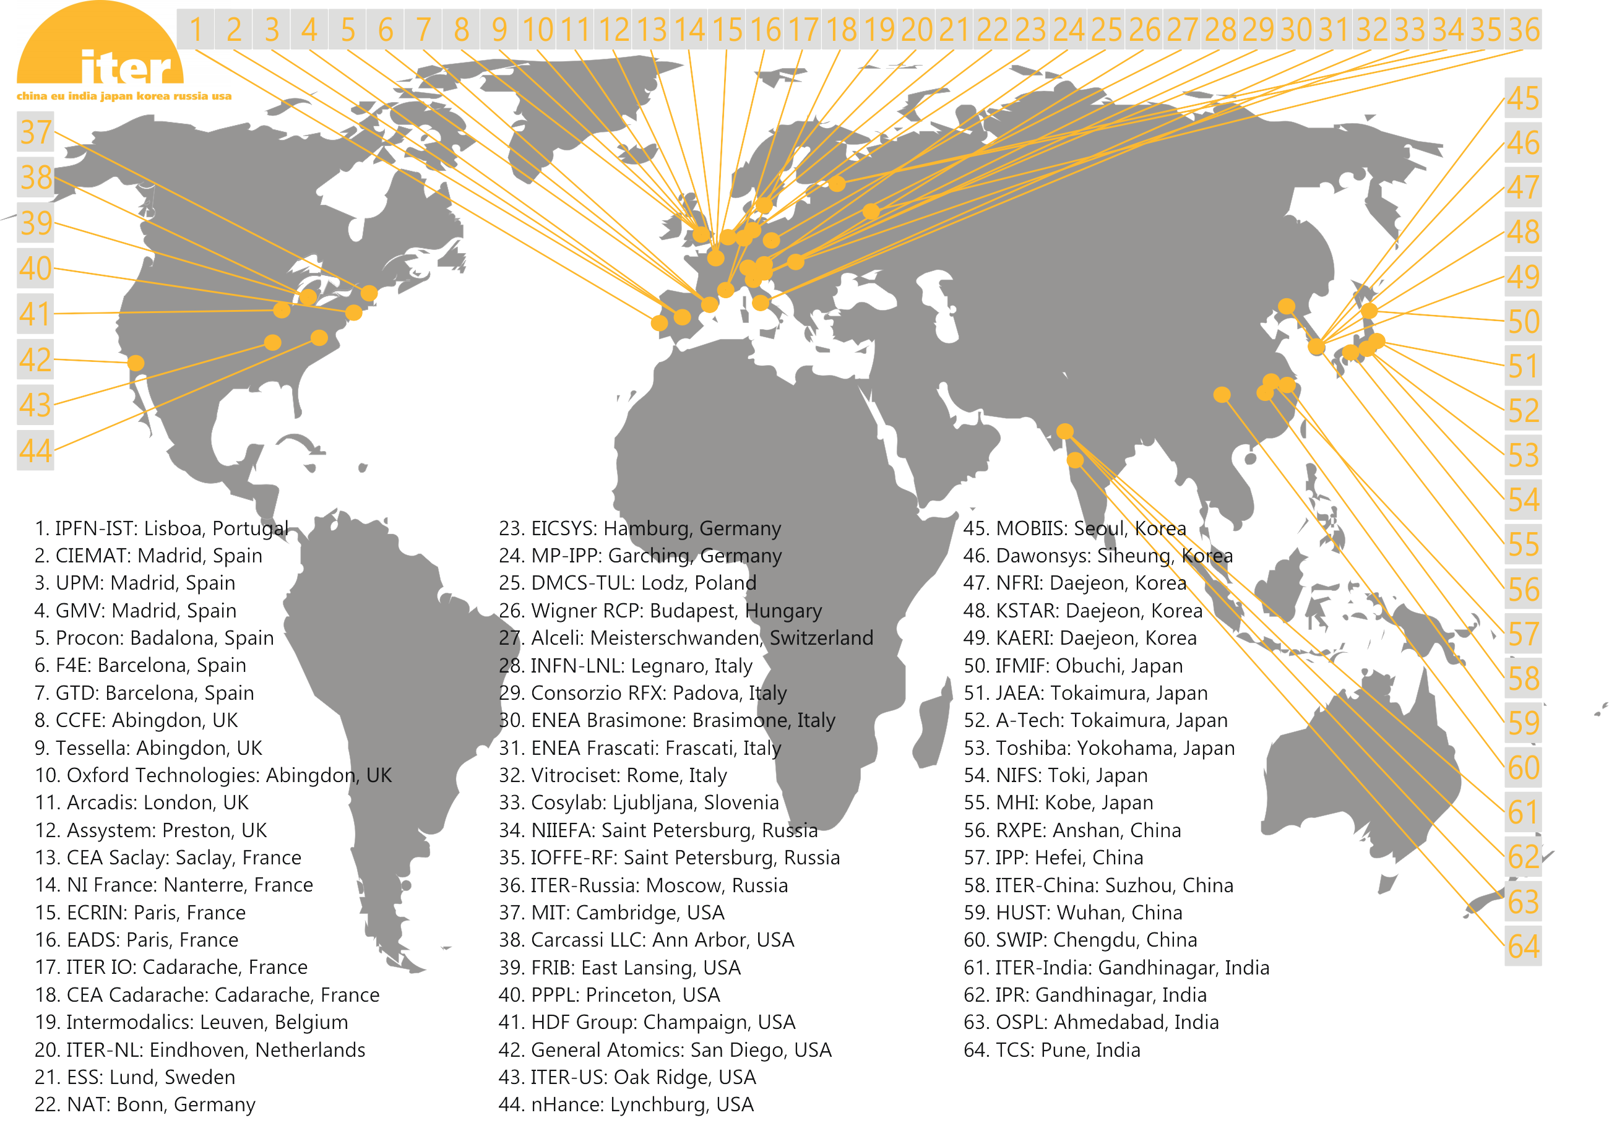
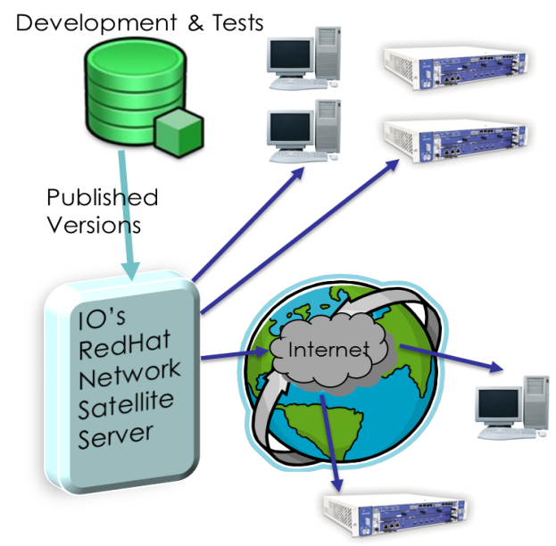
Standardization – Distribution Status
I&C Integration Kits Deliveries
102 kits (out of 171) shipped since 2013
CODAC Core System (CCS) Distribution:
RedHat satellite since 2012 has distributed
RPMs to 64 registered institutions
CN | 11
EU | 22
IN | 6
IO | 13
JA | 7
KO | 11
RF | 18
US | 15

Slide 18

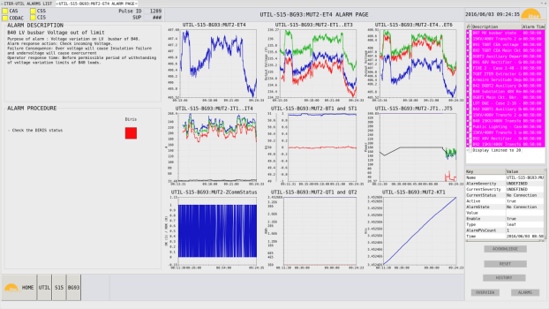
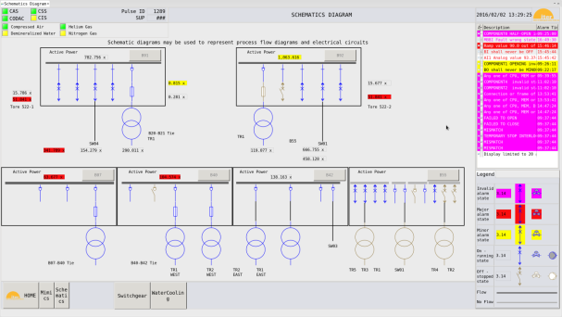
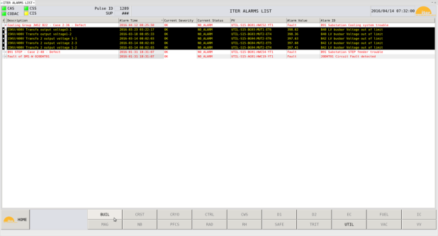


Standardization – HMI Style Guide and Toolkit
Plant System operator VDU workstation: 3 VDU (terminals)
  Ultra HD resolution as a minimum
  3840 x 2160 (4K) at 60Hz
  24 inches
  Aspect ratio of 16:9

Slide 19
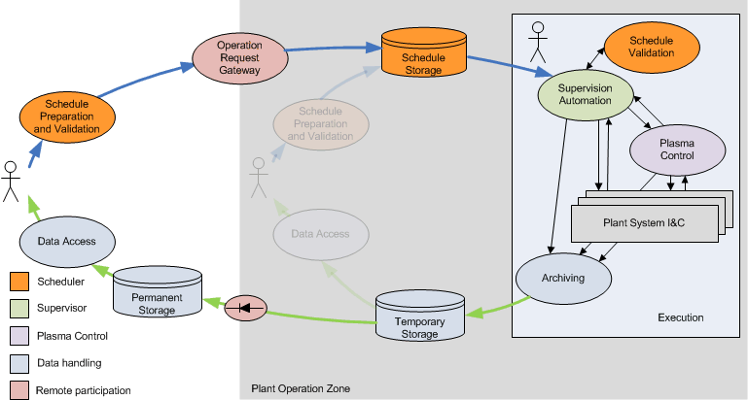
CODAC Operation Applications
CODAC Operation Applications are ITER dedicated software packages deployed on dedicated central servers
Preparation
Scheduling (PSPS)
Gateway (ORG)
Execution
Control (PCS)
Supervision (SUP)
Analysis
Data handling
Data access
eXternal to POZ

Slide 20
CODAC Operation Applications
Pulse Schedule Preparation System (PSPS)
Scheduler for schedule preparation and validation
Initial existing version allows editing, managing, saving and exporting configuration objects
Operation Request Gateway (ORG)
Support remote participation by securely controlling and screening interaction with the outside world
Initial existing version allows unidirectional mirroring of data from POZ to XPOS and configuration requests transmission from XPOZ to POZ

Slide 21
CODAC Operation Applications
Supervision and Automation (SUP)
Provides the infrastructure to execute a pulse schedule prepared by PSPS and to support automated operation and continuous monitoring
Initial existing version implements Plasma Operation State (POS) sequence and Common Operational State (COS) aggregation and partitioning function
Plasma Control System (PCS)
Performs the distributed real-time control and monitoring during the pulse
Final design of underlying real-time infrastructure framework completed. Preliminary design of physics algorithms completed.

Slide 22
CODAC Operation Applications
Data Handling
Provides the system to write, store, retrieve and visualize all data produced during ITER commissioning and operation.
First implementation to store fast data in HDF-5 format and interface to EPICS data archiving available
Data Access
Provides a unified access to all data produced by ITER and APIs for selected preferred user processing and visualization software (e.g. Matlab, MDSplus,…)
First implementation of Unified Data Access API available

Slide 23
Upgrade to EPICS 7
EPICS 7 introduces a network protocol that supports structured data
SUP (Supervision and Automation) will benefit from being able to consistently read/write configuration for a complete system
PCS (Plasma Control System) will benefit from consistent control and monitoring of real-time nodes
HMI will benefit from efficient image transfer across the network
The early plant systems’ I&C will be based on current EPICS V3 –
EPICS 7 provides multiple interoperability options
(more details in seminar this afternoon: 3rd bldg, 7F, meeting room, 1.30pm)

Slide 24
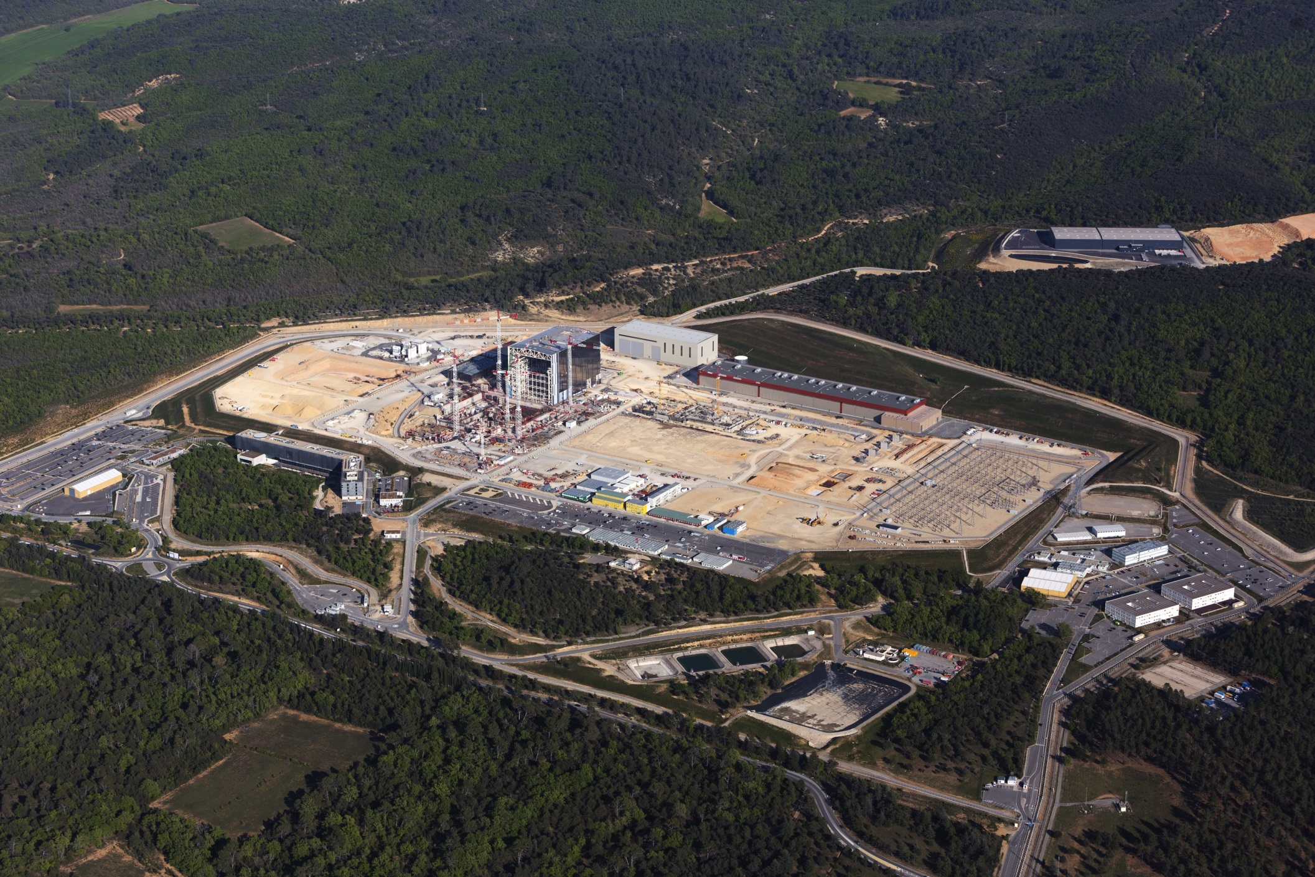
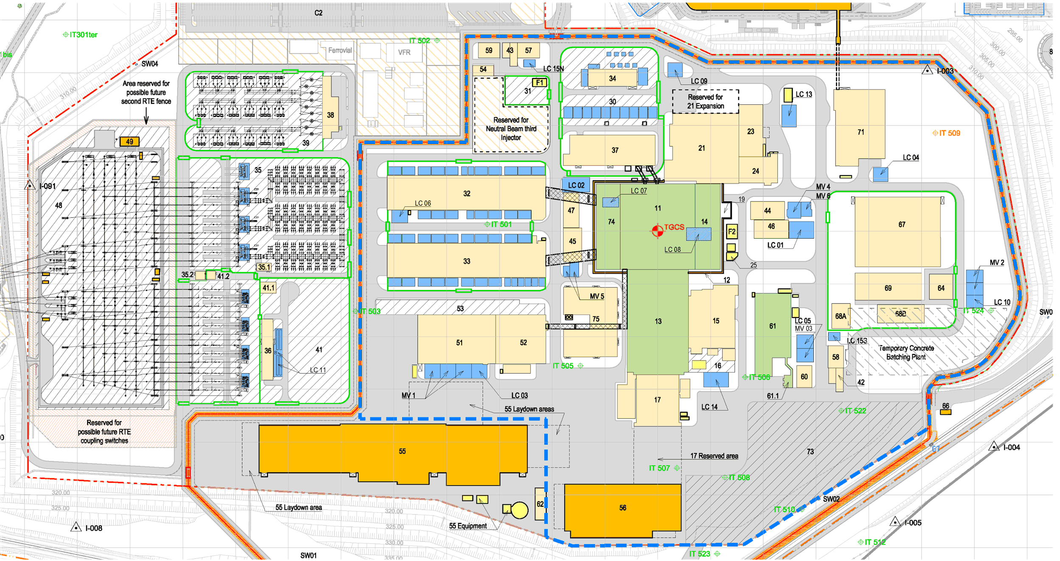
Infrastructure
Control building
Neutral beam
Hot cell
Backup control building
Coil power supplies
Tokamak complex
Electrical
Cryoplant
ICH/
ECH
Cooling water

Slide 25
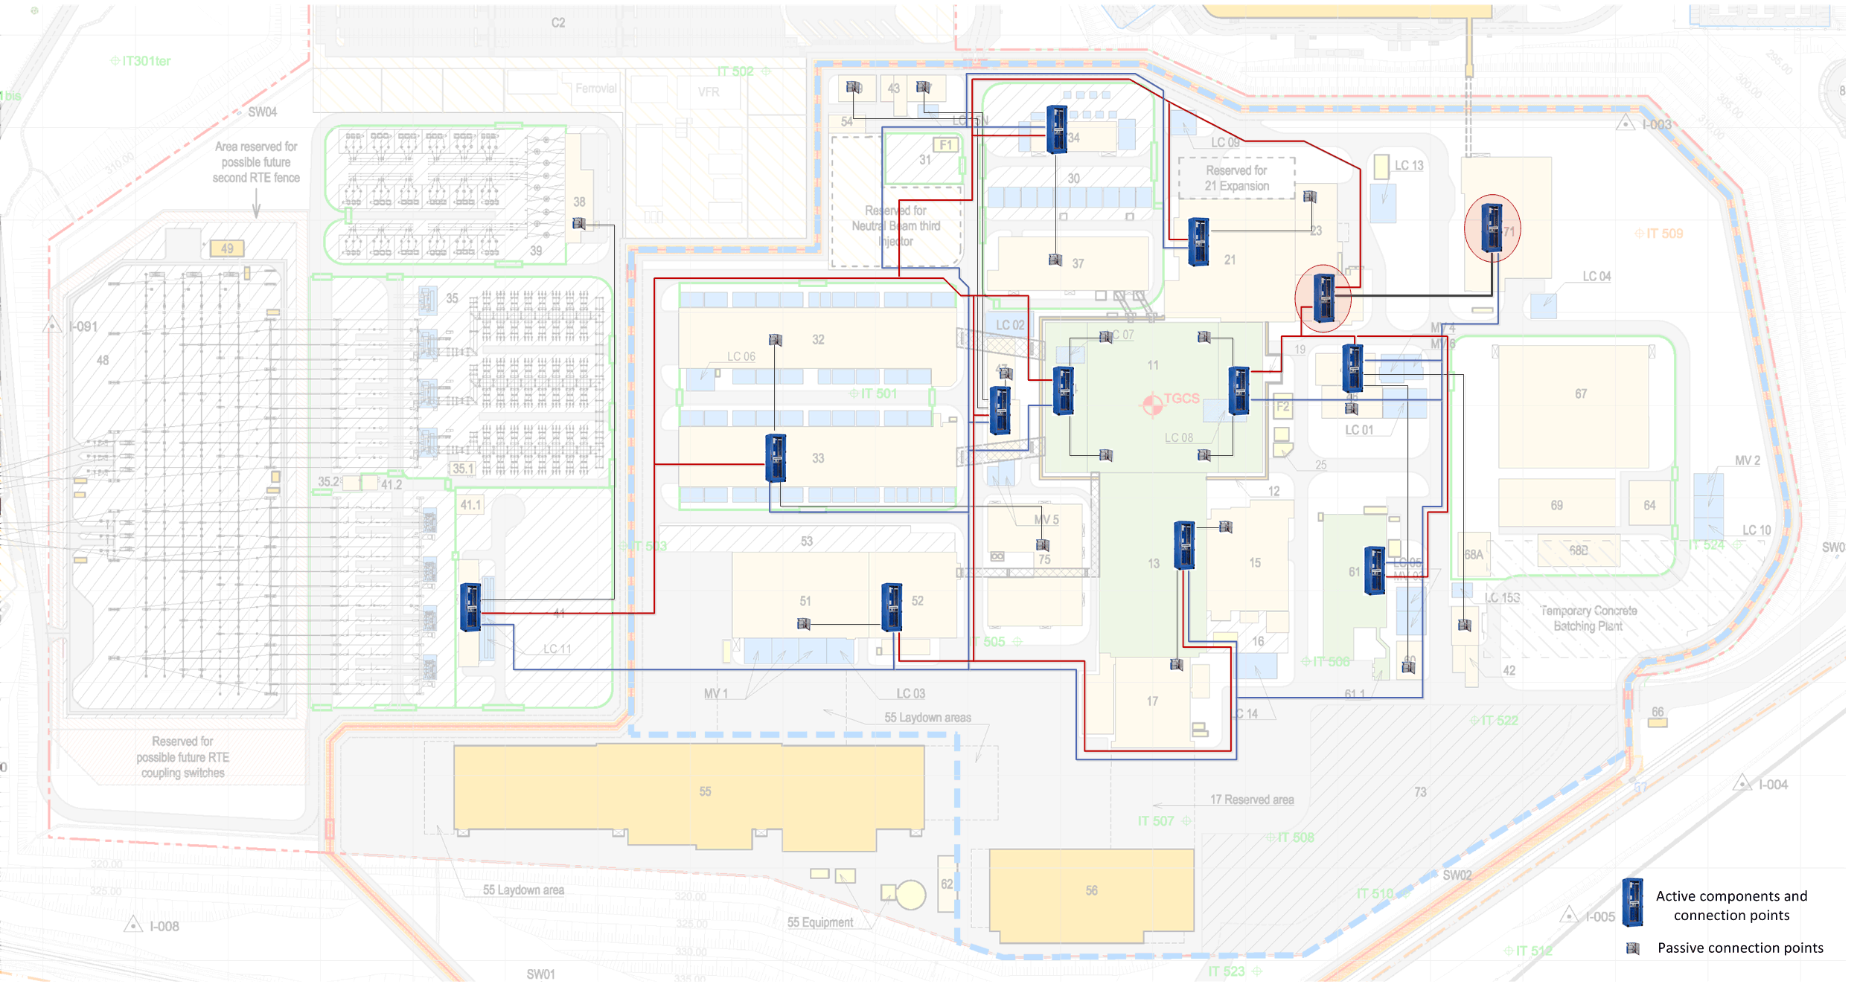
Infrastructure
Redundant dual star configuration
All cables end up in B71 and B24
Bill of Material
173 cubicles
175 passive network panels
300 km multi-core single mode
170 km multi-pair copper cables
Connecting thousands of plant system I&C client cubicles via network panels located in 28 buildings

Slide 26
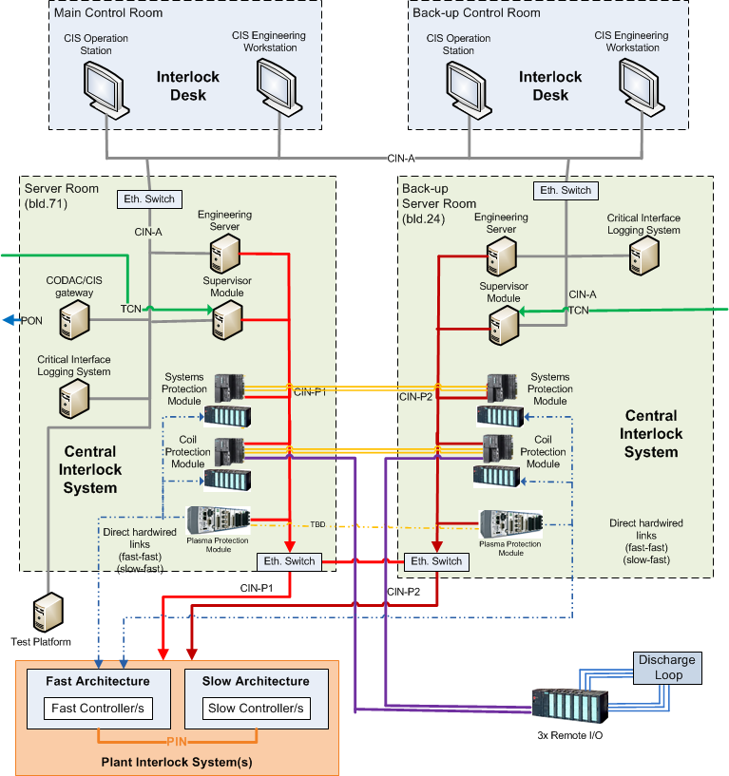
Machine Protection I&C
Architecture and Technologies
Different requirements on time response and action complexity lead to three architectures.
  Slow Interlock Architecture
  : slower than 0.3 sec
  Fast Interlock Architecture
  : 100µs - 0.3 sec
  Hardwired Loops : < 1µs
CIS
Final design completed
Manufacturing in progress
PIS

Slide 27
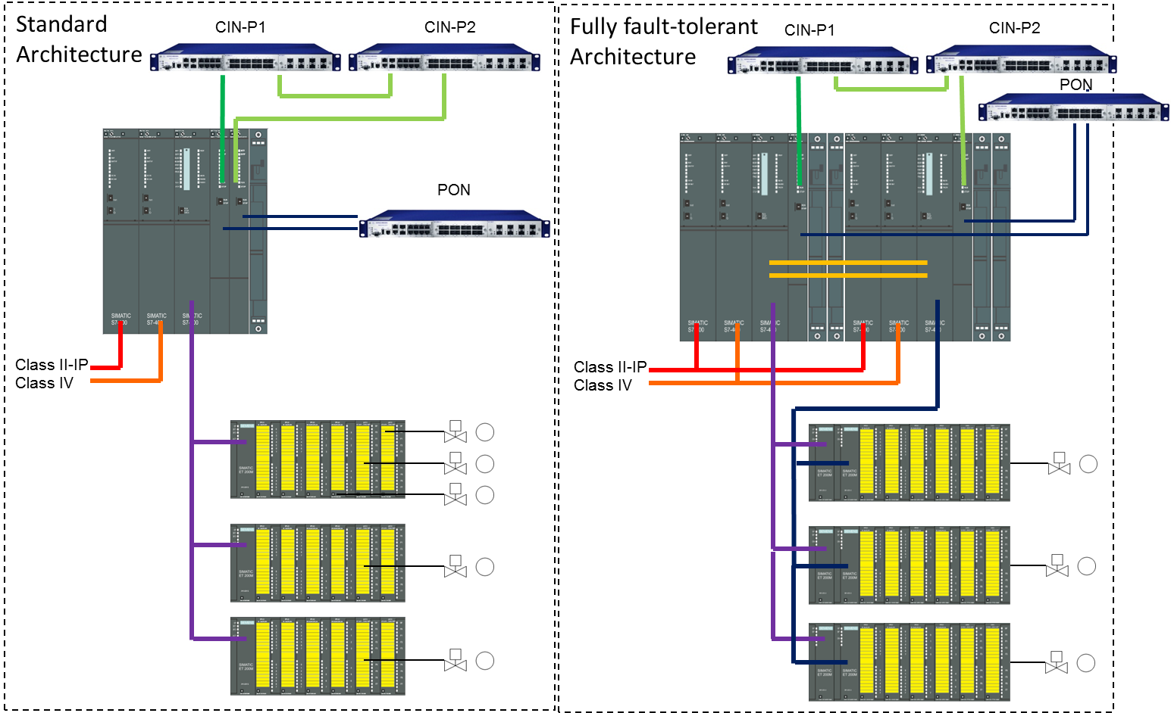
Machine Protection I&C – Slow Interlock
PLC based using
Siemens S7-400 F/FH
Example function:
Event: Loss of one LN2 plant
Action: Coil power permits removed, next pulse inhibited

Slide 28
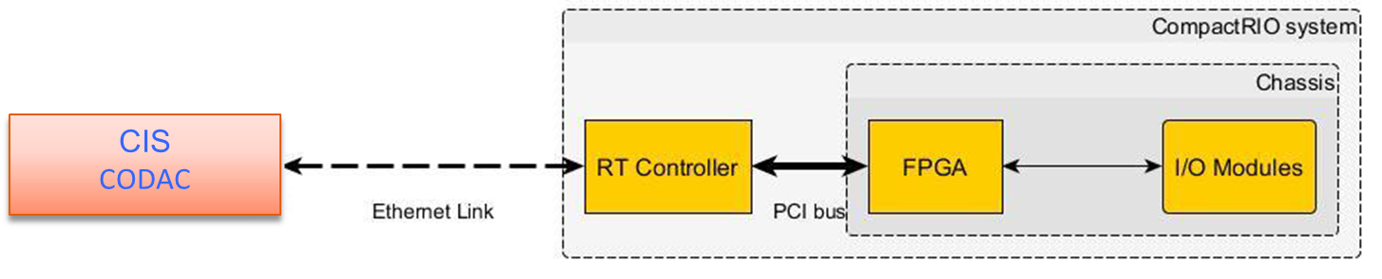
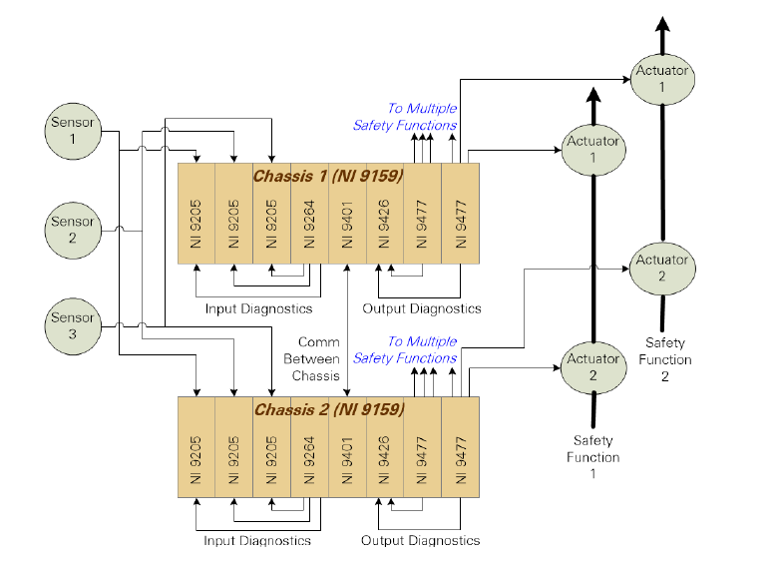
Machine Protection I&C – Fast Interlock
FPGA based using
Customized NI compactRIO
Example function:
Event: Diagnostics detect Neutral Beam shine-through
Action: Neutral Beam is stopped
Hardwired CIN
CIS

Slide 29
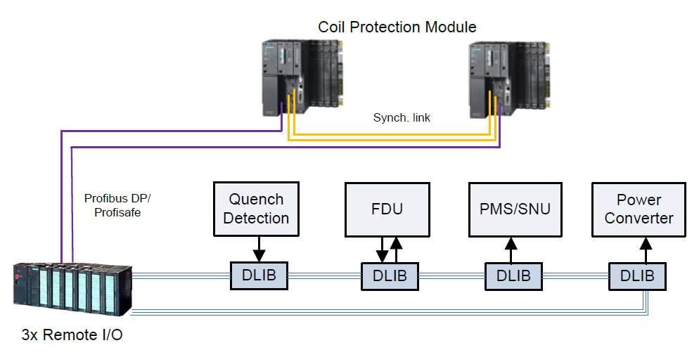
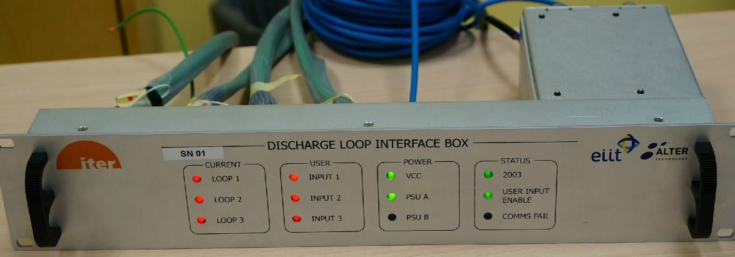
Machine Protection I&C – Hardwired Loops
Current loops based on
Custom design (CERN derived)
Example function:
Event: Magnet detects quench
Action: Fast Discharge Unit is activated
Discharge Loop Interface Box (DLIB)

Slide 30
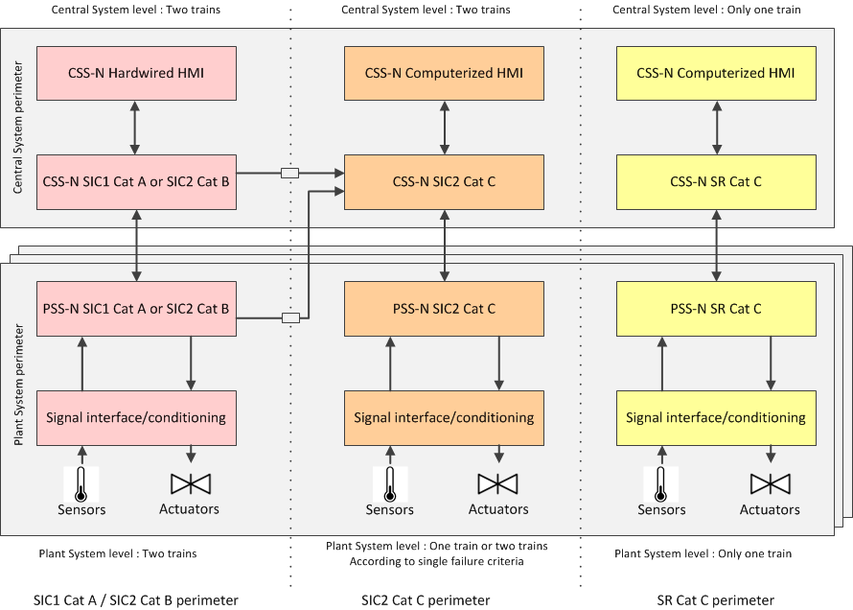
Nuclear Safety I&C
Architecture and Technologies
Safety functions are classified in four categories;
  SIC 1 cat A and SIC 2 cat B Hardwired HIMA Planar 4
  SIC 2 cat C and SR cat C Siemens S7-400 F/H
Number of inputs/outputs estimated to 29.000
Project Change Request transfers the scope of most PSS-N to Central Team
Final design in progress

Slide 31
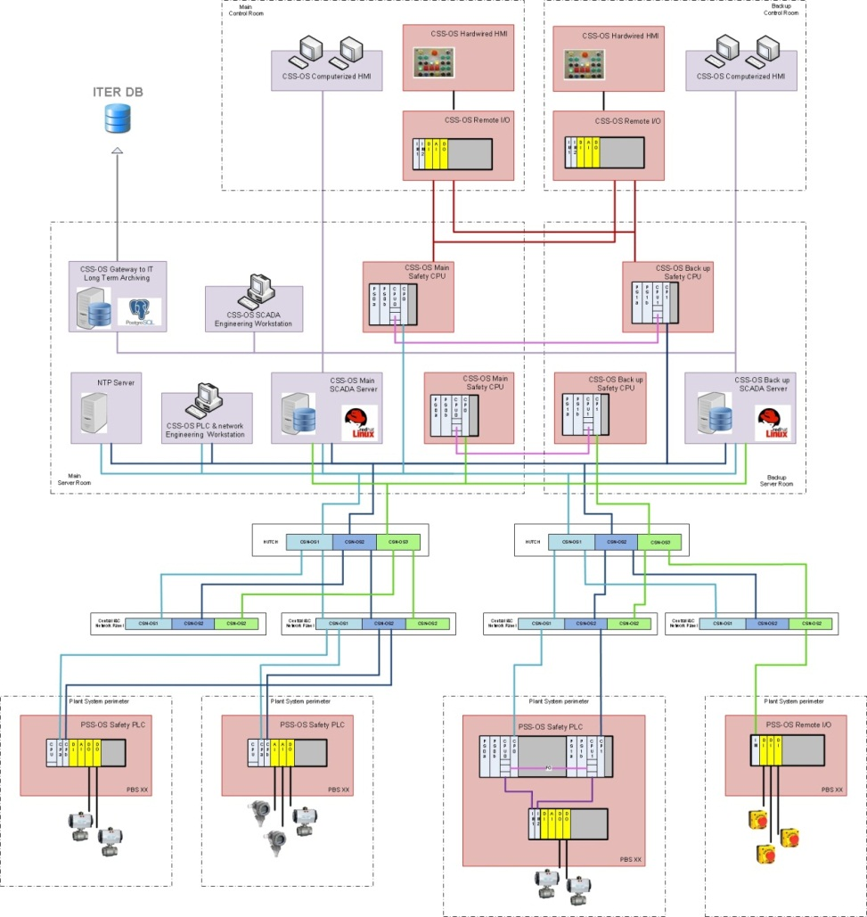
Occupational Safety I&C
Architecture and Technologies
Safety functions are classified in three categories; SIL 1, 2 or 3
S7-400 H and S7-300 F technologies
CSS-OS
Final design suspended for lack of inputs and project schedule
PSS-OS x n

Slide 32
Schedule
ITER 2016 baseline approved by ITER Council in November 2016
Underpinned with detailed resource loading
Staged approach
End of Pre-Fusion Power Operation-II and Start of Pre- Nuclear Shutdown for Assembly IV
Mar. 2034
End of Pre-Fusion Power Operation-I and Start of Assembly III
Jun. 2030
Start of Pre-Fusion Power Operation-I (SP)
Dec. 2028
End of Pre-Nuclear Shutdown for Assembly IV
Mar. 2035
Pre-Fusion Power Operation-II (TP)
Jun. 2032
Fusion Power Operation
(DT)
Dec. 2035
FP Finished and Start of Assembly II
Jun. 2026
First Plasma (FP)
Dec. 2025
End of Assembly II
Jun. 2028
End of Assembly III
Sep. 2031
Engineering Operation (SC Magnets)
(6 Months)
Assembly II
(24 Months)
Integrated Comm. II (6 Months)
Pre-Fusion Power Operation-I (18 Months)
Assembly III (15 Months)
Integrated Comm. III (9 Months)
Pre-Fusion Power Operation-II (21 Months)
Assembly IV (12 Months)
Integrated Comm. IV (9 Months)
add 46 add 29 add 18
plant system I&C plant system I&C plant system I&C

Slide 33
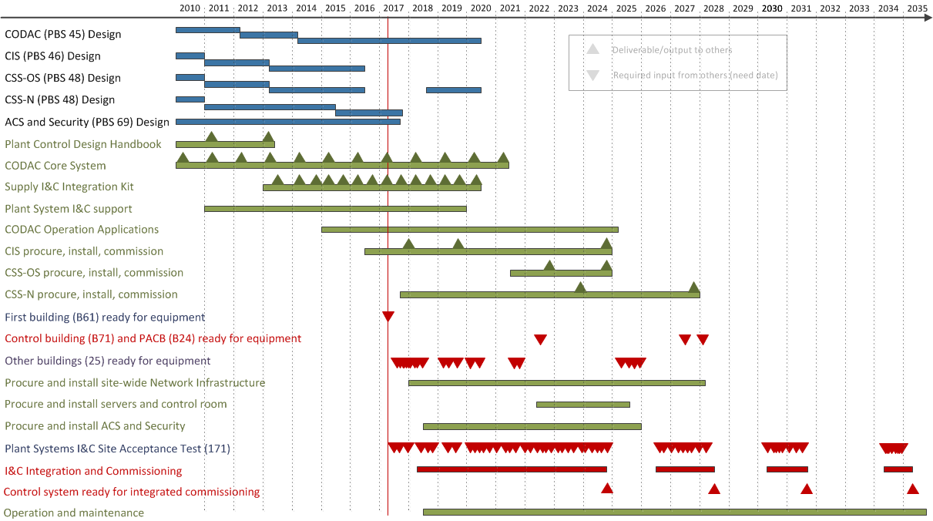
Schedule
Design of central systems almost complete
Deliveries to project (plant system I&C and site)
Dependency on buildings availability
Dependency on plant system I&C installation and site acceptance test

Slide 34
Schedule
Control building (B71)
postponed 4 years!

Slide 35
Mitigation: Temporary Control Rooms
Requirements
The central infrastructure and services must be available soon
Human Machine Interfaces must be provided for plant system I&C integration
Migration of all plant systems I&C control to B71 must be achieved within 18 months
Implementation
Create temporary local autonomous “islands” in strategic buildings,
providing central services and Human Machine Interfaces
Connect islands with temporary cables to provide inter building connectivity
Maximize emulation of final system to simplify migration to B71

Slide 36
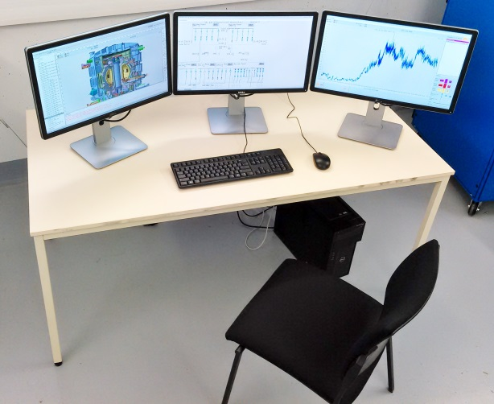
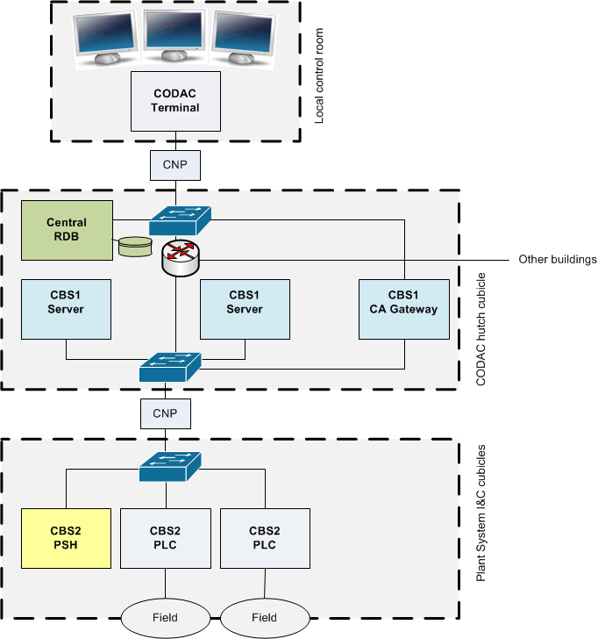
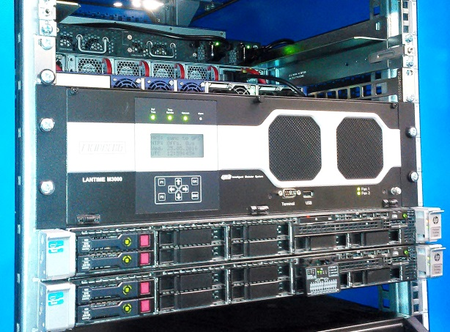
Temporary Control Rooms
Install central servers in existing CODAC hutch cubicles
Standard HMI stations in suitable room
Add CIS and CSS when applicable (local test tools)
Cover all Plant Systems for First Plasma (before Control Building availability) by six Temporary Control Rooms

Slide 37
Conclusions
ITER 2016 baseline schedule approved by Council
  Resource loaded, using staged approach
CODAC Core System stabilizing
  Plant system design tool set in place
CODAC Operation Applications under development
  Integrating important EPICS developments
Integration effort begins this year
  Using local control rooms as control room building is delayed

Slide 38
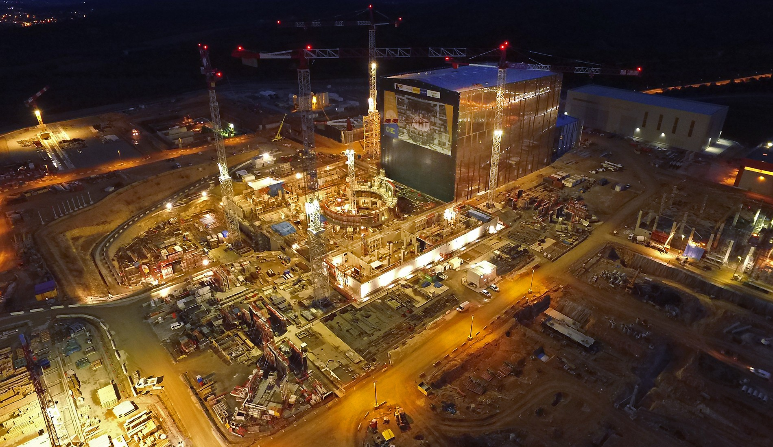
Thank you

