Slide 1
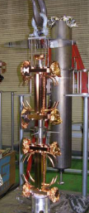
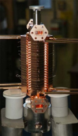
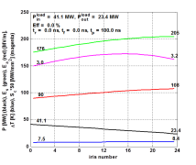
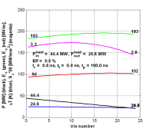
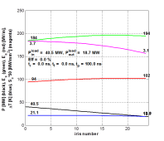
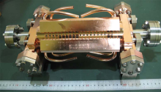
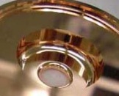
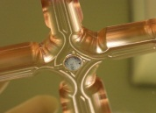
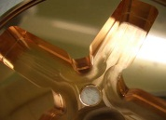
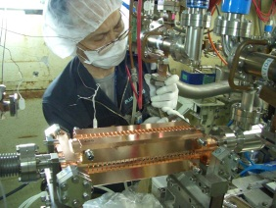
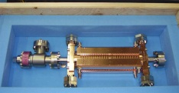
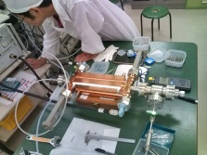
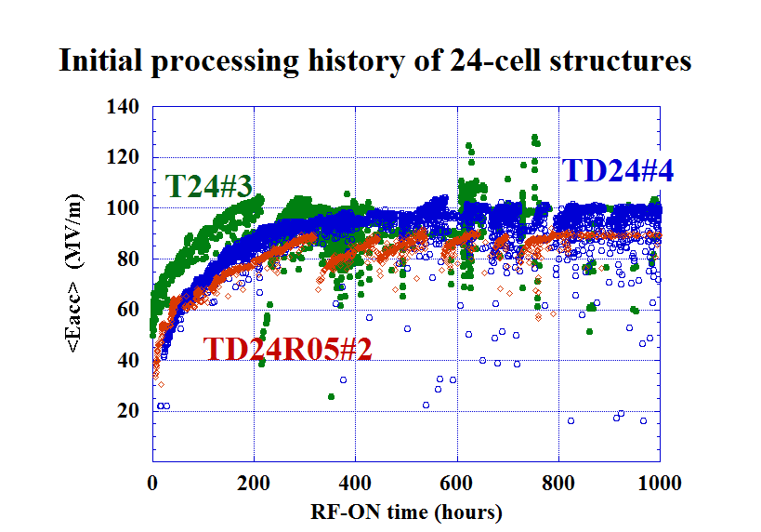
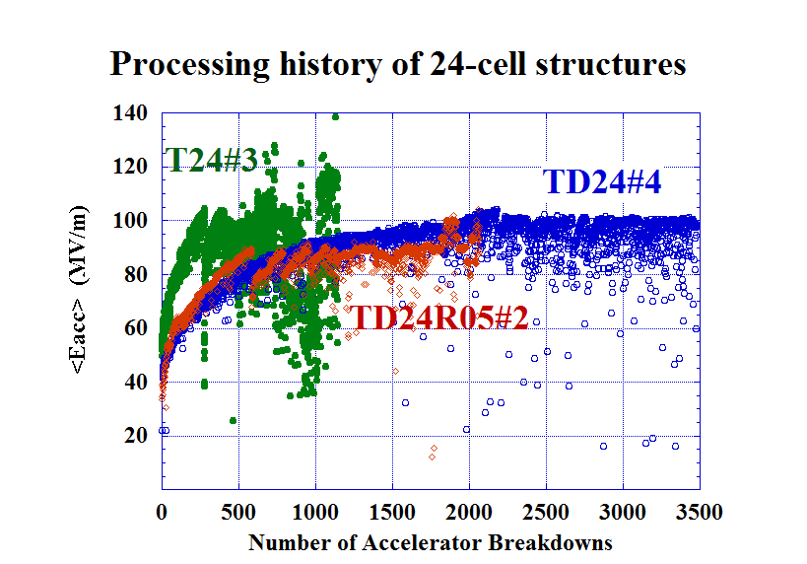
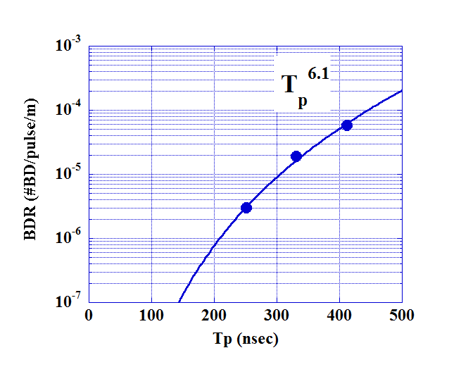
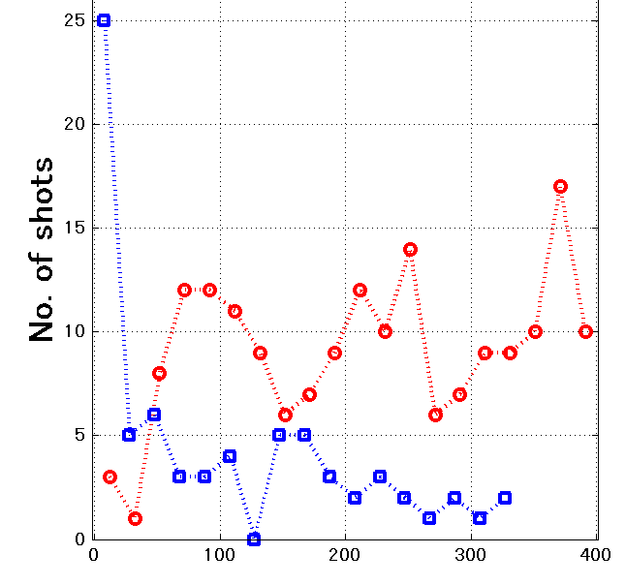
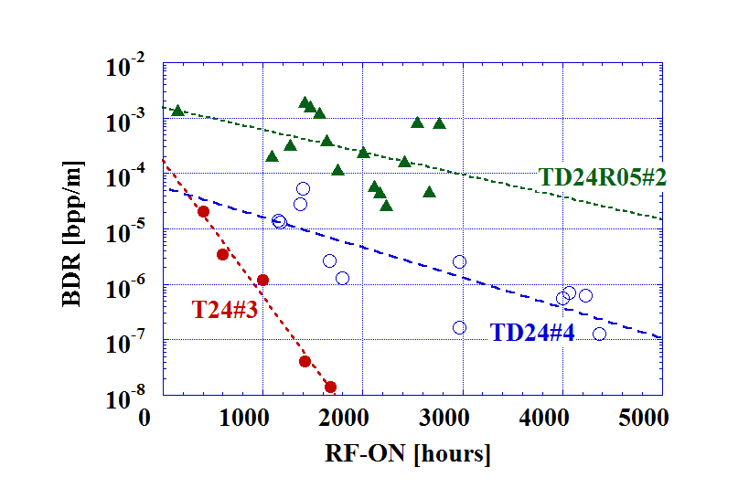
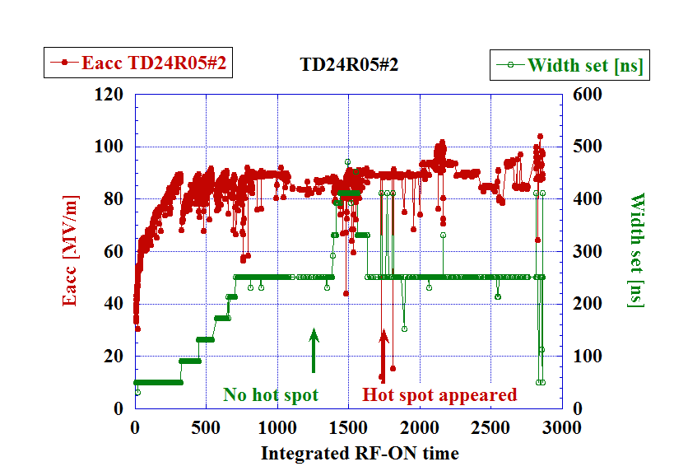
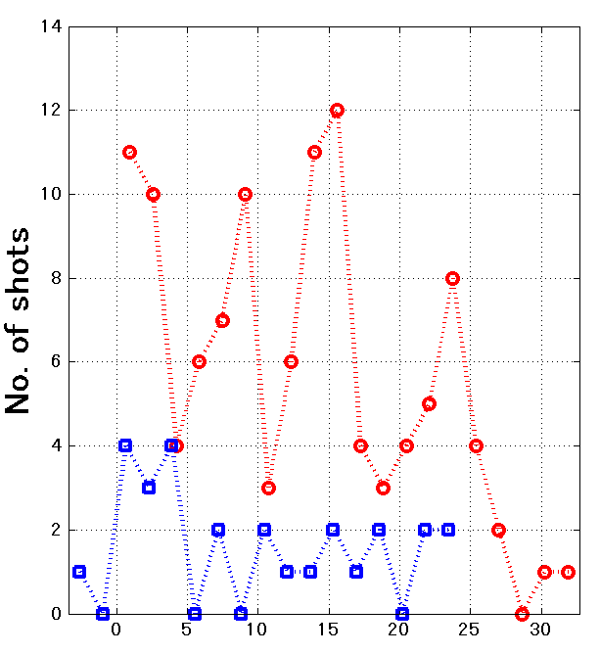
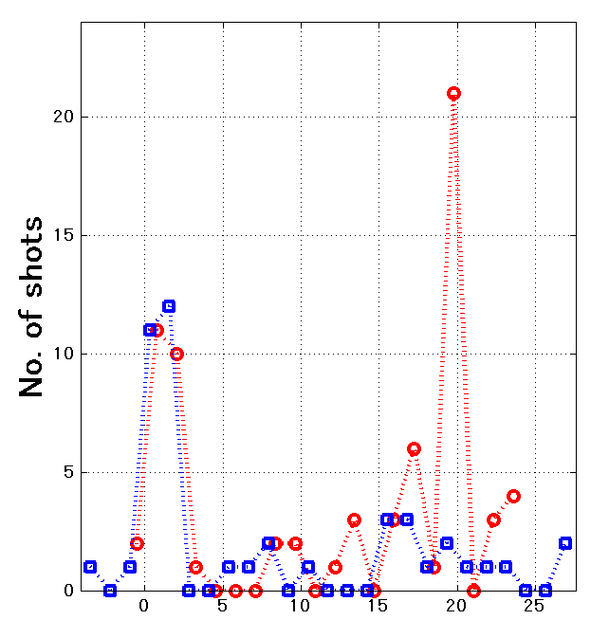
Comparison of High Gradient Performance in Varying Cavity Geometries
T. Higo#, T. Abe, Y. Arakida, S. Matsumoto, T. Shidara, T. Takatomi, M. Yamanaka, KEK, Ibaraki, Japan Y. Higashi, OKINAWA Institute of Science and Technology Graduate University, Okinawa, Japan A. Grudiev, G. Riddone, W. Wuensch, CERN, Geneva, Switzerland
Abstract
Five types of CLIC prototype TW accelerator structures were high-gradient tested up to 100 MV/m level since 2008 at KEK.
It was found that the ramping speed is slow in the structures with opening ports for HOM damping with magnetic coupling became slow. This indicates the role of the magnetic field on vacuum breakdowns.
The breakdown rate, BDR, of the un-damped structure T24 was very low, clearly meeting the CLIC requirement of a few 10⁻⁷/pulse/m at 100 MV/m. However, the BDR of the damped structures showed much higher than undamped ones.
One of the structures showed hot spots, where frequent breakdowns appear in particular regions of the structure. It indicates a mechanism reflecting not only the geometry or material characteristics but also the local features acquired after completion or even during the running.
Design with reduced magnetic field
T24
TD24
TD24R05
Cell prod.
Production and installation for setup at Nextef
DB & Brazing
VAC bake at 650C
Install to Nextef
RF check in cleanroom
Structure | TD18 | TD24 | TD24R05
E_{acc} [MV/m] | 79 ~ 120 | 94 ~ 102 | 94 ~ 102
ΔT [C] | 29 ~ 47 | 25 ~ 21 | 21 ~ 19
Oversea shipping
Breakdown and pulse width
Processing as time
Processing
as number of BD’s
BDR vs pulse width
BD timing
Need more breakdowns in damped structures and associated process time.
BDR scales T_{p}⁶ while BD timing in the pulse is flat.
→ Breakdown trigger is not developed within a pulse but due to the accumulated effect over many pulses.
BDR evolution as time
Hot spot
Distribution of BD position
Before (Hot spot appeared) After
Fast Processing Slow
Undamped Damping Damped
T24 >> TD24 >> TD24R05
TD24R05
Probably less processing but also some mechanism related to the hot spot made poor performance, especially even later time.
Frequent breakdown spots at both ends!
Concluding remarks
In the damped structures the gradient level such as 80 MV/m seems feasible if based on the present technology. One of the key parameters is the surface magnetic field, H_{s}. If high BDR is inevitable due to the high H_{s}, we need to introduce such structure as choke-mode type where no big enhancement of H_{s} is needed. The study is on-going in collaboration including Tsinghua University.
Another new issue is the hot spot. The mechanism and the technology to suppress such cases should be studies. We have been preparing studies with simple geometries in a small-sized setup at Nextef at KEK.

