Slide 1
CLIC structure collaboration meeting
G. Riddone, AB-RF
2008.07.04

Slide 2
Agenda
Status of the production and test program (CERN, KEK, SLAC)
Testing of PETS (CERN, SLAC)
Design of quadrants and disks (KEK)
Pulse compressor for Nextef at KEK

Slide 3
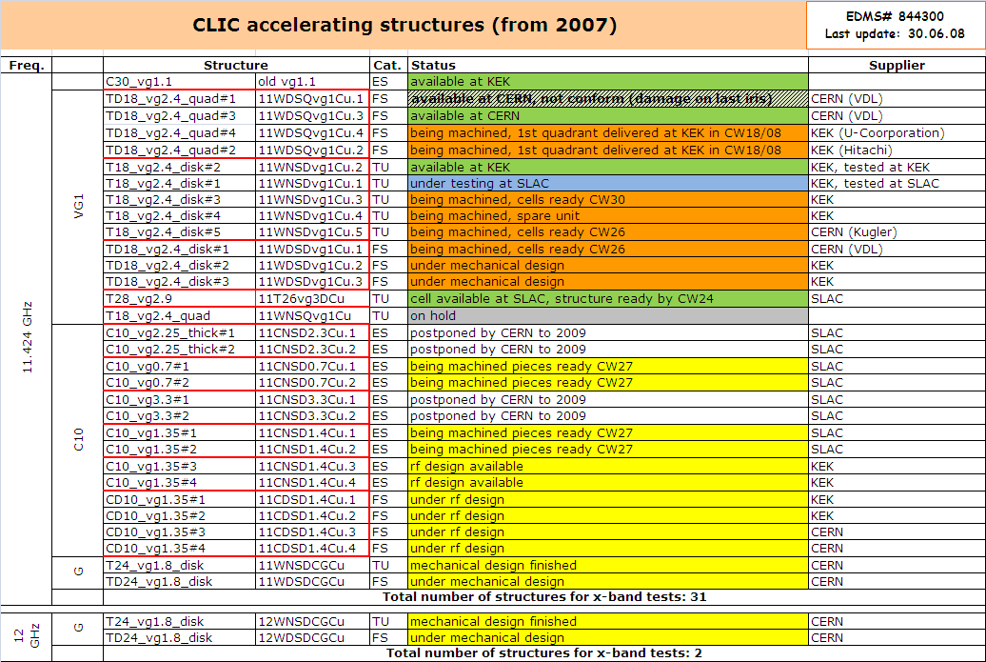
Status – x-band ac. structures

Slide 4
CLIC vg1 quadrant damped TD18_vg2.4_quad#3
For the preparation decision to follow the same procedure as SLAC for the disk version
Done at CERN: dimensional control, Rf check, cleaning, assembly test ➔ shipping to SLAC on 24.06
To be done at SLAC: heat treatment, brazing of the cooling pipes, SEM, baking, final assembly, rf checks
CERN agreement on additional SLAC costs
Question: Tuning (yes/no) ➔ decision postponed after heat treatment
Heat treatment at CERN done for #1 (same cycle as for SLAC) ➔ then rf check, dimensional control, tuning test

Slide 5
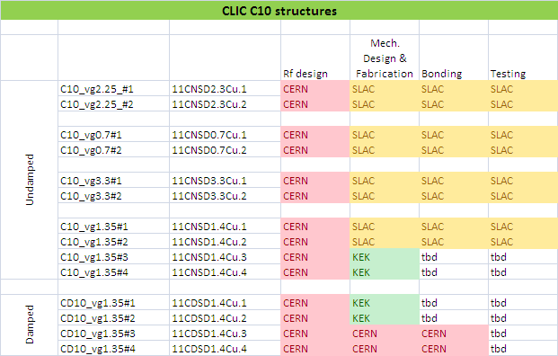
C10 damped structures
Cern agreement

Slide 6
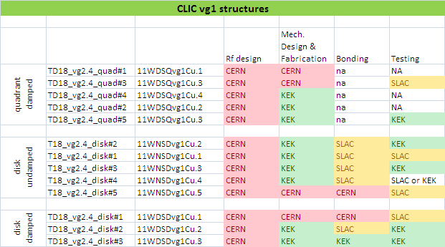
CLIC vg1 structures

Slide 7
Status - PETS
Received bars for 12 GHz test ➔ Dimensional control: OK (+/- 10 μm)

Slide 8
PETS 11.4 GHz w/o damping mat.
Done at CERN before shipping to SLAC
Dimensional control of two bars
Brazing and preparation of the couplers
Assembly test
Rf check
Cleaning of all pieces
EB welding of the bars
Tank and couplers assembly
Final EB welding: 07.07
rf test + UHV test
PETS shall be shipped to SLAC in CW28 at the latest

Slide 9
11.4 GHz Loads (x4) for KEK
11.4 GHz Loads (x4) for KEK 2 with KEK flanges and 2 with SLAC flanges
Rf design done
Mechanical design done
Call for tender under way
Fabrication: by end of October
Supply of the material: shipped to CERN, not received yet
SLAC flanges: pieces available at CERN, brazing and assembly by end of July

