Slide 1
Development of Control System towards SuperKEKB SuperKEKB に向けた運転制御システムの開発
< kazuro.furukawa @ kek.jp >
古川和朗、秋山篤美、岡崎知博、小田切淳一、門倉英一、草野史郎、工藤拓弥、倉品美帆、佐藤政則、中村卓也、中村達郎、諏訪田剛、三川勝彦、水川義和、宮原房史、吉井兼治
(Control Group, SuperKEKB Ring/Linac)
August 2011.

Slide 2
加速器制御
加速器の全てのコンポーネントとハードウェア・ソフトウェアを通して関わりを持てるので楽しい
加速器の全てのグループに対して人と人との関わりを持てるので楽しい
いつの間にか加速器の性能向上や実験成果に貢献できるので楽しい

Slide 3
昨年までの KEKB での制御
EPICS を制御ソフトウェア環境として利用
建設時にはこの業界で広く使われ始めていた
いくつかのフィールドネットワークを組み合わせた
VME, CAMAC, ArcNet, GPIB, etc
スクリプト言語を利用した運転ソフトウェア
SADScript/Tk, Python/Tk, Tcl/Tk などを多用
特に SADScript は加速器, EPICS, グラフィクスの橋渡し
朝のミーティングで新しい提案があると、夕方には運転方法が一変していることも
SLAC との競争では大きな力に

Slide 4
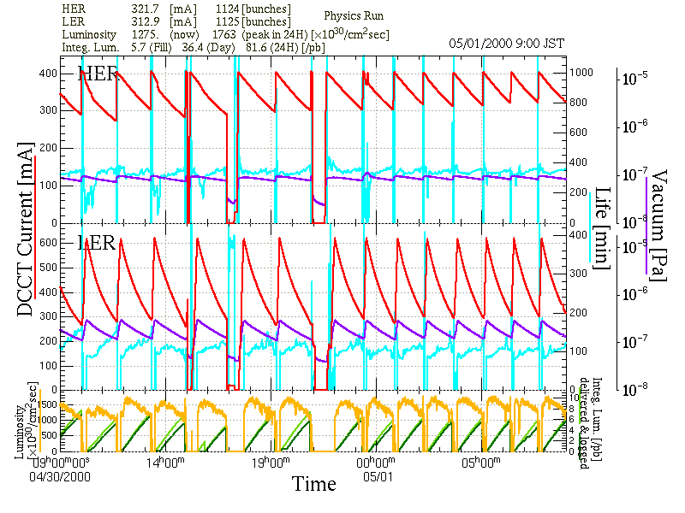
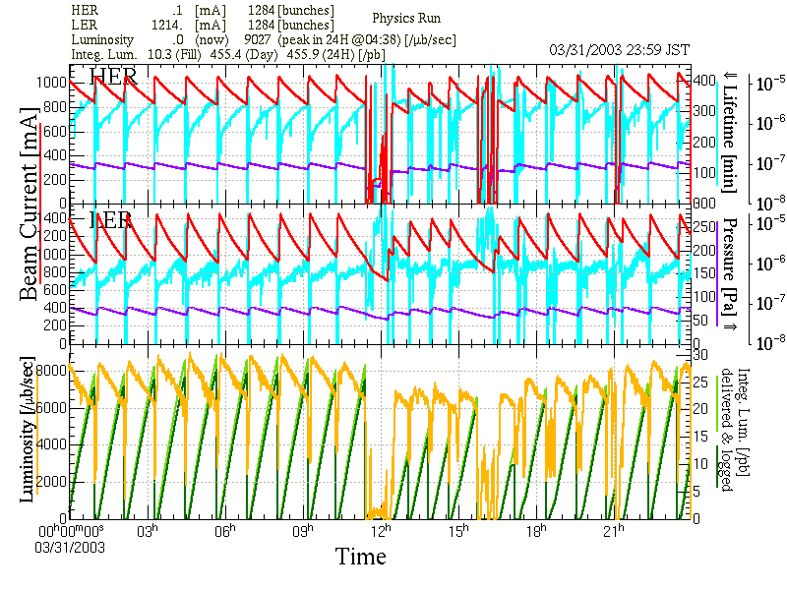
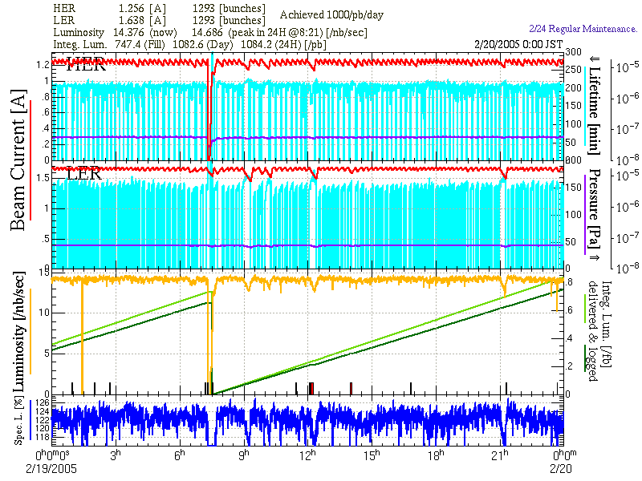
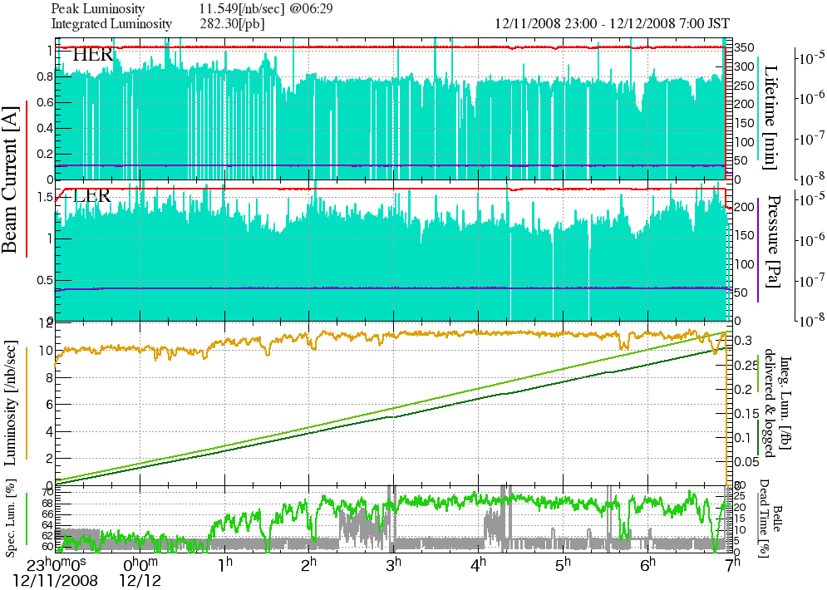
KEKB の運転形態の変化
Belle/KEK
制御が
運転の強固な基礎を形づくり
毎日の変化にも柔軟に対応する
May.2000
Apr.2003
Dual Bunch e⁺
Feb.2005
Continuous
Injections
Dec.2008
Crab Cavities and
Simultaneous Injection

Slide 5
じゃあ SuperKEKB の制御は？
基本は KEKB の制御を踏襲
老朽化したものは置き換える
CA Everywhere
どこでも EPICS
Another layer below/over EPICS
制御機能の拡張

Slide 6
KEK における制御
VME + Unix (1990年頃)
Standard (EPICS) configuration
複数のフィールドネットワークも利用
Every controller on IP network (1995年以降)
物理的に2階層、論理的には3階層 (電子Linac, J-PARC )
Every controller with EPICS IOC (2005年以降)
Channel Access everywhere (CA Everywhere)
長期保守・維持に有利
多数の IOC を効率よく管理するために Network に工夫

Slide 7
制御システムの変遷
Mini Computer
Unix
Unix
OPI
VME
VME/IOC
IOC
Mini Computer
Field
Networks
TCP/IP
Channel
Access
Devices
Device Controller
Device Controller
Device
IOC

Slide 8
組み込み EPICS IOC
単なる情報サーバだけでなく、共通のソフトウェア枠組みが動作し、開発・維持に有利
μTCA の LLRF モジュール: Linux/FPGA (小田切他)
横河製 PLC: Linux CPU モジュール (小田切他)
Oscilloscope による 50Hz パルス測定: Windows (佐藤他)
MPS 管理用 :Linux/FPGA/Suzaku (秋山他)
TDC Timing 監視: Linux/Armadillo (草野他)
Libera BPM 読み出し Linux/FPGA (佐藤他)
NI の cRIO による真空制御: FPGA (小田切他)
今後も…
OPI
CA
IOC
CA
Device
IOC

Slide 9
Standard EPICS
Channel Access (CA) as “Software bus”
CA on Ethernet
IOC
IOC
IOC
IOC

Slide 10
Channel Access on MicroTCA Backplane
CA on Hardware “bus”
CA
GbEther
IOC
IOC
IOC
IOC
MicroTCA
Picture by J.Odagiri

Slide 11
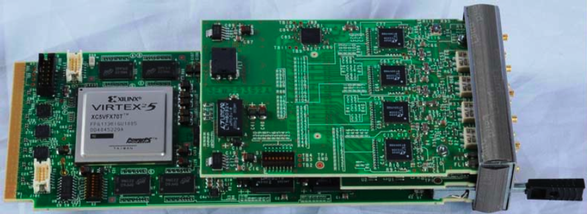
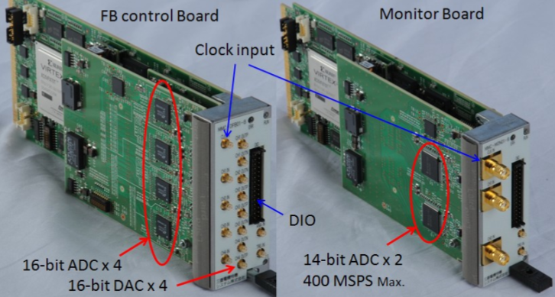
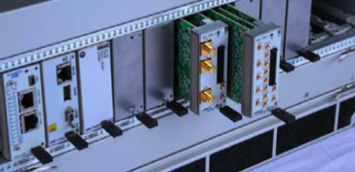
RF Group
Mitsubishi Tokki

Slide 12
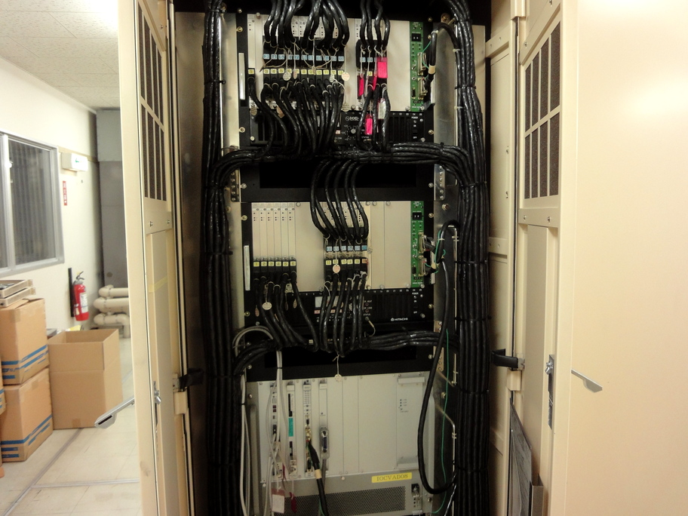
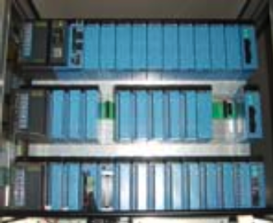
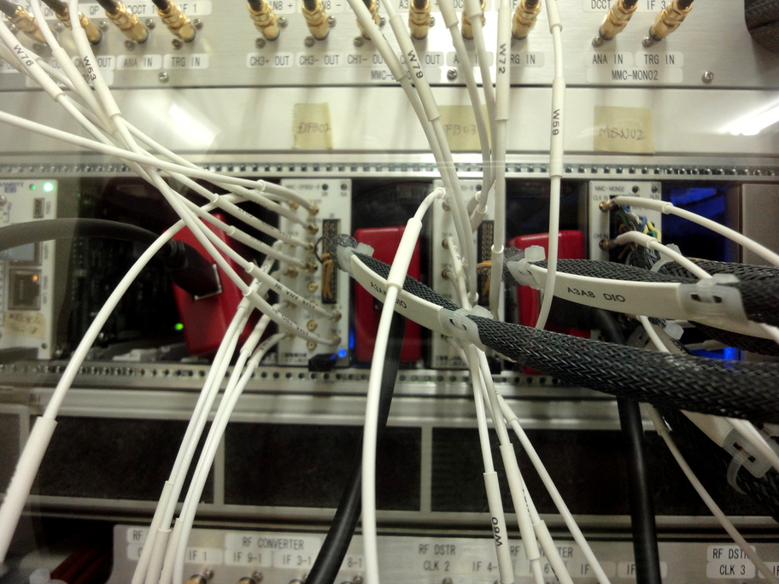
RF Controls
CAMAC and NIM modules
MicroTCA and PLC
gradually

Slide 13
PLC に組み込み EPICS IOC
200 台近くの PLC が使用されている
ほとんど全て Ethernet/IP 接続
ソフトウェアが共通化され、保守が容易になっている
Linux CPU が使えるようになり
組み込み EPICS IOC も可能になった
533MHz PPC, 128MB RAM, 2xEthernet, USB
Kernel 2.6 with realtime patch
Realtime 応答が 150μ秒以下 (EPICS を通した I/O)
全ての EPICS IOC 機能が使用でき、これまでの ラダーシーケンス CPU も併用できる

Slide 14
Simpler PLC Usage under EPICS
Conventional PLC usage with asynchronous access
OPI
CA Clients
IOC
(Logics)
FAM3 PLC
I/O Modules
Ladder CPU
(Logics)
OPI
CA Clients
FAM3 PLC
I/O Modules
F3RP61
IOC
If necessary, we can combine
OPI
CA Clients
FAM3 PLC
I/O Modules
F3RP61
IOC
Ladder CPU
Logics are confined in PLC, and management is easier

Slide 15
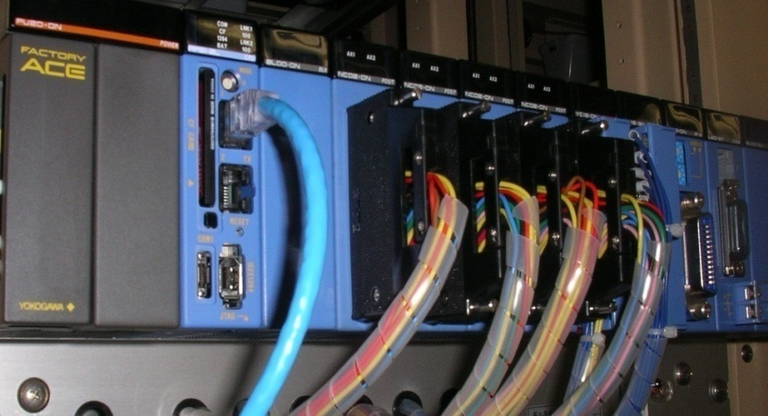
Many medium-speed
controllers implemented
KEKB, Linac, J-PARC, PF, cERL, RIKEN, NSRRC, (Korea/PAL, Beijing/IHEP)
Image processing module available
Discussing on EVR module production with SINAP/Shanghai
<http://www-linac.kek.jp/cont/epics/f3rp61/>

Slide 16
タイミングと高速広域同期制御
複数の RF を安定供給 (RF group)
114, 509, 571, 1298, 2856 MHz
独立の周長補正とバケット選択
KEKB は 4x10⁻⁷, PF, PF-AR は 4~20x10⁻⁶
SuperKEKB 入射タイミング 30ps 以下
PF と PF-AR に対しては偶然の同期 (~300ps)
４リング同時入射
20ms 毎にエネルギーや電荷、同期切り換え
ダンピングリング (≧20ms) を通すのでパルス間の依存関係も大きい
できればダンピングリングでの RF 位相制御

Slide 17
高速広域同期制御 (パルス毎制御)
MRF’s series-230 Event Generator / Receivers
VME64x and VxWorks v5.5.1
EPICS R3.14.9 with DevSup v2.4.1
17 event receivers up to now
114.24MHz event rate, 50Hz fiducials
More than hundred 50Hz-Analog/Timing data
Multi/single-mode fiber
Timing precision is < 10ps.
< 1ps with external module.
Central
Event Generator
SH_A1
Injection
KL_B5/B6
SB_B
SB_A
96ns
e⁻ Gun
e– BT (PF: 2.5GeV, 0.1nC)
>100ns
ARC
Cont-ABC
KL_51/52
SB_C
SB_1
SB_2
SB_3
SB_4
SB_5
e⁺ BT (KEKB: 3.5GeV, 2nC)
>100ns
e⁺ Target
96ns
Cont-1
Cont-2
Cont-3
Cont-4
Cont-5
e– BT (KEKB: 8GeV, 2nC,
PFAR: 3.0GeV, 0.1nC)
Event Receivers

Slide 18
二階層の制御
これまでの CA 経由の IOC 間制御
1ミリ秒以上の制御、順序は保証、タイミングは保証無し
高速同期の SFP/Fiber 経由の FPGA 間制御
10ピコ秒から1秒程度の 114MHz 同期制御
OPI
IOC
IOC
IOC
IOC
EVG
EVR
EVR
EVR

Slide 19
ひとつの加速器が複数の仮想加速器に見える
制御は測定は入射モード依存で行われ、モード間の依存関係は小さい
入射モード毎に独立の制御パラメタセットを使い、複数の仮想加速器のうちのひとつを制御する
SuperKEKB では HER (e-), LER (e+), PF, PF-AR と測定用の Linac 内モードいくつか
e⁻ Gun
e– BT (PF: 2.5GeV, 0.1nC)
ARC
PF Injection
e⁺ Target
Event-based Control System
e⁻ Gun
ARC
KEKB-LER Injection
Primary e– (4GeV, 10nC)
e⁺ BT (KEKB: 3.5GeV, 0.6nC)
e⁺ Target
e⁻ Gun
ARC
KEKB-HER Injection
e⁺ Target
e– BT (KEKB: 8GeV, 1.2nC)

Slide 20
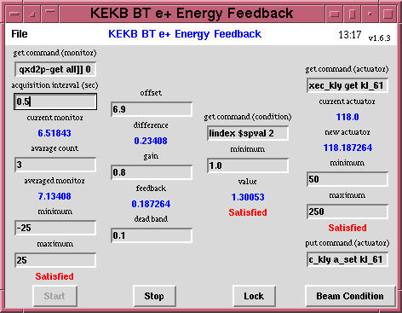
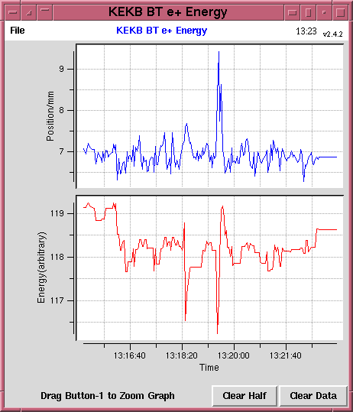
多重の独立閉ループ制御
おそいフィードバックループはひとつの仮想加速器だけに働く
KEKB での試験例
e⁻ Gun
e– BT (PF: 2.5GeV, 0.1nC)
ARC
PF Injection
e⁺ Target
Event-based Control System
e⁻ Gun
ARC
KEKB-LER Injection
Primary e– (4GeV, 10nC)
e⁺ BT (KEKB: 3.5GeV, 0.6nC)
e⁺ Target
e⁻ Gun
ARC
KEKB-HER Injection
e⁺ Target
e– BT (KEKB: 8GeV, 1.2nC)

Slide 21
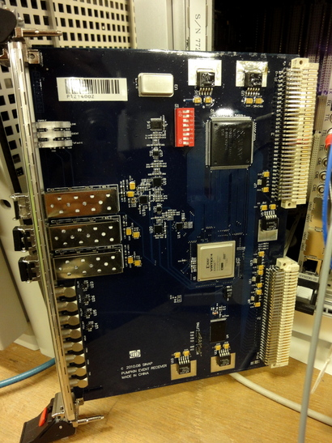
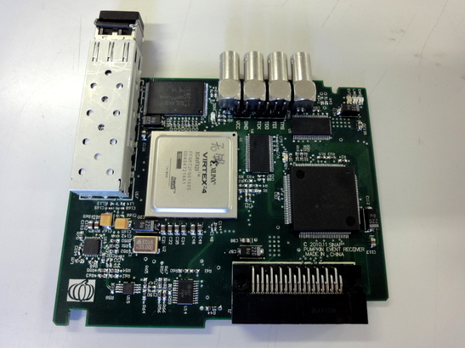
SSRF における PLC 向け Event Receiver 開発
横河 PLC (F3RP61 Linux CPU) 向け
昨年プロトタイプ製作
実用版が年内
同期制御の追加が Cost 1/3 以下

Slide 22
SuperKEKB での Linac ビーム運転
ビームモニタの性能向上
位置モニタ、ワイヤスキャナ、デフレクタ、等の測定系
精度と同期測定などのさらなる機能向上
４リング同時入射
運転中のビーム性能向上はまだ検討中
イベント制御を最大限活用
４リング入射間で独立のビーム測定
入射しないビームのデフレクタによる Stealth 測定
普通の閉ループ PID の他にできれば Dithering
ビームモニタの精度向上が必要

Slide 23
SuperKEKB に向けて
個々の装置の制御機器更新と機能向上
各グループとの個別ミーティング、老朽化対策
基本制御ソフトウェアの更新
特に EPICS 国際協力による成果共有
基本運転ソフトウェアの更新
アーカイバ、アーカイブビューワ、アラーム、運転ログ
居室への情報提供
さらに Web 経由の情報を増やす
セミナ・トレーニング
ネットワーク高速化、無線 LAN、コンソール

Slide 24
まとめ
制御は全ての加速器要素と関わりを持ち、重要であると共に、加速器を楽しめる有利な位置付け
“CA Everywhere” や “多重階層制御” を増強
フロネシス (実践的智恵, 普遍的真実を理解する能力) を持ってすれば必ずや性能向上が図られるはず

Slide 25
Thank you

Slide 26
Backup

Slide 27
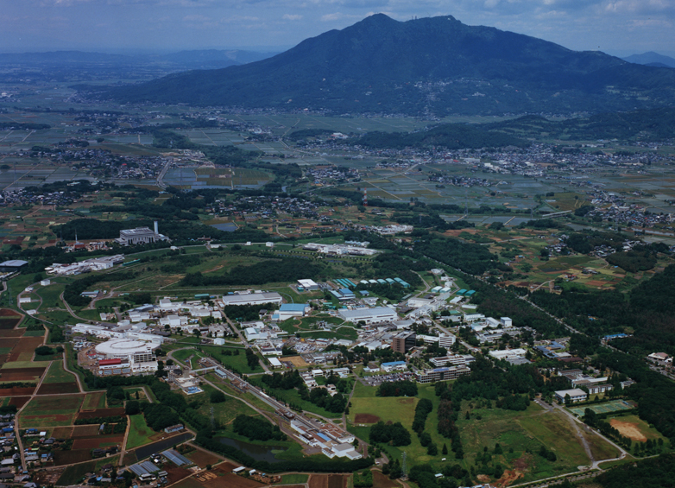
Accelerators at KEK
Several Accelerator
Projects are Running
Mt. Tsukuba
J-PARC
(at Tokai Site)
(Super)KEKB
PF-AR
ATF
STF
cERL
PF
Linac
50km from Tokyo
70km to Tokai
300km to Kamioka

Slide 28
Event System Consideration for SuperKEKB
Possibly Cascaded Event Systems
For damping ring, main ring and other sub-systems
New firmware with new register map
For newer device support software in EPICS community
Several local modification already, want to synchronize with other institutes
Several institutes in Asia may use CompactPCI as well
Whether PLC version can use the same environment??
Several fast control projects for SuperKEKB
Several embedded systems with PLC EVRs for RF stations
Bucket selection to cover both damping and main rings
In KEKB, separate system was used and selection signal was used as AC to EVG
Fast feedbacks in Linac and in main ring
Several others

Slide 29
SuperKEKB timing software upgrade
Basically the same configuration as KEKB
Intelligent panels – pulse-by-pulse EVG Sequences – EVR PV databases
Need to upgrade to newer device driver/support with new register mapping
Under evaluation with newer firmware/EPICS support
Need more coordinated beam pattern generation
Need dependencies between pulses
Need to decide whether to change phases at DR
Need synchronization to laser rf gun
Laser based on local oscillator, need PLL and stabilization strategy
Possible more addition of event receivers to BT and Rings
Possible upward links for bucket selection data (SSRF or MRF)
Linux-based device support for EVR/PLC from SSRF on F3RP61
Should be simple (?) based on standard FAM3 bus access

Slide 30
Pulsed power supply interface
In KEKB
Beam trigger was provided
50Hz, 25Hz, 10Hz, 5Hz, … non-equal interval
In SuperKEKB
Beam trigger and a pre-trigger 18-22ms before
To stabilize the power supply
If necessary and effective

Slide 31
Reducing deadtime at pixel detectors
Pixel detector read-out do not provide azimuthal veto
Are there any injection schemes that co-operate with pixel detectors better?
One of injection schemes (50Hz before DR and 25Hz (e- & e+) after DR) needs much modification to accelerators and may bring operational instabilities and difficulites. It provides only 50% improvement.
Basically we need many injectors to solve the issue, that cost much.
We may have to co-operate with 10-20% deadtime.

Slide 32
RF Phase Modulation
Recommendation at machine advisory committee
Consider RF phase modulation at damping ring to increase the flexibility
Originally, the super-conducting cavity was a only fear for instability
KEKB : linac phase modulation against MR, and phase modulations between pulsed RF stations
SuperKEKB : may add DR phase modulation against MR
Now it surely adds more room for future extensions
Planned to visit SLAC… Suetake et al.

Slide 33
SuperKEKB Plan (1)
For nano-beam scheme with 40-times higher luminosity
Many new facilities should be required
Will start based on the existent environment
With additional concept of CA everywhere
Help device groups to have better global controls
Replacement of old installations such as CAMAC
Solutions not only VME but also other types of controllers, embedded EPICS if possible
Faster networks for the groups who can build controllers by themselves
Better connection to operational environments
Keeping SAD environment, etc
Monitoring at offices

Slide 34
SuperKEKB Plan (2)
Archiving scheme and viewer
Maybe existing KEKBlog and channel archivers
New viewer should be developed
Alarm handler
CSS or Python (to simulate KEKBalarm)
Evaluating
Operational Log
In house, two versions with different origins
Postgres + (Python/Zope and Flash/Flex)
Scripts
SADscript/Tk, Python/Tk, (decreasing Tcl/Tk)
Displays
CSS and MEDM/EDM

Slide 35
SuperKEKB Plan (3)
Interviews to each device groups
Planning to have meetings and trainings
To collect user requirements, etc
Partially successful for old hardware replacements
Not yet effective for new functionalities
Whether both sides do not have experiences
Additional controls
ex. Global orbit feedback
May provide EPICS interface, middle-speed feedback, etc

Slide 36
Summary
Controls Have Interface to Every System in Accelerators
We can Enjoy Accelerator
There should be Room to Establish Further Controls Utilizing Beam Monitors, RF Monitors, and More
With Phronesis, (Ability to understand the Universal Truth)

Slide 37
SuperKEKB
Electron-positron asymmetric collider
Based on a decade of successful operation at KEKB
(Most part of) the budget was approved
Have to start the operation in 2014
Have to recover the damages by earthquake
Aims at 40-times higher luminosity
8 x 10³⁵cm⁻²s⁻¹ for further flavor physics studies
7GeV / 2.6A electron, 4GeV / 3.6A positron
β_{y}* ~ 0.3mm, ε_{x} /ε_{y} ~ 4nm/9pm, σ_{y} ~ 50nm, σ_{z} ~ 6mm
Ante chamber, longer bend, damping ring, rf gun,etc

Slide 38
In this meeting
J-PARC
Norihiko Kamikubota (上窪田)
Shuei Yamada (山田)
PF, PF-AR, cERL
Takashi Obina (帯名)
SuperKEKB, Linac
Masanori Satoh (佐藤)
Kazuro Furukawa (古川)

Slide 39
Control Systems at KEK/Tsukuba (1)
SuperKEKB
Will inherit resources from KEKB (and TRISTAN)
Upgrade 2011-2014 was approved
Linac (electron/positron)
Inject beam to (Super)KEKB, PF, PF-AR
Pulse-to-pulse beam modulation
PF (Photon Factory)
Moved to EPICS environment
Mainly with Linux-VME
PF-AR (Photon Factory Advanced Ring)
Mostly the same environment as KEKB
Many CAMAC installations

Slide 40
Control Systems at KEK/Tsukuba (2)
ATF (Accelerator Test Facility)
Vista Controls environment with CAMAC
Linux and socket environment with some EPICS devices
STF (Superconducting RF Test Facility)
Test facility for ILC
EPICS with Linux, ATCA test, PLC, …
cERL (Compact ERL)
Being built for ERL development
May share the resources with other accelerators
Sharing resources as much as possible

Slide 41
Parameters
Parameters switched via event system
LLRF phase/timing : 14x4
Overall energy profile, dual-bunch energy equalization, final energy adjustment
HP RF timing : ~60
Energy profile and backup management
Gun voltages, picosecond delay : 4
Beam charge selection, dual bunch selection, bunching
Pulsed magnets/solenoid : 14
Beam transport selection, orbit controls, positron focusing
Injection phase interface : 2
Bucket selection interface : 2
BPM : ~100x3
Sufficient for fast beam mode switching
Integrity monitors soon

Slide 42
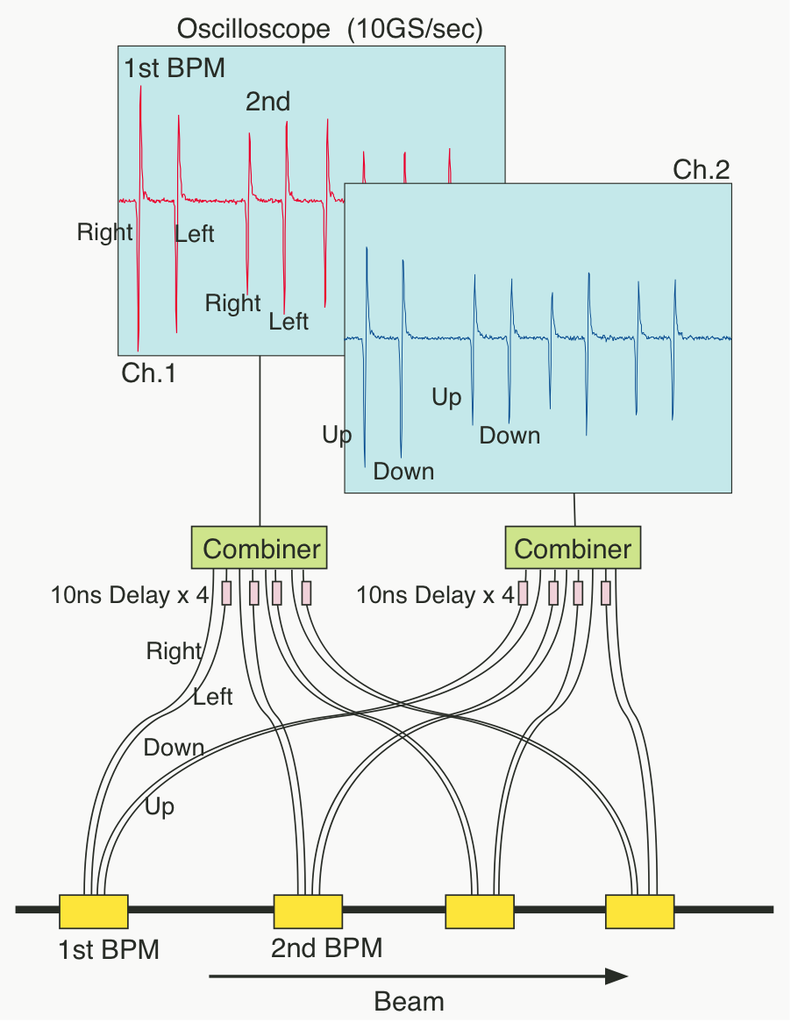
BPM at Linac and BT
BPM need only 0.1mm resolution
Using ~30 coefficients per BPM
Many signals are combined into one waveform digitizer
Again reduction of resources
Recent Embedded IOC Solution
Much helped by Dr. Yong Hu
100 BPMs
24 x DPO7104
Clients
Old configuration
100 BPMs
19 x TDS680B
19 VMEs
~5 Unix
Clients

Slide 43
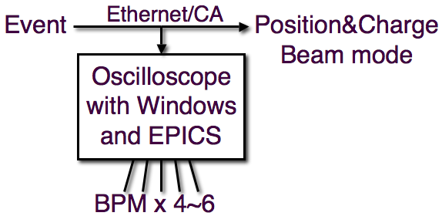
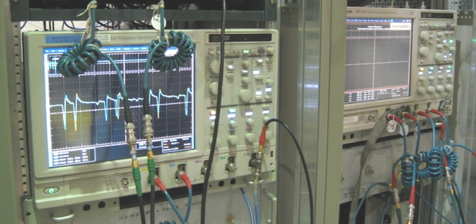
BPM DAQ
Tektronix DPO7104 can acquire data at >50Hz.
With embedded EPICS, under pulse-to-pulse beam modulation
Beam modes are recognized by events through CA network.
Missed less than once in million times
Clients can monitor data of an interested beam mode.
24 oscilloscopes are installed for Linac, and 4 for BT.
200 BPMs are synchronized for Linac and BT.

Slide 44
KEKB Commissioning Groups
KEKB and Linac Operation
Formation of Commissioning Group (KCG)
Linac Commissioning (LCG)
7 from Linac
~10 from Ring
KEKB Ring Commissioning Group (KCG)
All LCG
~20 from Ring
Several from Detector (BCG)
Commissioning software base was formed during Linac Commissioning (1997~)
SADscript/Tk , Python/Tk
KEKB
Commissioning
Group
Linac
Commissioning
Group
KEKB Ring
Linac

Slide 45
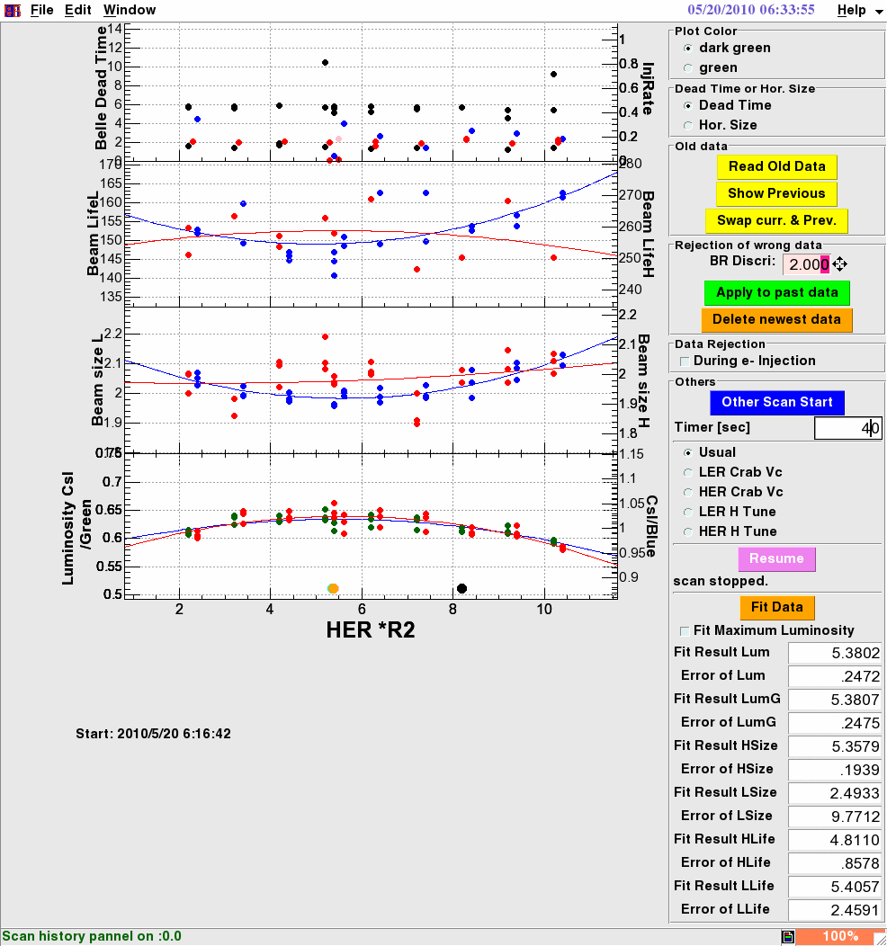
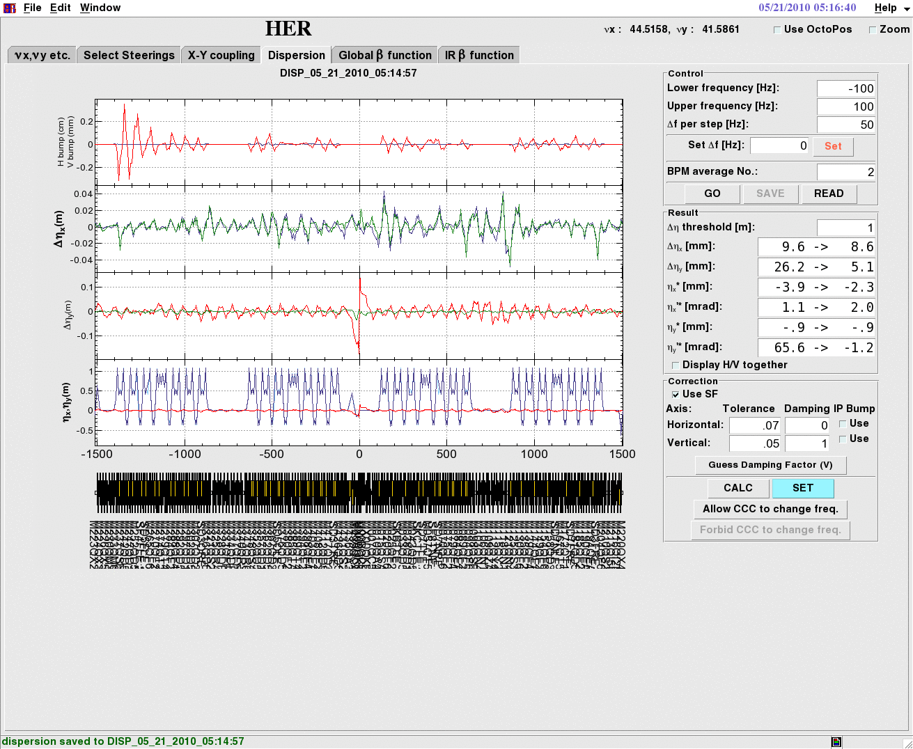
SADscripts/Tk
Many machine diagnostic and correction/feedback tools

Slide 46
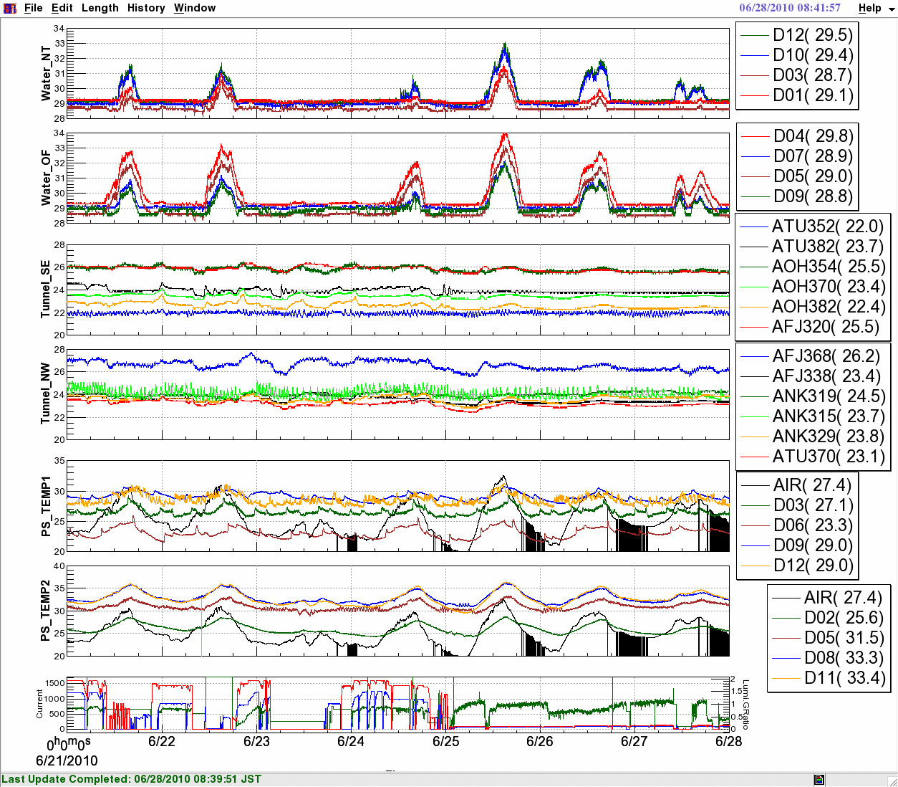
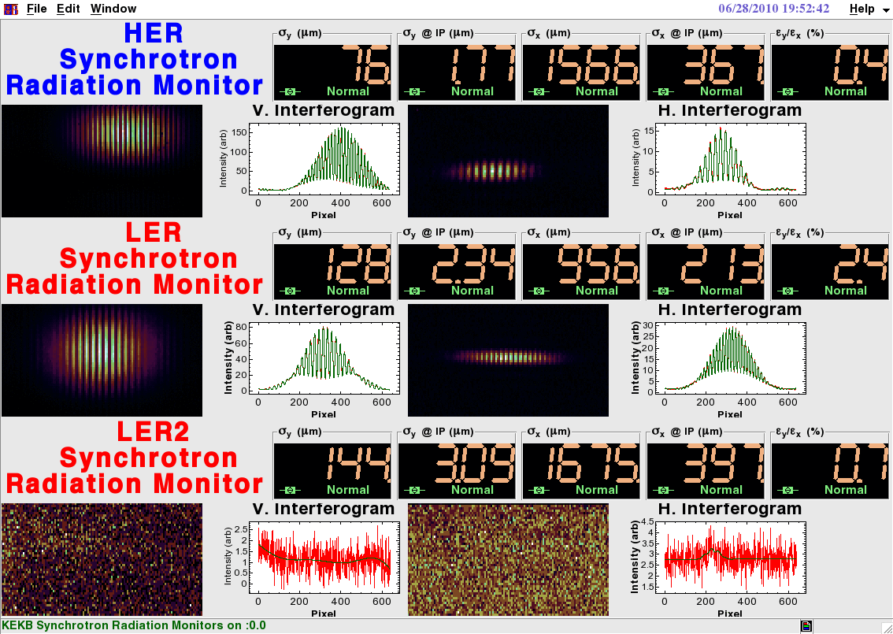
Archive viewers and Strip charts
Visualization is important

Slide 47
Linac Power/Energy Management
Power management at each power source
of 60 50-MW power sources
In order to maximize the power
But not to increase the trip rate
Interlock at a reflection level VSWR of 1.4
If a trip rate is higher, the voltage is lowered
Surveyed statistically every week
Some sources will be stand-by state
As backups, if the energy is enough
KEKB e+ has several stand-by, KEKB e– has typically one
Energy conversion
Energy gain = constant x sqrt( power )

Slide 48
Crest Phase Calibration
Each power source with slow phase shifter
Energy measurement scanning the phase shifter
Primitive but reliable, while there were several methods
Chicken and egg issue exists on bootstrap
If no beam at the end, no measurement possible
Every several month at least after the long shutdown
Automated measurement takes ~2hours for 60 sources
Result is saved as a reference to other software
If the voltage was changed, nominal crest change is applied (1kV => ~8degree) (to be measured later)

Slide 49
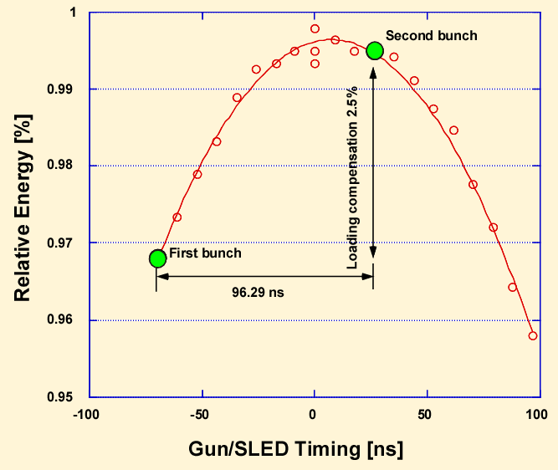
Two-bunch Energy Equalization
Two bunch in a pulse
Energy compensation
Depending on beam charge
Fast timing adjustment
Automated measurement
Same procedure
As crest phase measurement
With ns timing as a variable

Slide 50
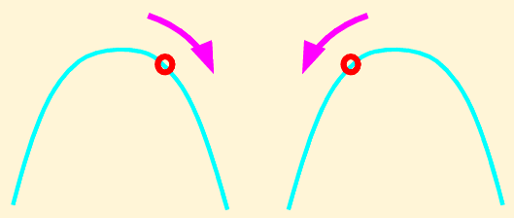
Energy Profile
8 driver klystrons with fast phase shifters
Each manage ~8 high power klystrons
Define the overall energy profile
With Small phase angle (from the crest)
Energy spread compensation depending on beam charge
4 klystrons with fast phase shifters
Forming two energy-knobs to adjust the energies
Before the arc and at the end of the linac
Not to enlarge the energy spread
Two klystrons are grouped

Slide 51
IOC on MicroTCA
Decided to put IOC on μTCA LLRF Controller
Natural after generations of LLRF Controllers
Shared among STF, cERL, and SuperKEKB
Chose GbEthernet as a main media on the backplane interconnect
Somewhat unique
Some other institutes chose PCIe as the media
Chose PowerPC core on Virtex5
ML507 of Xilinx as a good reference
Linux on PowerPC (Windriver Linux)
No realtime processing is necessary for now
Later, we may use realtime PREEMPT_RT (<100μs) of Linux

Slide 52
MicroTCA based LLRF Controller
RF Group
Single-width full-height module
Without physics experiment extension (we started earlier)
Front-panel connectors (rather busy)
Digital part and Analog part are separate
ADC 16bit, 130Msps, x4
DAC 16bit, 500Msps, x4
Virtex5 with PPC440
RAM 640MB, Flash 64MB
Also monitor card with the same digital part
ADC 14bit, 400Msps, 1.4GHz, x2
Fabrication subcontracted
Mitsubishi Electric Tokki System
<http://www-linac.kek.jp/cont/epics/mtca/>

Slide 53
KEKB Controls
EPICS as basic environment
As standard software configuration as of 1997
Several field networks, CAMAC, ArcNet, etc
Scripting languages for operational tools
SADscript, Python/Tk, Tcl/Tk
Rapid modifications based on daily meetings
Any operators should be able to manipulate beams, and so on

Slide 54
Vacuum Controls
With Hisamatsu et al.
CAMAC, GPIB, VME, PLC, …
CompactRIO(?) and Yokogawa-PLC, …
with possibly embedded EPICS IOC/CA-server
Joined in developments in vacuum group
Component software for SuperKEKB is ready
Application software requirement is being analyzed

Slide 55
Magnet Controls
With Tokuda et al.
Several options in the past
Analysis of ARCnet-based controllers
Versions of Ethernet-based controllers
Decided to develop new ARCnet system
Power-supply control card
ARCnet Hub
VME interface card
Fabrication in FY2011, Evaluation in FY2012

Slide 56
Beam monitor
with Tobiyama et al.
Provide VME basis and networks
VME “is” slow, as you know
Part of issues was resolved
VME extension (64bit, serial-bus) is possible, but modification to I/O cards necessary
MicroTCA with physics extension?
GbE IP networks to devices, 1G or 10G for backbone
Dark fiber for direct feedback communication?

Slide 57
Protection systems
Personnel protection system
EPICS interface to safety system based on Yokogawa PLCs
Provide help for CSS user interfaces, archivers, …
Machine protection system
Maybe as it is
Possible to provide replacement with FPGA-based controller (,which is used at J-PARC and STF, cERL)
with Mimashi et al.
with Suetake et al.

Slide 58
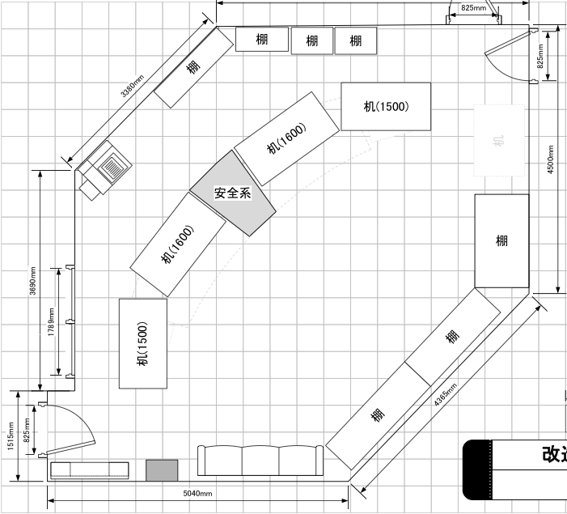
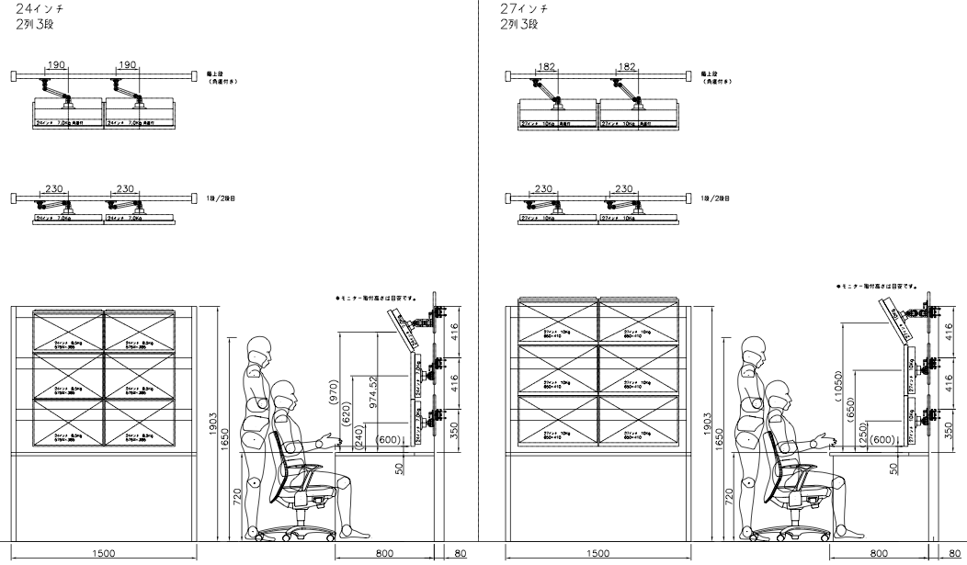
Console (?)
Linac console modification this summer
For flexible display arrangement

Slide 59
Timing requirement at SuperKEKB
Stable multiple frequencies (114, 571, 1298, 2856, 509MHz)
Beam bunching for large-current positron single-bunch generation
Need integer relations (common freq. 10.38MHz)
Injection timing precision of 30 picoseconds
Integer relation to (Super)KEKB for aperture at IP
Accidental coincidence for PF and PF-AR with less severe condition
Independent Circumference corrections at KEKB, PF, PF-AR
KEKB changes 4x10⁻⁷, PF and PF-AR changes 4~20x10⁻⁶
2bunches in a single pulse (50Hz)
Separated by 96ns (common freq. 10.38MHz)
Simultaneous top-up injections to 4 rings SuperKEKB HER/LER, PF and PF-AR, thru damping ring
Common beam transport to KEKB and PF-AR will be upgraded

Slide 60
Fast Controls
~150 parameter switching within 20ms
Keep most of magnet fields with compatible optics
Control llrf to change energy
Pulsed magnet triggers and delays
Delays to keep the constant rate for certain power-supplies
LLRF phases and delays
Gun voltage and fine delay
Interface to bucket selection, etc
(Ethernet-based controls are not reliable enough?)
FPGA and fiber-optic RocketIO might be the way ?

Slide 61
Event System
Simultaneous Injection
to KEKB-HER, KEKB-LER, and PF, PF-AR
2.5GeV to 7GeV, 0.1nC to 10nC
Stable stored beam current at four rings
Should improve collision tuning in SuperKEKB
Should improve the quality of experimental data at light sources
Fast switching of many device parameters
In 20ms / 50Hz
Should be reliable because beam power is much different
MRF Series 230 Event Generator / Receiver
VxWorks 5.5.1, MVME5500 (Originally with RTEMS but…)
Timing precision less than 10ps is sufficient (TD4 provides 3ps)
Multi-mode fiber, and single-mode fiber for longer distance

Slide 62
Event Manipulation
Flexible with script and reliable/fast with FPGA.
Human Operator
Injection Programs
Arbitrate and Generate Beam Mode Pattern (in PythonTk)
considering priorities of the rings
equalizing pulsed power supply interval
in 4 arrays (waveforms) of length 2 (40ms) to 500 (10s)
each element corresponds to a 20-ms time slot and a beam mode
Generate Events for the Next 20-ms Time Slot (in Event Generator)
reading two consecutive elements from the beam mode pattern
generate several events for the next pulse
generate preparation events for the next after next
Generate Signals based on Received Events (in Event Receiver)
generate pulsed signals as prepared in the previous time slot
program the signals (enable/disable, delays, etc) for the next
start to generate analog signals for the next

Slide 63
Damping ring injection for SuperKEKB
Accommodate 2 bunches 2 pulses
e⁻ Gun
KEKB
ARC
For e+ 25Hz e– 25Hz
Primary e– (4GeV, 10nC)
e⁺ BT (KEKB: 3.5GeV, 0.6nC)
e⁺ Target
Inj. | D.R. | Ext.
e+ 1 | e+ 1
e– 2 | e+ 1 | e– 2
e+ 3 | e+ 3,1 | e+ 1
e– 4 | e+ 3 | e– 4
e+ 5 | e+ 5,3 | e+ 3
e– 6 | e+ 5 | e– 6
e⁺ DR (1.1 GeV, 4nC)
e⁻ Gun
SuperKEKB
ARC
Primary e– (3.5GeV, 10nC)
e⁺ BT (KEKB: 4GeV, 4nC)
e⁺ Target

