Slide 1
Progress of Injector Linac
Kazuro Furukawa
for Injector Linac

Slide 2
概要
Alignment
電子銃
RF 電子銃
熱電子銃
陽電子発生装置
Schedule

Slide 3
Linac Upgrade Overview

Slide 4
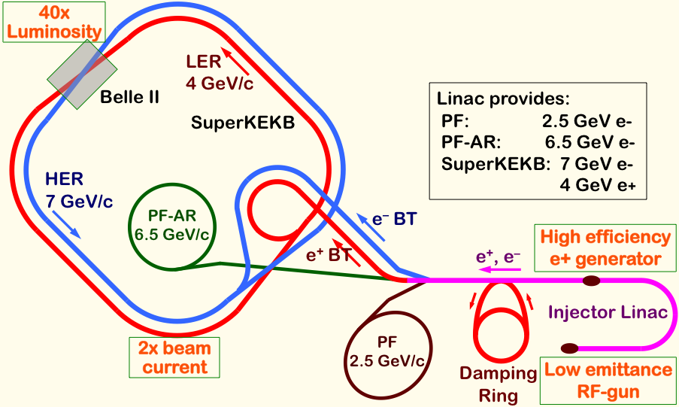
Mission of electron/positron Injector in SuperKEKB
Linac Upgrade Overview
40-times higher Luminosity
  Twice larger storage beam → Higher beam current at Linac
  20-times higher collision rate with nano-beam scheme
    → Low-emittance even at first turn → Low-emittance beam from Linac
    → Shorter storage lifetime → Higher Linac beam current
Linac challenges
  Low emittance e-
    with high-charge RF-gun
  Low emittance e+
    with damping ring
  Higher e+ beam current
    with new capture section
  Emittance preservation
    with precise beam control
  4+1 ring simultaneous injection
Notes:
Higher Injection Beam Current
To Meet the larger stored beam current and shorter beam lifetime in the ring
4~8-times larger bunch current for electron and positron
Reconstruction of positron generator, etc
Lower-emittance Injection Beam
To meet nano-beam scheme in the ring
Positron with a damping ring
Electron with a photo-cathode RF gun
Emittance preservation by alignment and beam instrumentation
Quasi-simultaneous injections into 4 storage rings
SuperKEKB e–/e⁺ rings, and light sources of PF and PF-AR
Improvements to beam instrumentation, low-level RF, controls, timing, etc

Slide 5
電子ビームパラメタ
Linac Upgrade Overview
 | SuperKEKB | KEKB
エネルギー (GeV) | 7.0 | 8.0
HER蓄積電流値 (A) | 2.6 | 1.1
HERビーム寿命 (min.) | 6 | 200
最大ビーム繰り返し (Hz) | 50 | 50
最大バンチ数 (rfパルス当たり) | 2 | 2
エミッタンス (mm⋅mrad) | 50/20 (Hor./Ver.) | 100
バンチ電荷量 (nC) | 5 | 1
エネルギー広がり (%) | 0.1 | 0.05
バンチ長 σz (mm) | 1.3 | 1.3
ダンピングリング | n/a | n/a
同時トップアップ入射 | 4 rings (SuperKEKB e-/e+, PF, PF-AR) | 3 rings (KEKB e-/e+, PF)

Slide 6
陽電子ビームパラメタ
Linac Upgrade Overview
 | SuperKEKB | KEKB
エネルギー (GeV) | 4 | 3.5
LER蓄積電流値 (A) | 3.6 | 1.6
LERビーム寿命 (min.) | 6 | 133
最大ビーム繰り返し (Hz) | 50 | 50
最大バンチ数 (rfパルス当たり) | 2 | 2
エミッタンス (mm⋅mrad) | 100/20 (Hor./Ver.) | 2100
バンチ電荷量 (nC) | 4 | 1
エネルギー広がり (%) | 0.1 | 0.125
バンチ長 σz (mm) | 0.7 | 2.6
ダンピングリング | 〇 | n/a
同時トップアップ入射 | 4 rings (SuperKEKB e-/e+, PF, PF-AR) | 3 rings (KEKB e-/e+, PF)

Slide 7
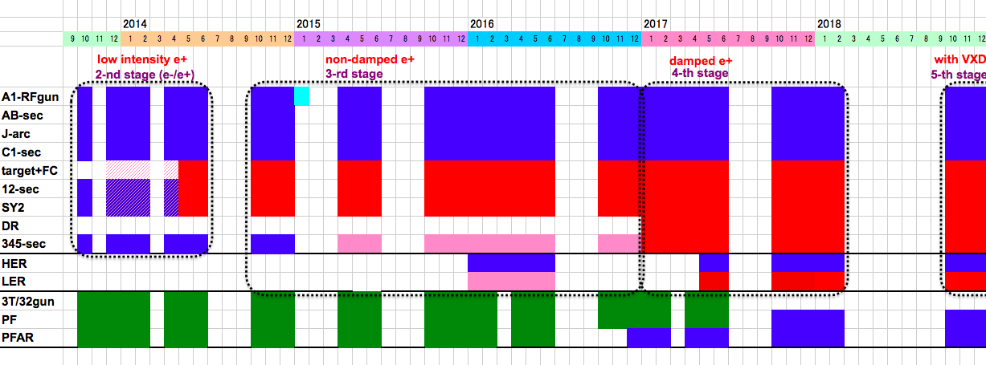
Linac Schedule Overview
Schedule
RF-Gun e- beam
commissioning
at A,B-sector
e- commiss.
at A,B,J,C,1
e+ commiss.
at 1,2 sector (FC, DCS, Qe- 50%)
e- commiss.
at 1,2,3,4,5 sector
Phase1: high emittance beam for vacuum scrub
Phase2,3: low emittance beam for collision
Time →
Location
↓
1 nC
Phase1
2 nC
Phase2
4 nC
Phase3
Without Top-up
Direct PF-AR BT
: Electron
non damped e+ commiss.
at 1,2, 3,4,5 sectors
e- commiss. at A→5 sectors
damped e+ commiss.
at 1→5 Qe+ = 1~4nC
e- commiss.
at A→5 Qe- = 1~5nC
Improved
RF gun
: Positron
: Low current electron

Slide 8
Operation Status
Operation
FY2014 の運転
  運転時間: 3900 hours (FY2013 -27%)
    PF/PF-AR Injection (and Commissioning for SuperKEKB)
    Apr.11 – Apr.25
    May.7 – Jul.1
    Sep.24 – Dec.26
    5 days in Jan, Feb
  故障 (FY2013 0.43%)
    偏向電磁石コイル発熱 (May)
    マイクロ波パルス電源デスパイカー発熱 (May)
    フラックスコンセントレータ電源側ケーブル発熱 (Dec)
    マイクロ波パルス電源トランス端末発熱 (Dec)

Slide 9
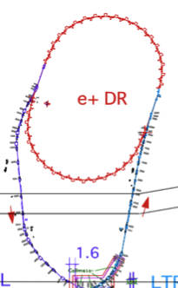
Facility for Electric Power and Cooling Water
Linac Upgrade Overview
Linac needs electricity and cooling water extensions, especially for positron generator upgrade
Separate building construction in FY2013 not to impact PF/PF-AR
Facility extensions performed during summer 2014
SuperKEKB injector
50 Hz (e+ or e-)
pulse-by-pulse
mode switching
low emittance
RF gun
1.1 GeV
Damping Ring
circ. 136 m
PF
AR
6.5 GeV e-
2.5 GeV e-
0.1nC x 1
Bunch
Compressor
LER
3.5 GeV
10nC x 2 (prim. e-)
5nC x 2 (inj. e-)
Energy-spread
Compression System
S-band
linac
4.0 GeV e+
4nC x 2
3T
RF gun
HER
ECS
e+ target &
LAS capture section
7.0 GeV e-
5nC x 2
[1] Sector 1,2
Electricity and cooling water addition for new positron generator
+920 kVA, +900 L/min
[2] Sector 2,3
Electricity addition for new damping ring
+310 kVA
[3] Sector 5
Electricity and cooling water addition for energy compression, beam diag., injection beamlines
+300 kVA, +460L/min

Slide 10
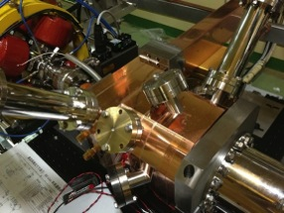
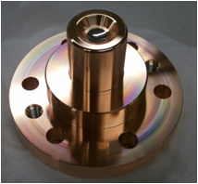
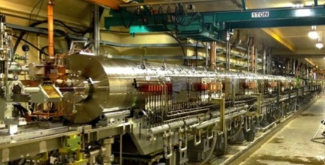
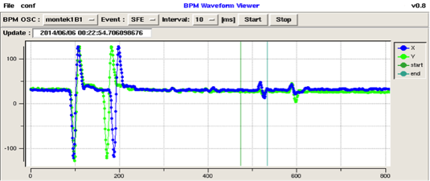
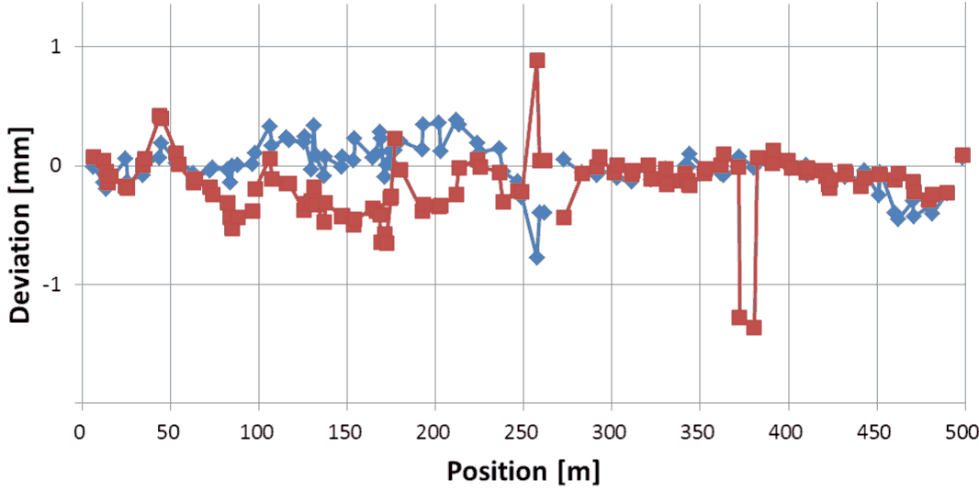
Linac Upgrade Progress towards SuperKEKB (1)
Linac Upgrade Overview
High-charge low-emittance RF gun development
  QTWSC cavity and Ir5Ce
  photo cathode works well
Positron generation confirmation for the first time
  Good agreement with
  the simulation results
Precise alignment for emittance preservation
  Recovering after earthquake
  Reaching specification of 0.3mm
Utility upgrade during summer 2014
  for electricity (+1.5MW) and cooling water (+1400L/min)
Quasi traveling wave
side couple cavity
Ir₅Ce
Cathode
Positron generator
Signal from
primary electron
Signal from positron
with opposite polarity

Slide 11
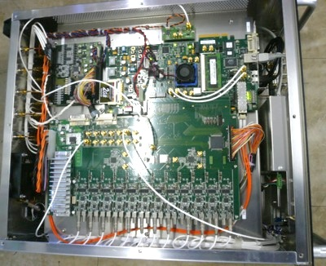
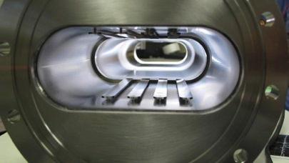
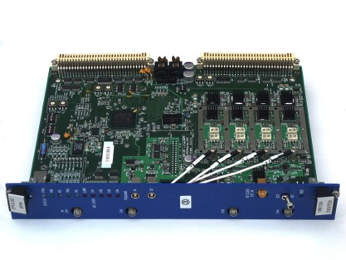
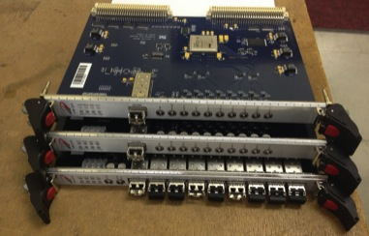
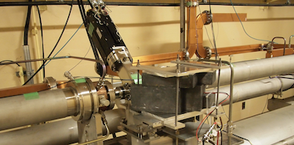
Linac Upgrade Progress towards SuperKEKB (2)
Linac Upgrade Overview
High power modulator upgrades
Low-level RF controls/monitor
  Pulse-to-pulse modulation (PPM) between 4+1 rings
  More spaces for increased number of devices
Beam instrumentation
  Large/small aperture beam position monitors (BPM)
  Precise/fast and synchronized BPM readout system
  Wire scanners and beam loss monitors
  Streak cameras
  (Deflectors, etc)
Event timing control system
  Combination of MRF and SINAP modules
  Essential for PPM operation
  Precise timing & synchronized controls
  Bucket selection at DR and MR
SINAP event modules
Beam wire scanner

Slide 12
Alignment
Alignment

Slide 13
Alignment
Alignment
High-precision alignment was not necessary in PF and KEKB injections, and it was much damaged by earthquake in 2011.
Instead of flexible-structure girder before earthquake, rigid-structure was adopted with jack-volts and fixed supports.
Reflector pedestals are developed and mounted onto quad magnets and accelerating cavities for laser-tracker measurement.
Iterative measurement and adjustment with 500-m straight laser and position sensors should enable 0.3-mm global alignment.
Laser tracker should enable 0.1-mm measurement within 10-m girder unit.
Displacement gauges, hydrostatic leveling, inclinometer are also employed.
Remote measurement system and girder mover system will be necessary for longer term, and are under development.

Slide 14
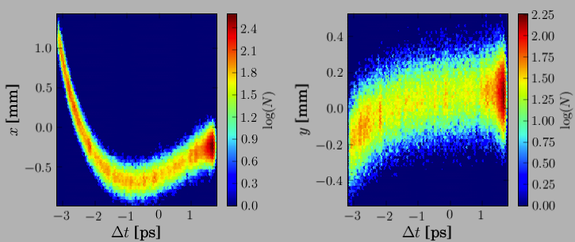
Emittance Preservation and Alignment
Alignment
If Device is off center of the beam
  Focusing magnet (quad) kicks the beam bunch
  Accelerating structure (cavity) excites wakefield, to bend the tail
Distorted bunch in banana shape
  Emittance dilution or blow-up, even 100 times larger
    Depending on the beam optics and the beam charge
Alignment and orbit correction is crucial to preserve the emittance
Sugimoto et al.
Beam
Focusing
Magnet
Accelerating
Structure
Transverse beam distribution in time direction

Slide 15
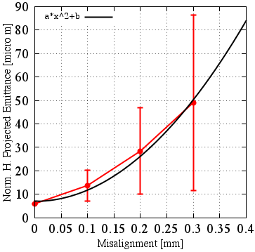
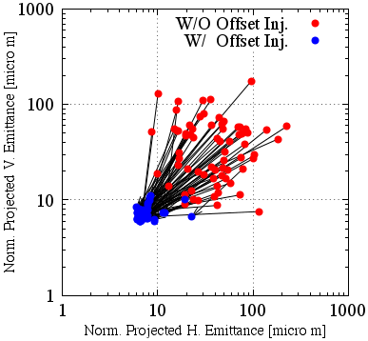
Emittance Preservation
Alignment
Offset injection may solve the issue
Orbit have to be maintained precisely
Mis-alignment should be <0.1mm locally, <0.3mm globally
Mis-alignment leads to Emittance blow-up
Orbit manipulation compensates it
100 samples
Sugimoto et al.

Slide 16
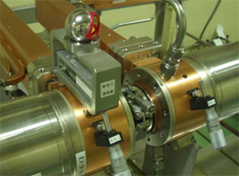
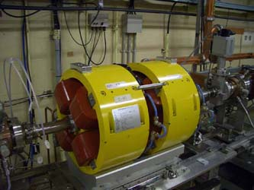
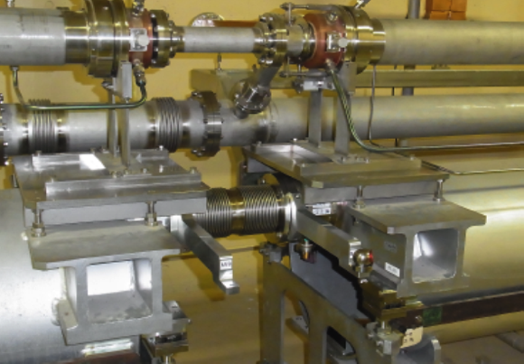
Reflector setting for hardware positioning
Alignment
Higo et al.
Mounted on coupler OD
Reflectors for old Q-magnet
Arm from Laser PD system to reflector

Slide 17
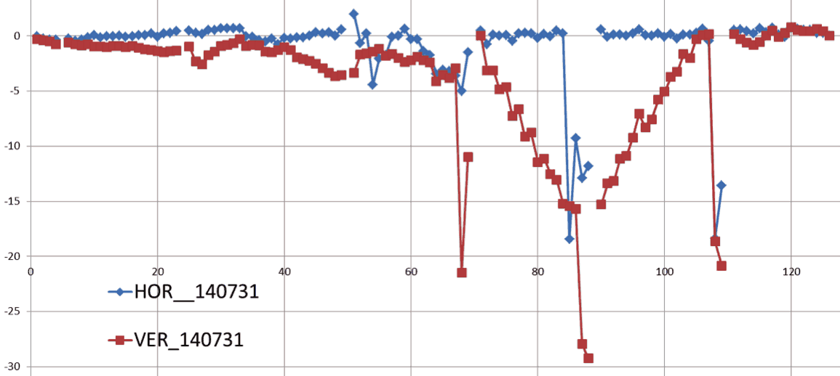
Alignment progress in 2014
Alignment
For the first time at 3-5 sectors
Horizontal axis: sensor number from sector C, 1-4, to sector 5
(~80 m/sector)
Vertical axis: voltage (~displacement at 0.25~0.5mm/mV)
Some girders were not yet upgraded
Moved up to 3 mm not to break vaccuum
Displacement / mV
Sector C
Sector 5

Slide 18
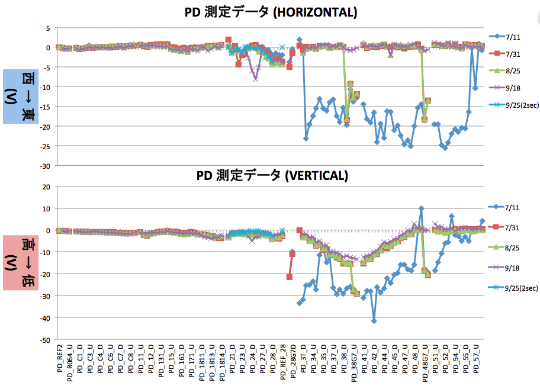
Alignment progress in 2014
Alignment
Higo et al.
For the first time after earthquake at downstream sectors
Several measurements during summer
Measurement reproducibility was confirmed up to ~0.2 mm
While there existed
several conflicting
measurements,
consistent scheme
has been established
Movement of tunnel
by several 10’s of
micrometer was
observed (→ mover)
Further work necessary
in 2015, for alignment
and girder replacement
~5mm
~10mm

Slide 19
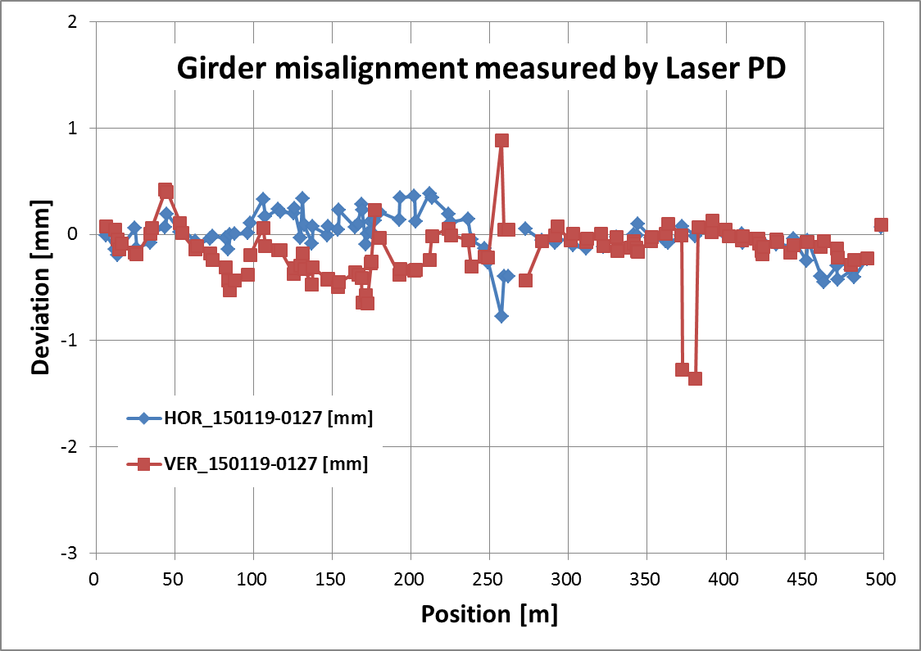
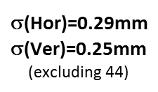
Recent 500-m alignment over C-5 after completion of initial alignment in late Jan. 2015
Alignment
Higo et al.

Slide 20
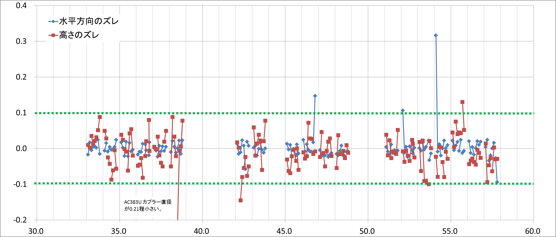
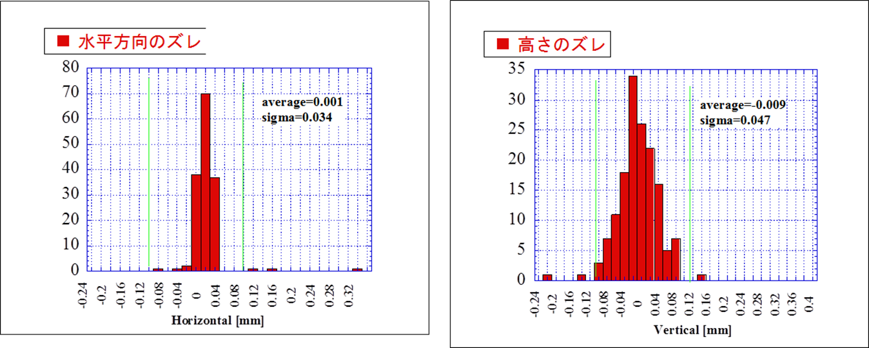
Hardware alignment on girders in sectors 3~5
Alignment
Horizontal
Vertical
Higo et al.
Horizontal
σ=34μm
Vertical
σ=47μm

Slide 21
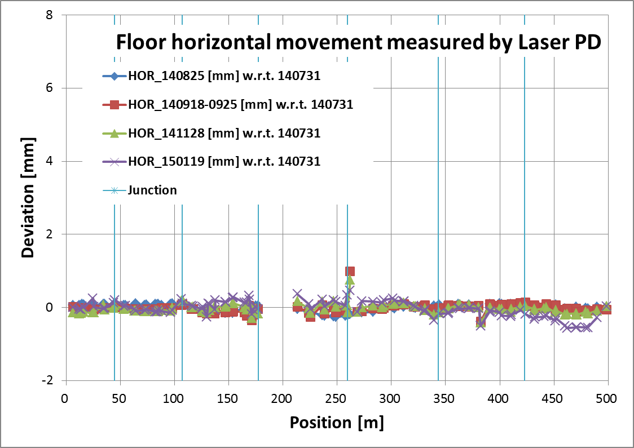
Floor horizontal movement in a half year from summer to winter
Alignment
Higo et al.
C3
11
18
28
38
48

Slide 22
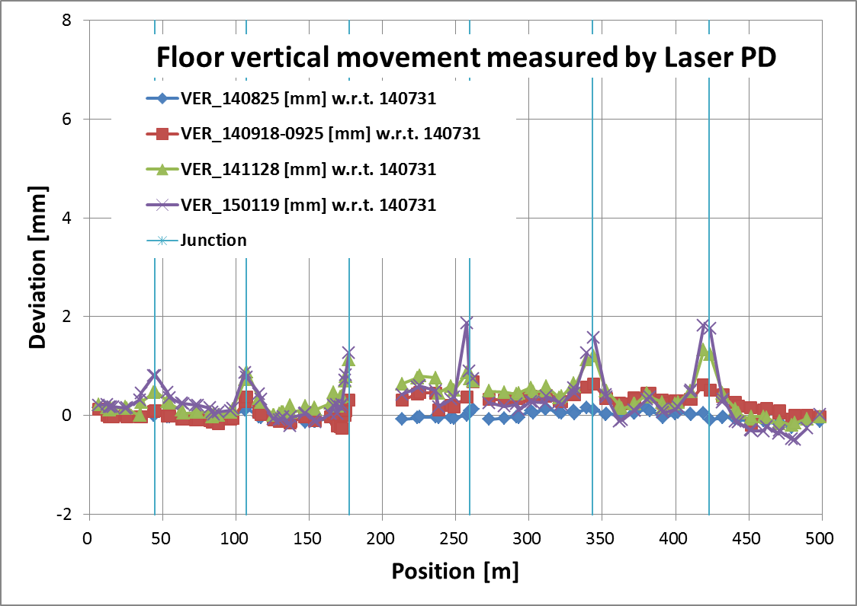
Floor vertical movement in a half year from summer to winter
Alignment
Higo et al.
C3
11
18
28
38
48

Slide 23
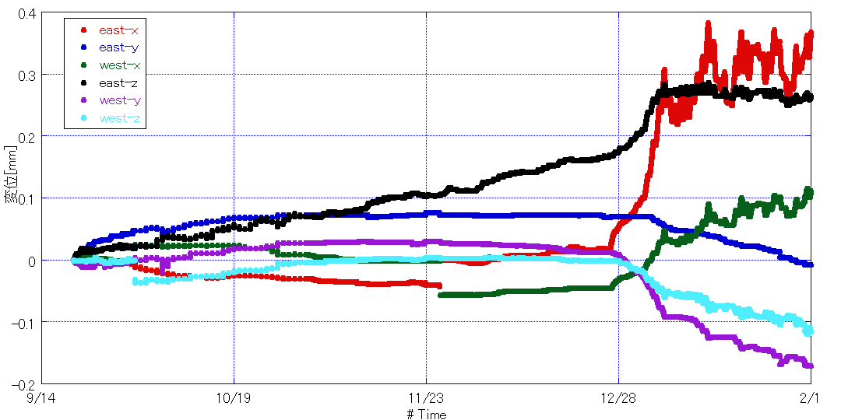
Junction relative movement at 28
19 Sep. 2014 – 31 Jan. 2015
Alignment
Higo et al.
↑ Up, East, North(beam line)
Up
North (beam)
0.4
0.3
0.2
0.1
0.0
-0.1
-0.2
East
Water flood due to typhoon
Linac stop
Air cond. restart
14 Sep.
23 Nov.
1 Feb.
↓ Down, West, South
Found daily movement, month-long drift, climate effect, etc. These are related to those observed in laser PD long-term result.

Slide 24
Estimation of floor movement some typical observed values
Alignment
 | Horizontal | Vertical
Daily | 0.1 | 0.1
Week | 0.1 | 0.1
Half a year | 0.5 | 2
Speed | 0.01mm/hour | 0.01mm/hour
Unit mm
We should study/develop the linac system
with these values in mind.
Precise beam orbit control is necessary
to preserve emittance

Slide 25
RF gun

Slide 26
RF-Gun development strategy for SuperKEKB
RF gun for low-emittance electron
Cavity : Strong electric field focusing structure
  Disk And Washer (DAW) => 3-2, A-1(test)
  Quasi Traveling Wave Side Couple => A-1
  => Reduce beam divergence and projected emittance dilution
Cathode : Long term stable cathode
  Middle QE (QE=10⁻⁴～10⁻³ @266nm)
  Solid material (no thin film) => Metal composite cathode
  => Started from LaB₆ (short life time)
  => Ir₅Ce has very long life time and QE>10⁻⁴ @266nm
Laser : Stable laser with temporal manipulation
  LD pumped laser medium => Nd / Yb doped
  Temporal manipulation => Yb doped
  => Minimum energy spread

Slide 27
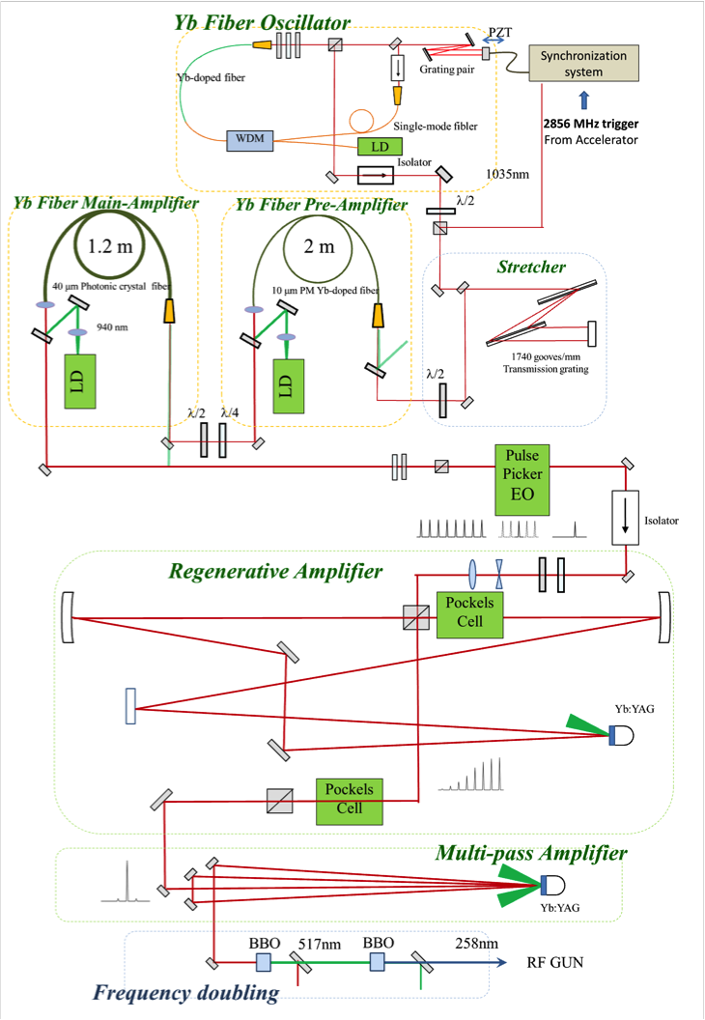
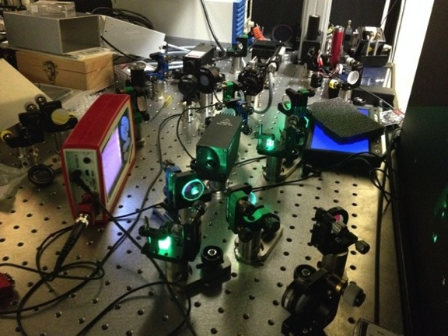

Photo cathode RF gun development
RF gun for low-emittance electron
Cascaded frequency doublers
Quasi traveling wave side couple cavity
Yb fiber and Yb:YAG think disk laser
Ir₅Ce
Cathode
5.6 nC / bunch was confirmed
Next step: 50-Hz beam generation &
Radiation control
Ir5Ce photo cathode

Slide 28
Schedule
These few months:
  Reconfigure thermal gun for positron generation
  Step by step RF-Gun RF ageing.
  New laser system in ground laser room.
    Increase pulse energy from fiber laser
    Simplify the laser system (new multi-pass amplifier)
This comming summer:
  Third RF-Gun (nomal laser injection / cavity modification / cathode change)
  Simple Nd amplifier for Phase-I & II stable injection
Yoshida et al.
Following the RF-Gun
reviewer’s comments
(Postponed the pulse shaping until Phase-III )
10 ps gaussian is enough for Phase-I (1nC) & II (2nC), postponed the pulse shaping until Phase-III

Slide 29
Beam line will be upgrade on up and down.
Yoshida et al.
Thermionic DC gun will be installed to upper beam line.
10 nC
for positron primary
70 MeV
Thermionic DC gun
triplet
Acc.tube
buncher
prebuncher
SHB2
SHB1
Energy slope
Chicane
Acc.tube
RF gun
Bunch compression
30 MeV
20 psec
20 psec
5 nC
Low emittance

Slide 30
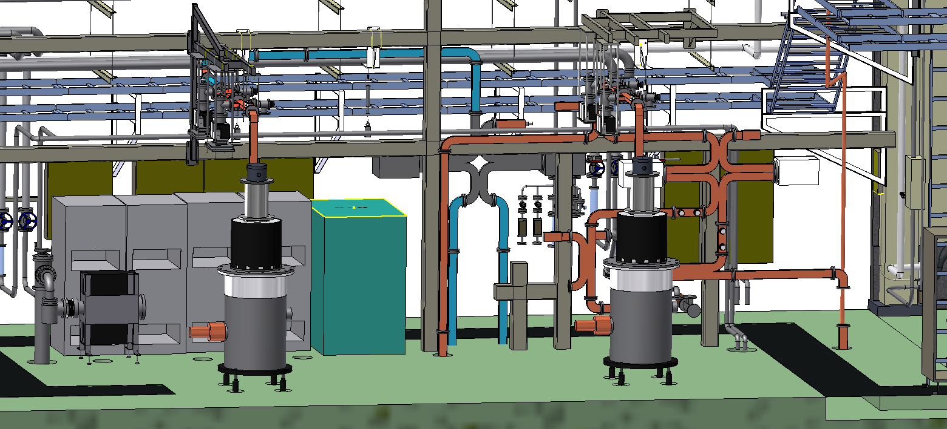
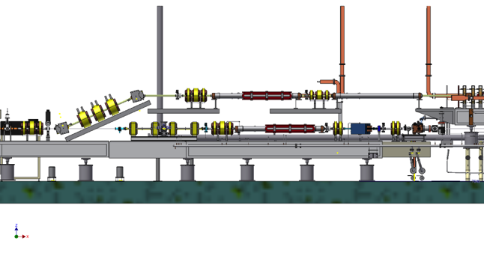
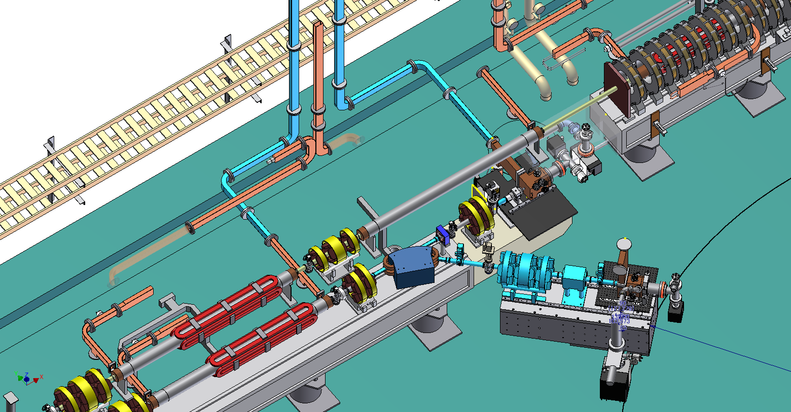
Reconfiguration of A-1 injector area
KL_A1_B
KL_A1_A
RF-Gun1
RF-Gun2
加速管

Slide 31
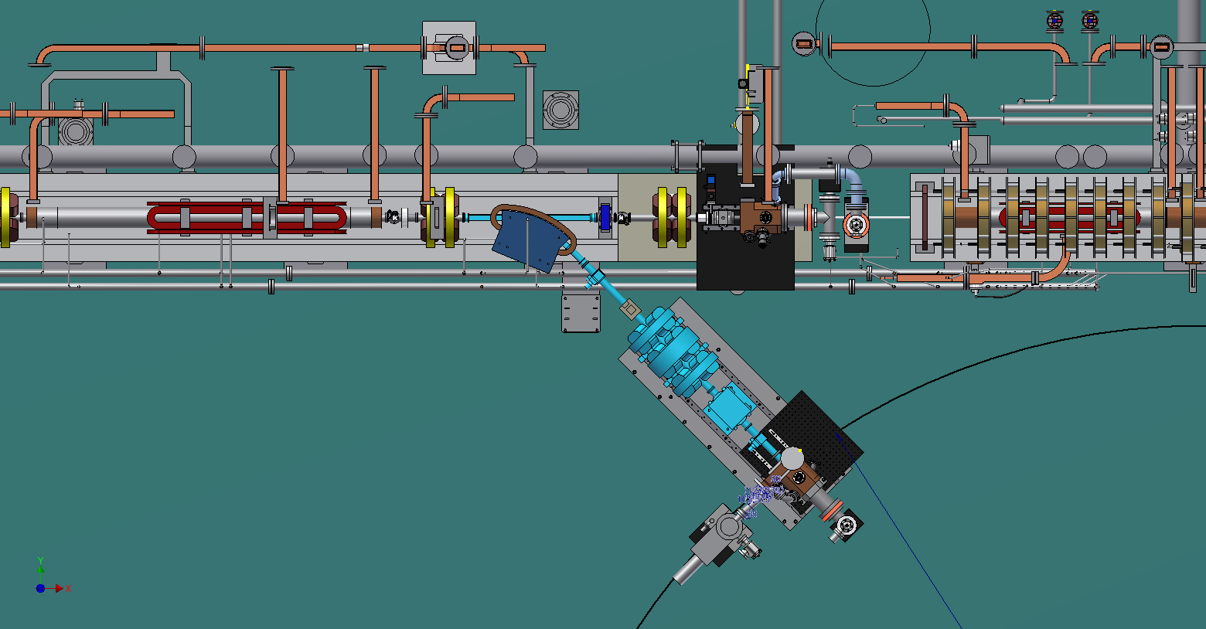
Second RF gun on the 45 degree line
Normal laser injection
Angled laser injection
Studies on
Improved RF-Gun cavity
Normal laser injection
Cathode change including alkaline cathode

Slide 32
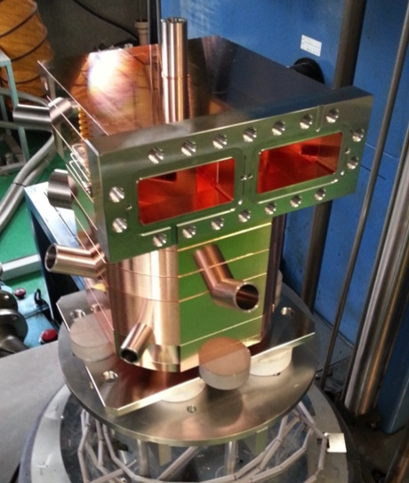
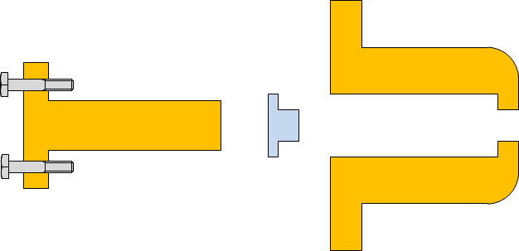
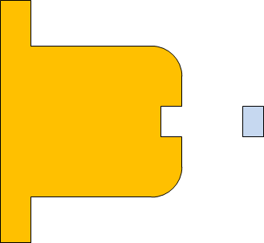
Second Side coupled Quasi-travelling wave RF-Gun
Second RF-Gun under brazing
Conditioning progress was too slow.
Frequent break down is the issue to be cured.
Cathode rod contact?
Cathode material fixation?
Cathode material sputtering due to laser?
We have to analyze break-down issues.
Cavity conditioning, used dummy cathode rod without cathode material (all Cu).
Replace new cathode rod with material (new fixation is shrinkage fit).
For reduce multipactoring effect, another cathode cell design is required.
Present cathode
New cathode
shrinkage fit

Slide 33
Short term plan for laser development
Undeground Yb-Fiber + Yb:YAG (Existing)
  Downgrade to 25Hz 2-loop amplifier(Done p.8) => Fix configuration
  Increase monitor points / quadrant detector etc..
  Improve stability.
Underground Yb-Fiber + Nd:YAG (Yb-Fiber small upgrade)
  1064nm(Nd:YAG wavelength) is converted by existing Yb oscillator. (p.9)
  Stretcher for 10 ps is similar to existing one. (p.11)
  Existing fiber amplifier (Thorlabs) is best fit to amplify 1064nm. (p.9)
  Preliminary test using existing Nd:YAG DPSS Module (10Hz). (p.10)
Ground Yb-Fiber(Commercial) + Cryogenic Yb:YAG
=> Postpond the operation until Phase-III.
Ground Yb-Fiber(Commercial) + Nd:YAG(Commercial)
  MENLO Orange oscillator wavelength must be shifted. (p.9)
  or use Nd:YLF (1047nm). (p.9)
  Yb-Fiber commercial amplifier can be used for 1064nm. (p.10)
  Nd:YAG 50Hz DPSS commercial module (p.13)
  Vacuum duct / Room environment / Virtual cathode.

Slide 34
Short term plan for laser development
Following recommendations at review meetings
Undeground Yb-Fiber + Yb:YAG (Existing)
  Downgrade to 25Hz 2-loop amplifier(Done) => Fix configuration
  Increase monitor points / quadrant detector etc..
  Improve stability.
Underground Yb-Fiber + Nd:YAG (Yb-Fiber small upgrade)
  1064nm(Nd:YAG wavelength) is converted by existing Yb oscillator.
  Stretcher for 10 ps is similar to existing one.
  Existing fiber amplifier (Thorlabs) is best fit to amplify 1064nm.
  Preliminary test using existing Nd:YAG DPSS Module (10Hz).
Ground Yb-Fiber(Commercial) + Cryogenic Yb:YAG
=> Postponed the operation until Phase-III.
Ground Yb-Fiber(Commercial) + Nd:YAG(Commercial)
  MENLO Orange oscillator wavelength must be shifted.
  or use Nd:YLF (1047nm).
  Yb-Fiber commercial amplifier can be used for 1064nm.
  Nd:YAG 50Hz DPSS commercial module
  Vacuum duct / Room environment / Virtual cathode.

Slide 35
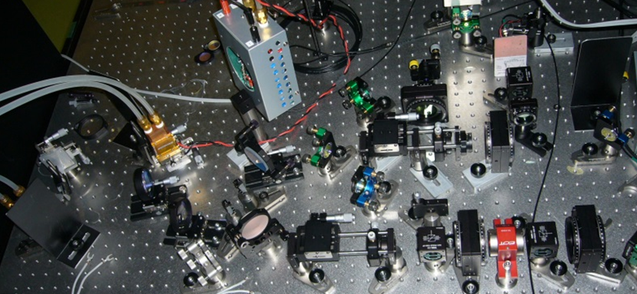
New high gain multi-pass amplifier(10-15 pass x 2 loop)
to simplify the laser
LD
Laser Diode
1pass
10-15pass
OUTPUT
INPUT
←

Slide 36
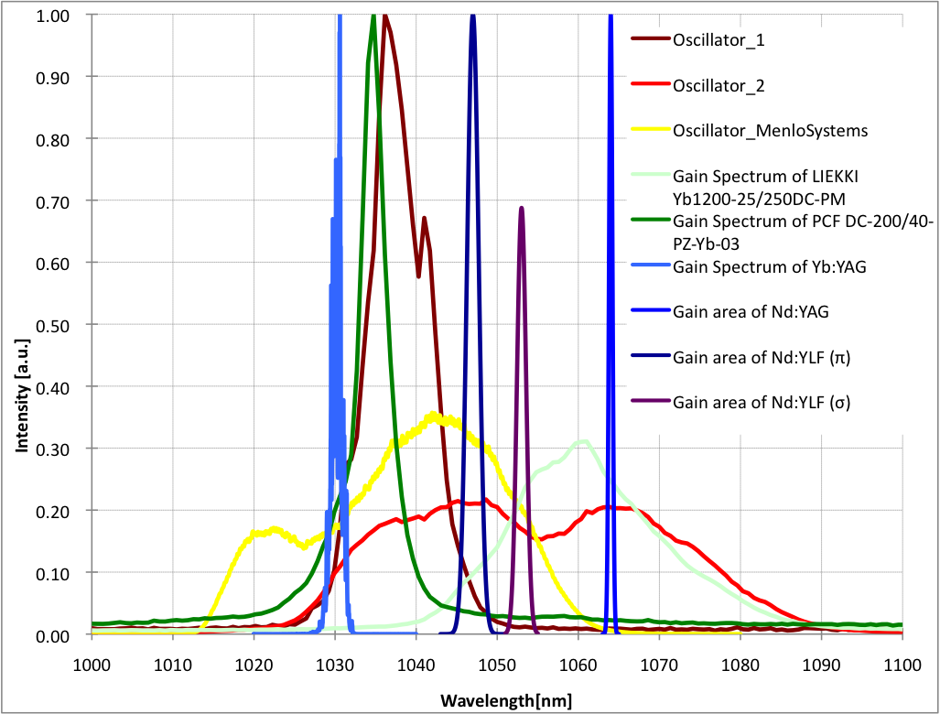
Spectrum

Slide 37
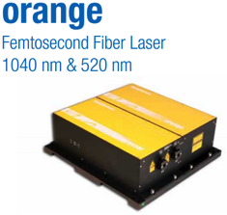
Simplify and stabilize our laser system without pulse shaping
Existing laser system
114.2 MHz
Yb-doped fiber oscillator with Transmission grating
@ 1030 nm
PCF Yb-doped fiber amplifier
Yb:YAG thin-disk multipass amplifier
(25 Hz)
Pulse picker
Menlo
@ 1064 nm
Simple Nd amplifier laser system without pulse shaping
according to RF-Gun reviewer’s comment
LIEKKI Yb-doped fiber amplifier
Commertial Nd:YAG rod
multipass amplifier (10 Hz => 50 Hz)
Pulse picker
Optilab YDFA-r-40-S, Output power of 20W
Grating pair
Fiber Amplifier @1030 nm
Yb fiber Oscillator
Fiber Amplifier @1064 nm
Spatially dispersed

Slide 38
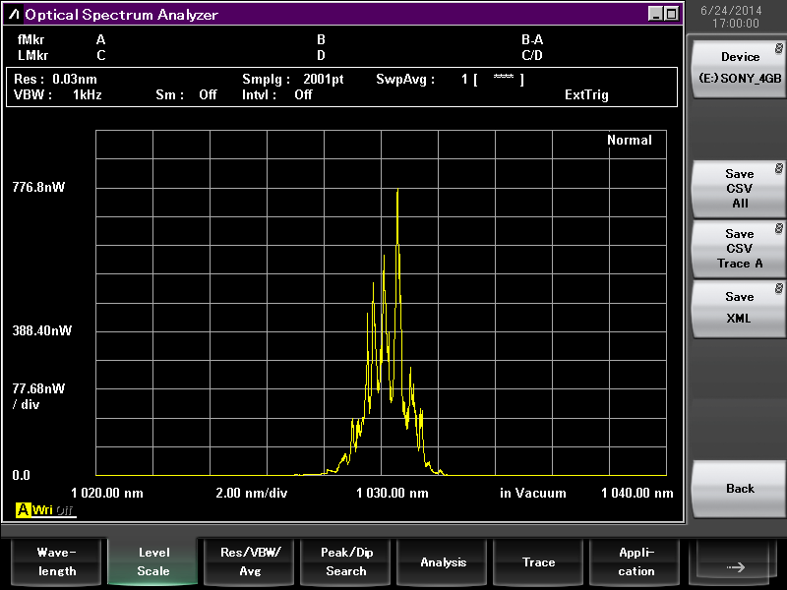
Strecher for Yb:YAG & Nd:YAG
 | Yb:YAG | Nd:YAG
Center wavelength | 1030 nm | 1064 nm
Gain spectrum width | ~2 nm | ~0.5nm
Distance of the Stretcher to 30 ps | 1.5 m | 6 m (×4)
Gain spectrum of Yb:YAG
Distance of grating pair
30 ps
Grating pair
2.0nm

Slide 39
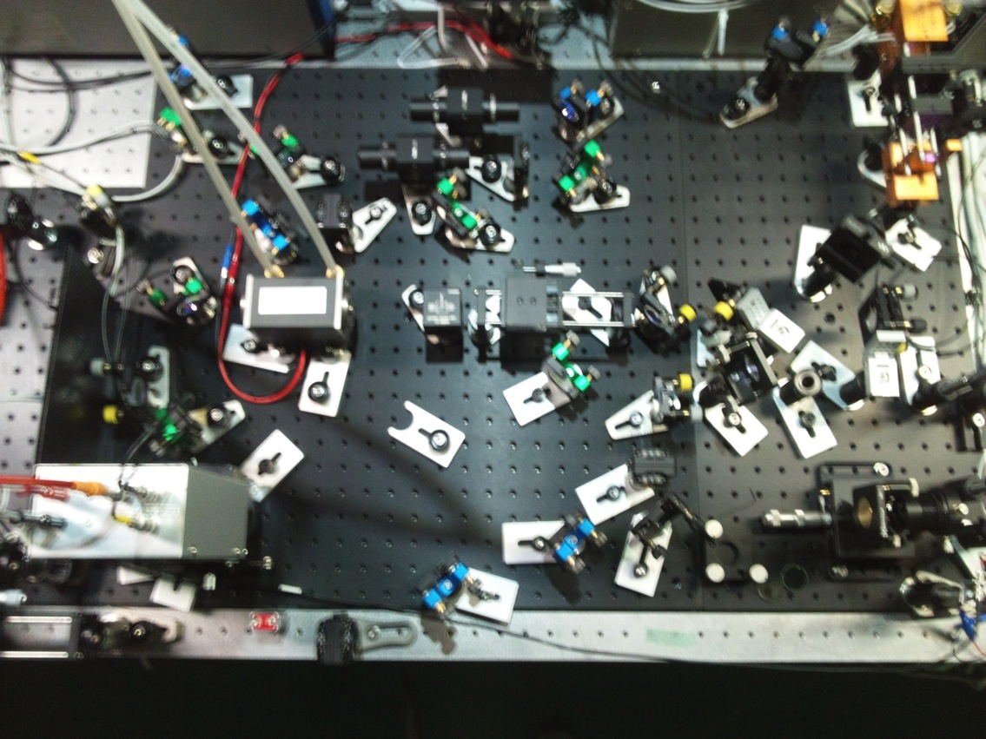
Nd:YAG DPSS module regenerative amplifier (experimental)
Regenerative amplifier
Oscillator
Test at A-1 underground using existing Yb-Fiber oscillator.

Slide 40
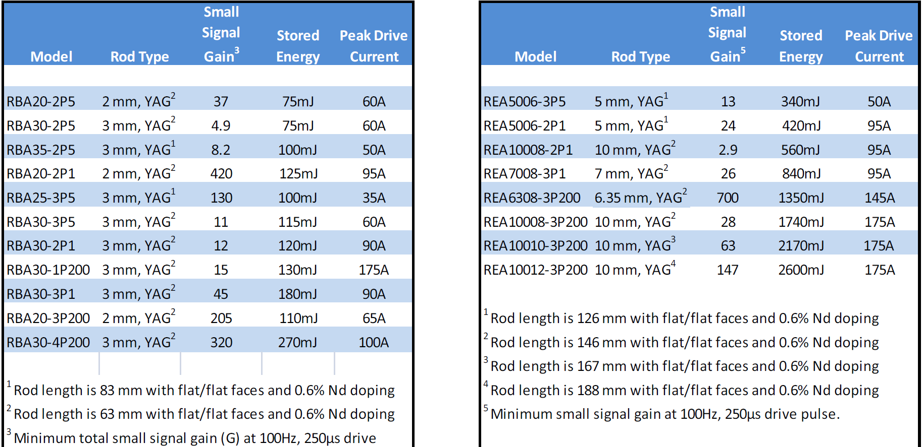
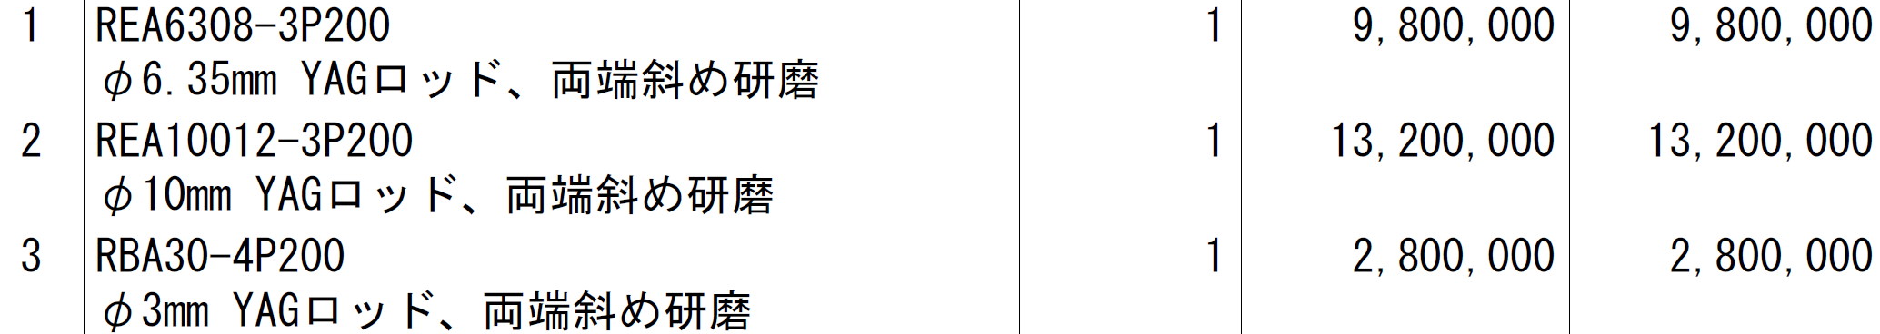
Nd:YAG DPSS module / Northrup Grumann
円安 → ×3台 → 1200万円？

Slide 41
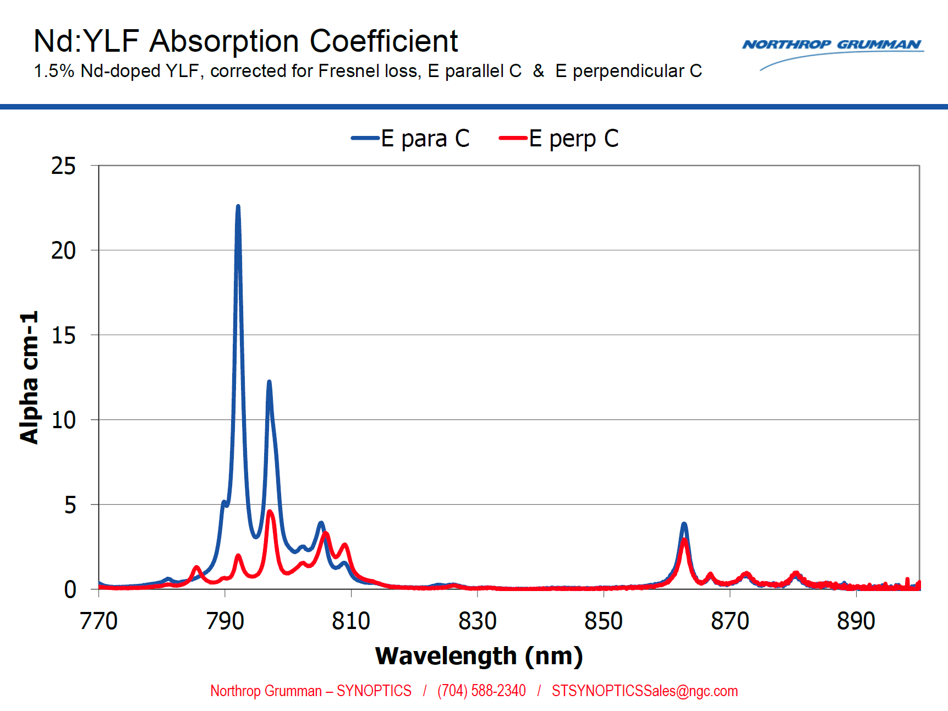
Nd:YLF
蛍光寿命が長い ～485μs (Nd:YAG の倍)
発振波長が Yb に近い

Slide 42
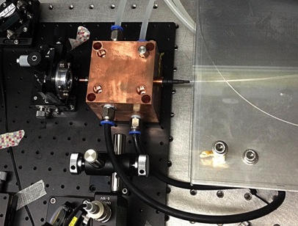
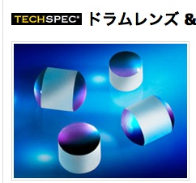
Improvement of fiber collimation
PCF fiber damage is one issue => Improve the fiber collimation
Fiber coupler
Cooling system
Fiber coupler in ERL
Drum Lens
Higher output pulse energy from fiber amplifier
=> Reduce number of stages of Yb:YAG multi-pass amplifier

Slide 43
Thermionic gun
Thermionic Gun

Slide 44
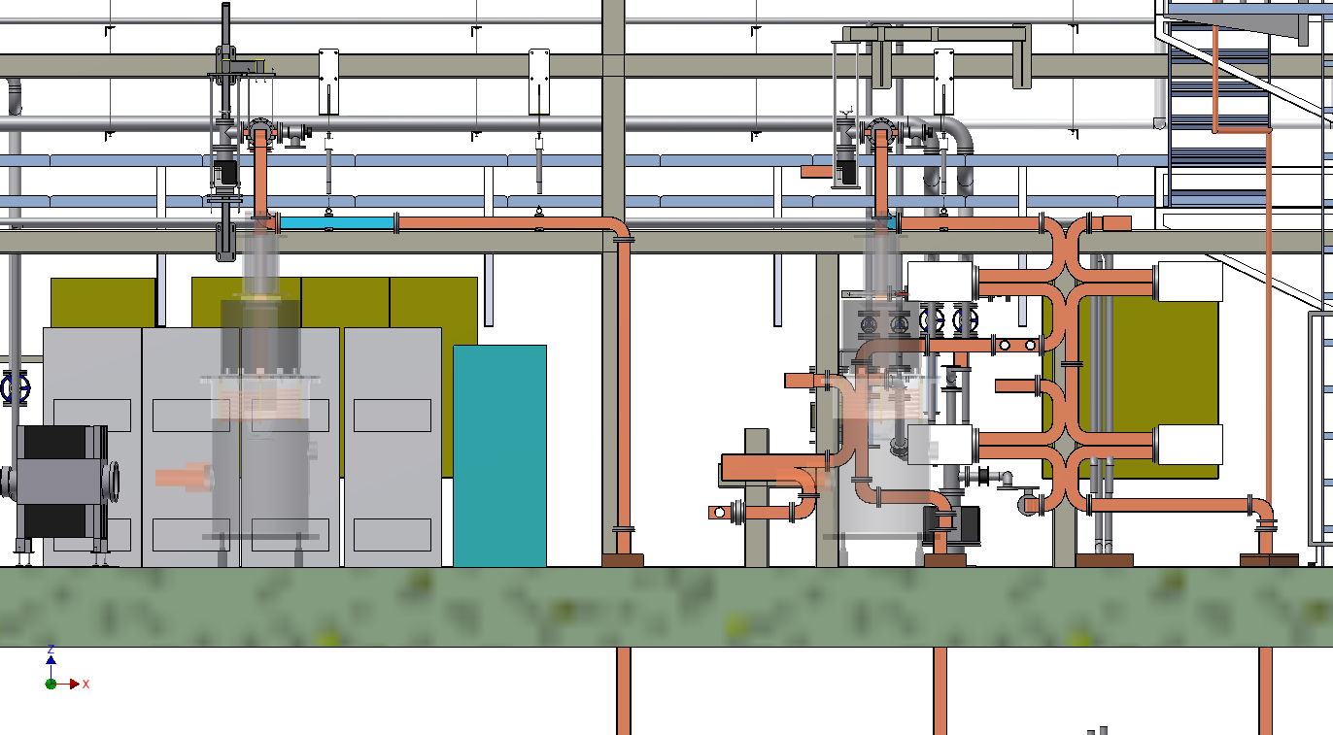
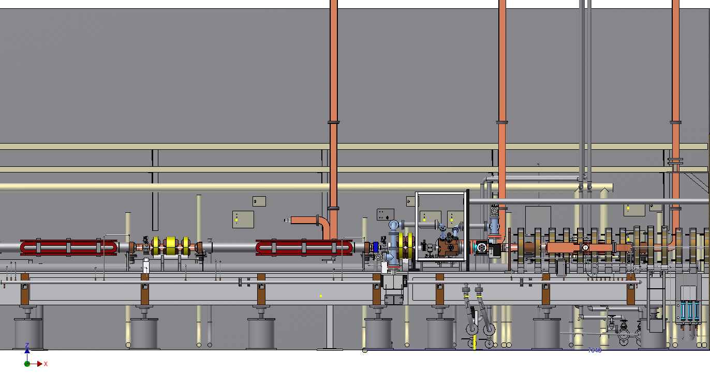
Electron gun rearrangement
現状
KL-A1-B
KL-A1-A
移相器・減衰器
第2加速管
RF-gun
（Pre-buncher）

Slide 45

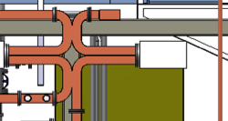






Electron gun rearrangement
S.Ohsawa
改造案2
KL-A1-B
KL-A1-A
3dB DC
復元
移相器・減衰器
（移設）
他のWG新規製作
又は流用
WG 1本 新規製作
移相器・減衰器
（移設）
加速管１本
(第2RF-gun)
第1RF-gun
加速管2本
Buncher
Pre-buncher
WG 3本を
600mmつめる
(第2RF-gun用パルスベンドと予備スペース)

Slide 46

Preparation of Thermionic Gun
Thermionic Gun
Under refurbishment
  Raise by 75cm not to conflict with straight RF-gun
    As well as angled RF-gun
  ~ Jun.2015.
May serve primary electron for positron generation
Thermionic gun
RF gun

Slide 47


Recent Works in Progress
Recent works
#15 region
Iron shield
#A1 region
Thermionic gun
RF gun

Slide 48





Slide 49





Slide 50





Slide 51
Positron generator
Positron Enhancement

Slide 52

Positron Generation
Positron Enhancement
4-times more positron is required at SuperKEKB than KEKB
  Safety measure was taken after cable fire during the test of Flux Concentrator (FC)
  New components in
  100-m capture section
  were tested in steps
  High voltage tests in
  tunnel in April
  Beam tests with electron
  in May

Slide 53


Positron generation for SuperKEKB
Positron Enhancement
bridge coils
solenoid
side view
primary
e- beam
10 nC
primary e-
DC QM
spoiler
LAS Accel.
structure
target
e+
positron
production
Target
beam
hole
5 nC injection e-
Flux
Concentrator
pulsed ST
pulsed QM
Flux
Concentrator
Bridge
Coils
e+ beam
New positron capture section after target with
Flux concentrator (FC) and large-aperture S-band structure (LAS)
Satellite bunch (beam loss) elimination with velocity bunching
Pinhole (2mm) for electrons beside target (3.5mm)
Beam spoiler for target protection

Slide 54

陽電子捕獲部@Linacトンネル
Positron Enhancement
T.Kamitani
この中にFC、標的
ブリッジコイルが
収められている。
DCソレノイド
電子ビーム
2014年4月に陽電子捕獲部
をビームラインの設置し、
5月より陽電子のコミッショニング
を開始した。

Slide 55


Positron from New Positron Capture Section
Positron Enhancement
Generated positron ~0.1nC was
transferred to the entrance of
damping ring
With higher magnetic and electric
field, 4-nC positron will be
generated
Target shield
(40cm x 6m long)
will be finalized
Alignment will be
improved
3mm → 0.1mm
Flux concentrator and
following solenoid/quad
Large aperture S-band structure
before solenoid & quad installation
400 m
Beam position
Horizontal
Vertical
~0.1 nC
Beam charge
Primary Electron
Positron
W target

Slide 56

(1) FC current
Positron Enhancement
T.Kamitani
6kAより大きな電流値でもまだ
saturationせずに順調に伸びていくと
期待される
新型電源では12kAまで上がる予定。
伝送路の inductance も下げる予定。
FC currentがzeroでも
ある程度のyieldがある
FCでの実電流値は1.07倍
plot上の6kA => 6.42 kA
CT測定値

Slide 57
陽電子生成装置遮蔽体
Positron Enhancement
1-5 陽電子ターゲット下流の加速器上空に鉄を主体としたシールドを設置する．
遮蔽体の全体図
S. Matsumoto

Slide 58

Positron Enhancement
雛 段
通 路
鳥瞰図：南東方向から見た図． トンネル1-5 陽電子ターゲットの60cm上流から６ｍの範囲に設置．3 月時の遮蔽鉄の厚みは200mm（図中の赤＋灰色部）．
200mm角柱 6本が現場通路上ビームラインよりに設置される．鉛カーテンを設置すると、通路の幅が現場では1400mm．申請電流値に合わせて鉄の厚さを追加する予定．

Slide 59

Radiation Shield Construction
Radiation Shield
#15 region
Iron shield
Flux Concentrator

Slide 60
Positron Generation
Positron Enhancement
T.Kamitani
Installation of positron generator for SuperKEKB in April 2014
(Beamline construction since summer 2013)
(positron target, spoiler, Flux Concentrator, bridge coils, LAS structures [x6], DC solenoids [16+13],
e+/e- separator, quads [>90])
Commissioning of positron beam, observation of the first positron after reconstruction for SuperKEKB, further improvements expected
Oct.~Dec.2014 : Linac commissioning
Jan.~Mar.2015 : Construction
Apr.2015~ : Linac commissioning
Feb.2016 : LER injection
 | Primary e- [nC] | Positron [nC] | Efficiency | Parameters
June 2014 | 0.6 | 0.12 | 20% | FC 6.4kA, Solenoids 370A, LAS capture field 10 MV/m
Specification (at SY2) | 10.0 | 5.0 | 50% | FC 12kA, Solenoids 650A, LAS capture field 14 MV/m
DR injection (2017?) |  | 4.0 | 40% | Energy spread acceptance 0.5%
x17
x42
x2.5

Slide 61
Schedule
Schedule

Slide 62
Linac Schedule Overview
Schedule
RF-Gun e- beam
commissioning
at A,B-sector
e- commiss.
at A,B,J,C,1
e+ commiss.
at 1,2 sector (FC, DCS, Qe- 50%)
e- commiss.
at 1,2,3,4,5 sector
Phase1: high emittance beam for vacuum scrub
Phase2,3: low emittance beam for collision
Time →
Location
↓
Staged
Licenses
Low Emittance Beams
4+1 Ring
Injections
DR
Commiss.
1 nC
Phase1
2 nC
Phase2
4 nC
Phase3
Without Top-up
Direct PF-AR BT
: Electron
non damped e+ commiss.
at 1,2, 3,4,5 sectors
e- commiss. at A→5 sectors
damped e+ commiss.
at 1→5 Qe+ = 1~4nC
e- commiss.
at A→5 Qe- = 1~5nC
Improved
RF gun
: Positron
: Low current electron

Slide 63

Injector linac schedule
Schedule
Feb.2016 – Jun.2016: Phase-1 commissioning
  Normal-emittance, 1nC/bunch electron/positron beams, without damping ring (DR)
    With combination of RF-gun and thermionic gun
    ex. Electron with 1nC RF-gun, Positron with ~6nC thermionic gun
      (depends on downstream configuration after DR delay affecting PF/PF-AR injections)
Jan.2017 – May.2017, Damping ring commissioning
  1nC – 2nC/bunch positron beam, to/from DR
Jun/Oct.2017 – Feb.2018, Phase-2 commissioning
  Low-emittance (20mm.mrad, 0.1%), 2nC electron/positron beams, with DR
    Low-emittance electron beam with RF-gun, 2nC
    Primary beam for positron with RF-gun or thermionic gun, 5nC
Oct.2018 – …, Phase-3 commissioning
  Low-emittance (20mm.mrad, 0.1%), High charge electron/positron beams, with DR
    Low-emittance electron beam with RF-gun, 4nC
    Primary beam for positron with RF-gun or thermionic gun, 10nC

Slide 64
Radiation protection licenses
Schedule
Staged upgrade of beam limits
Final goal is 1250/625 nA before/after target
  Same as KEKB (with limited shields)
Applications
  Fall.2013. 10 nA at #28 dump, 1250 nA at #A2 dump
  Spring.2014. New utility rooms, 50 nA at #61 straight dump
  Feb.2015. 200 nA at #15 target
  Late 2015.(?) 800 nA at #15 target, 625 nA at #61
  Sometime 2016.(?) 1250 nA at #15 target

Slide 65
Summary
Summary
Steady progress towards first MR injection in 2015
Finished earthquake disaster recovery in 2014
Will make staged improvements up to Phase-III
Alignment: almost confident on the required precision (0.1-mm local, 0.3-mm global), need to maintain for longer term
RF gun: following recommendations at review meetings with commercial devices and Nd-based lasers
Thermionic gun: waiting to be commissioned
Positron generator: waiting for license test
Will balance between final beam quality and staged operation
Will select optimized route depending on available resources

Slide 66

Mt. Tsukuba
Thank you
SuperKEKB
dual rings
PF-AR
PF
Injector
Linac

Slide 68




Design of a quasi traveling wave side couple RF gun
RF gun for low-emittance electron
M. Yoshida et al
Normal side couple structure
Quasi traveling wave sidecouple structure
Quasi traveling wave side couple has stronger focusing field

Slide 69






Beam tracking simulation result
RF gun for low-emittance electron
M. Yoshida
5 nC
10 nC
Emittance 5.5 mm-mrad
Gun Exit
Size 0.4 mm
Energy spread 0.6%
Bunch shape

Slide 70




RF-Gun comparison
RF gun for low-emittance electron
M. Yoshida
Quasi traveling wave side couple RF gun
(100 MV/m, 6mm-mrad, 13.5 MeV)
DAW-type RF gun
(90 MV/m, 5 mm-mrad, 3.2 MeV)
BNL-type RF gun
(120 MV/m, 11.0 mm-mrad, 5.5 MeV)
Beam Size
Quasi traveling wave side couple cavity
BNL (3.8 mm)
DAW (1.7 mm)
QTW (0.2 mm)

Slide 71



Ir₅Ce Cathode
RF gun for low-emittance electron
Carbon
LaB₆
Quantum efficiency improvement
by Laser cleaning
SEM-EDX
M. Yoshida
Oxigen
Lower energy density
is enough to activate Ir₅Ce
SEM-EDX
Ir₅Ce
Carbon
No oxidization
is observed
×２０
QE Enhancement of IrCe cathode
QE lifetime
Ir₅Ce
Cathode

Slide 72
Energy spread reduction using temporal manipulation
RF gun for low-emittance electron
M. Yoshida
Energy spread of 0.1% is required for SuperKEKB synchrotron injection.
15nC
t
20nC
5nC
10nC
Gaussian
t
Square
5nC
10nC
15nC
20nC
5nC electron
15nC
Primary beam for positron production

Slide 73


Properties of laser medium
RF gun for low-emittance electron
Nd laser system for 3-2 RF-Gun
Nd-doped
τ～200μs, 40%
○ 4-state laser is easy to operate.
○ High power pump LD is available.
○ Large crystal is available
× Pulse width is determined by SESAM.
(Gaussian)
LD Pump
(808nm)
Nd:YVO4
Nd:YAG
SHG(532nm) 40%
FHG(266nm) 20%
5HG(213nm) 3%
808nm
1064nm
Yb-doped
○ Wide bandwidth => pulse shaping
○ Long fluorescent time => High power
○ Fiber laser oscillator => Stable
○ Small state difference
× ASE
× Absorption
τ～900μs, 40%
LD Pump
(941/976nm)
Yb-glass
Yb:YAG
Yb:BOYS
SHG(520nm) 40%
FHG(260nm) 20%
5HG(208nm) 3%
Best for Linac RF-Gun
941/976nm
1040nm
Ti-doped
τ=200μs, 40%
τ～3μs, 40%
Pump
40%
SHG(400nm) 40%
THG(266nm) 20%
FHG(200nm) 10%
Pump
(808nm)
Nd:YAG
SHG
Ti:Sapphire
808nm
1064nm
532nm
800nm
○ Very wide bandwidth
○ High breakdown threshold
× Low cross section
× Short fluorescent time => Q-switched laser is required for pumping
Ti:Sapphire laser system.
TW laser is based on Ti-Sapphire

Slide 74





A-1 RF gun results
5.6 nC bunch charge
was observed.
RF gun
A1 sector at KEK linac
Q-scan emittance measurement
beam size measurement for Q-scan
x | y
32.7 ±3.1 mm-mrad | 10.7 ±1.4 mm-mrad

Slide 75

Photo cathode RF gun development
RF gun for low-emittance electron
Cascaded frequency doublers
Quasi traveling wave side couple cavity
Part of multi-pass Amplifier
Yb fiber and Yb:YAG think disk laser
5.6 nC / bunch was confirmed
Next step: 50-Hz beam generation &
Radiation control
Ir5Ce photo cathode

Slide 76

GU_A1 Laser Configuration as of Nov.2014
RF gun for low-emittance electron

Slide 77











GU_A1 Laser Configuration as of Dec.2014
RF gun for low-emittance electron

Slide 78
Photo cathode RF gun improvement
RF gun for low-emittance electron
Crucial for high-current low-emmittance beam
New Ir5Ce cathode and new cavity QTWSC were successful
Basic features were confirmed at 2 ~ 5 Hz
Expect beam parameter and stability performance at 50 Hz, with multi-pass amplifiers and cooling system
Resolved the issue of oscillator synchronization
Staged laser system improvements with beam measurement system

Slide 79
Pulse-to-pulse modulation
Event-based
Control System
Four PPM virtual accelerators
for SuperKEKB project
maybe with
additional PPM VAs
for stealth beam
measurements
based on
Dual-tier controls with
EPICS and event-system
Every
20 ms
F.B
e⁻ Gun
F.B
ARC
PF Injection
e– (2.5GeV, 0.2nC)
F.B
e⁻ Gun
Damping ring
SuperKEKB-LER Injection
F.B
ARC
e– (3.5GeV, 10nC)
F.B
e⁺ Target
e⁺ (4GeV, 4nC)
e⁻ Gun
ARC
SuperKEKB-HER Injection
F.B
F.B
e– (7GeV, 5nC)
e⁻ Gun
F.B
ARC
PF-AR Injection
e– (6.5GeV, 5nC)

